Slide 1
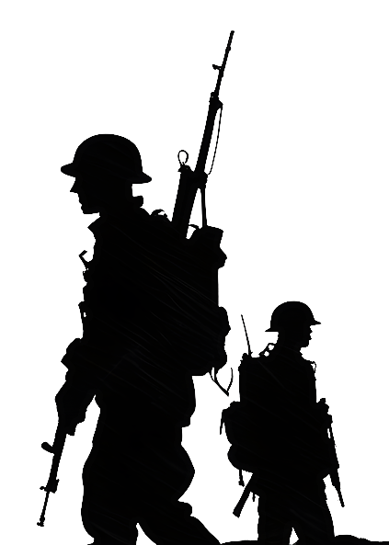


World War I - History
8th grade
1914 - 1918

Slide 2
Background
World War I, also known as the Great War, started in 1914 after the assassination of Archduke Franz Ferdinand of Austria.
His murder catapulted into a war across Europe that lasted until 1918.
During the four-year conflict, Germany, Austria-Hungary, Bulgaria and the Ottoman Empire (the Central Powers) fought against Great Britain, France, Russia, Italy, Romania, Canada, Japan and the United States (the Allied Powers).
By the time the war was over and the Allied Powers had won, more than 16 million people—soldiers and civilians alike—were dead.

Slide 3
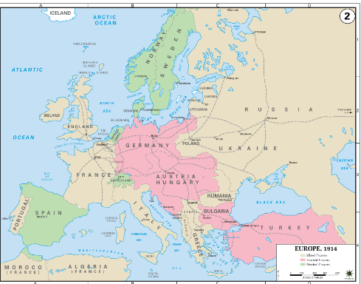
Why Did WW1 Begin?
https://www.youtube.com/watch?v=c7nUDLKKEBY
Short Version:
https://www.youtube.com/watch?v=SLj5r2nZHB8

Slide 4
WW1 - Oversimplified
Part 1
https://www.youtube.com/watch?v=dHSQAEam2yc&t=32s
Part 2
https://www.youtube.com/watch?v=Mun1dKkc_As

Slide 5
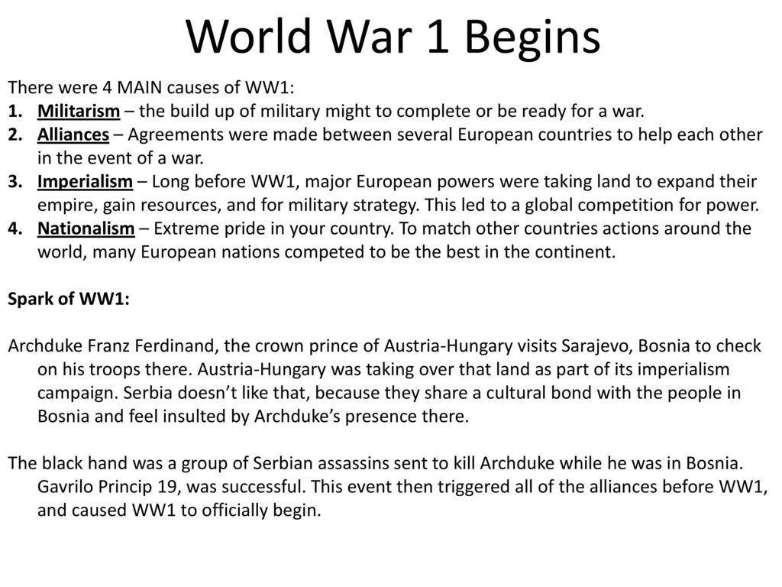

Slide 6
Archduke Franz Ferdinand
https://www.youtube.com/watch?v=JEGVcSpfM9k
Tensions had been brewing throughout Europe—especially in the troubled Balkan region of southeast Europe—for years before World War I actually broke out.
Political instability in the Balkans (particularly Bosnia, Serbia and Herzegovina) threatened to destroy these agreements in Europe at the time.
The spark that ignited World War I was struck in Sarajevo, Bosnia, where Archduke Franz Ferdinand—heir to the Austro-Hungarian Empire—was shot to death along with his wife, Sophie, by the Serbian nationalist Gavrilo Princip on June 28, 1914.

Slide 7
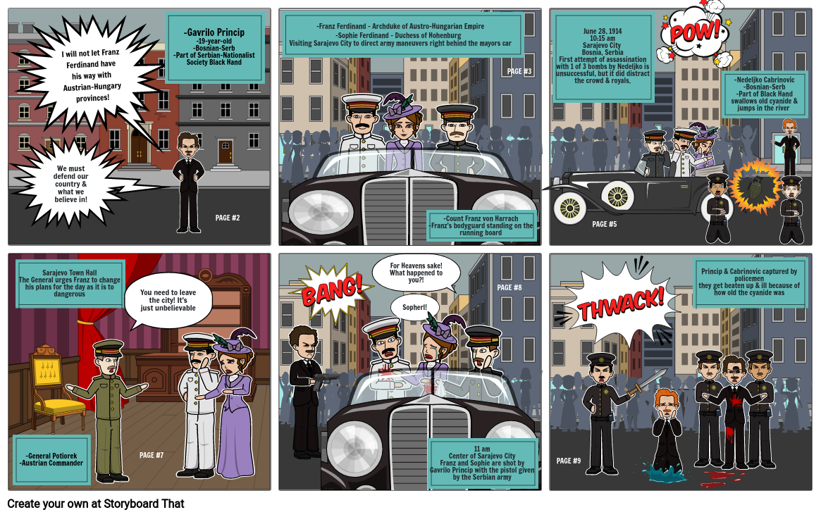

Slide 8
World War I Begins
Convinced that Austria-Hungary was readying for war, the Serbian government ordered the Serbian army to mobilize and appealed to Russia for assistance.
On July 28, Austria-Hungary declared war on Serbia, and the tenuous peace between Europe’s great powers quickly collapsed.
Within a week, Russia, Belgium, France, Great Britain and Serbia had lined up against Austria-Hungary and Germany, and World War I had begun.

Slide 9
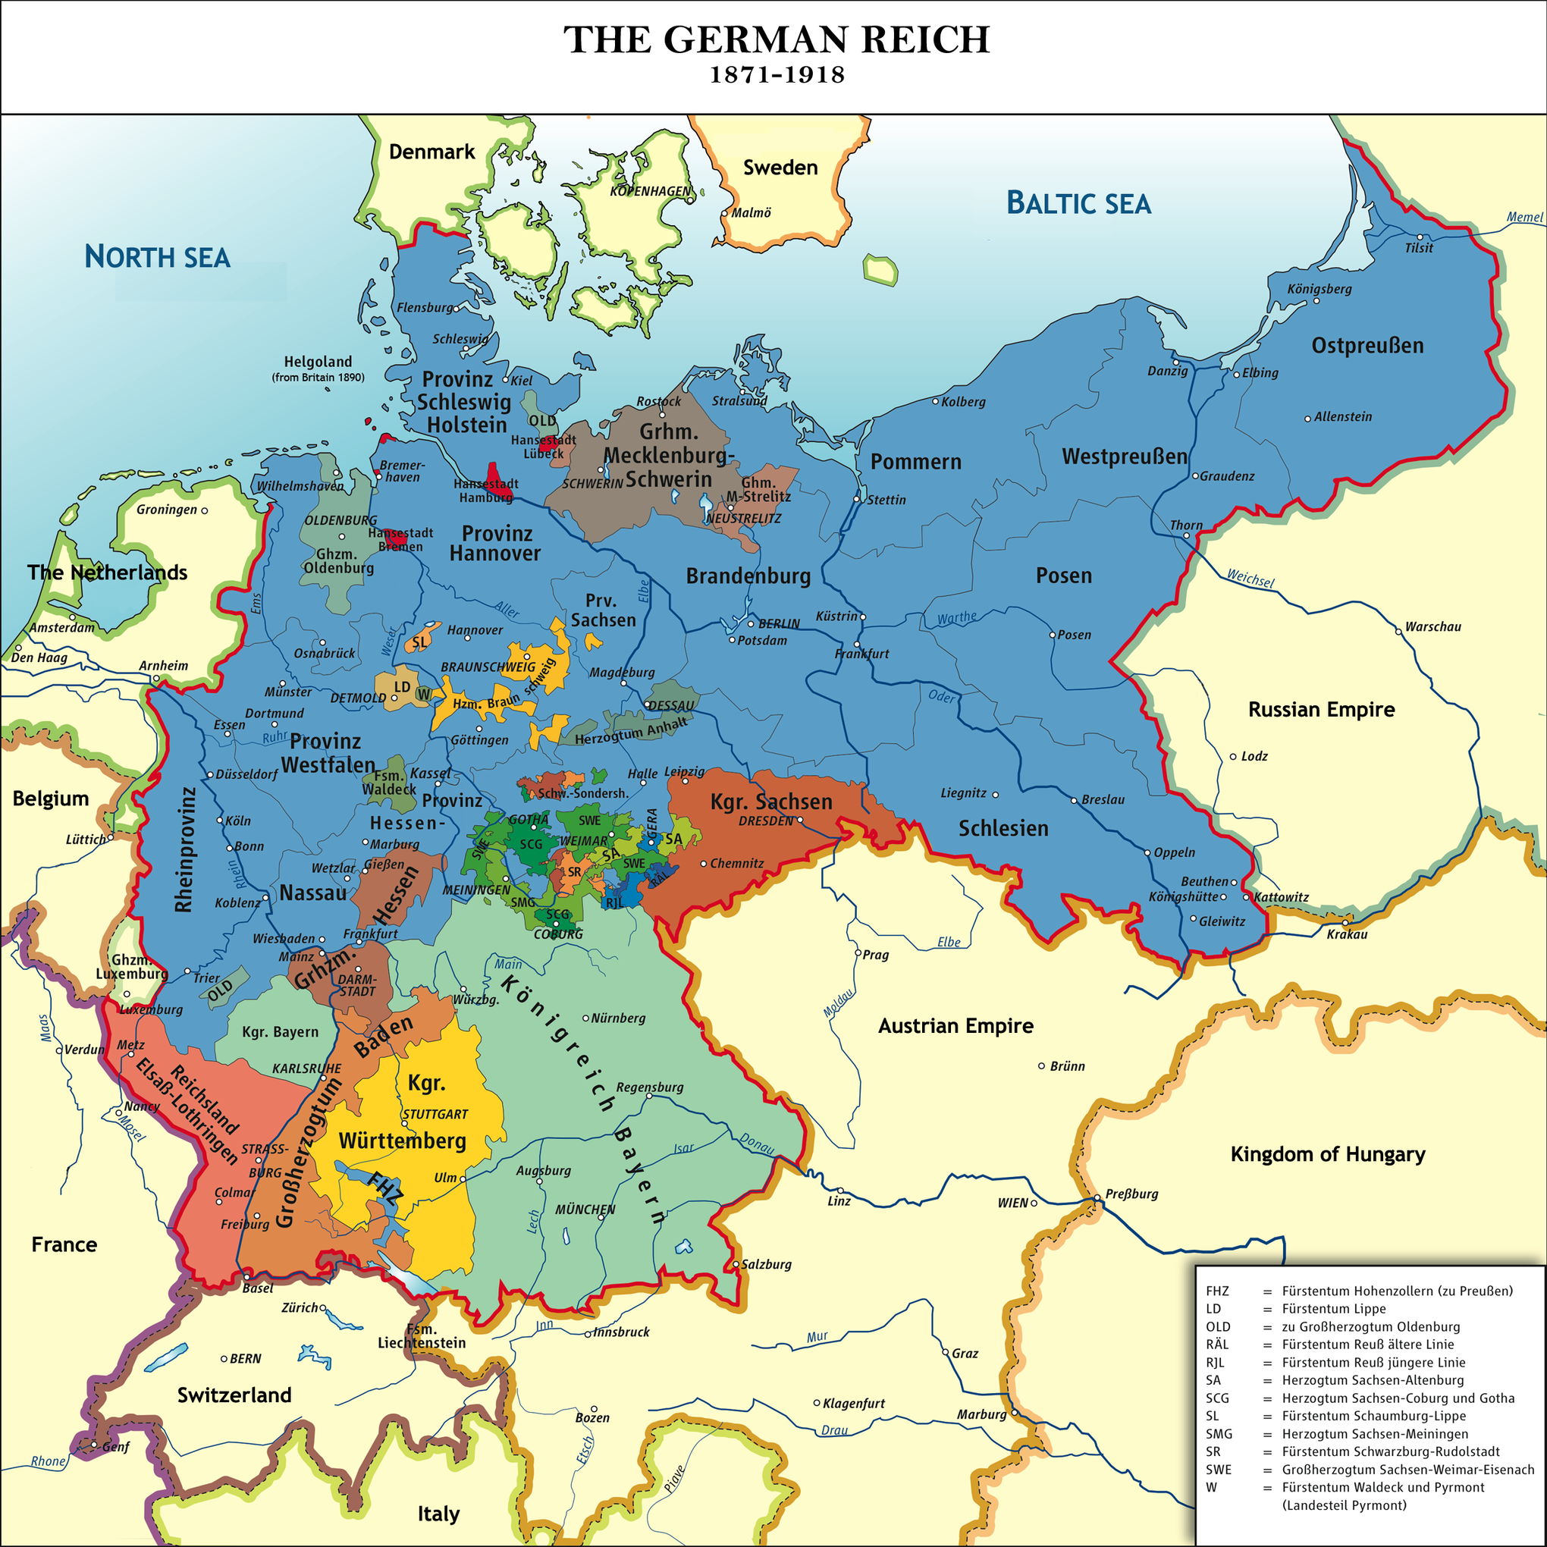
The German Reich
The Franco-Prussian War, 40 years before World War I, birthed the unified German state. Prussia baited the French into launching a war, and then aligned with several small German states to decisively defeat France and seize the economically valuable Alsace-Lorraine province. The unified Germany that emerged from the war instantly became one of the most powerful states in Europe, overturning the continental balance of power. Germany's rising power alarmed Britain and Russia, drawing both countries into closer alignment with their long-time rival, France.

Slide 10
Canada Goes to War
In 1914, Canada's external affairs were governed by the United Kingdom. This meant that once Britain declared war, Canada automatically followed.
The First World War opened with great enthusiasm and patriotism on the part of many Canadians, with tens of thousands rushing to join the military in the first months of the conflict so they would not miss the action.
They need not have worried as the war would grind on for more than four years, killing as many as ten million combatants in fighting that would be revolutionized by high-explosive shells, powerful machine guns, poison gas, submarines and war planes.

Slide 11
Canada’s Role in WWI
Canada entered the war in 1914, shortly after Britain declared war on Germany, as it was part of the British Empire.
Many Canadians volunteered, and the Canadian Expeditionary Force (CEF) was formed, eventually sending over 620,000 Canadians to fight in Europe.
https://www.youtube.com/watch?v=zW9Uonmp7qI

Slide 12
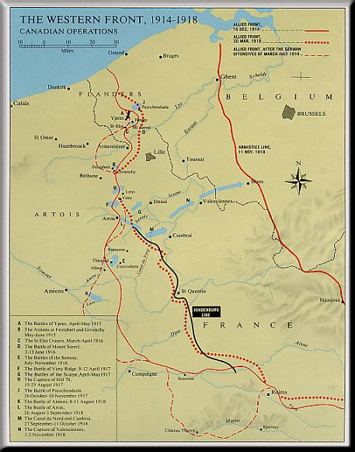
The Western Front
The Western Front, 1914 - 1918, Canadian Operations

Slide 13
Major Battles
Canadian troops distinguished themselves in several key battles, including:
The Battle of Ypres (1915), where they faced the first large-scale poison gas attacks;
The Battle of the Somme (1916), where they endured heavy losses;
The Battle of Vimy Ridge (1917), a defining victory where Canadian forces took control of a strategically critical position that others had failed to capture.

Slide 14
Making a Plan
By the spring of 1917, Europe had been at war for more than two-and-a-half years, with neither side being able to make a significant breakthrough.
As part of an Allied offensive, a major attack was planned for April in the area of Arras, France. In this attack, the Canadians would be tasked with capturing Vimy Ridge.

Slide 15
Vimy Ridge
The success at Vimy Ridge is often cited as a moment of national pride and a turning point in Canadian identity.
Canadian forces fought as a united Canadian Corps, and their success brought them respect and recognition.
Vimy Ridge is located in northern France, about 175 kilometres north of Paris. It is a long, high hill that dominates the surrounding landscape.
Germany captured Vimy Ridge early in the war and transformed it into a strong defensive position, with a complex system of tunnels and trenches manned by highly trained soldiers with many machine guns and artillery pieces.
Previous Allied assaults on Vimy Ridge in 1914 and 1915 had resulted in hundreds of thousands of casualties but had been largely unsuccessful.

Slide 16
Vimy Ridge
The Canadians moved to the front lines across from Vimy Ridge in the late autumn of 1916.
The Battle of Vimy Ridge would be the first time all four divisions of the Canadian Corps fought together as one formation.
The planning and preparations for the battle were extensive. The Canadians spent the entire winter strengthening the lines, preparing for the assault on Vimy and training rigorously.
Models of the trench systems were built and the soldiers drilled on what they were to do.
They also raided German positions to gather intelligence on enemy defences.

Slide 17
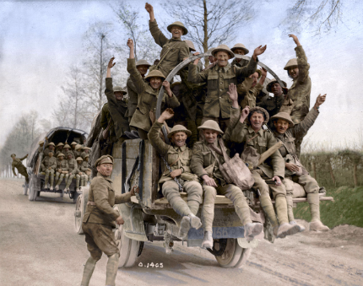
The Battle of Vimy Ridge
https://www.youtube.com/watch?v=FMJ_yjchLrc

Slide 18
Targeting & Capturing the German Army
The Canadians advanced behind a "creeping barrage." This precise line of intense Allied artillery fire moved ahead at a set rate and was timed to the minute.
The Canadian infantrymen followed the line of explosions closely. This allowed them to capture German positions in the critical moments after the barrage moved on to the next targets but before the enemy soldiers could emerge from the safety of their underground bunkers.
The Germans were forced to withdraw three kilometres east and the Battle of Vimy Ridge was over. The Allies now commanded the heights overlooking the Douai Plain, which was still occupied by the enemy.

Slide 19
Canadian Sacrifice
The Battle of Vimy Ridge proved to be a great success, but it only came at a heavy cost.
The some 100,000 Canadians who served there suffered more than 10,600 casualties, nearly 3,600 of which were fatal.
By the end of the First World War, Canada, a country of less than eight million people, would see more than 650,000 men and women serve in uniform.
The conflict took a huge toll with more than 66,000 Canadians losing their lives and over 170,000 being wounded.

Slide 20
Support from Home & Women
Canadians at home helped by producing supplies, conserving food, and buying “Victory Bonds” to support the war.
Many women took jobs in factories and other workplaces while men were fighting, which later influenced women’s rights in Canada.

Slide 21
Conscription Crisis
By 1917, not enough men were volunteering, so Canada introduced conscription (mandatory enlistment), leading to protests and division, especially in Quebec.

Slide 22
Impact on Canadian Identity
After the war, Canada gained more independence in global affairs and began to be seen as its own country, not just part of Britain.
Canada emerged from the First World War a proud, victorious nation with newfound standing in the world.
It also emerged grieving and divided, forever changed by the war’s unprecedented exertions and horrific costs.
Prime Minister Borden’s decision in early 1917 to invoke conscription, or compulsory service, in order to maintain Canada’s armies in the field nearly tore the country apart
Borden used the scale and importance of Canada’s growing war effort to advocate greater national autonomy within the Empire.

Slide 23
Five Things To Remember about WWI
It was a global war
It happened as a result of human actions and decisions.
It was a war of production that changed how wars would be fought in future.
It was a war of innovation - new technologies and artillery changed the war.
It was a war of destruction:
  The First World War left an estimated 16 million soldiers and civilians dead and countless others physically and psychologically wounded. The war also forever altered the world’s social and political landscape. It accelerated changes in attitudes towards gender and class and led to the collapse of the Russian, Austro-Hungarian and Ottoman empires. The cost of waging total war - and of rebuilding afterwards - ravaged the national economies of both the victorious European Allies and the defeated Central Powers.

Slide 24
Project Idea
Create a storyboard for an event from World War 1 that explains the event in a simple, artistic way.
Use images and simple language to explain what happened, who was involved, and the outcome from this event.

