Slide 1
8th grade
The Metis & Confederation
Lesson 7

Slide 2
The Metis

Slide 3
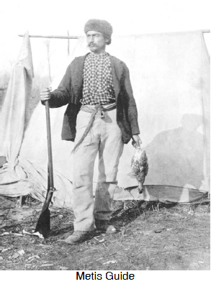
Background
Who are they?
They live in the 3 prairie provinces: Alberta, Saskatchewan, and Manitoba
They are of mixed European descent (French, Scottish, and English) and First Nations ancestry (Cree)
Their community was primarily in Red River Valley, now Winnipeg
Many were French speaking and Catholic
Their lifestyle blended Indigenous ways of life with European farming and culture

Slide 4
The Northwest Region
An area under control of the Hudson’s Bay Company (HBC) and was known as Rupert’s Land
Economic Activity:
  Fur Trade: dominated this area; HBC established trading posts and interacted with many Indigenous communities. Their trade network extended through the region’s river systems
  Métis Involvement: the Métis, particularly in the Red River region, were renowned for their buffalo hunts, which provided sustenance and resources like hides and pemmican (a protein-rich food).

Slide 5
Indigenous Presence
Indigenous Nations: The Plains Cree, Blackfoot, Assiniboine, and Dene were among the prominent Indigenous groups in the Northwest. They relied on the land for hunting and fishing and maintained intricate social and trade networks.
Interactions with the HBC: Indigenous groups held strategic trading relationships with HBC posts, which often included mutual agreements. However, as settlers began eyeing the region, Indigenous peoples grew increasingly concerned about the future of their land and ways of life.

Slide 6
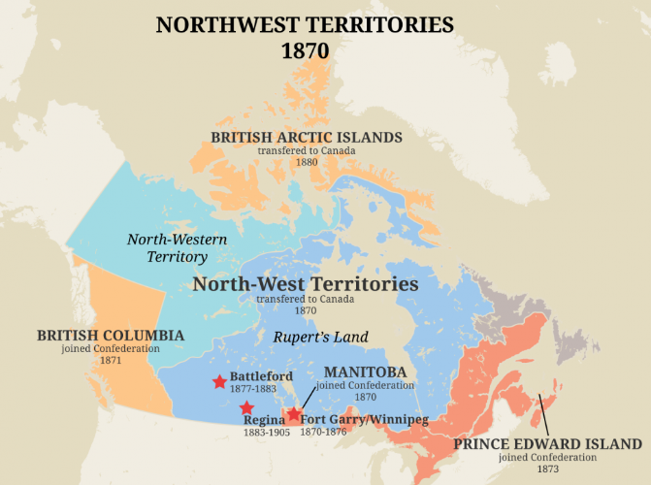

Slide 7
HBC & Métis
When the rival Hudson's Bay Company tried to move in settlers to establish farms in the Red River area in the early 1800s, the Nor'Westers encouraged the growing national sentiment of the Métis people and their territorial claims on the area.
Of the 12,000 non-Indigenous people living along the Red River at the time of Louis Riel in 1870, 10,000 were Métis.

Slide 8
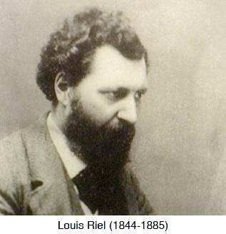
Louis Riel (1844 - 1885)
When settlers and surveyors started to move in and divide up the lands Canada was buying from the Hudson's Bay Company, Riel quickly rose to be spokesman for the Métis whose lands were being appropriated.
Riel was forced to flee to the United States in 1870 to escape arrest for the execution of an Irish Protestant, Thomas Scott.
The traditional life of the Métis was again threatened, this time by the westward expansion of the railway. After the Northwest Rebellion of 1885, Riel was arrested, tried and finally executed.

Slide 9
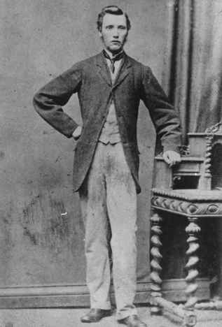
Execution of Thomas Scott: 1870
Background: Thomas Scott, an Irish Protestant from Ontario, came to the Red River Settlement and was outspoken against the Métis and Louis Riel’s provisional government. His anti-Métis views and conflicts with Riel’s forces led to his arrest.
Imprisonment and Execution: While imprisoned at Fort Garry, Scott was reportedly defiant and combative, leading the Métis court to sentence him to death. Riel, seeking to establish authority, approved the execution, carried out on March 4, 1870.
Aftermath: Scott’s execution ignited outrage in Ontario, especially among English Protestants, who viewed him as a martyr. This deepened Canada’s cultural divide, with English Canadians condemning Riel, while French Canadians and Métis viewed Riel as a defender of their rights. The incident would haunt Riel, eventually leading to his exile and setting the stage for his later trial and execution.

Slide 10
Red River Rebellion: 1869 - 1870
Land Transfer
Métis Concerns
1869 - the Canadian Government bought Rupert’s land from HBC without consulting with the local community.
The people of the Red River Settlement were scared to lose their land rights and cultural autonomy due to the anticipated rise of English-speaking Protestant settlers.
The Métis, led by Louis Riel, were primarily French-speaking, Catholic, and had a unique culture combining Indigenous and European influences.
They were concerned about losing control of their land, culture, and political power, especially since their rights to their lands were unrecognized by Canada.

Slide 11
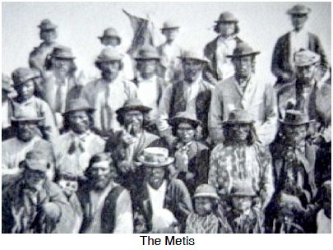
Red River Rebellion: 1869 - 1870
Resistance Begins: To assert their rights, Riel and other Métis leaders took over Fort Garry (now Winnipeg), a strategic HBC trading post.
Riel then established a provisional government, asserting the Métis' authority over the Red River area and calling for negotiations with the Canadian government.
List of Rights: The provisional government drew up a “List of Rights,” which outlined the conditions under which they would join Canada, including protection of their land rights, language, and religion.

Slide 12
Land Rights
Why the Canadian Government Denied Métis Legal Rights to the Land
No Formal Land Titles: The government operated on British common law principles, which required official land titles or deeds to recognize ownership. Since the Métis often did not have formal titles, the government considered their claims unofficial.
Colonial Expansion and Settlement Plans: Canada viewed the Red River and surrounding areas as territory to be settled, organized, and legally divided among new settlers, making it easier to govern and expand westward.
Control Over Indigenous and Métis Populations: With goals to assimilate Indigenous and Métis communities, the government often undermined traditional land claims to encourage relocation and integration into settler society.
Why the Métis Felt They Had Rights to the Land
Traditional Use and Occupation: The Métis had lived, farmed, and hunted on the land for generations, giving them a sense of ownership based on longstanding presence and stewardship.
Cultural Practices and Land Allotment: The Métis used a “river lot” system, where long, narrow plots of land extended from rivers, suited to their farming needs. This system symbolized an inherited right to live and work the land.
Land Promises in Agreements: The Métis believed that their land rights were recognized implicitly through their role in the fur trade and prior agreements with the Hudson’s Bay Company, which had allowed them to settle and use the land freely.

Slide 13
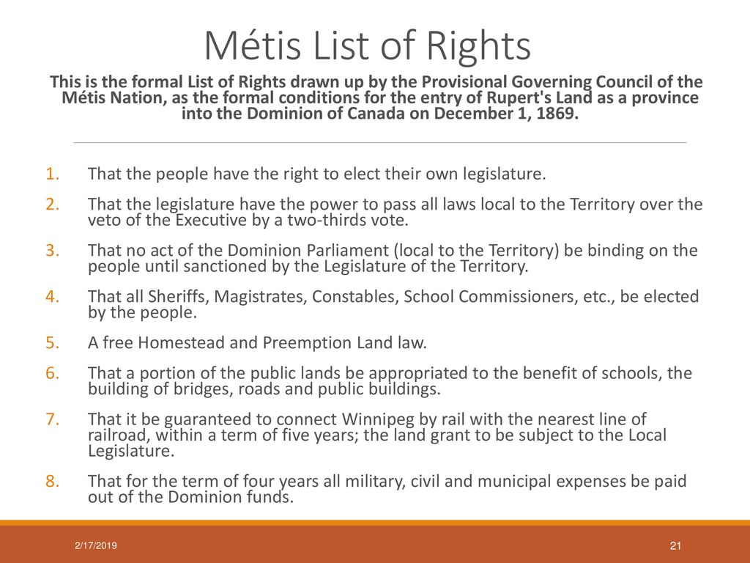
Métis List of Rights
A document created by the Métis provisional government led by Louis Riel during the Red River Rebellion of 1869-1870. This list outlined the demands and conditions under which the people of the Red River Settlement, especially the Métis, would agree to join Canada. The list addressed their concerns about land rights, cultural protection, and self-governance.

Slide 14
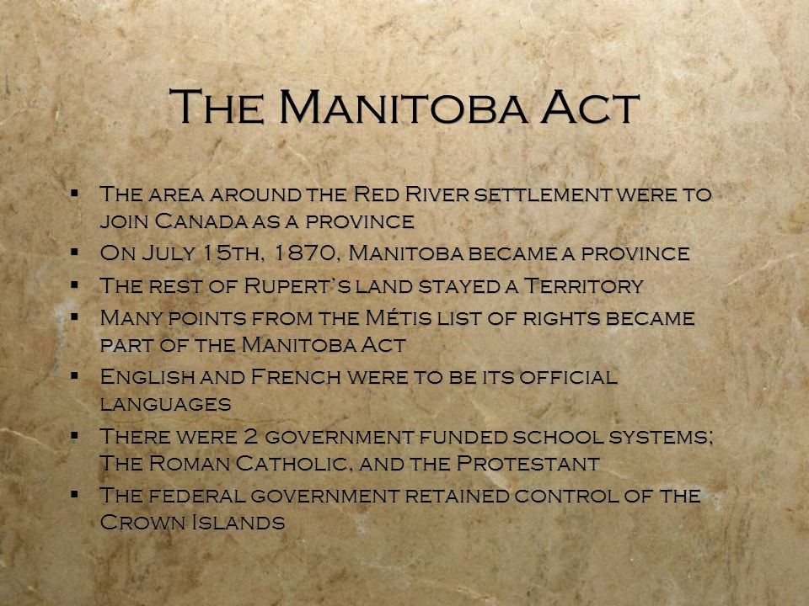
Significance of the List of Rights
The List of Rights served as a foundation for negotiations with the Canadian government and influenced the Manitoba Act of 1870, which brought Manitoba into Confederation as a province. While the List of Rights helped secure some protections, not all promises were upheld, leading to continued struggles for land rights and cultural recognition for the Métis people.

Slide 15
Key Métis Actions
Formation of a Provisional Government: Riel and the Métis established a provisional government in 1869 to organize the community and negotiate with Canada on their terms. This government allowed the Métis to assert authority over the Red River Settlement and oppose Canadian intervention.
Seizure of Fort Garry: The Métis occupied Fort Garry, the main Hudson’s Bay Company post, which gave them control over a vital economic and strategic location. This action allowed the Métis to assert physical and symbolic control over the settlement.
Blocking Canadian Surveyors: As government surveyors arrived to divide land for new settlers, the Métis, led by Riel, obstructed their work. This prevented the Canadian government from executing its plans to redistribute the land without recognizing Métis claims.
Negotiating the Métis List of Rights: Riel and the Métis crafted a List of Rights outlining conditions under which they would join Canada, including land protections, cultural rights, and local governance. They insisted these demands be recognized before any transfer of territory to Canada, forcing the government into negotiations.
Execution of Thomas Scott: The Métis arrested and executed Thomas Scott, a vocal anti-Métis agitator, to demonstrate their determination. While controversial, this act sent a strong message to the Canadian government about the seriousness of Métis grievances and demands.
These actions collectively delayed the Canadian government’s plans, drawing national attention to Métis rights.

Slide 16
Manitoba Act, 1870
May 12, 1870, the Manitoba Act leads to creating Canada's fifth province.
Its name, Manitoba, was an Assiniboine word that meant "water of the prairie" because there were many lakes and rivers in the area.
It was only a small square of land - about 35000 sq. km . - around the Red River Valley and Portage La Prairie. The rest of Rupert's Land became the Northwest Territories.
  The Métis were not legally given their lands (called a scrip) until the Dominion surveyors had finished sectioning the land - a job which took three years to complete and assess.
  Because much of Indigenous culture did not include written laws, deeds or money, many of them did were easily cheated out of the land which should have been theirs.
The Manitoba Act claimed all Métis lands would be protected but the rest were the property of the Dominion of Canada.
It guaranteed French language and publicly funded Roman Catholic schools.
The Act did not state that Roman Catholic education would be given in French. This led to conflicts later on.

Slide 17
Post Manitoba Act, 1870 - 1885
Increased settler migration from Ontario dramatically changed demographics and marginalized Metis in their homeland. The settlers often held anti-Metis marches, leading to a rise in tensions.
The Canadian government delayed granting promised land titles to the Metis. Many land allotments were smaller and not where the Metis traditionally lived which forced them off their ancestral lands.
Many Metis sold their land scrips at a low price because the process was so complex and difficult.
Led to a westward migration to Saskatchewan and Alberta, but it also led to further frustrations as Canada expanded (main cause for the Northwest Rebellion, 1885).
Louis Riel’s exile to the US and return to Canada for the 1885 Rebellion.

Slide 18
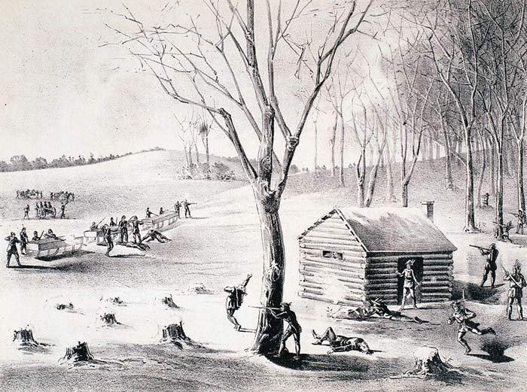
Northwest Rebellion, 1885
Led by Louis Riel and other Indigenous leaders, this rebellion stemmed from growing frustrations over land rights, broken promises, and the encroachment of settlers into Métis and Indigenous territories.
The Northwest Rebellion was a critical moment in Canadian history, reflecting the struggles of the Métis and Indigenous peoples to assert their rights and identities in the face of colonial expansion and government indifference.

Slide 19
Background & Causes
Land and Rights Issues: After the Red River Rebellion and the Manitoba Act, the Métis faced significant challenges in securing land titles. Many had moved westward into the Saskatchewan River Valley, hoping for better opportunities. However, they again encountered Canadian expansion, as settlers moved in and the government failed to formally recognize Métis land claims.
Economic Hardships: The fur trade, a primary source of Métis income, was declining, and bison (buffalo) populations, critical to Métis and Indigenous life, had nearly vanished. This created food shortages and economic difficulties, especially for Indigenous communities reliant on traditional hunting.
Indigenous Discontent: Indigenous groups, such as the Cree and Blackfoot, were also affected by the government’s neglect of treaty obligations, particularly in terms of food, aid, and autonomy. Leaders like Big Bear and Poundmaker grew increasingly frustrated with the lack of government support.

Slide 20
Louis Riel’s Return
Riel’s Leadership: The Métis invited Louis Riel, who had been living in exile in the United States, to return and advocate for their rights. Riel saw this as a chance to establish a distinct Métis nation and began organizing a resistance movement, creating a new Métis provisional government at Batoche in Saskatchewan.
Calls for Negotiation: Riel initially hoped to negotiate with the Canadian government, presenting them with demands similar to the Métis List of Rights. When the government ignored these pleas, Riel and his followers felt they had no choice but to take up arms.

Slide 21
Key Battles & Events
Battle of Duck Lake (March 1885): The first confrontation took place at Duck Lake, where Riel’s forces, led by Gabriel Dumont, clashed with North-West Mounted Police and local militia. The Métis forces won this battle, which sparked further support from Métis and Indigenous fighters.
Battles at Fish Creek and Cut Knife: Métis and Cree forces achieved initial victories against Canadian troops at Fish Creek and Cut Knife, led by Dumont and Cree leaders like Poundmaker.
Battle of Batoche (May 1885): The decisive battle of the rebellion took place at Batoche, where government troops, with superior numbers and artillery, eventually overwhelmed Riel’s forces after several days of fighting. The defeat at Batoche marked the end of the Métis armed resistance.

Slide 22
After the Rebellion
Riel’s Trial and Execution: Louis Riel was captured, tried for treason, and hanged in November 1885, a controversial decision that sparked significant backlash, particularly among French Canadians who saw him as a defender of their rights and identity.
Impact on Indigenous and Métis Rights: Riel’s execution and the defeat of the Northwest Rebellion marked a period of increased government control over the Northwest. The government imposed stricter regulations on Indigenous peoples, including forcing them onto reserves, and further restricted their cultural practices and freedoms.
National Division: Riel’s death polarized Canada, deepening divides between French and English Canadians. He was later viewed by many as a martyr and a symbol of resistance against injustice.

Slide 23
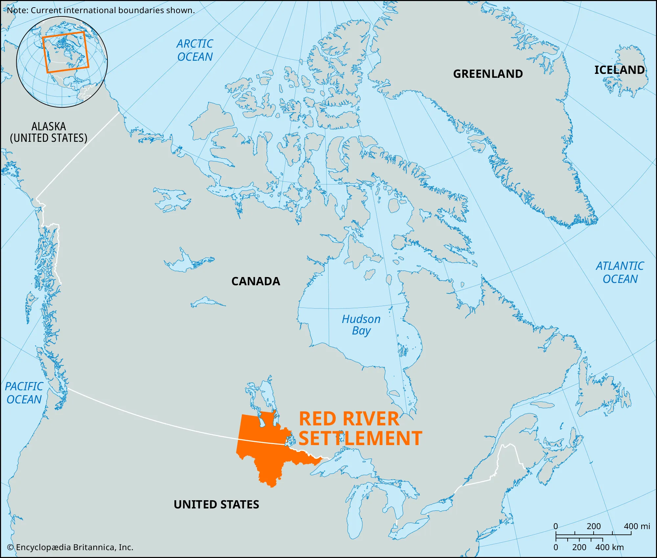

Slide 24
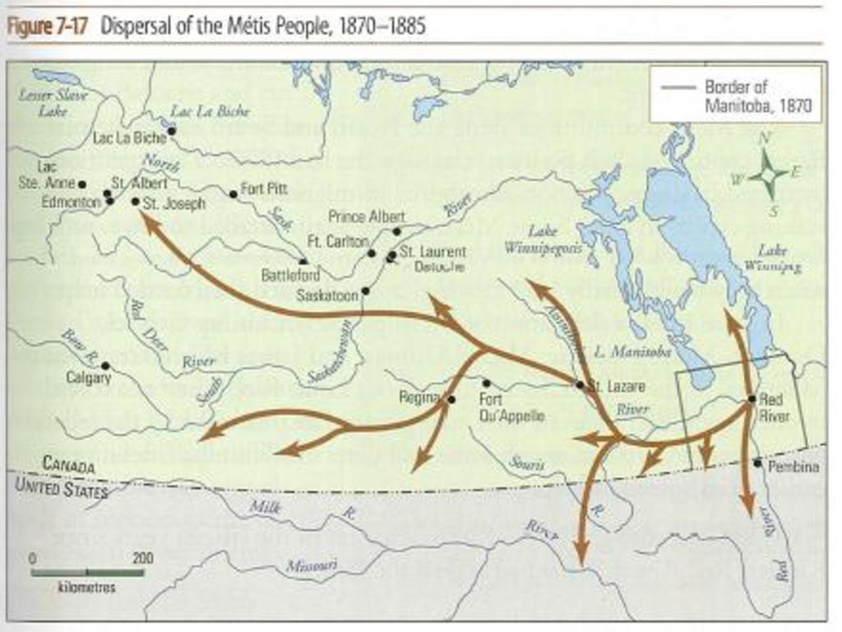

Slide 25
Discussion Question
If you were a Métis individual living during the time of the Northwest Rebellion, how would you feel about the government’s actions? What steps would you want to take to protect your rights and community?

Slide 26
Discussion Question
Imagining a scenario where Louis Riel chose to show mercy during the Northwest Rebellion. How would this influence the following?
Relations with settlers and government,
His leadership,
Métis struggle.

Slide 27
Debate Question
Was the Northwest Rebellion of 1885 a justified response to the Canadian government's treatment of the Métis and Indigenous peoples?

Slide 28
Lesson 8
The Railway, Central Canada, and the Maritimes

Slide 29
Railways
In 1871, Canada was in a period of significant growth and development, particularly concerning its railway network. The Canadian Pacific Railway (CPR) was a critical element in uniting the vast country, facilitating trade, transportation, and immigration.

Slide 30
British Columbia Joins Confederation, 1871
Here are some reasons why British Columbia joined Canada in 1871:
Economic Support: British Columbia needed help to develop its economy, and joining Canada promised better financial support.
Transcontinental Railway: The Canadian government promised to build a railway that would connect British Columbia to the rest of Canada, making travel and trade easier.
Security: Joining Canada offered protection and security, especially from potential threats, like the United States.
Population Growth: Becoming part of Canada encouraged more people to move to British Columbia, which would help grow the population and economy.
Political Stability: Joining a larger country provided more political stability and representation for British Columbia.

Slide 31
PEI’s Personal Railway Problem
Here’s a simple summary of PEI’s railway situation:
Railway Plans: PEI started building its own railway in the late 1800s to connect towns and help the economy.
Money Problems: They ran out of money and couldn’t get enough funding to finish the railway.
Construction Stopped: By the late 1880s, they had to stop building because they didn’t have enough funds.
Transportation Issues: Because the railway wasn’t completed, it made it harder for people and goods to move around the island.
Joining Canada: Later, PEI joined Canada, which promised better railway connections, but their own railway plans were never completed.

Slide 32
PEI Joins Confederation, 1873
Here’s a simple summary of Prince Edward Island (PEI):
Joining Canada: PEI became part of Canada on July 1, 1873, to get help with its economic problems.
Economy: The island's economy mainly relied on farming, especially potatoes, and fishing because of its good soil.
Population: PEI had a mix of people, including Acadians, Irish, Scottish, and English, which created a unique culture but also some conflicts.
Land Issues: Many families didn’t own land, which caused problems and led to calls for land reform.
Political Struggles: There were tensions between different religious groups, mainly Protestants and Catholics, which affected local politics.

Slide 33
Transcontinental Railway
The transcontinental railway in Canada, primarily represented by the Canadian Pacific Railway (CPR), was a monumental project aimed at uniting the country from coast to coast.
Confederation: The railway was a crucial promise during the negotiations for British Columbia’s entry into Confederation in 1871. The province required a commitment for a transcontinental railway to facilitate trade and transportation.

Slide 34
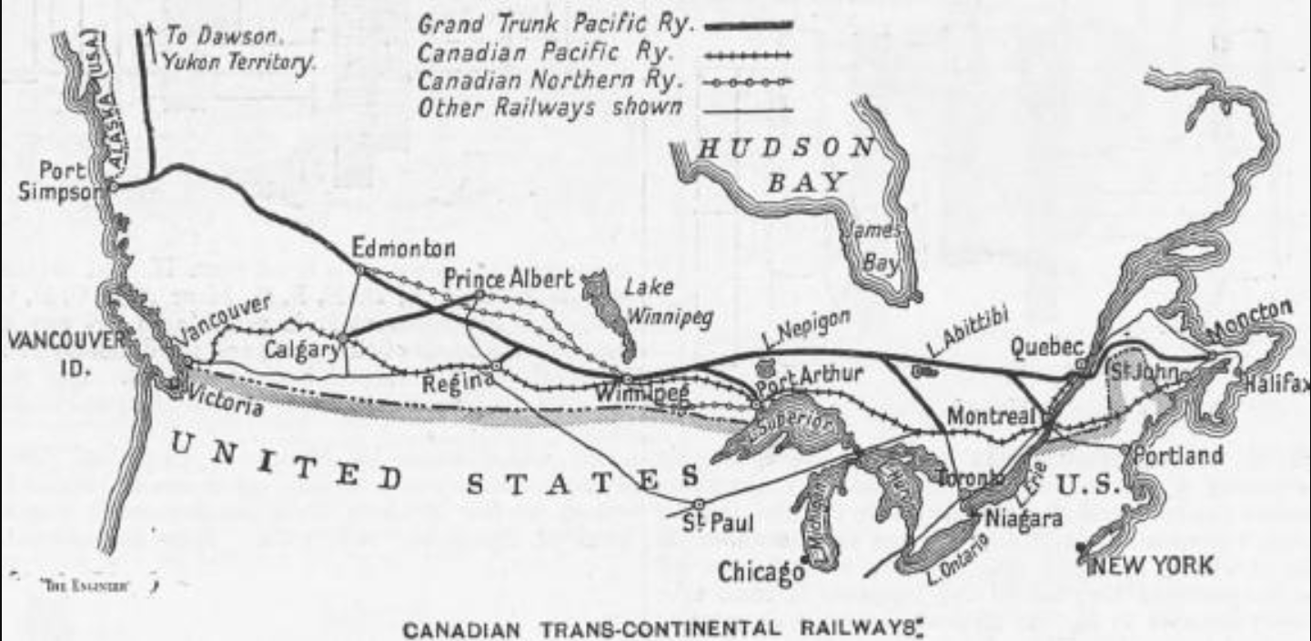

Slide 35
Construction
Start: Construction officially began in 1881 under the leadership of Prime Minister John A. Macdonald.
Challenges: The project faced numerous challenges, including financing issues, difficult terrain (particularly through the Rocky Mountains), labor shortages, and conflicts with Indigenous peoples.
Workers: A diverse workforce was employed, including many Chinese laborers who played a significant role in building the railway, especially through the Rockies.

Slide 36
Impact
Economic Development: The railway facilitated the movement of goods, people, and resources, significantly boosting economic development across Canada.
Settlement: It encouraged westward expansion and settlement in the Prairies, attracting immigrants and promoting agricultural development.
National Identity: The railway contributed to the growth of a national identity, helping to connect the diverse regions of Canada.

Slide 37
Road Blocks
The railway, although a great idea for Canadian expansion, came with a few issues.
It costs A TON of money to build and maintain. Spending was an issue as the country isn’t fully formed and people weren’t exactly rich.
The Rocky Mountains - where do you build? Do you just blow up the mountain?
First Nations communities were not consulted and many had their lands stripped, demolished, and replaced with the railway.

Slide 38
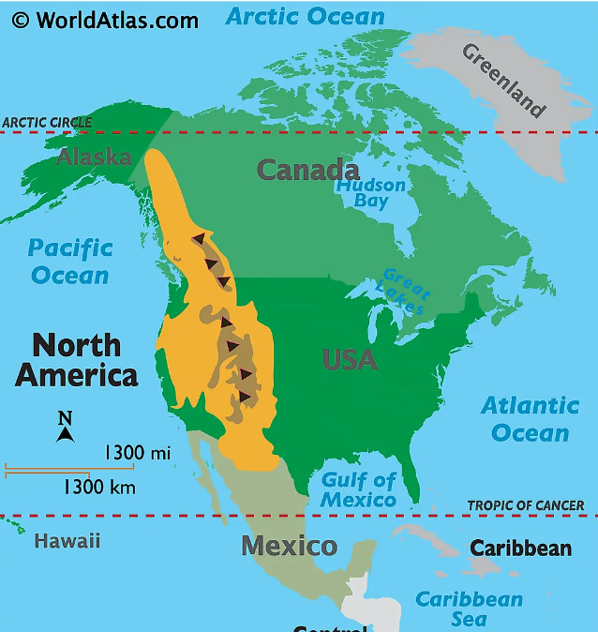
Map of the Rocky Mountains
Question:
You’re in charge of building this railway. But there’s the mountains in the way. What is your solution?

Slide 39
Activity
Building a train across the second largest land mass on the planet, what can possibly go wrong?
Everybody stand up and form a line around the room.
You represent the railway.
Let’s play broken telephone and see what happens.

Slide 40
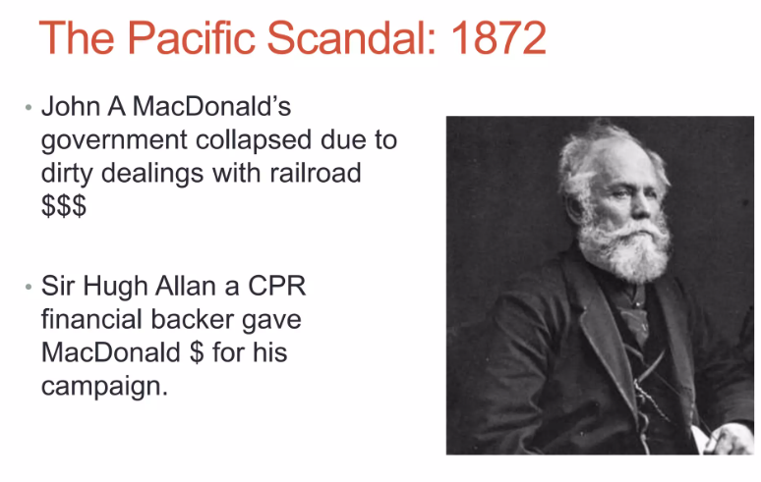
The Pacific Scandal of 1872
Background
Confederation Context: The scandal arose in the context of the promise to build the CPR as a condition for British Columbia joining Confederation in 1871.
Allegations
Bribery: The scandal erupted in 1873 when it was revealed that Prime Minister John A. Macdonald and members of his Conservative government had allegedly accepted bribes from the CPR’s promoters in exchange for favorable treatment and contracts related to the railway's construction.
Key Figures: The scandal involved several prominent figures, including Macdonald and railway financier Sir Hugh Allan.

Slide 41
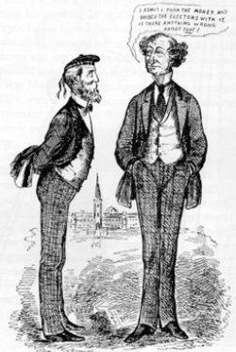
Public Reaction
Political Fallout: As news of the scandal broke, it caused a public outcry and led to a loss of trust in the government. Opposition parties seized on the issue, demanding accountability.
Resignation: In the face of mounting pressure, Macdonald’s government ultimately resigned in 1873. This marked one of the first instances of a Canadian prime minister being forced from office due to a scandal.

Slide 42
Consequences of the Scandal
Change in Government: After Macdonald's resignation, the Liberal Party, led by Alexander Mackenzie, came to power.
Impact on CPR: The scandal delayed the railway’s construction, although it was eventually completed in 1885, under a different administration.
Legacy: The Pacific Scandal highlighted issues of political corruption and accountability in Canadian politics. It set a precedent for future political scrutiny and reforms aimed at increasing transparency in government dealings.

Slide 43
Alexander Mackenzie - 1873
Key Policies
Challenges
The Mackenzie government, led by Alexander Mackenzie, came to power in 1873 after the fall of John A. Macdonald's Conservative government due to the Pacific Scandal. Here are some key points about Mackenzie’s administration:
Focus on Transparency: Mackenzie’s government prioritized issues of accountability and reform in response to the corruption scandal that had plagued the previous administration.
Infrastructure Development: The government continued the push for the construction of the Canadian Pacific Railway, although progress was initially slow due to the political turmoil.
Economic Policy: Mackenzie’s administration implemented a number of economic policies aimed at promoting trade and development, including a focus on agriculture.
Minority Government: Mackenzie led a minority government, which made it challenging to pass legislation. He relied on negotiations and alliances with other parties to maintain stability.
Economic Issues: His government faced economic difficulties, including a financial downturn in the mid-1870s that led to increased public discontent.

Slide 44
End of Government
Defeat in 1878: After a series of economic challenges and dissatisfaction with the pace of development, Mackenzie’s government was defeated in the 1878 federal election by Macdonald’s Conservatives, who returned to power on a platform emphasizing the importance of the CPR.

Slide 45
John A. Macdonald - 1878
In 1878, John A. Macdonald returned to power, leading the Conservative Party and introducing his "National Policy," which aimed to promote economic growth and national unity in Canada. Here are the key components of this policy:
Protective Tariffs: Higher taxes on imported goods to encourage people to buy Canadian products instead of foreign ones.
Canadian Pacific Railway (CPR): Building a railway to connect the east and west coasts, which was essential for travel, trade, and settlement.
Encouraging Immigration: Attracting new settlers to the western provinces to help develop agriculture and grow the population.
Infrastructure Development: Improving roads, bridges, and other public works to support economic activities and connect communities.
Overall, the National Policy was about boosting Canadian industry, promoting trade within Canada, and helping the country grow and stay united.

Slide 46
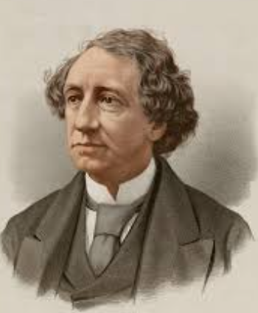
Back to the Railroad
Macdonald is back in power - again. His Focus? The railroad. But why?
Promote unity,
Drive economic growth,
Settle the west,
Maintain control over the western territories
Fulfill promises to BC of the transcontinental railway.

Slide 47
Change in Route
The railway was moved closer to the U.S. border in 1878 for a few main reasons:
Protection: Canada wanted to show control over its western land so the U.S. wouldn’t try to take it.
Trade: Being near the border made it easier to trade with the U.S., helping towns along the railway grow.
Easier Building: The southern route helped avoid tough mountain areas, making it faster and cheaper to build.
Fertile Lands: Moving south helped Canada attract settlers to its best farmland, build new communities, and grow a strong agricultural economy.

Slide 48
Impact on First Nations
The railway built in 1881 had serious effects on First Nations communities:
Loss of Land: Indigenous people were pushed off their land to make room for the railway and new settlers, disrupting their lives.
Loss of Resources: Settlers hunted bison, a key food and material source for many First Nations, almost to extinction. This led to hunger and hardship for Indigenous communities.
Broken Promises: The government often ignored its treaty promises to help and protect First Nations, focusing instead on building the railway.
More Settlers: The railway brought more settlers onto Indigenous lands, taking away space and pressuring First Nations to change their way of life.

Slide 49
Impact on Chinese Workers
The construction of the railway in the 1880s also had a big impact on Chinese workers:
Dangerous Work: Thousands of Chinese workers were hired to build the railway, often doing the most dangerous jobs, like blasting tunnels through mountains. They faced deadly risks, and many lost their lives.
Low Pay: Chinese workers were paid much less than other workers and had to pay for their own food, shelter, and tools, leaving them with very little money.
Discrimination: Chinese workers faced harsh discrimination and were often treated unfairly. After the railway was finished, many were left without work and faced racist laws that made it hard for them to stay or bring their families to Canada.
Legacy: Despite the hardships, Chinese workers played a crucial role in completing the railway, helping Canada grow and connect. Their contributions are recognized today, though it took many years for their sacrifices to be honored.

Slide 50
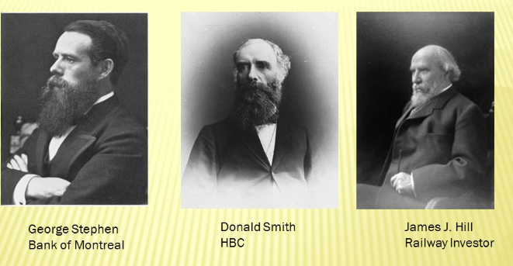
CPR Syndicate of 1880
What is it? a group of investors responsible for the construction of the Canadian Pacific Railway (CPR).
What did they do? Give a ton of money…about $25 million and 25 million acres of land to build on.
What else did they get? A tax exemption.

Slide 51
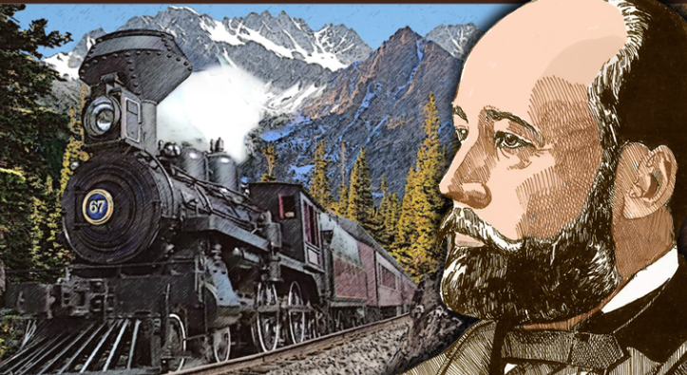
The Rockies
Proved to be a rocky ride…
The railway budget was almost out and they still needed to tackle this problem.
William Van Horne was hired to take the railroad over the rockies.

Slide 52
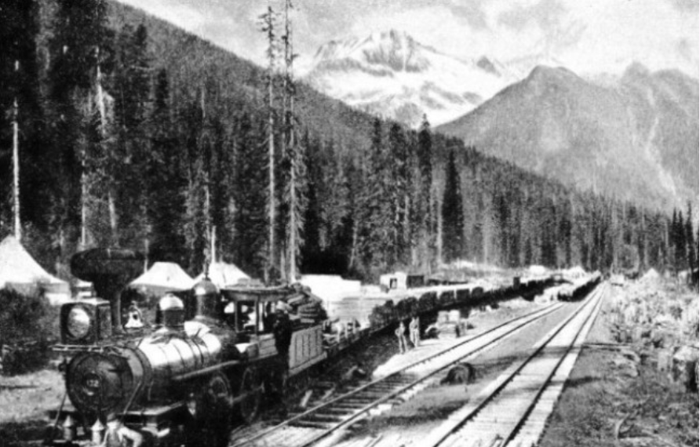
Support for the Rockies?
The railway needed the public’s support and money if it was to continue to be built. So, how were they going to get it?
Everybody stand up and get back onto the railway line. Let’s debate this using our knowledge of who’s for and against expansion.

Slide 53
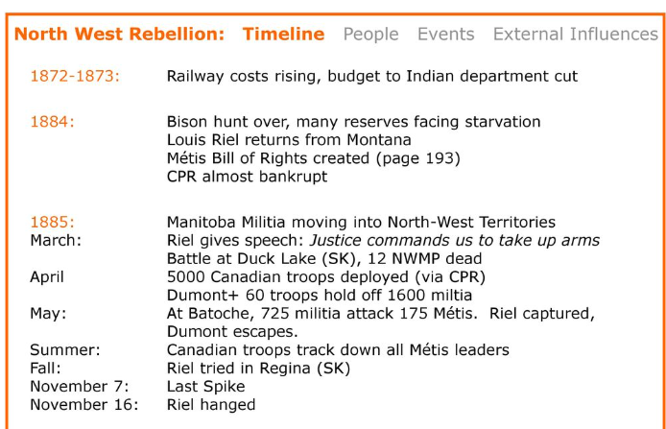
Northwest Rebellion
Remember that? Well, with the successful defeat of the Northwest Rebellion in 1885, the people actually supported the CPR development even though it was pretty expensive to build.
What would previously take weeks to reach now would only take days.

Slide 54
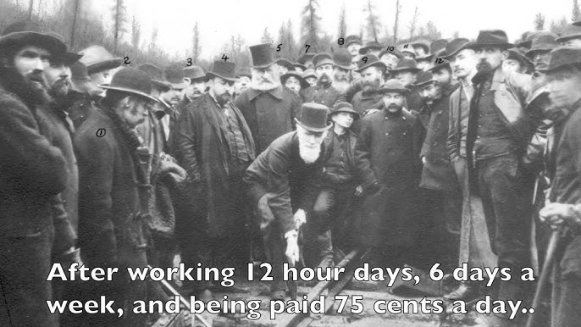
The Last Spike, 1885
Donald Smith drove the last spike of the CPR railway in British Columbia in 1885. The railway was completed.

Slide 55
Central Canada - 1867
After Confederation in 1867, Central Canada (Ontario and Quebec) went through big changes:
Growing Economy: Trade between provinces became easier, helping industries like factories, lumber, and mining grow, especially in cities like Toronto and Montreal.
Railways: New railways connected Central Canada to the West, making it faster to move goods and people across Canada, which boosted the economy.
City Growth: With more jobs in factories, people moved from farms to cities, causing cities in Ontario and Quebec to grow quickly.
Immigration: More people came to Canada, especially to Central Canada, bringing different cultures and adding to the workforce.
Political Power: Ontario and Quebec had a lot of say in how Canada was run, making important decisions for the country.
Overall, Central Canada became wealthier, more urban, and more powerful, helping Canada grow as a nation.

Slide 56
Maritimes
After Confederation in 1867, the Maritime provinces (Nova Scotia, New Brunswick, and later Prince Edward Island) faced several challenges:
Economic Struggles: The Maritimes relied on fishing and shipbuilding, but as Canada shifted to factories and railways, they found it hard to keep up.
Lack of Railways: Most new railways connected Central Canada to the West, with few built in the Maritimes. This made it tough for businesses in the Maritimes to trade with other parts of Canada.
People Leaving: Many residents moved away to find jobs in Central Canada or the U.S. because there were fewer job opportunities at home.
Less Political Power: The Maritimes had less say in national decisions compared to Ontario and Quebec, so their needs were often ignored.
In summary, after Confederation, the Maritimes faced economic challenges, job losses, and a decrease in population, leading to slower growth compared to other regions in Canada.

Slide 57
July 4, 1875
In 1875, the Protestant Orangemen, part of the Orange Order, were very active in Canada. Here’s what happened:
Jubilee Celebrations: Catholics were celebrating a special year for Pope Pius IX, which included parades.
Protestant Opposition: The Orangemen did not like these parades because they felt it threatened their beliefs and power.
Riots: On July 4, 1875, during a Catholic parade in Toronto, violence broke out between the Orangemen and Catholics. People threw stones and fought.
Police Struggle: The police had a hard time controlling the situation, and there were many injuries.
Ongoing Tensions: These events showed the deep divisions between Protestants and Catholics in Canada at the time.
In short, in 1875, the Orangemen clashed with Catholics during celebrations, leading to riots and highlighting the tensions between the two groups.

Slide 58
Joseph Guibord
Joseph Guibord was a Canadian businessman known for a famous controversy in the 1800s about religious rights.
Background: Guibord was from Quebec and was a Catholic, but he had different ideas about religion.
Burial Issue: When he died, he wanted to be buried in a Catholic cemetery, but the church refused because he wasn’t a practicing Catholic anymore.
Court Case: Guibord took the case to court, arguing that he should have the right to be buried where he wanted.
Support: Many people supported him, believing it was important for individuals to have freedom of choice in matters of religion.
Significance: His case raised important questions about the power of the church and the rights of individuals, showing changing attitudes toward religion in Quebec.
So, to summarize, Joseph Guibord fought for the right to be buried in a Catholic cemetery, and his case highlighted the struggle between personal rights and church authority in Canada.

Slide 59
Debate Questions
Let’s pretend the railway is in the middle of the class. If you agree with the question topic, move to the right. If you disagree, move to the left side.
Be ready to debate your reasons!
Indigenous Rights: To what extent did the construction of the CPR infringe on the rights and lands of Indigenous peoples in Canada?
Government Responsibility: Was the Canadian government's financial support for the CPR justified given the challenges it faced in construction and operation?
National Unity vs. Local Interests: Did the construction of the CPR foster genuine national unity, or did it prioritize the interests of certain provinces over others?
Labor Issues: Were the working conditions and wages for laborers involved in the CPR construction acceptable, or did they exploit workers for profit?

Slide 60
First Nations Resistance
Lessons 11 & 12

Slide 61
Overview
Definition: Resistance refers to the actions First Nations took to defend their lands, rights, and cultures against colonial policies and practices.
Historical Context:
Colonization led to the loss of land, resources, and autonomy for First Nations peoples.
The Indian Act (1876) imposed government control over First Nations.

Slide 62
Red River Resistance
Location: Red River Settlement (modern-day Manitoba).
Cause:
  Canada bought Rupert's Land from the Hudson’s Bay Company without consulting the Métis.
  Fear of losing land, culture, and self-determination.
Events:
  Louis Riel led the Métis to form a provisional government.
  They demanded rights for the Métis and negotiated Manitoba's entry into Confederation.
Outcome:
  Manitoba Act (1870) created Manitoba as a province, recognizing some Métis land rights.
  However, promises were not fully honored, and Métis land was later lost.

Slide 63
Northwest Resistance
Location: Saskatchewan.
Cause:
  Métis and First Nations faced food shortages due to bison extinction and broken government promises.
  Loss of land and declining influence in their territories.
Events:
  Riel returned to lead the Métis and allied with some Cree and Assiniboine groups.
  Armed confrontations occurred, including the Battle of Batoche.
Outcome:
  The resistance was defeated by Canadian forces.
  Riel was captured, tried, and hanged for treason.
  Increased government control over the Prairies.

Slide 64
Impact
Highlighted the struggles of Métis and Indigenous peoples for rights and recognition.
Led to increased government suppression but also greater awareness of Indigenous issues in Canada.

Slide 65
The Numbered Treaties
The Numbered Treaties (1871-1921)
Context: Treaties between First Nations and the Canadian government were often signed under duress or deceit.
Resistance:
  Many leaders resisted signing or sought to renegotiate terms for better protections of land and rights.
  Chief Mistahimaskwa (Big Bear) delayed signing Treaty 6, advocating for more sustainable terms.

Slide 66
The Indian Act
The Indian Act (1876)
Context: Imposed severe restrictions on Indigenous governance, culture, and movement.
Resistance:
  First Nations used petitions, delegations, and legal challenges to oppose oppressive policies.
  Leaders like Poundmaker and Mistahimaskwa advocated for self-governance.

Slide 67
Potlatch Ban
Potlatch Ban (1885-1951)
Context: The Canadian government banned cultural practices like the potlatch, a ceremonial gift-giving event central to many Pacific Northwest First Nations.
Resistance:
  First Nations continued to hold potlatches in secret despite legal threats.
  Chiefs and community members were imprisoned for preserving their traditions.

Slide 68
Residential Schools
Context: The government and churches forced Indigenous children into residential schools to assimilate them.
Resistance:
Families hid their children or fled to avoid them being taken.
Some Indigenous leaders spoke out against the system, despite the risk of retaliation.

Slide 69
Forms of Resistance
Legal Challenges:
Fought unfair treaties and land claims in courts.
Example: Calder Case (1973), which recognized land rights.
Protests and Movements:
Organized demonstrations and blockades to protect land and resources.
Example: Oka Crisis (1990) over disputed land in Quebec.

Slide 70
Forms of Resistance
Cultural Revival:
Preserved languages, traditions, and ceremonies despite bans.
Example: Resurgence of powwows and smudging practices.
Political Advocacy:
Formed groups like the Assembly of First Nations to push for rights.
Educational Efforts:
Shared their stories to inform Canadians about injustices.

Slide 71
Key Issues
Land disputes.
Protection of natural resources.
Resistance to residential schools and assimilation policies.

Slide 72
Ongoing Resistance
Continued opposition to pipelines and resource extraction projects on traditional lands.
Advocacy for the recognition of treaties and self-governance.

Slide 73
In The Last 10 Years
In the past decade, Indigenous resistance in Canada has been marked by numerous significant events aimed at protecting land, rights, and sovereignty. Here are key examples.

Slide 74
Idle No More - 2012 to Present
This grassroots movement began in response to Bill C-45, which proposed changes to environmental protections. It grew into a nationwide call for Indigenous sovereignty, environmental protection, and respect for treaty rights, using social media and peaceful protests as tools for change.

Slide 75
Wet'suwet'en Pipeline Protests (2019-Present)
Members of the Wet'suwet'en Nation opposed the Coastal GasLink pipeline in British Columbia, which would cut through their traditional territories. The protests involved blockades, legal challenges, and international attention to Indigenous land rights.

Slide 76
Land Defenders Movements
In 2020, the Six Nations people established a blockade in Caledonia, Ontario, over a housing development on disputed lands. This followed ongoing struggles for land reclamation across the country, like the Oka Crisis's echoes.

Slide 77
Resistance to Environmental Projects
First Nations communities, including the Tsleil-Waututh and Secwepemc peoples, opposed projects such as the Trans Mountain and Keystone XL pipelines due to concerns about environmental damage and violation of their territories.

Slide 78
Justice for Indigenous Women & Girls
Grassroots initiatives have highlighted the crisis of missing and murdered Indigenous women and girls (MMIWG), demanding systemic change and greater accountability.

