Slide 1
Short Stories, Legends, & Myths

Slide 2
Table of contents
1
3
2
4
Short Stories
Myths
Legends
Project

Slide 3
Elements of a Plot
1
Exposition
Rising Action
Introduce characters, setting, and conflict.
Builds tension and interest.
2
Falling Action
Climax
Resolves the conflict.
4
The highest point of excitement in a story.
3
Conclusion
5
Final outcome.

Slide 4
1
Short Stories
The mist crept silently.

Slide 5
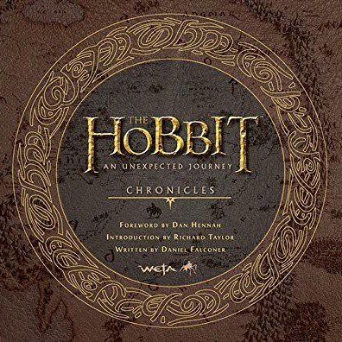
Discussion Question
What makes a story memorable?

Slide 6
Introduction to Storytelling
Storytelling is a way to communicate and interact with others. It is a way to discuss ideas, information, or experiences using a narrative structure.
The narrative structure includes a plot, characters, setting, and a conflict.
Storytelling can be done through various mediums, such as:
Oral storytelling: Sharing stories through spoken language.
Written storytelling: Creating stories in books, articles, or scripts.
Visual storytelling: Using images, films, or animations to convey a narrative.
Interactive storytelling: Allowing the audience to participate in shaping the story.

Slide 7
Key Elements to Stories
Key elements of storytelling include:
Characters: The people, animals, or objects that drive the story.
Plot: The sequence of events that make up the story.
Setting: The time and place where the story takes place.
Conflict: The problem or challenge that the characters must overcome.
Theme: The underlying message or lesson of the story.
Narration is another crucial element of storytelling. It refers to the voice or perspective through which the story is told. There are two main types of narration:
First-person narration: The story is told from the perspective of a character within the story, using "I" or "we."
Third-person narration: The story is told from an outside perspective, using "he," "she," "it," or "they."
Solution/resolution is the final outcome of the story. It's the point where the conflict is resolved, and the characters learn a lesson or experience a change.

Slide 8
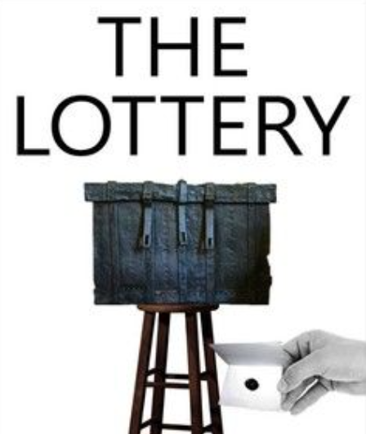
The Lottery - Shirley Jackson
Why is this a short story?
Follows a single plot or storyline;
Limited characters;
Focuses on a single event;
A climactic ending that’s shocking and unexpected.
How did you feel when you reached the story’s ending?
Why do you think Shirley Jackson ends the story in such a sudden and violent way?

Slide 9
Mini-Challenge
Write a Scary Story in 6 Words or Less
Challenge: Can you craft a terrifying story in such a limited space?
For example, “I thought everyone could hear them?” or “Run!, but the door slammed shut…”

Slide 10
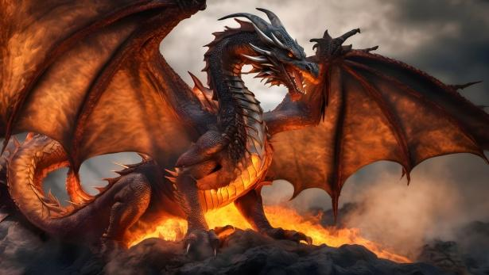
2
Legends
The dragon guarded the hidden gold.

Slide 11
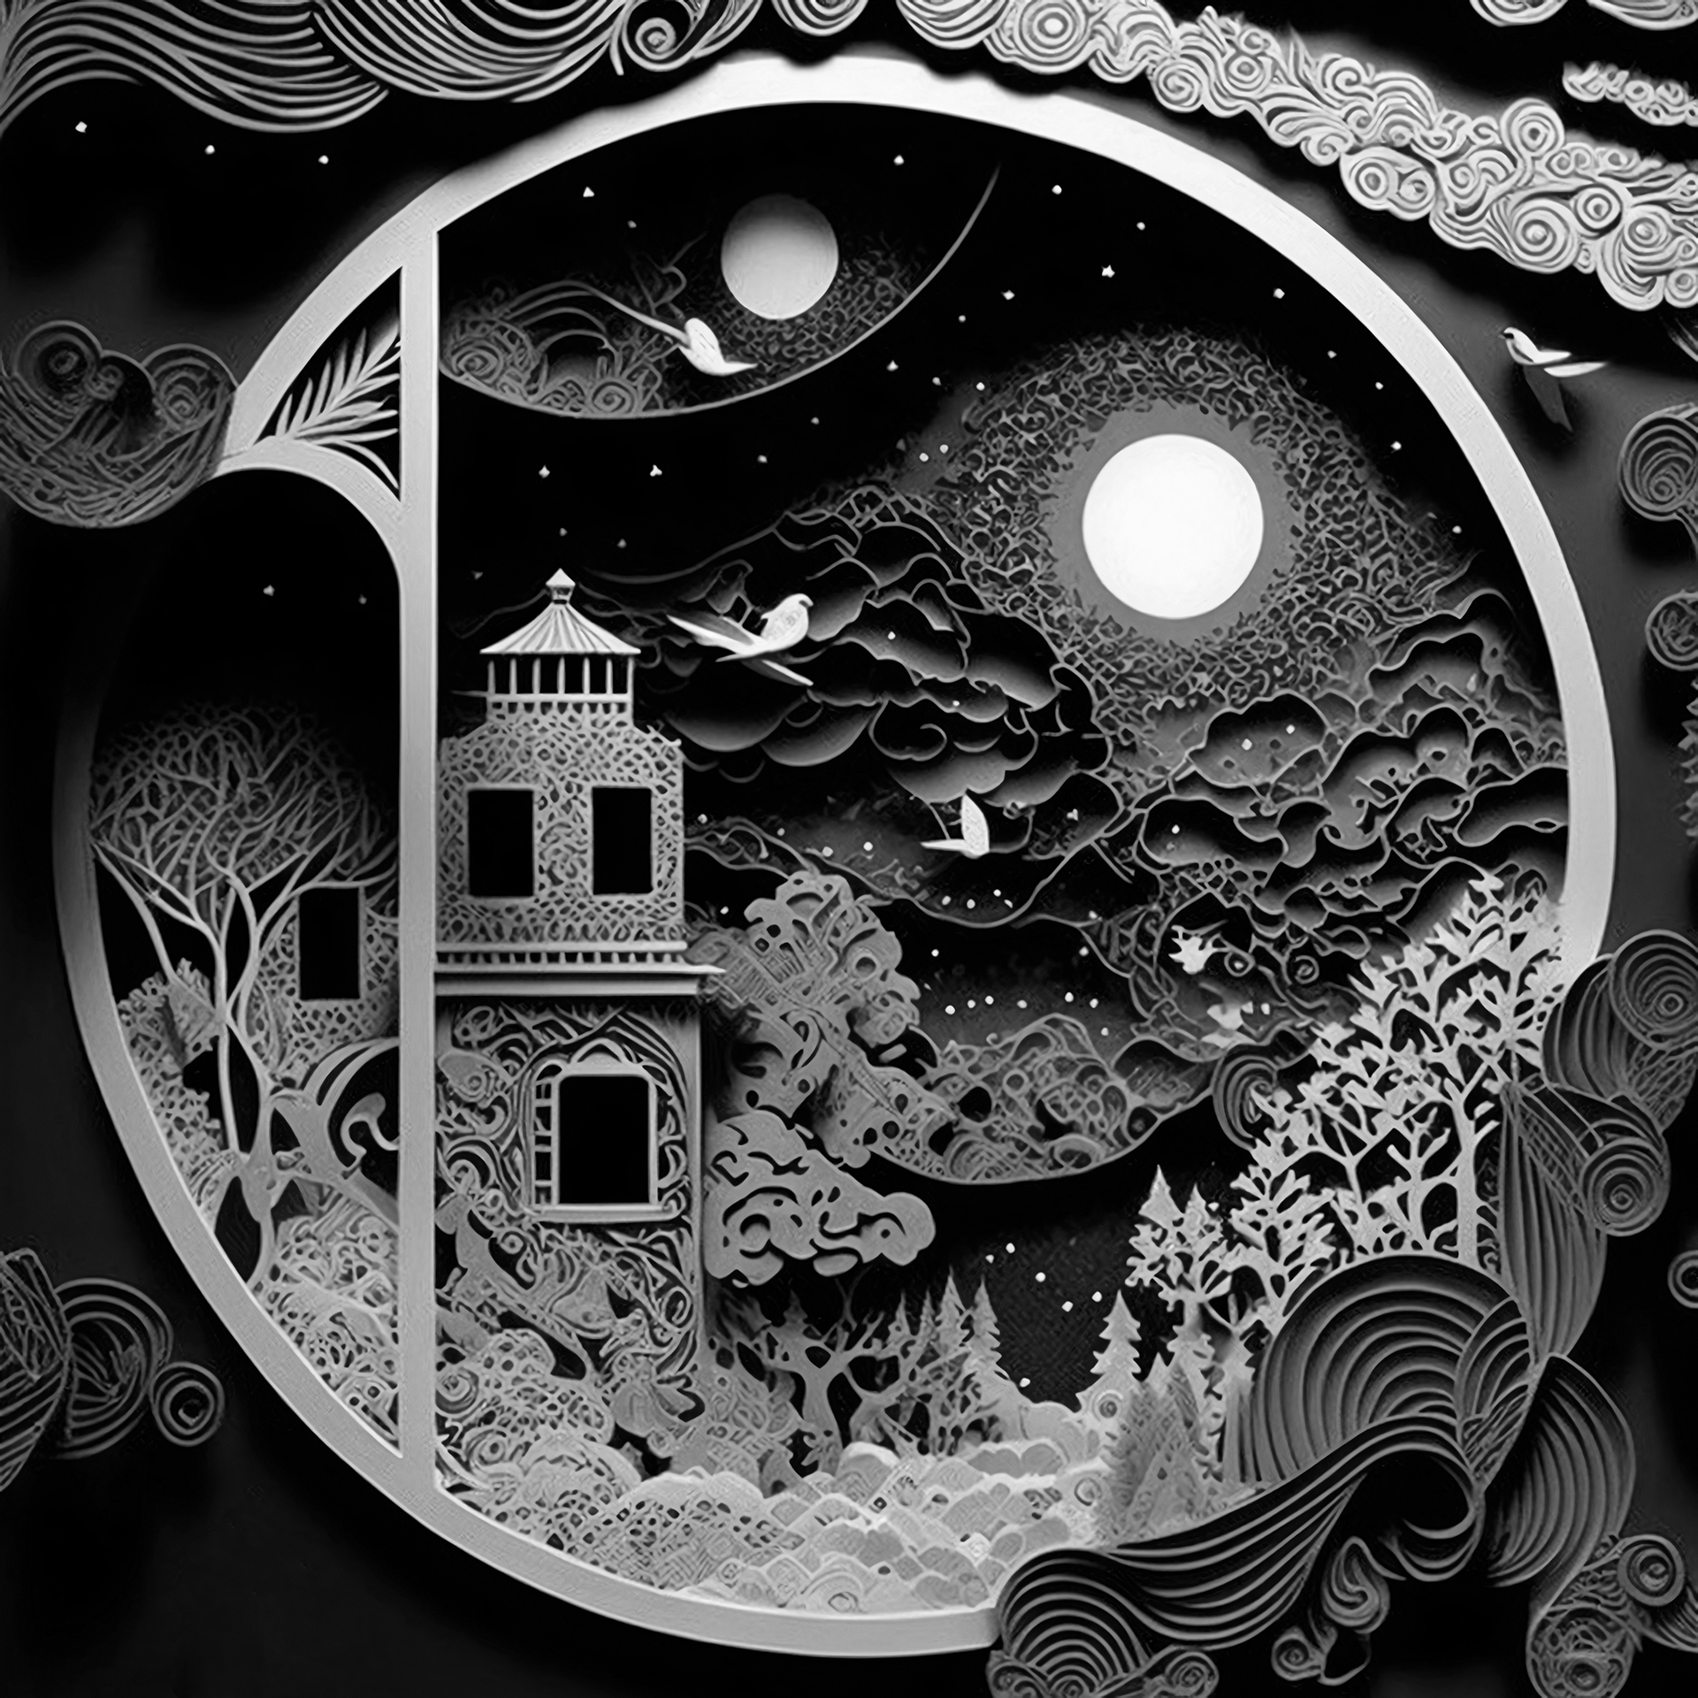
Legends
What is a legend?
A legend is a traditional story, often involving supernatural or fantastical elements, that is passed down through generations. Unlike myths, which are often associated with gods or deities, legends are typically grounded in historical events or real people.
Legends often serve as a way to explain natural phenomena, cultural practices, or historical events. They can also be used to teach moral lessons or inspire people.

Slide 12
So, how is a legend different?
Purpose:
Legends: Primarily serve to explain natural phenomena, cultural practices, or historical events. They often contain supernatural or fantastical elements.
Short stories: Typically aim to entertain and explore a particular theme or idea. They are often more focused on character development and plot.
Origin:
Legends: Often have oral origins and are passed down through generations, sometimes undergoing changes over time.
Short stories: Are usually written by individual authors and are more likely to be original works.
Length:
Legends: Can vary in length but are often shorter than novels.
Short stories: Are typically much shorter than novels, often only a few thousand words long.
Reality:
Legends: Often involve supernatural or fantastical elements and may not be based on historical facts.
Short stories: Can be based on real-world events or characters, but they often involve fictional elements.
Theme:
Legends: Often focus on themes related to nature, morality, or heroism.
Short stories: Can explore a wide range of themes, from love and loss to social issues and personal struggles.

Slide 13
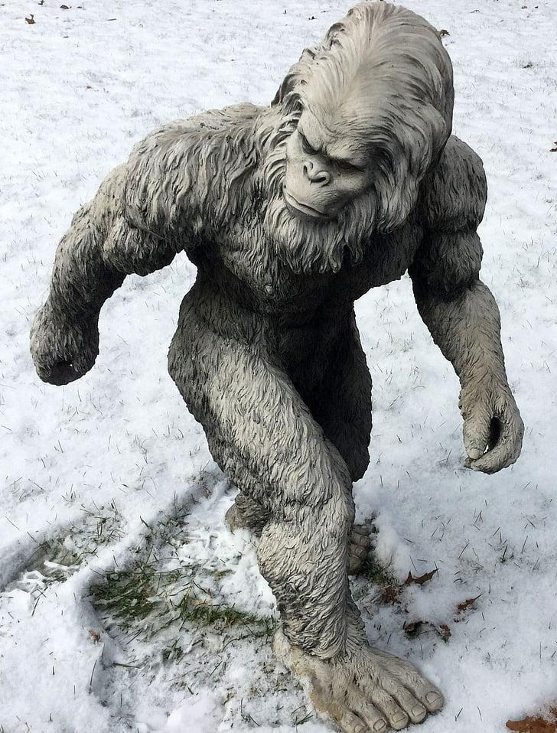
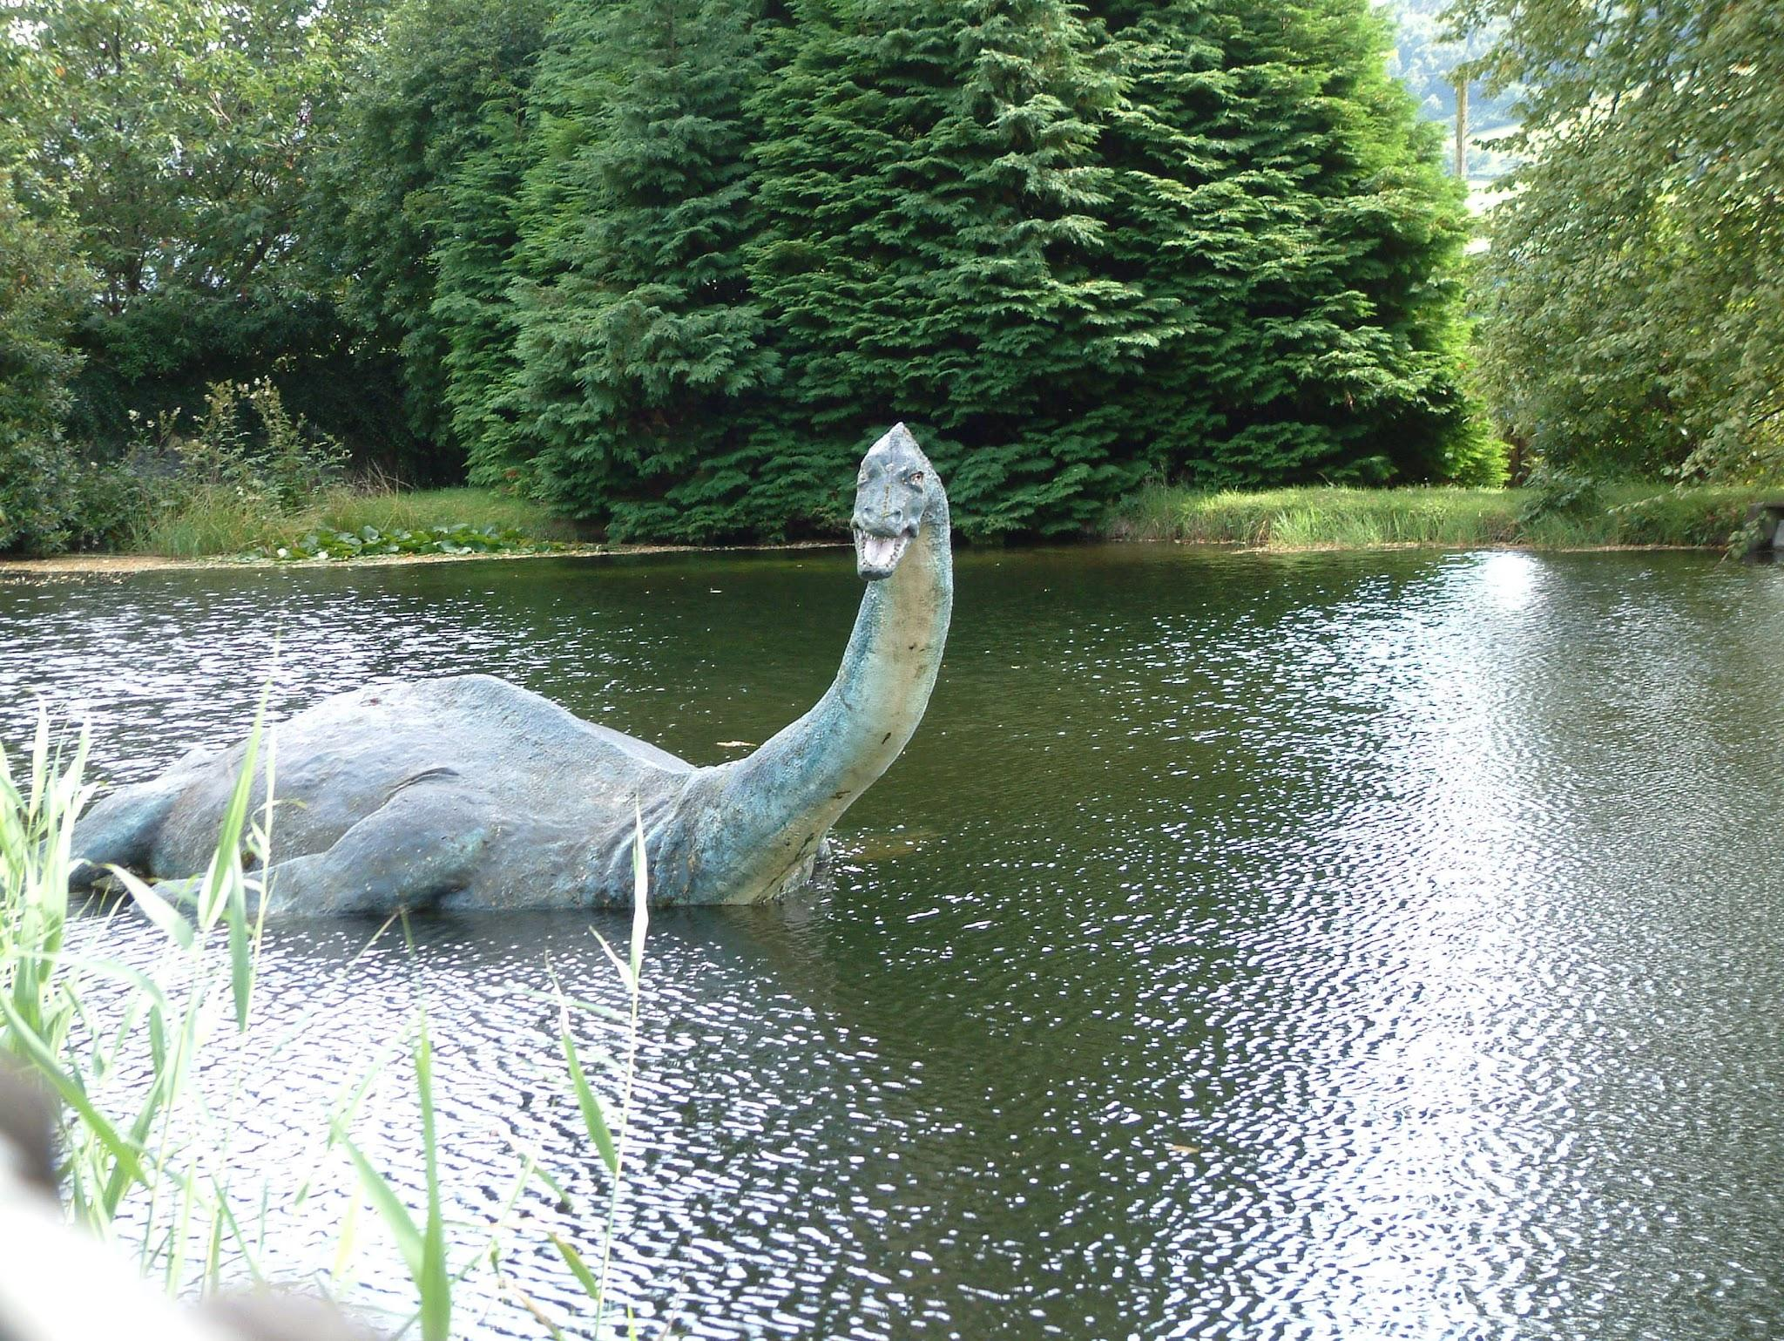
Are these Legends?
Bigfoot
Loch Ness Monster
Yes! It is a cryptid whose existence has not been proven by science. However, there have been numerous reported sightings and alleged evidence of Bigfoot. This makes it a legend.
Yes! The mystery has led to countless theories and speculations. Some believe it could be a plesiosaur, a prehistoric marine reptile, while others suggest it might be a hoax or a misidentification of other creatures. Regardless of the truth, the Loch Ness Monster remains a fascinating and enduring legend.

Slide 14
What are some common legends you know?
Iceland
Troll: Large, ugly creatures often associated with mountains and rocks.
Mexico
La Llorona: The Weeping Woman, a ghost of a woman who drowned her children and now wanders the streets, crying for them.
El Chupacabra: The Goat Sucker, a mysterious creature said to attack and drain the blood of livestock.
Argentina
El Pombero: A mischievous spirit often associated with the forest and the countryside.
Italy
La Befana: A kindly witch who delivers gifts to children on Epiphany.
Il Lupo Mannaro: The Werewolf, a creature that transforms into a wolf on certain nights.
Africa
Anansi the Spider: A trickster god in West African folklore who is known for his wisdom and cunning.

Slide 15
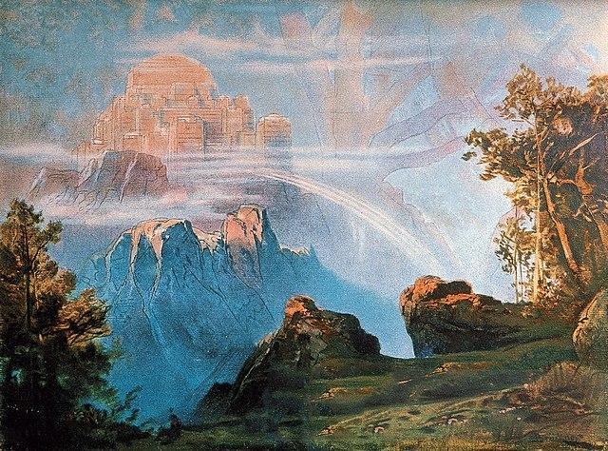
3
Myths
The gods fought for the sky.

Slide 16
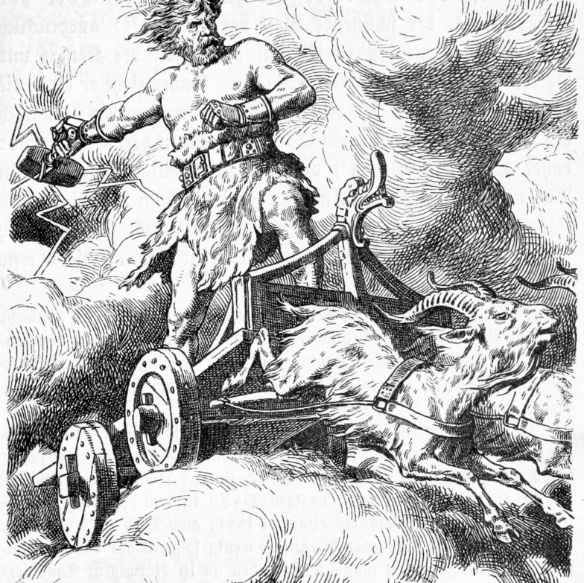
Myths
A myth is a traditional story, often involving gods or supernatural beings, that is used to explain natural phenomena, cultural practices, or the origins of the universe. Myths are often rooted in a particular culture or religion and can be passed down through generations orally or in written form.

Slide 17
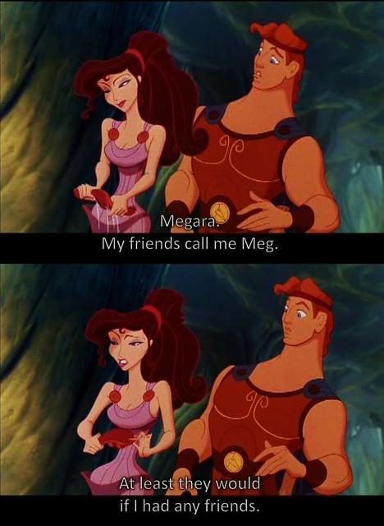
Key Characteristics of a Myth
Supernatural elements: Myths often involve gods, goddesses, heroes, and other supernatural beings.
Explanation of the world: Myths are often used to explain the origins of the universe, the creation of humans, and natural phenomena such as the seasons, weather, and eclipses.
Cultural significance: Myths are often deeply rooted in a particular culture and can reflect its values, beliefs, and traditions.
Symbolic meaning: Myths often contain symbolic elements that can be interpreted in different ways.

Slide 18
Just a few myths…
Greek mythology:
The stories of gods like Zeus, Hera, and Poseidon, and heroes like Hercules and Achilles.
Norse mythology:
The tales of gods like Odin, Thor, and Loki, and the Norse creation myth of Yggdrasil.
Egyptian mythology:
The stories of gods like Ra, Osiris, and Isis, and the Egyptian afterlife beliefs.
Hindu mythology:
The stories of gods like Vishnu, Shiva, and Brahma, and the Hindu creation myth of the Puranas.
African Mythology:
The Leopard Men: A group of mythical creatures that are said to be half-human and half-leopard.
Native American Mythology:
Thunderbird: A powerful bird-like creature that controls the weather.
Latin American Mythology:
Quetzalcoatl: A feathered serpent god in Aztec mythology associated with the wind, knowledge, and wisdom.

Slide 19
What is the Difference?
Short Stories
Myths
To entertain and explore a particular theme or idea.
Primarily used to explain natural phenomena, cultural practices, or the origins of the universe.
Legends
Often used to explain historical events or local customs.

Slide 20
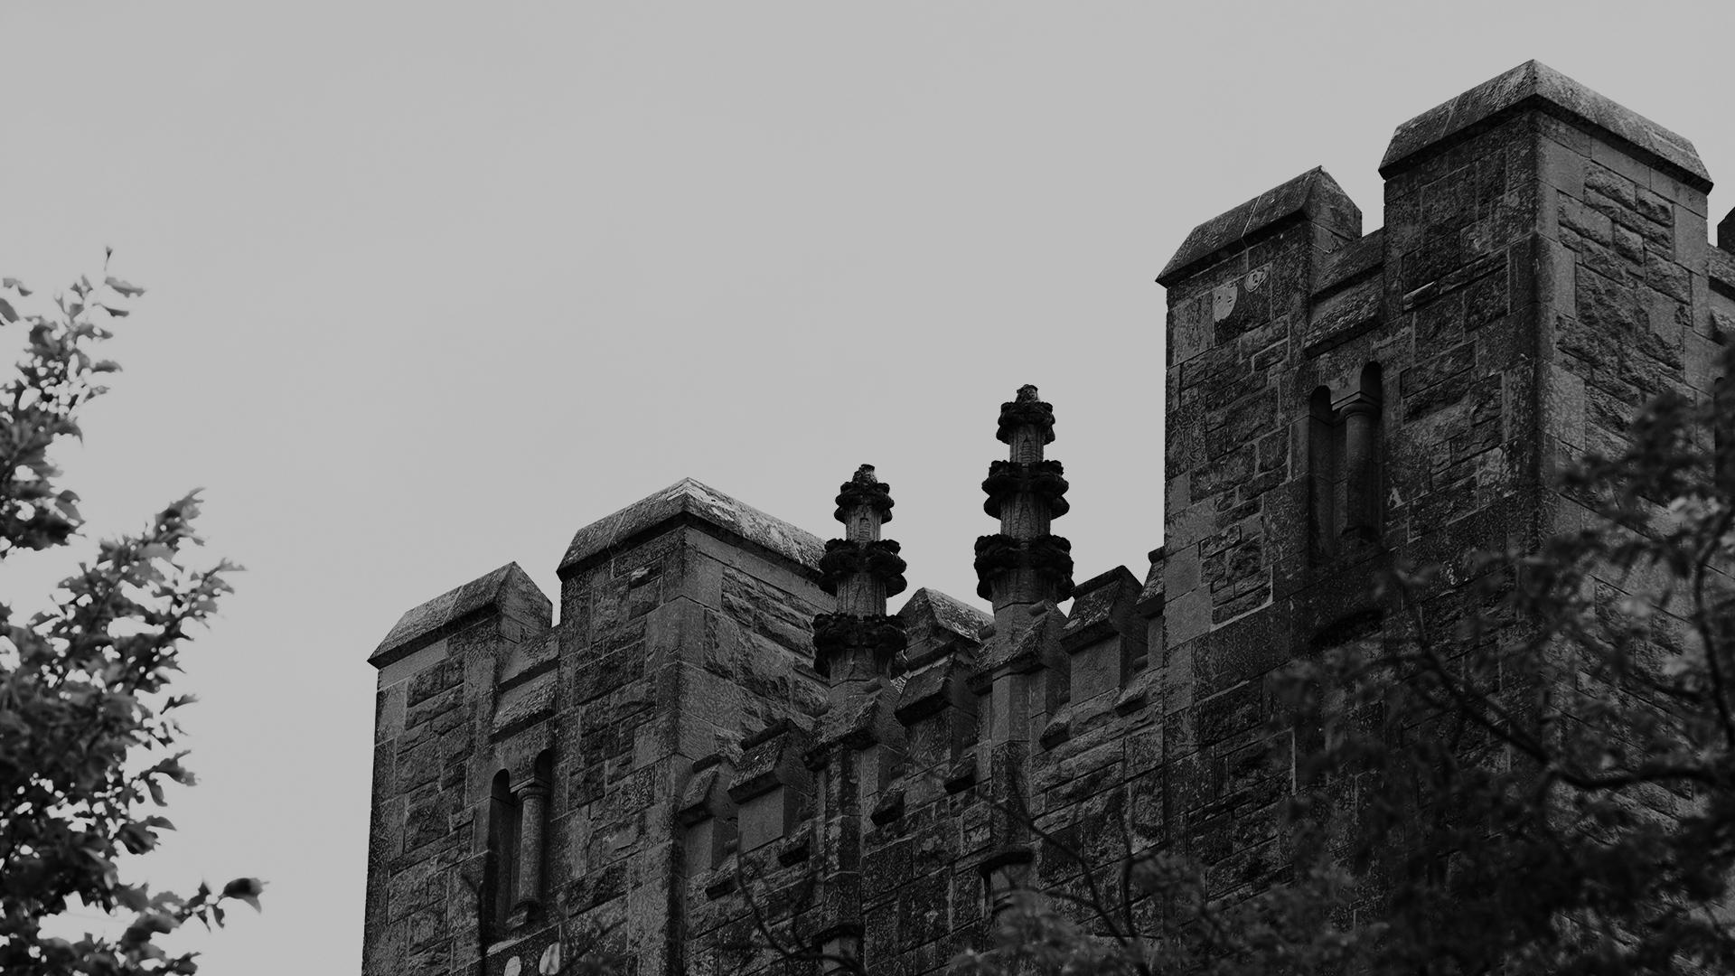
A picture is worth a thousand words. What legend, myth, or short story comes to mind?

Slide 21
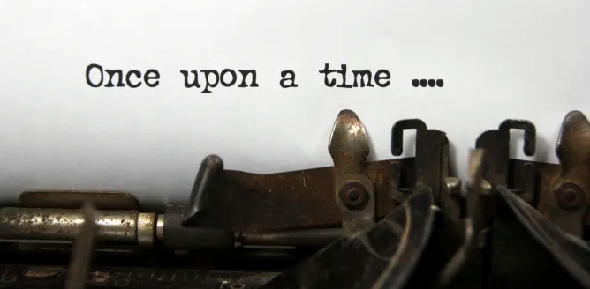
Short Story Time…

Slide 22
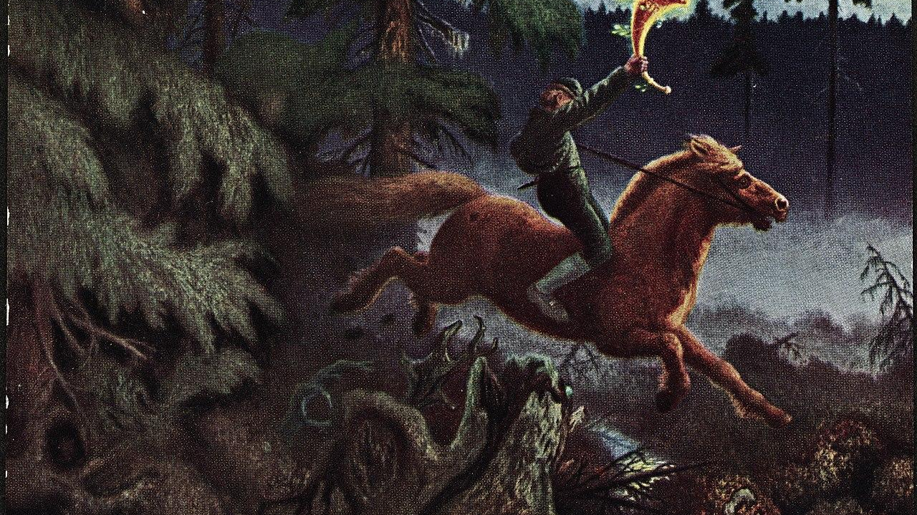
The Legend of Sleepy Hollow
The Legend of Sleepy Hollow is a famous American folktale, often associated with the town of Sleepy Hollow, New York. It was popularized by Washington Irving in his short story "The Legend of Sleepy Hollow," published in 1820.

Slide 23
Summary of the Legend of Sleepy Hollow
The story revolves around the mysterious disappearance of Ichabod Crane, a schoolmaster from Connecticut who moves to Sleepy Hollow. Ichabod is a superstitious man who becomes terrified of the local legend of the Headless Horseman, a ghostly figure said to haunt the area, searching for his lost head.
One night, Ichabod encounters the Headless Horseman while riding home from a party. The Horseman chases Ichabod through the woods, and Ichabod's horse rears up, throwing him off. When the townspeople search for Ichabod the next day, they find his horse, but no trace of Ichabod himself. It is assumed that he was frightened away by the Headless Horseman.
The Legend of Sleepy Hollow has become a popular Halloween tale and has been adapted into various media, including films, television shows, and comic books. The story's enduring popularity can be attributed to its combination of mystery, suspense, and folklore.

Slide 24
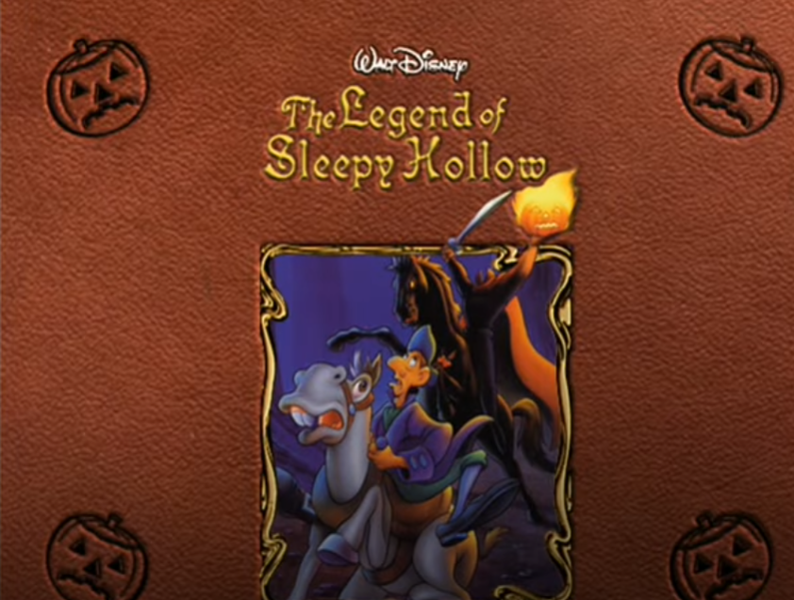
This Disney video is an adaptation of the original "The Legend of Sleepy Hollow" short story by Washington Irving.

Slide 25
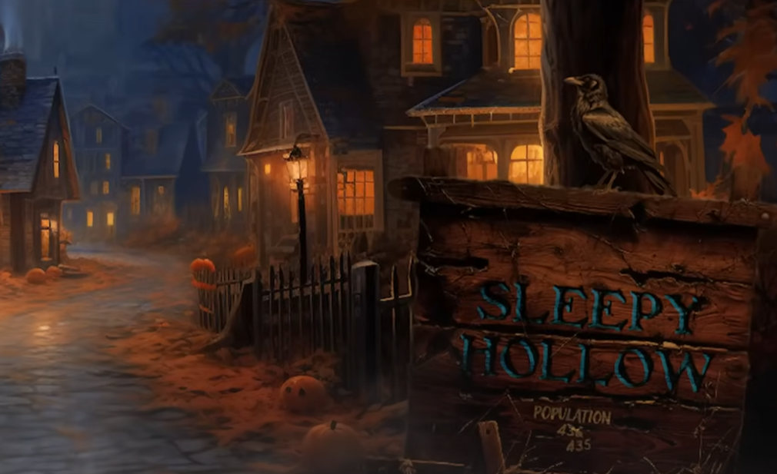
This version of "The Legend of Sleepy Hollow" is the same as the written story by Washington Irving.

Slide 26
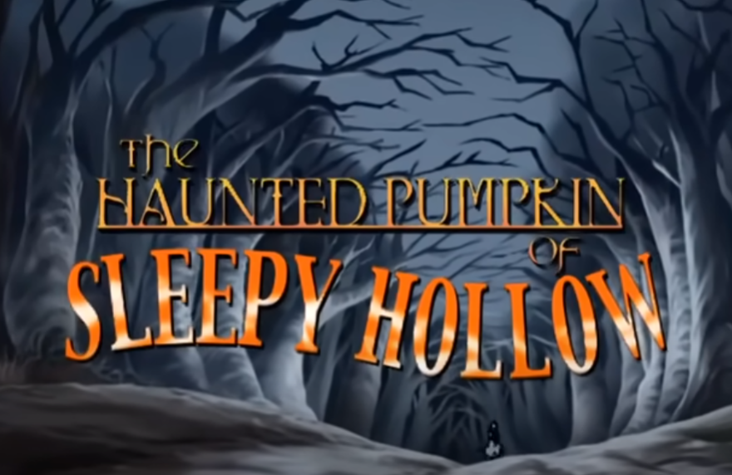
This version is influenced by the original short story. The author used the story to recreate a new short story.

Slide 27
Disney vs. Original vs. Modern Movie
How are the characters portrayed in each adaptation - Ichabod Crane, the Headless Horseman, and others?
What are the key plot points and themes in each version? Are there more similarities or differences?
How does the setting of Sleepy Hollow differ in each version?
Which version do you think is most appealing to modern audiences and why?
Which version did you prefer and why?
What might be some pros and cons of adaptations of short stories?
How do each version of the story contribute to your understanding of the story? Did it help, if at all?

Slide 28
Let’s Review

Slide 29
Writing Task
Think of your favorite color - not blue or red!
For every letter, make a word that starts with that letter.
Write a short story, myth, or legend using all of those words.
For example, GREEN: gryffindor, rainbow, everlasting, eternal, neverland.
In the beginning, *Gryffindor* was a world of shadow, untouched by color or light, until the *Rainbow Serpent* emerged from the depths of the *Eternal Waters*. As it slithered across the land, each scale it shed left behind a new hue, forming the first *Everlasting Rainbow*. When the serpent reached the border of *Neverland*, it paused, exhausted but proud of its work, and coiled itself into the earth, becoming the mountains and valleys. But a jealous spirit, envious of the vibrant world, tried to steal the colors back into darkness. In defense, the Rainbow Serpent breathed one final breath, casting a veil of eternal light that would protect *Gryffindor* forever. And so, every dawn, the colors return in brilliance, a reminder of the serpent’s sacrifice and the promise that *Neverland’s* light would never fade.

Slide 30
Review from last class
- **Short Stories**
- Short stories are made-up tales that focus on one idea or event.
- They’re usually short, with only a few characters and a simple plot.
- The purpose is to make readers feel or think about something important.
- **Myths**
- Myths are very old stories that explain things in nature or teach beliefs.
- They often include gods, magical creatures, or heroes.
- Myths help explain why things are the way they are, like why the sun rises.
- **Legends**
- Legends are stories based on real people or events but are sometimes exaggerated.
- They often talk about heroes who do amazing things.
- Legends are connected to a specific place or culture and keep history alive.
Each of these stories helps us understand ideas about life, people, and nature in fun and creative ways.

Slide 31
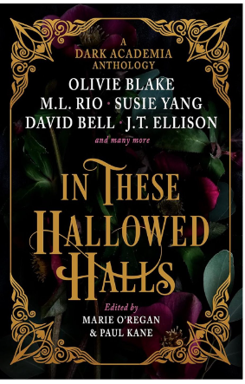
Dark Academia
A genre of writing that embrace drama, mystery, ambition, and tragedy. They are short stories that blend intellectual curiosity with other themes like philosophy, obsessions, loneliness, mortality, and power. Because of their dark themes, they are perfect for Halloween!

Slide 32
How do they relate to legends?
Mysterious Atmosphere:
  The settings often involve old, haunted buildings, libraries, or schools—perfect for creating a spooky ambiance during Halloween.
Themes of Death and Mortality:
  Many dark academia stories explore existential themes, death, and the consequences of obsession, which resonate with the Halloween spirit of reflecting on mortality and the supernatural.
Supernatural Elements:
  Some dark academia narratives incorporate ghosts, occult practices, or magical elements, making them ideal for Halloween storytelling.
Character Obsession and Tragedy:
  The tragic and obsessive nature of characters can create suspenseful and haunting stories, fitting well with the themes of fear and mystery often celebrated during Halloween.
Cultural Exploration:
  Halloween is a time when folklore and legends are shared. Dark academia can draw on myths, legends, and classic literature, enriching the celebration with stories that explore deeper themes.

Slide 33
The Professor of Ontography - Helen Grant
The Professor of Ontography is a novel by Helen Grant that delves into themes of mystery, obsession, and the complexities of existence, characteristic of dark academia. Here’s a brief overview of the story:
Overview of The Professor of Ontography
Plot Summary: The story follows a group of students at a prestigious university who become fascinated by their enigmatic professor, known for his unorthodox theories on ontography—the study of being and existence. As they delve deeper into his teachings, they uncover layers of mystery surrounding his life and past. The professor's intense focus on the nature of reality leads the students to question their own identities and relationships.

Slide 34
Themes, Setting, and Characters
Themes:
Existence and Identity: The novel explores philosophical questions about what it means to be and how knowledge shapes our understanding of ourselves and the world around us.
Obsession: The students' obsession with the professor and his ideas reflects the dangers of intellectual fixation and the impact it can have on personal relationships.
Mystery and Discovery: The narrative is infused with elements of mystery, as the students investigate the professor's enigmatic past, leading to unexpected revelations.
Setting: The atmospheric backdrop of the university, with its ancient architecture, dark libraries, and shadowy hallways, enhances the story's eerie and reflective tone.
Characters: The professor is a complex figure, embodying both brilliance and darkness, while the students represent a diverse array of personalities, each grappling with their own existential questions.

Slide 35
Discussion Questions
Setting: How does the university setting help create a spooky or mysterious feeling in the story? How does it affect the characters?
Symbols and Motifs: Can you find any symbols in the story, like objects or places that represent something deeper? What do they mean?
Personal Connection: Do you relate to any of the characters’ struggles with understanding themselves? How do your own experiences relate to their challenges?
Key Moments: What was the most important moment in the story that changed everything for the characters? How did it make you feel?
Ending Thoughts: What do you think the ending of the book tells us about learning and finding out who we are? Does it give a clear answer, or does it leave you with more questions?

Slide 36

4
The Mission
(But not impossible…)

Slide 37

Myth-Making Madness
Create your own myth or legend explaining a natural phenomenon or moral lesson. Or, if you’re up for it, create something new - use your imagination and be free.

Slide 38
Requirements
Phenomenon or Lesson
Mythological Elements
Consider using events that happen naturally like eclipses, thunderstorms, rainbows, or floods. You may want to even think of a theme like courage or honesty.
Be creative! Use and incorporate symbolic imagery, supernatural beings, or cultural references.
Plot
Your story should have all of the elements of plot we talked about, including characters, rising action, climax, and a conclusion.

Slide 39
Project Part 2
Now that you have your story, choose how to best represent it - live!
Here are a few ideas to get you started.
Dramatic Skit
Diorama
Act out a key scene from your story.
Build a three-dimensional model of the setting or a key scene from your story.
Movie Trailer
Create a short video that captures the essence of your myth or legend.

Slide 40
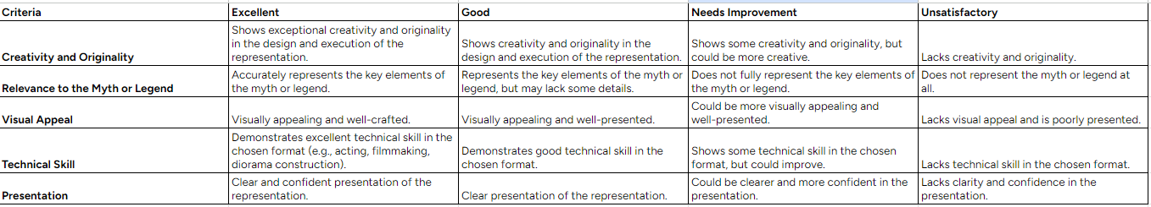
Rubric for your Project

