Slide 1
Science:
Animal & Plant Cells
8th Grade

Slide 2
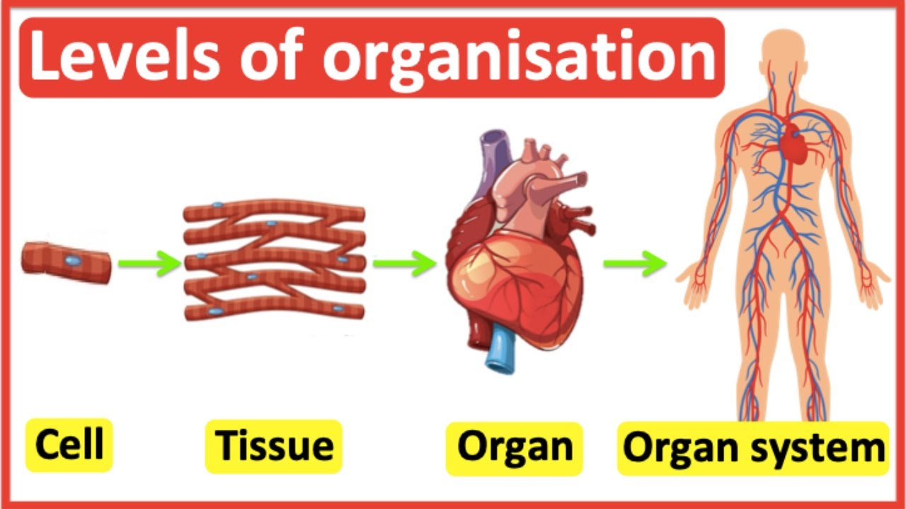

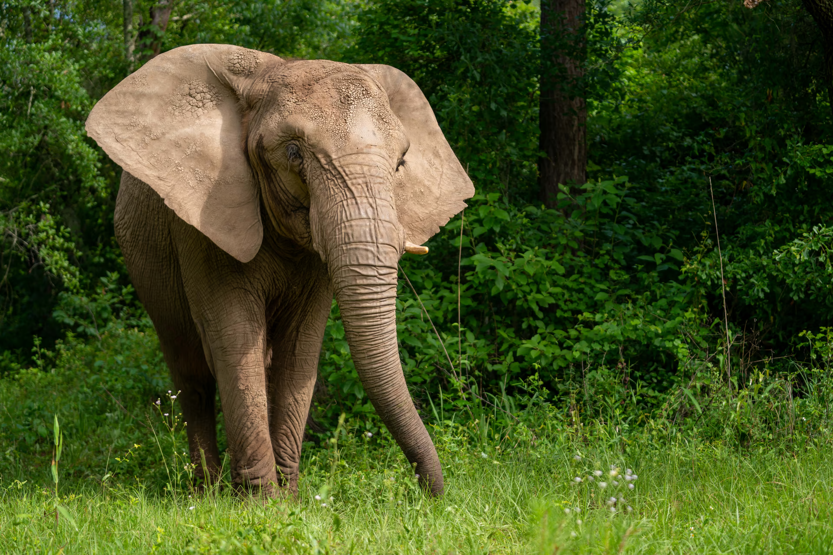
Learning Goals
Identify and compare plant and animal cells.
Explain the functions of key cell structures.
Understand how cells form systems in living organisms.
Describe the principles of cell theory.

Slide 3
01
Introduction
Cell Theory & Cell Types

Slide 4
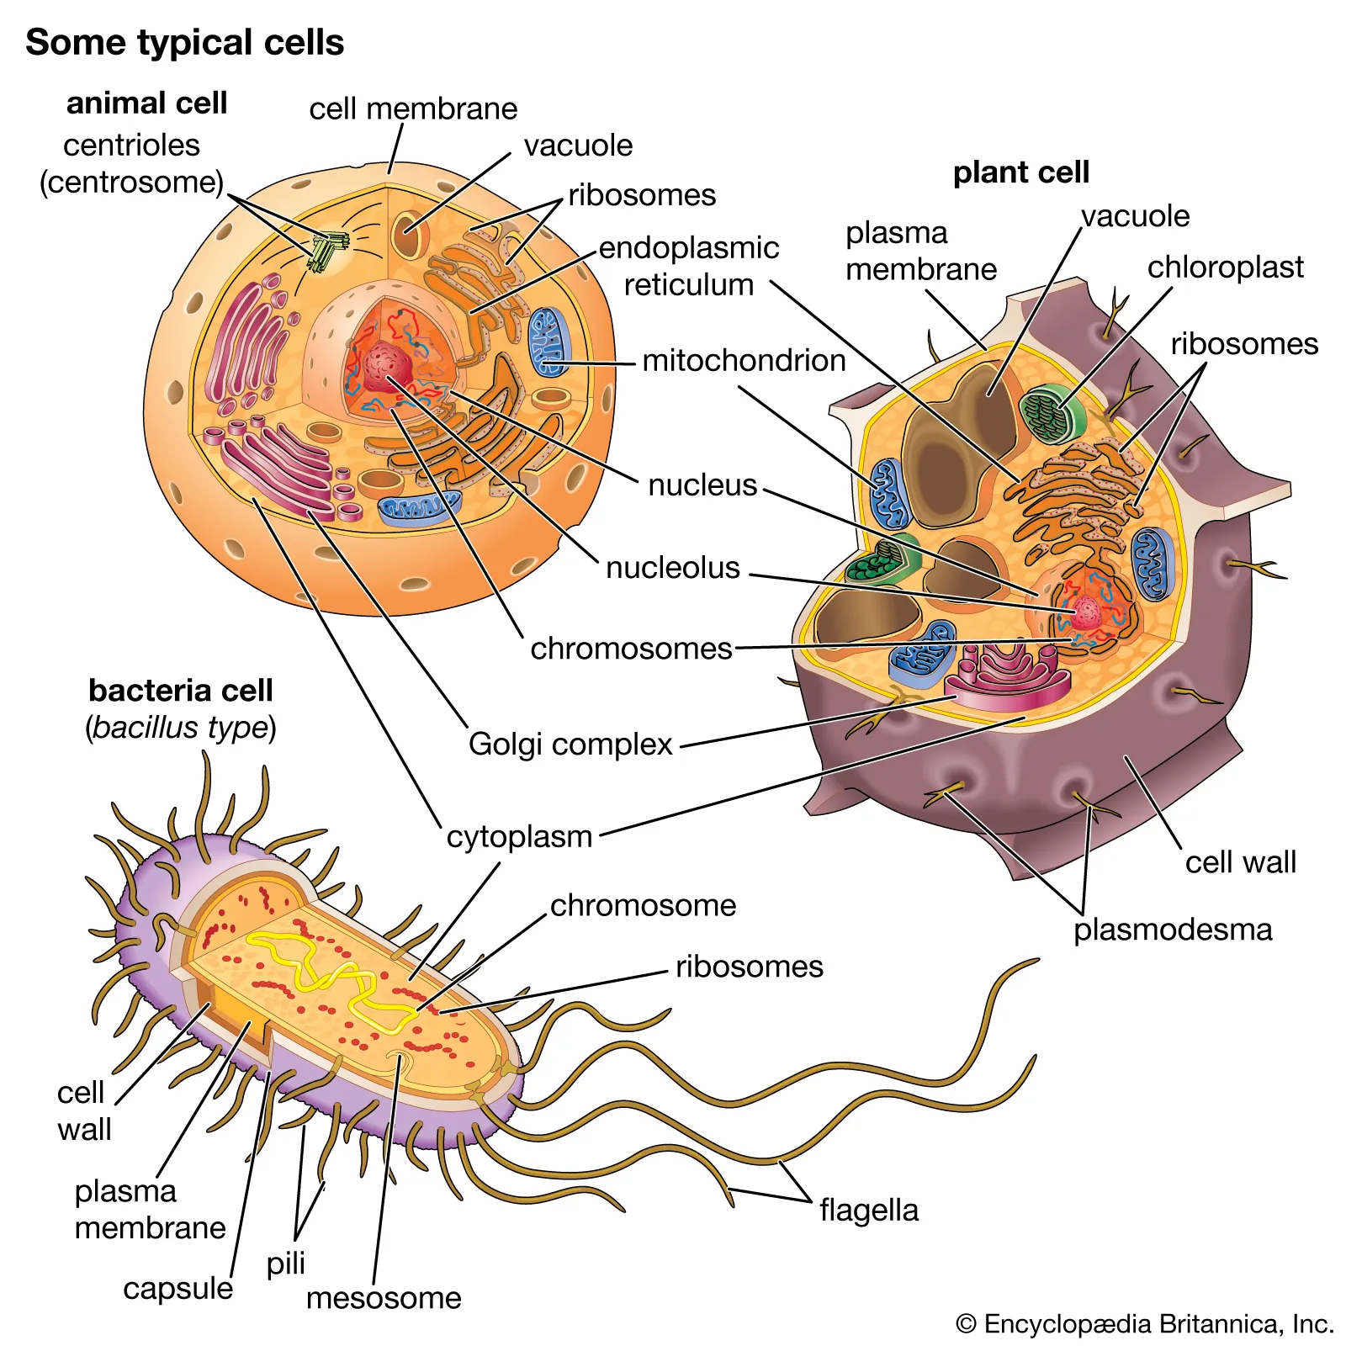
What is a Cell?
Definition: “A cell is the basic structural and functional unit of life.”
Types of organisms:
Unicellular: One cell (e.g., bacteria).
Multicellular: Many cells (e.g., humans, plants).

Slide 5
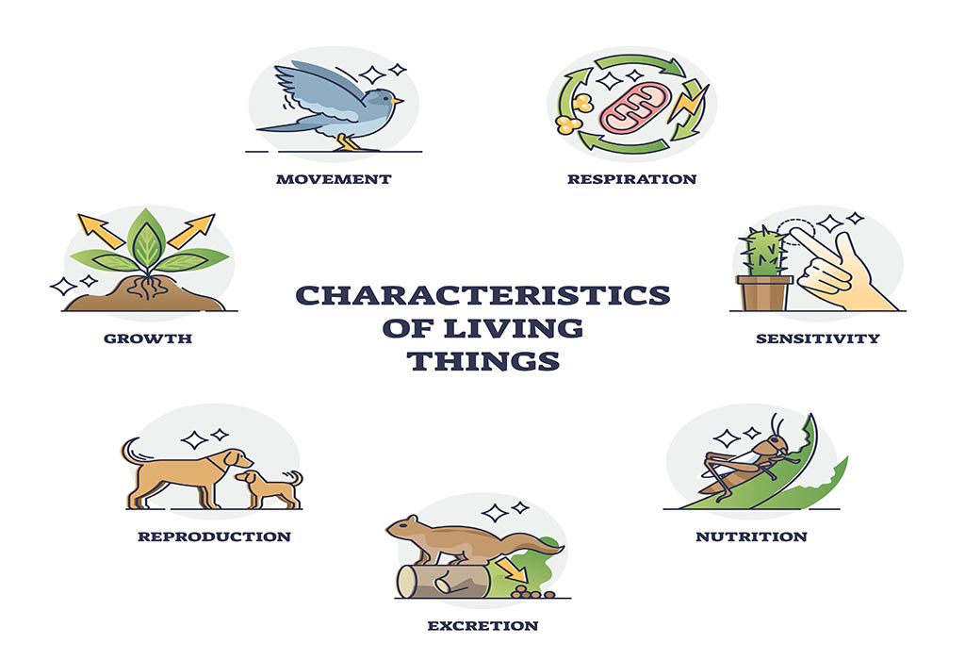
Characteristics of Living Things
All living organisms:
Are made up of cells.
Reproduce (sexually or asexually) & Grow and develop.
Learn, Adapt & Respond to stimuli in their environment.
Have a lifespan.
Excrete waste.

Slide 6
What is Cell Theory?
Cell Theory is a fundamental principle in biology that explains the role of cells as the basic unit of life. It consists of three main principles:
All living organisms are made up of one or more cells.
  Every living thing, from tiny bacteria to large animals and plants, is composed of cells.
The cell is the basic unit of structure and function in living organisms.
  Cells are the smallest units capable of performing all life processes, such as energy production, growth, and reproduction.
All cells come from pre-existing cells.
  New cells are produced through cell division (e.g., mitosis or meiosis), not from non-living matter.
Historical Context:
Robert Hooke (1665): First observed cells in cork and coined the term “cell.”
Matthias Schleiden and Theodor Schwann (1839): Proposed the first two principles of cell theory.
Rudolf Virchow (1855): Added the third principle, emphasizing that cells only come from existing cells.
Significance:
Cell theory unified the study of biology by showing that all life forms share a common cellular structure, making it easier to understand processes like disease, growth, and reproduction.

Slide 7
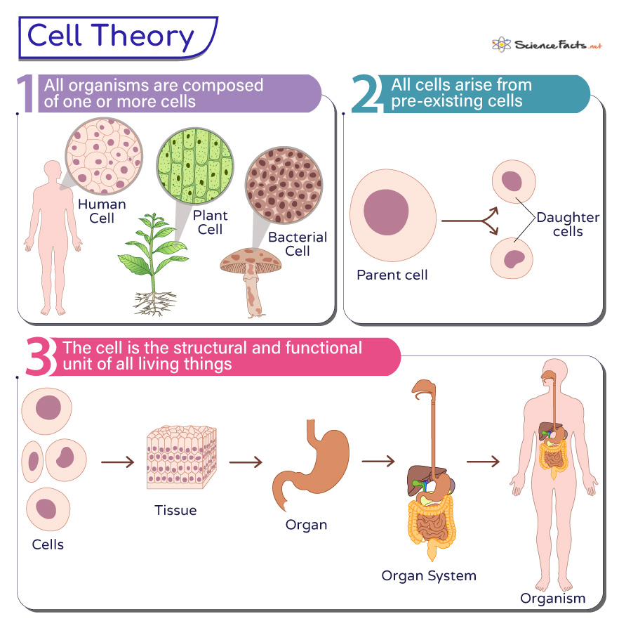
Cell Theory
All living things are composed of 1 or more cells;
The cell is the basic unit of life;
All cells come from pre-existing cells.

Slide 8
Field of View
Field of View (FOV) refers to the visible area that can be observed through the lens of a microscope or other optical devices. It’s the circular area you see when looking through the eyepiece.
Key Points About Field of View:
Magnification and FOV Relationship:
  As magnification increases, the field of view decreases.
  At lower magnification, you see a larger area, but with less detail. At higher magnification, you see a smaller area, but with greater detail.
Measuring the FOV:
  The diameter of the field of view can be measured in millimeters (mm) or micrometers (µm).
  It's often calculated using a calibrated slide or known values for the objective lens.
Importance in Biology:
  Helps estimate the size of cells or structures under observation.
  Aids in understanding the scale and relationships between cellular components.

Slide 9
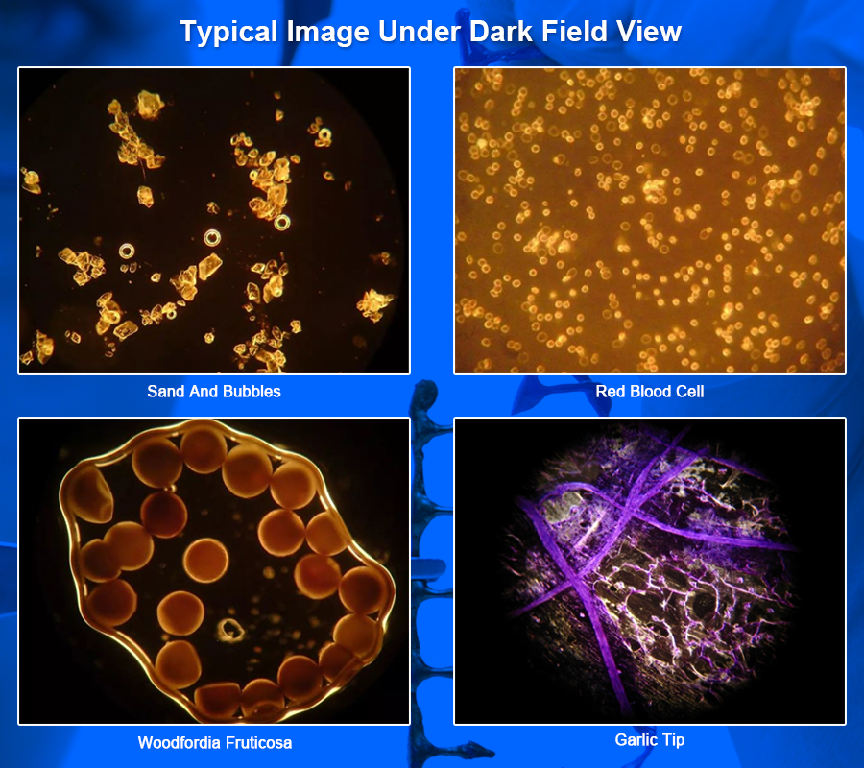
Field of View

Slide 10
Plant and Animal Cells
Plant and animal cells are both eukaryotic, meaning they have a nucleus and membrane-bound organelles. However, they differ in several key ways due to their roles in organisms.
Similarities Between Plant and Animal Cells:
Nucleus (The Hub of the Cell): Both have a nucleus that controls cell activities and contains genetic material.
Cytoplasm (The Bubble Wrap of a Cell): A gel-like substance where organelles are suspended.
Mitochondria (The Main Power House of the Cell): Powerhouses of the cell, producing energy (ATP).
Cell Membrane (The Border Wall): A flexible barrier that controls what enters and exits the cell.
Endoplasmic Reticulum (ER) (The Supervisors in the Cell): Synthesizes proteins (rough ER) and lipids (smooth ER).
Golgi Apparatus (The Amazon Delivery people): Modifies and packages proteins and lipids.

Slide 11
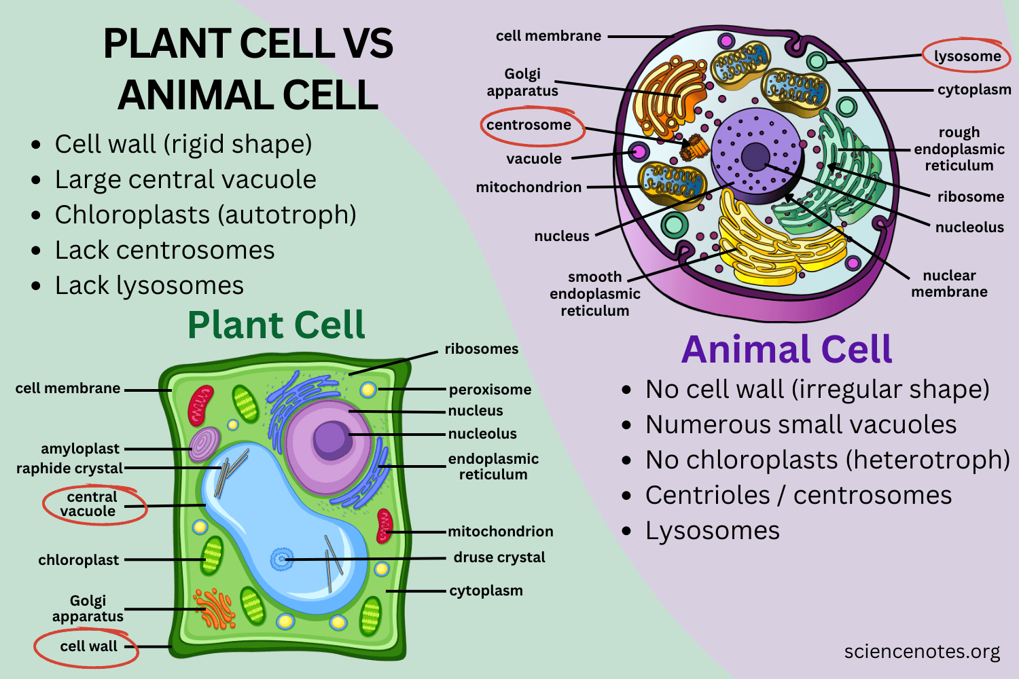
Eukaryotic Cells (They have a nucleus and membrane)

Slide 12
Plant Cells
Unique Features of Plant Cells:
Cell Wall:
  Made of cellulose.
  Provides structure and rigidity to the cell.
Chloroplasts:
  Contain chlorophyll, the green pigment used in photosynthesis.
  Convert sunlight into glucose and oxygen.
Large Central Vacuole:
  A large storage sac filled with water, nutrients, and waste.
  Helps maintain cell turgor (rigidity).
Plasmodesmata:
  Channels between plant cells for communication and transport of substances.
Travel Deep Inside a Leaf - Annotated Version | California Academy of Sciences

Slide 13
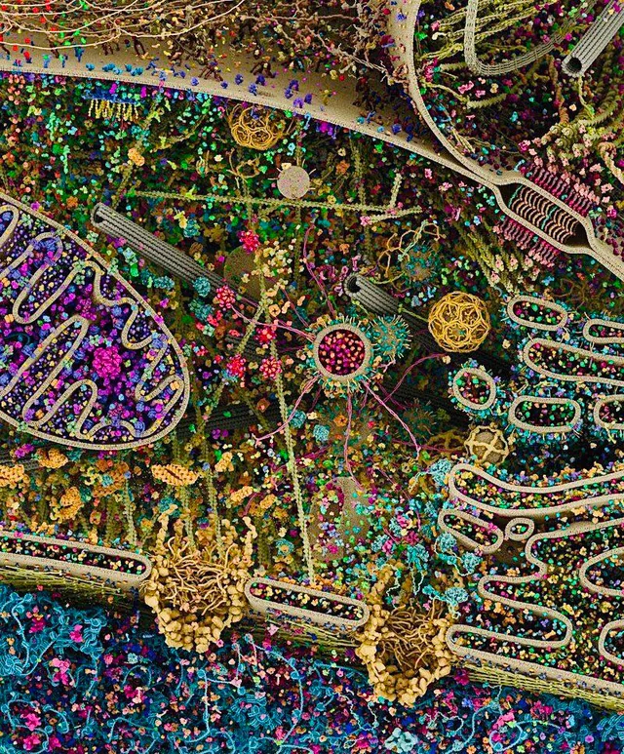
Animal Cells
Unique Features of Animal Cells:
Centrioles:
  Play a role in cell division by organizing microtubules.
  Found in centrosomes.
Small Vacuoles:
  Many small vacuoles instead of one large one.
Flexible Shape:
  No rigid cell wall allows animal cells to have a variety of shapes.
Lysosomes (more common):
  Contain digestive enzymes to break down waste and cellular debris.

Slide 14
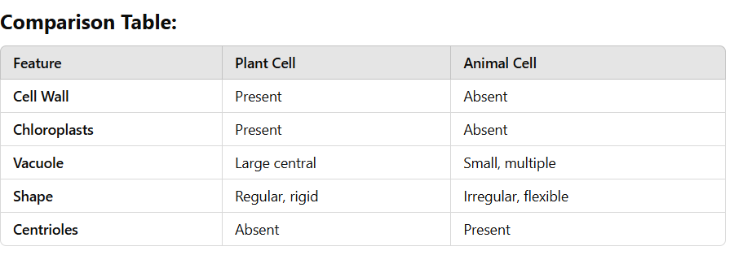
Plant vs. Animal

Slide 15
Diagrams of Cells
Cell diagrams are visual representations of cells that help illustrate their structures and functions. These diagrams are commonly used in biology to study and explain the components of different types of cells, such as plant, animal, or bacterial cells.
Key Features of Cell Diagrams
Labeled Organelles:
  Each part of the cell is labeled to indicate its name (e.g., nucleus, mitochondria).
  Labels often include brief descriptions or color coding.
Detailed Structures:
  The cell diagram shows the cell's organelles in their relative positions.
  Some diagrams depict the 2D internal structure, while others offer 3D views for better visualization.
Types of Cells Depicted:
  Plant Cells: Typically rectangular with a cell wall, large vacuole, and chloroplasts.
  Animal Cells: More rounded with centrioles and lysosomes.
  Bacterial Cells: Simpler structures, showing a cell wall, membrane, and genetic material without a nucleus.
Purpose:
  Aid in understanding cell biology, including the structure, function, and differences between cell types.
  Used in teaching, learning, and research.

Slide 16
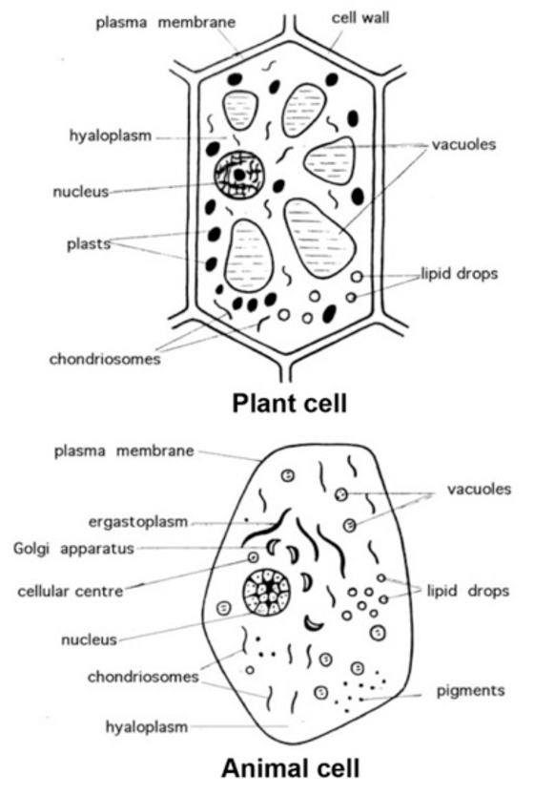

Slide 17
The Electron Microscope
An electron microscope is a powerful tool used to observe tiny structures that are too small to be seen with a light microscope. It uses beams of electrons instead of light, allowing for much higher magnification and resolution.
Advantages of Electron Microscopes
High Magnification and Resolution: Allows detailed observation of structures like viruses, cell membranes, and organelles.
3D Imaging: SEM provides detailed images of surfaces.
Study of Ultrastructure: TEM reveals intricate cell components.
Limitations
Costly: Expensive to purchase and maintain.
Complex Preparation: Samples must be specially prepared, often requiring dehydration or coating with metal.
No Live Specimens: Samples are usually dead because of the vacuum and preparation techniques.
Fun Fact: The first electron microscope was developed in 1931 by Ernst Ruska and Max Knoll. It revolutionized how scientists study cells and molecules!

Slide 18
The Compound Microscope
A compound microscope is a type of microscope that uses multiple lenses to magnify small objects, typically living organisms, cells, and tissues. It’s commonly used in biology labs for studying specimens at a relatively low magnification.
Key Features of a Compound Microscope
Objective Lenses:
  The compound microscope typically has multiple objective lenses with different magnification powers:
    Low Power (4x): Used for general scanning.
    Medium Power (10x): Used for more detailed observations.
    High Power (40x or 100x): Used for studying very small details in specimens.
Eyepiece (Ocular Lens):
  The lens you look through, typically with a magnification of 10x.
  Works in combination with the objective lenses to determine total magnification.
Stage:
  The platform where the specimen slide is placed.
  May have clips to hold the slide in place.
Light Source:
  The compound microscope requires a light source (either built-in or external) to illuminate the specimen.
  The light passes through the specimen for better visibility.
Coarse and Fine Focus:
  Coarse Focus: Used for large adjustments to bring the specimen into general view.
  Fine Focus: Used for small adjustments, fine-tuning the image for clearer details.

Slide 19
02
Cell Functions
How Do Cells Work?

Slide 20
The Cell Membrane
The cell membrane, also known as the plasma membrane, is a vital component of all cells. It surrounds the cell, providing structure, protection, and regulating what enters and exits the cell.
Structure of the Cell Membrane
Phospholipid Bilayer:
  The cell membrane is primarily made up of two layers of phospholipids.
  Each phospholipid has a hydrophilic (water-attracting) head and hydrophobic (water-repelling) tails.
  The hydrophilic heads face outward, toward the water inside and outside the cell, while the hydrophobic tails face inward, away from water. This creates the bilayer structure.
Proteins:
  Integral Proteins: These span across the membrane and may act as channels, receptors, or transporters.
  Peripheral Proteins: Located on the inner or outer surface of the membrane, they help with signaling and maintaining cell shape.
Carbohydrates:
  Attached to proteins or lipids on the outside of the membrane.
  These glycoproteins and glycolipids are involved in cell recognition, signaling, and interaction with the environment.
Cholesterol:
  Present between phospholipids to provide stability and fluidity to the membrane, preventing it from becoming too rigid or too fluid.

Slide 21
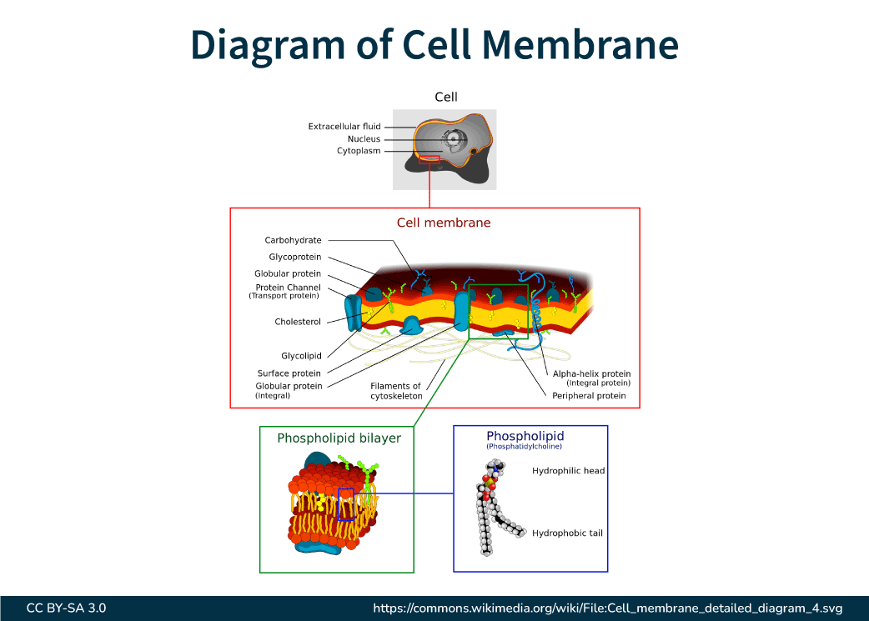

Slide 22
Functions of the Cell Membrane
Selective Permeability:
The cell membrane controls the movement of substances in and out of the cell.
Small molecules (e.g., oxygen, carbon dioxide) can pass through easily, while larger molecules or charged particles may require transport proteins.
Protection and Support:
The membrane acts as a barrier, protecting the cell from harmful substances and environmental changes.
It also helps maintain the shape and integrity of the cell.
Communication and Signaling:
Receptors on the cell membrane detect external signals (e.g., hormones, nutrients) and send messages to the inside of the cell to trigger responses.
Cell Recognition:
Carbohydrates on the membrane play a role in identifying and distinguishing cells, which is critical for immune response and tissue formation.

Slide 23
Transport in the Cell Membrane
Passive Transport (No energy required):
  Diffusion: Movement of molecules from an area of high concentration to low concentration.
  Osmosis: Diffusion of water molecules across a semi-permeable membrane.
  Facilitated Diffusion: Movement of molecules through a membrane protein from high to low concentration.
Active Transport (Requires energy):
  Movement of molecules against the concentration gradient (from low to high concentration) through membrane proteins, using energy (ATP).
Endocytosis and Exocytosis:
  Endocytosis: Process by which cells engulf substances (e.g., food, fluids) by wrapping the membrane around them to form a vesicle.
  Exocytosis: Process by which cells expel substances by fusing vesicles with the membrane.

Slide 24
Fluid Movement in Cells: Diffusion
Diffusion is the movement of particles from an area where they are crowded (high concentration) to an area where they are less crowded (low concentration). This process doesn’t need energy from the cell. Diffusion helps keep things balanced inside the cell.
Key Ideas About Diffusion
Concentration Gradient:
  Diffusion happens because of a difference in how many particles are in different areas.
  Particles move from areas where there are more of them (high concentration) to areas where there are fewer (low concentration).
Equilibrium:
  Diffusion keeps going until the concentration of particles is the same everywhere. This is called equilibrium.
  Once equilibrium is reached, the particles still move, but they stay evenly spread out.

Slide 25
What Affects Diffusion?
What Affects Diffusion?
Concentration Gradient:
  The bigger the difference in concentration, the faster the diffusion happens.
Temperature:
  Warmer temperatures make particles move faster, so diffusion happens quicker.
Size of Molecules:
  Smaller molecules move faster than bigger ones.
Medium (Type of Matter):
  Particles move faster in gases than in liquids, and faster in liquids than in solids.

Slide 26
How Diffusion Works
How Diffusion Works in Cells
Oxygen and Carbon Dioxide Exchange:
In our lungs, oxygen moves from the air (high concentration) into the blood (low concentration), and carbon dioxide moves the other way to be exhaled.
Getting Nutrients and Getting Rid of Waste:
Cells use diffusion to take in important things like glucose (sugar) from the blood and to get rid of waste products like urea.
Example: Diffusion Across the Cell Membrane
If a cell is in water with less salt outside, water moves into the cell.
If the cell is in water with more salt outside, water moves out of the cell.
If the amount of salt is the same inside and outside the cell, there is no net movement of water.

Slide 27
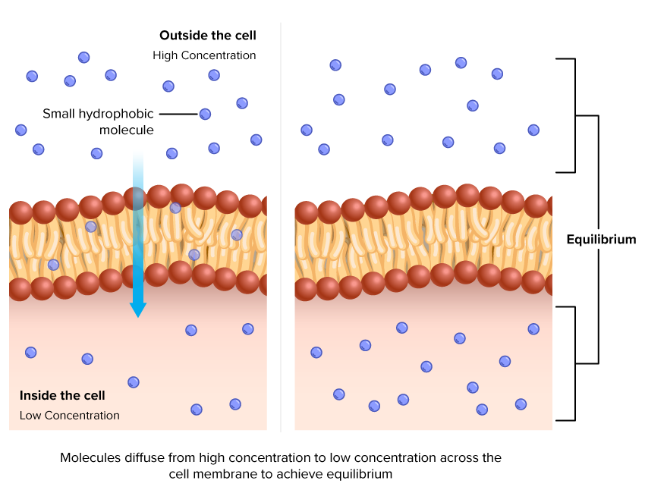

Slide 28
Osmosis
Osmosis is a special type of diffusion that involves the movement of water. It happens when water moves from an area with low concentration of solutes (like salt or sugar) to an area with high concentration of solutes through a semi-permeable membrane (a membrane that allows only certain things to pass through).
Key Ideas About Osmosis
Water Movement:
  Osmosis is all about water moving to where there is more dissolved stuff (like salt or sugar).
  Water always moves toward the area with more solutes (dissolved substances) to try to balance things out.
Semi-Permeable Membrane:
  The membrane in osmosis lets water pass through but blocks larger molecules or solutes. This allows only water to move from one side to the other.

Slide 29
Why is Osmosis Important?
Water Balance: Osmosis helps maintain the balance of water in and out of the cell, which is important for the cell’s survival.
Cell Shape and Size: By controlling water movement, osmosis helps the cell keep its shape and prevents it from getting too large or too small.
Nutrient and Waste Transport: Osmosis helps cells manage nutrients and waste by allowing water to move freely across membranes.

Slide 30
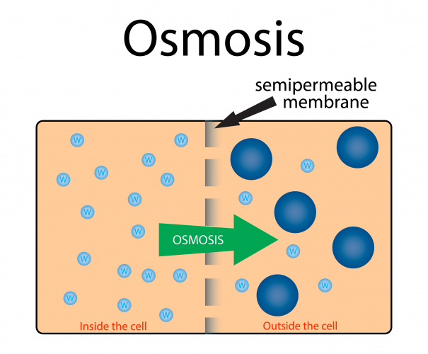

Slide 31
Turgor Pressure
Turgor pressure is the pressure exerted by the cell membrane against the cell wall in plant cells, caused by the water inside the central vacuole pushing against the cell wall. It is an important factor in maintaining the rigidity and shape of plant cells.
Key Ideas About Turgor Pressure
Water Intake:
  When water enters a plant cell through osmosis, it fills the central vacuole.
  As the vacuole fills with water, it pushes against the cell membrane and the rigid cell wall.
Cell Wall Support:
  The cell wall prevents the cell from bursting by providing resistance to the pressure from the vacuole.
  The cell wall is strong enough to contain the water pressure but flexible enough to allow growth.
Why Turgor Pressure is Important
Cell Rigidity: Turgor pressure helps maintain the structural integrity of plant cells, allowing the plant to stand upright and support its leaves and flowers.
Growth and Development: Healthy turgor pressure is essential for the growth of young plant cells, as it aids in the expansion and elongation of cells.

Slide 32
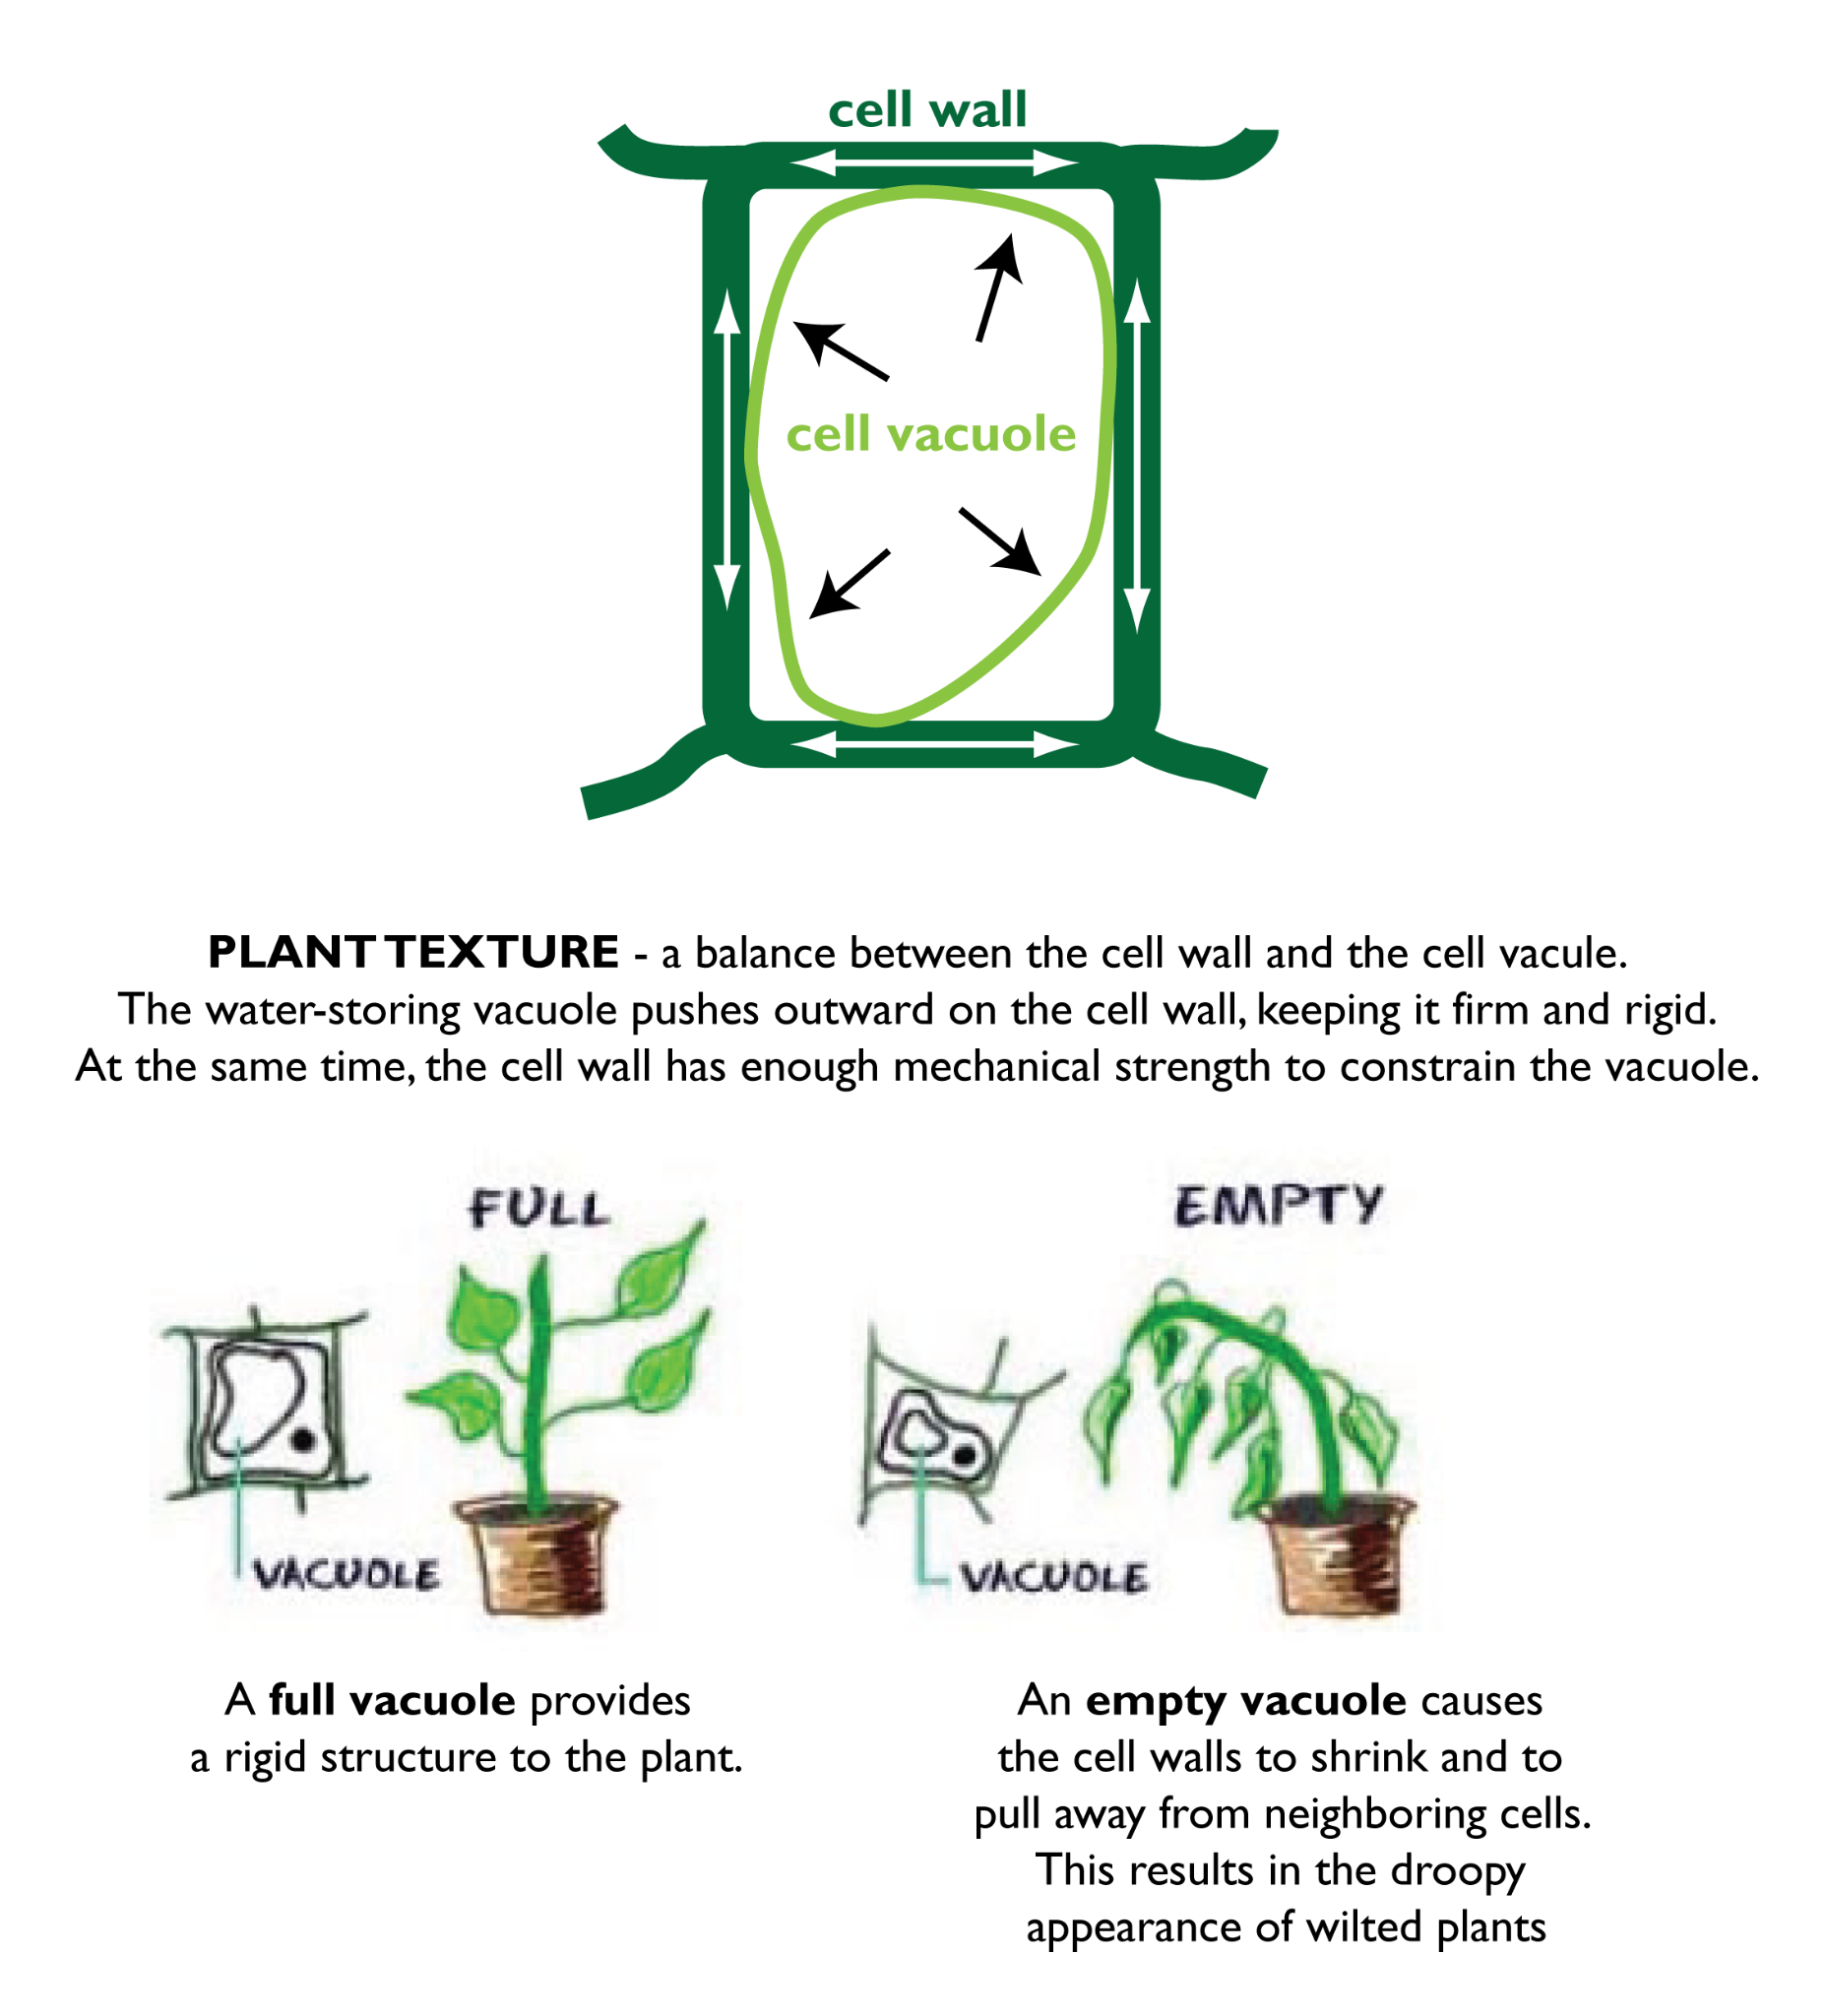

Slide 33
Endocytosis
Endocytosis is a process where a cell engulfs substances (like food, liquids, or other particles) from outside the cell by wrapping its cell membrane around them and bringing them inside the cell. This process requires energy (ATP) and is an example of active transport.
Why Endocytosis is Important
Nutrient Uptake: Endocytosis allows cells to take in large or specific nutrients that cannot pass through the membrane easily.
Immune Defense: Phagocytosis helps immune cells, like white blood cells, to engulf and digest harmful pathogens, such as bacteria.
Regulating Substances: Cells can regulate the intake of specific molecules or ions through receptor-mediated endocytosis, which is important for controlling processes like hormone signaling.
Waste Removal: Endocytosis also plays a role in removing unwanted particles or dead cells from the surrounding environment.

Slide 34
Exocytosis
Exocytosis is the process by which a cell expels substances from inside to outside by using its cell membrane. This is the reverse of endocytosis, where the cell moves materials out of the cell in a vesicle. Exocytosis requires energy (ATP) and is an example of active transport.
Why Exocytosis is Important
Secretion of Products: Exocytosis allows cells to release important substances like hormones, enzymes, and neurotransmitters, which are crucial for communication and regulation in the body.
Waste Removal: It helps the cell get rid of waste materials that are too large to pass through the membrane, such as undigested material in lysosomes.
Cell Membrane Repair: Exocytosis helps in the constant recycling and repair of the cell membrane by delivering new lipids and proteins.

Slide 35
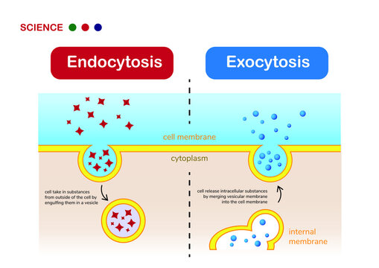

Slide 36
03
Organizing Cells
How Do Cells Work Together?

Slide 37
When Cell Systems Fail?
Cell systems can fail when the processes that normally keep a cell functioning properly are disrupted. This can happen for many reasons, and when cell systems fail, it can lead to various diseases or conditions. Let's explore what happens when different cell systems fail:
Failure of the Cell Membrane (Membrane Transport)
What It Is: The cell membrane controls what enters and leaves the cell, allowing nutrients to enter and waste to exit. It also helps the cell maintain its shape and internal environment.
What Happens When It Fails: If the membrane becomes damaged or less effective, the cell cannot control the movement of materials, which can lead to:
  Cell swelling or shrinking due to an imbalance of water and ions.
  Cell death if harmful substances enter or if essential molecules cannot enter.
Example: In conditions like cystic fibrosis, the membrane transport system for certain ions is faulty, leading to thick mucus buildup and difficulty breathing.

Slide 38
When Cell Systems Fail?
2. Mitochondrial Dysfunction
What It Is: Mitochondria are the powerhouses of the cell, providing energy (ATP) for all cell functions.
What Happens When It Fails: If mitochondria can't produce enough energy, cells may struggle to perform basic functions, leading to:
  Muscle weakness and fatigue.
  Organ failure if cells cannot meet their energy needs.
Example: Mitochondrial diseases like Leber's hereditary optic neuropathy can lead to vision loss because of energy failure in the optic nerve cells.
3. Failure of the Nucleus (DNA Damage)
What It Is: The nucleus controls cell activities by storing genetic information (DNA) and directing protein production.
What Happens When It Fails: If the DNA is damaged or mutations occur, the cell cannot carry out its normal functions. This can lead to:
  Cancer if DNA mutations cause uncontrollable cell growth.
  Aging and cell death if the DNA cannot repair itself.
Example: In cancer, mutations in the DNA of cells can lead to abnormal growth and spread.

Slide 39
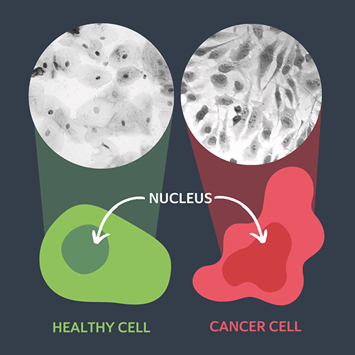

Slide 40
Classifying Organisms
Classification is the process of organizing living organisms into groups based on shared characteristics. This helps scientists understand the relationships between different species and track their evolution. The classification system, known as taxonomy, groups organisms from the most general category to the most specific.
Levels of Classification (From Broad to Specific)
Domain:
  The broadest category.
  There are three domains of life:
    Archaea (ancient, single-celled organisms that live in extreme environments)
    Bacteria (single-celled organisms that can be found almost anywhere)
    Eukarya (organisms with complex cells, including plants, animals, fungi, and protists)
Kingdom:
  Organisms are divided into five kingdoms (some classifications use six):
    Animalia (animals)
    Plantae (plants)
    Fungi (fungi like mushrooms and yeasts)
    Protista (mostly single-celled organisms, like algae)
    Monera (bacteria and archaea, which are single-celled organisms)

Slide 41
Classifying Organisms
Phylum:
  A group of related classes. For example, animals are divided into phyla like Chordata (vertebrates) or Arthropoda (insects, spiders).
Class:
  A group of related orders. For example, the Mammalia class includes animals that are warm-blooded and have hair or fur, like humans, dogs, and whales.
Order:
  A group of related families. For example, the order Carnivora includes carnivores like lions, tigers, and bears.
Family:
  A group of related genera (plural of genus). For example, Felidae is the family that includes cats, both big (lions, tigers) and domestic.
Genus:
  A group of closely related species. The genus name is always capitalized. For example, the genus Panthera includes lions, tigers, and leopards.
Species:
  The most specific level of classification. A species is a group of organisms that can reproduce and produce fertile offspring. For example, Homo sapiens is the species name for humans.

Slide 42
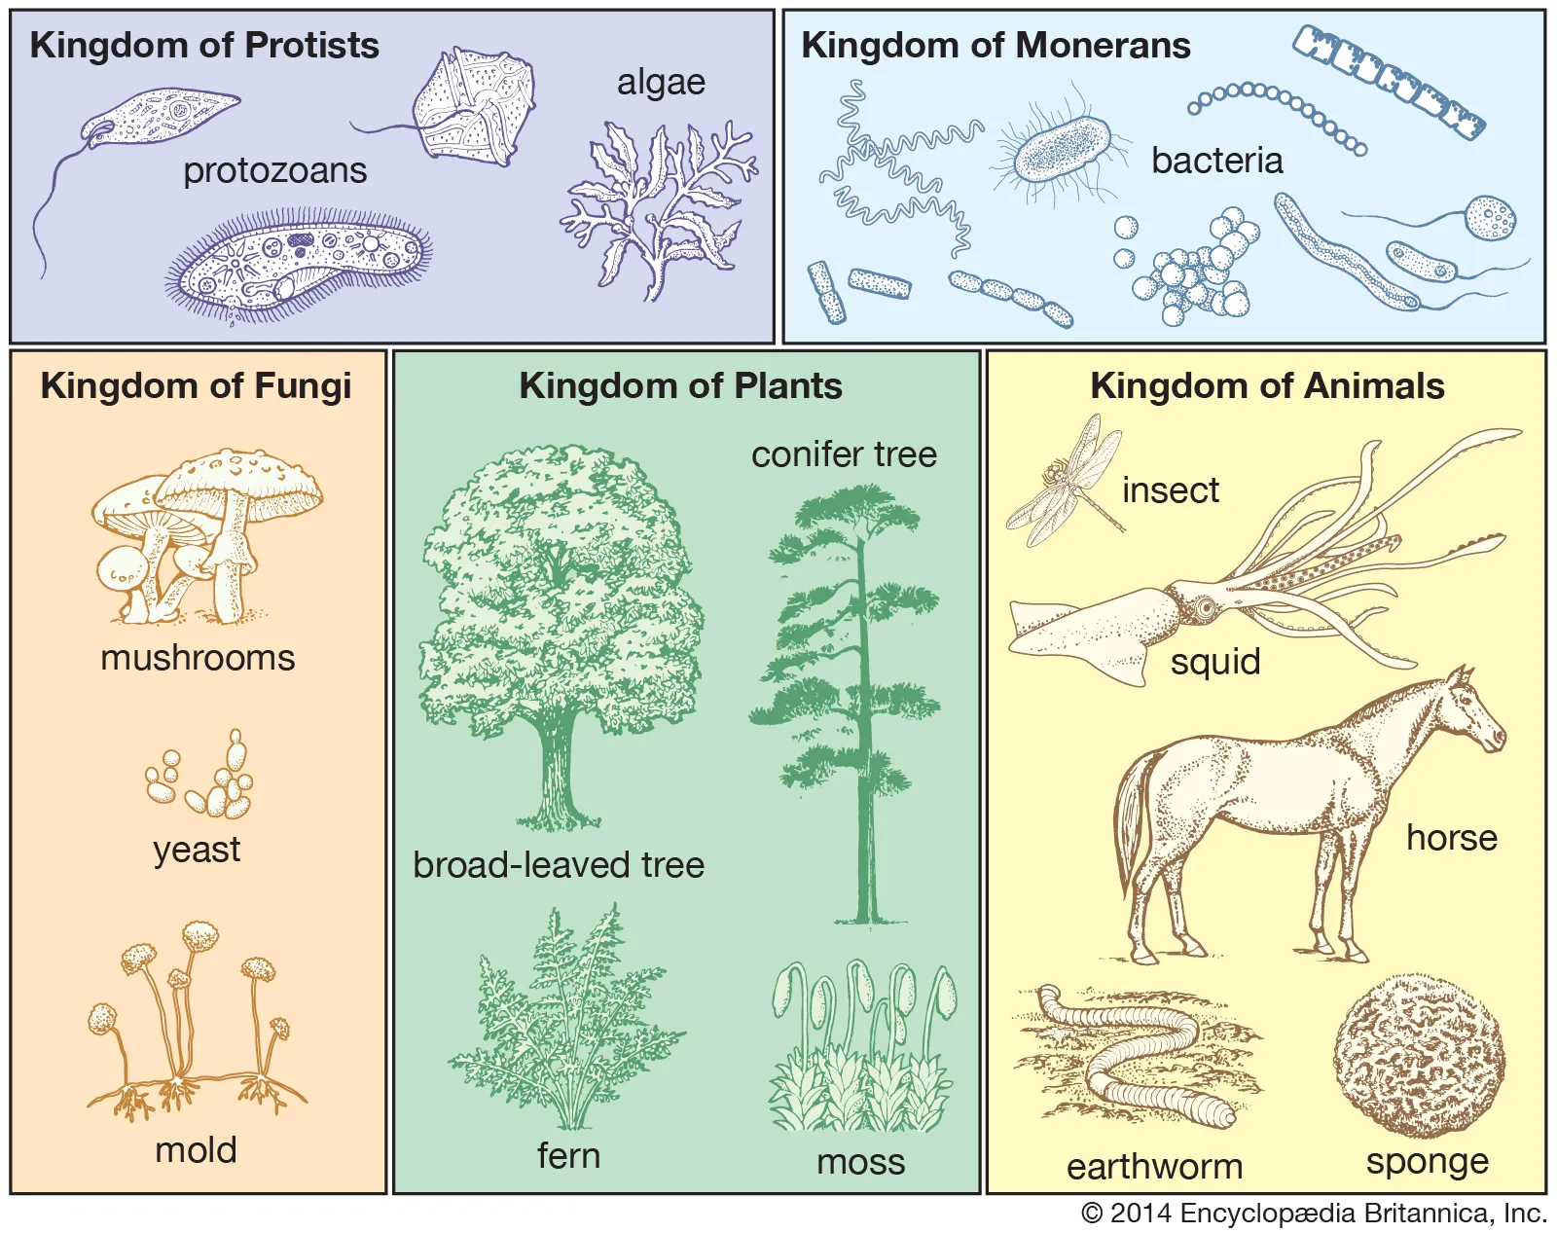

Slide 43
Why is this Important?
Why Classifying Organisms Is Important
Understanding Relationships: Classification helps scientists understand how different organisms are related to one another and how they evolved.
Communication: Using a universal naming system allows scientists from around the world to communicate more effectively about organisms.
Study of Biodiversity: Classifying organisms helps track the variety of life on Earth, which is important for conservation efforts and understanding ecosystems.
Medical and Agricultural Benefits: By classifying organisms, scientists can better study diseases, pests, and other biological factors that impact human health and food production.

Slide 44
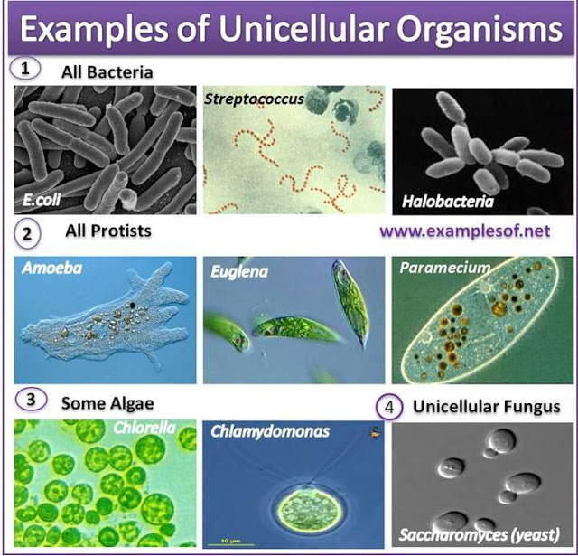
Unicellular Organisms
Unicellular organisms are living organisms that consist of only one cell. Despite their simplicity, they can carry out all the essential life functions, including metabolism, reproduction, and response to the environment, within that single cell. Unicellular organisms are incredibly diverse and can be found in many environments, from water to soil to inside the bodies of other organisms.

Slide 45
Types of Unicellular Organisms
Bacteria
Structure: Bacteria are simple, single-celled organisms that lack a nucleus (prokaryotes). They have a cell wall and can have various shapes (spherical, rod-like, spiral).
Examples: Escherichia coli (E. coli), Streptococcus (causes strep throat).
Archaea
Structure: Archaea are similar to bacteria but have unique biochemical features that allow them to survive in extreme environments, such as hot springs, deep-sea vents, and high-salinity areas.
Examples: Thermophiles (heat-loving), Halophiles (salt-loving).
Protists
Structure: Protists are a diverse group of eukaryotic (with a nucleus) unicellular organisms. Some are plant-like (algae), some are animal-like (protozoa), and some are fungus-like.
Examples: Amoeba (protozoa), Paramecium (protozoa), Euglena (algae).
Yeasts (Fungi)
Structure: Yeasts are unicellular fungi, eukaryotic organisms with a nucleus. They are often oval or round in shape.
Examples: Saccharomyces cerevisiae (used in baking and brewing).

Slide 46
Unicellular Organisms: Environment
Unicellular organisms are highly adaptable to their surroundings. They can live in a wide range of environments, including extreme conditions such as hot springs, deep ocean vents, or even frozen environments. They do so by:
Changing their shape or behavior to suit different conditions.
Forming spores or cysts to survive harsh environments like extreme heat or dryness.
Adjusting metabolism to cope with limited resources.
For example, some bacteria can survive in environments with little or no oxygen (anaerobic conditions), while others thrive in oxygen-rich environments.

Slide 47
Unicellular Organisms: Role
Unicellular organisms have essential roles in ecosystems:
Decomposers: Many bacteria and fungi are decomposers that break down dead plant and animal matter. This recycling process releases nutrients back into the environment, helping plants grow and maintaining ecosystem balance.
Producers (in Aquatic Ecosystems): Some unicellular organisms, like phytoplankton, are photosynthetic and serve as producers in aquatic ecosystems. They use sunlight to create energy, forming the base of the food chain for larger organisms, such as fish.
Nitrogen Fixation: Certain bacteria can "fix" nitrogen from the air into a form that plants can use for growth. This is crucial for plant nutrition and overall ecosystem health.
Symbiotic Relationships: Unicellular organisms can have symbiotic relationships with other organisms. For example, some bacteria live in the intestines of animals, helping digest food and providing nutrients.

Slide 48
Impact of Unicellular Organisms
Environmental Impact of Unicellular Organisms
Unicellular organisms can have both positive and negative effects on the environment:
Positive Effects:
  Waste Breakdown: Decomposers help break down waste, returning important nutrients to the ecosystem.
  Environmental Remediation: Some bacteria can clean up environmental pollutants, such as oil spills or heavy metals, through a process called bioremediation.
Negative Effects:
  Pathogens: Some unicellular organisms, like certain bacteria and protozoa, can be harmful to humans, animals, and plants. These pathogens can cause diseases such as cholera, malaria, and food poisoning.
  Harmful Algal Blooms: Some types of unicellular algae, when they grow in large numbers, can create harmful algal blooms (HABs). These blooms can produce toxins that harm marine life and disrupt ecosystems.

Slide 49
How Do They Exchange Gas?
Diffusion:
Unicellular organisms rely on diffusion for gas exchange. Diffusion is the movement of gases from areas of higher concentration to areas of lower concentration.
Oxygen moves from the surrounding environment (where its concentration is higher) into the cell, while carbon dioxide, produced during respiration, diffuses out of the cell (where its concentration is higher) into the surrounding environment.
This process happens directly across the cell membrane without the need for specialized structures like lungs or gills.
Surface Area and Volume:
Unicellular organisms have a high surface area to volume ratio, which makes diffusion an effective way to exchange gases.
The small size of unicellular organisms means that gases can quickly diffuse in and out of the cell, as the distance for the gases to travel is minimal.
Types of Gases Exchanged:
Oxygen (O₂): This gas is used for cellular respiration, a process that provides energy for the cell.
Carbon Dioxide (CO₂): This is a waste product of cellular respiration and must be removed from the cell.

Slide 50
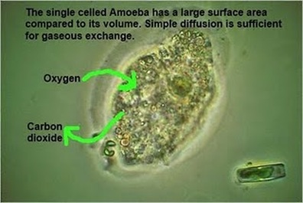

Slide 51
Environment
Interactions with the Environment
Oxygen Production: Through photosynthesis, some unicellular organisms like algae produce oxygen, which is vital for other life forms. Phytoplankton in the oceans, for example, are responsible for producing a large portion of the Earth's oxygen.
Food Chain and Energy Flow: Unicellular organisms form the base of many food webs. They are consumed by larger organisms, providing energy that supports more complex life forms.
Influencing the Carbon Cycle: Unicellular organisms like algae absorb carbon dioxide during photosynthesis. When they die, they sink to the ocean floor, helping sequester carbon and maintain the balance of gases in the atmosphere.

Slide 52
The Importance of Unicellular Organisms
1. Basis of Life on Earth
First Life Forms: Unicellular organisms were the first forms of life on Earth. They are believed to have existed billions of years ago and are the ancestors of more complex, multicellular organisms.
Evolutionary Significance: The evolution of unicellular organisms led to the development of multicellular life, paving the way for the diversity of life forms we see today.
2. Essential in Ecosystems
Food Chain: Many unicellular organisms, like phytoplankton and zooplankton, form the base of aquatic food chains. They serve as food for larger organisms, such as small fish and marine animals, and thus help sustain the ecosystem.
Decomposers: Unicellular organisms, such as bacteria and fungi, act as decomposers. They break down organic matter (dead plants and animals), recycling nutrients back into the soil, which supports plant growth and maintains ecosystem balance.
3. Contribution to Oxygen Production
Photosynthesis: Some unicellular organisms, like algae and cyanobacteria, are photosynthetic. They convert sunlight into energy and produce oxygen as a byproduct. This process is critical for maintaining oxygen levels in the atmosphere, which supports life for many organisms, including humans.

Slide 53
The Importance of Unicellular Organisms
4. Nitrogen Fixation
Certain unicellular bacteria are capable of nitrogen fixation, converting nitrogen from the air into forms that plants can use to grow. Without these organisms, plants would not be able to obtain nitrogen, an essential nutrient for their growth.
5. Medical and Industrial Uses
Biotechnology and Medicine: Some unicellular organisms, such as yeast and bacteria, are used in the production of medicines, including insulin, antibiotics, and vaccines. They are also used in the fermentation process to make foods like bread, yogurt, and alcoholic beverages.
Research: Unicellular organisms like bacteria and yeast are model organisms used in scientific research to study genetics, disease mechanisms, and drug development.
6. Disease and Health
While many unicellular organisms are beneficial, some can cause diseases in humans, animals, and plants. Pathogenic bacteria and protozoa are responsible for illnesses like tuberculosis, malaria, and cholera. Studying these organisms helps scientists develop ways to treat and prevent diseases.

Slide 54
The Importance of Unicellular Organisms
7. Environmental Role
Bioremediation: Some unicellular organisms can break down toxic substances in the environment. For example, certain bacteria are used in bioremediation to clean up oil spills and other pollutants in water and soil.
Symbiotic Relationships: Many unicellular organisms form symbiotic relationships with other organisms. For example, the bacteria in our gut help digest food and produce nutrients, benefiting both the bacteria and the host organism.
8. Adaptability and Resilience
Survival in Extreme Conditions: Unicellular organisms are incredibly resilient and can survive in extreme environments, such as hot springs, deep ocean vents, and acidic waters. Their ability to adapt to harsh conditions contributes to their survival and the understanding of life on Earth in extreme environments.

Slide 55
Multicellular Organisms
Multicellular organisms are organisms made up of more than one cell. These organisms have specialized cells that perform specific functions, allowing them to live and thrive in various environments. Unlike unicellular organisms, multicellular organisms have a higher degree of complexity due to the organization of cells into tissues, organs, and organ systems.

Slide 56
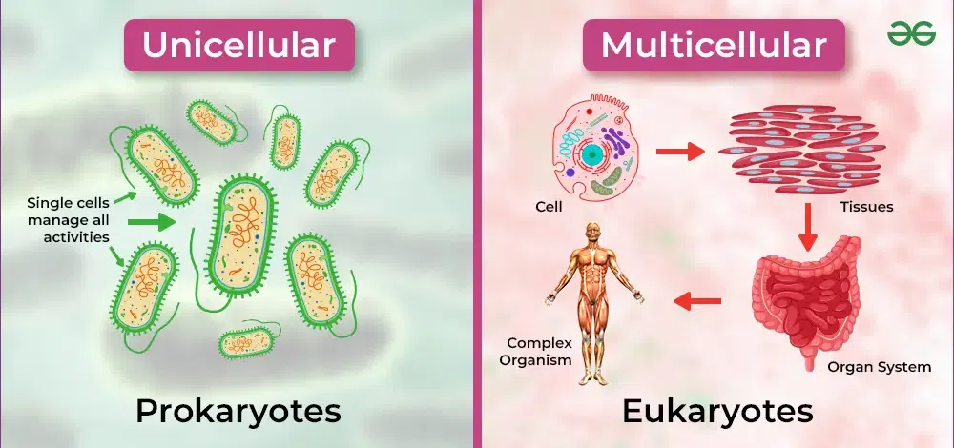

Slide 57
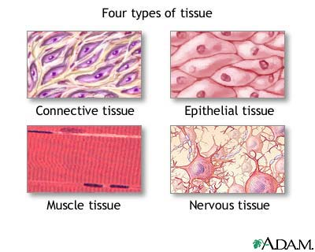
Tissues
Definition: Tissues are groups of similar cells that work together to perform a specific function. In multicellular organisms, tissues are essential for carrying out complex tasks.
Types of Tissues in Humans:
Epithelial Tissue: Covers body surfaces and lines organs (e.g., skin).
Muscle Tissue: Allows movement through contraction (e.g., skeletal muscles).
Nervous Tissue: Transmits signals to and from the brain and body (e.g., neurons).
Connective Tissue: Supports and binds other tissues (e.g., bones, blood, cartilage).

Slide 58
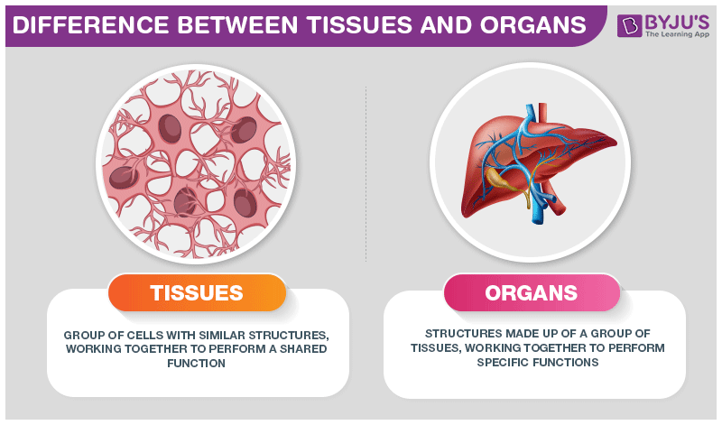
Organs
Definition: Organs are made up of multiple types of tissues working together to perform a specific function. Each organ in a multicellular organism has a unique job.
Examples of Human Organs:
  Heart: Pumps blood throughout the body.
  Lungs: Responsible for gas exchange (oxygen and carbon dioxide).
  Stomach: Breaks down food for digestion.
  Kidneys: Filter waste from the blood and regulate fluid balance.

Slide 59
Organ Systems
Definition: An organ system is a group of organs that work together to perform a larger, more complex function necessary for survival.
Examples of Organ Systems in Humans:
  Circulatory System: Includes the heart and blood vessels, transporting oxygen, nutrients, and waste products.
  Respiratory System: Includes the lungs, allowing gas exchange (oxygen in, carbon dioxide out).
  Digestive System: Includes the stomach and intestines, breaking down food and absorbing nutrients.
  Nervous System: Includes the brain, spinal cord, and nerves, coordinating body activities and responses to stimuli.
  Muscular System: Includes muscles that allow movement and support the body.

Slide 60
Human Organ Systems
Here’s an overview of the main human organ systems:
Circulatory System: Transports blood, nutrients, and gases.
Respiratory System: Facilitates gas exchange (oxygen in, carbon dioxide out).
Digestive System: Breaks down food into nutrients that the body can use.
Nervous System: Sends signals and processes information throughout the body.
Muscular System: Enables movement by contracting muscles.
Skeletal System: Provides structure and support for the body.
Endocrine System: Produces hormones that regulate bodily functions.
Excretory System: Removes waste products from the body.
Immune System: Defends the body against infections and diseases.

Slide 61
Systems Working Together
Organ systems do not function in isolation. They interact with one another to maintain homeostasis (internal balance) and ensure the survival of the organism. For example:
Circulatory and Respiratory Systems: Work together to deliver oxygen to the cells and remove carbon dioxide.
Digestive and Circulatory Systems: The digestive system breaks down food into nutrients, and the circulatory system transports those nutrients to the cells.
Nervous and Muscular Systems: The nervous system sends signals to muscles, causing them to contract and enable movement.

Slide 62
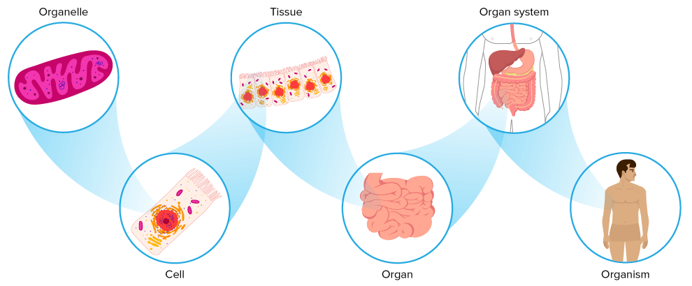

Slide 63
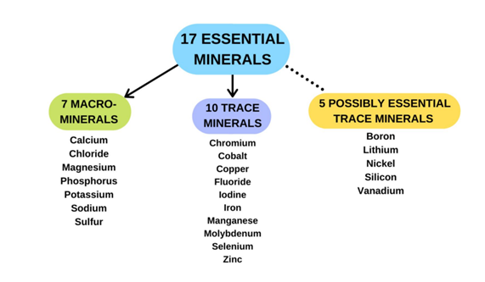
Nutrition
Definition: Nutrition is the process by which organisms take in and use food to maintain their health and energy levels.
Types of Nutrition:
  Autotrophic: Organisms, like plants, produce their own food through photosynthesis.
  Heterotrophic: Organisms, like humans and animals, obtain food by eating other organisms.
Digestive Process in Humans:
  Food is ingested, broken down in the stomach, and nutrients are absorbed into the bloodstream through the intestines.
  The circulatory system transports nutrients to cells for energy, growth, and repair.

Slide 64
Gas Exchange
Definition: Gas exchange is the process of taking in oxygen and expelling carbon dioxide.
In Humans:
  Lungs are responsible for gas exchange. Oxygen is absorbed into the blood, while carbon dioxide is removed from the blood and exhaled.
  The respiratory system works with the circulatory system to transport gases to and from cells throughout the body.
In Plants:
Plants exchange gases through stomata (small openings on leaves), where they take in carbon dioxide for photosynthesis and release oxygen.

Slide 65
Responding to the Environment
Multicellular organisms can respond to changes in their environment to maintain homeostasis. This ability helps organisms survive and adapt to varying conditions.
Nervous System:
The nervous system detects changes in the environment (stimuli) and sends signals to appropriate parts of the body to initiate a response. For example, the body sweats to cool down when the temperature rises.
Endocrine System:
The endocrine system releases hormones that regulate various functions, like growth, metabolism, and stress responses. For example, insulin regulates blood sugar levels when they rise after eating.
Immune System:
The immune system helps the body respond to infections and foreign substances by producing antibodies and activating white blood cells.

Slide 66
Movement & Locomotion
Definition: Movement is the ability to change position, while locomotion refers to movement from one place to another.
Types of Movement in Multicellular Organisms:
  Muscle Contraction: In humans, the muscular system allows movement by contracting and relaxing muscles.
  Ciliary Movement: In some organisms (like in the respiratory system), cilia help move substances, such as mucus, in the body.
  Flagella or Cilia in Animals: Some cells in animals (like sperm cells) use flagella for locomotion.
Importance of Movement:
  Movement is necessary for obtaining food, avoiding predators, and reproducing.
  In humans, locomotion (e.g., walking, running) is crucial for performing daily activities and maintaining health.

Slide 67
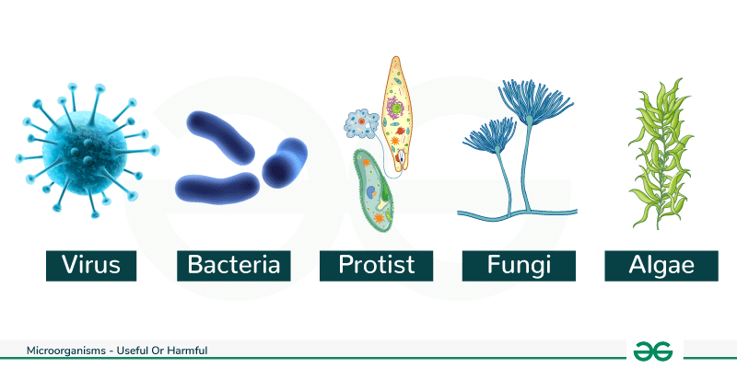
Micro-organisms & Disease
Micro-organisms, which include bacteria, viruses, fungi, and protozoa, are often linked to the spread of disease. While many micro-organisms are beneficial to human health and the environment, others can cause illnesses when they invade the body. Understanding how these organisms work and how diseases spread is important in preventing and treating infections.

Slide 68
Types of Microorganisms that Cause Disease
Bacteria: These are single-celled organisms that can cause a wide range of diseases, from mild infections (like strep throat) to severe conditions (like tuberculosis and pneumonia). Some bacteria are harmful because they produce toxins that damage the body.
Viruses: Viruses are even smaller than bacteria and need a host cell to reproduce. They can cause illnesses like the flu, the common cold, HIV/AIDS, and COVID-19. Viruses invade living cells, hijacking their machinery to replicate, often destroying the host cell in the process.
Fungi: Fungi, like molds and yeasts, can also cause infections, especially in people with weakened immune systems. Conditions like athlete's foot, ringworm, and thrush are caused by fungal infections.
Protozoa: These are single-celled organisms that can cause diseases such as malaria, amoebic dysentery, and sleeping sickness. Protozoa are often transmitted through contaminated water or insect bites.

Slide 69
How Microorganisms Spread
Direct Contact: Some diseases spread through physical contact, such as touching an infected person or contaminated surfaces. Examples include the common cold and skin infections.
Airborne Transmission: Many viruses, like the flu and COVID-19, spread through the air when an infected person coughs, sneezes, or talks, releasing tiny droplets that others inhale.
Water and Food: Some micro-organisms are transmitted through contaminated water or food. For example, bacteria like Salmonella can cause food poisoning if food is improperly cooked or stored.
Insect Vectors: Diseases like malaria and dengue fever are spread by insects like mosquitoes, which carry protozoa or viruses and transmit them through bites.

Slide 70
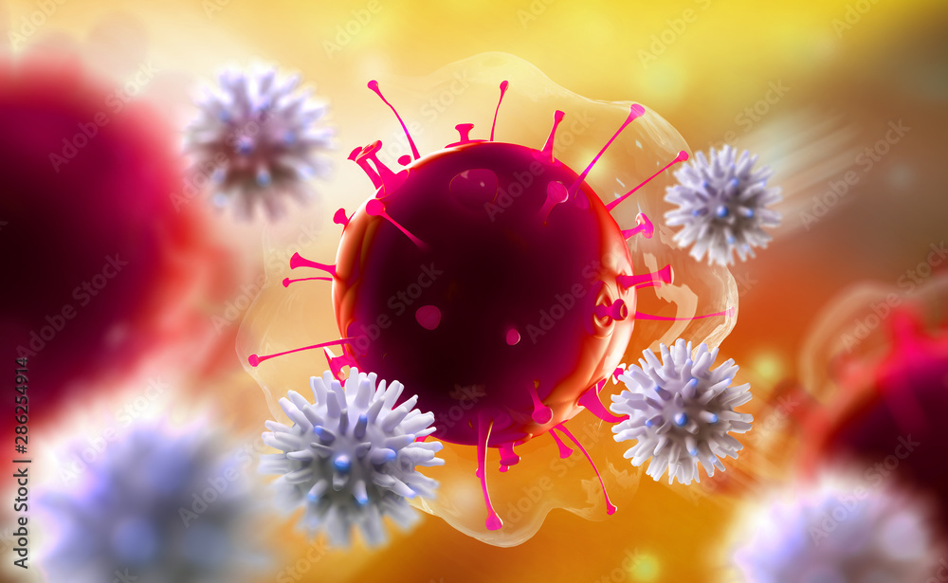
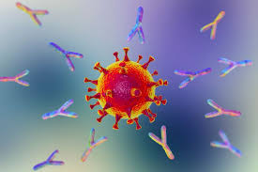
The Body’s Defense Against Microorganisms
The body has several ways to defend itself from harmful micro-organisms:
Immune System: The immune system recognizes and attacks harmful invaders, including bacteria, viruses, and fungi. White blood cells play a key role in identifying and destroying pathogens.
Antibodies: The body produces antibodies that specifically target and neutralize pathogens. Vaccines help the body produce antibodies against certain diseases, providing immunity.
Physical Barriers: The skin, mucous membranes, and other barriers help prevent pathogens from entering the body. Mucus in the nose and throat traps particles and micro-organisms, which are then expelled by coughing or sneezing.

Slide 71
Cells Gone Wrong
Sometimes, diseases occur not because of external pathogens but due to problems within the body’s own cells. These diseases can arise when cells malfunction, divide uncontrollably, or become dysfunctional.
Cancer: Uncontrolled Cell Growth
What is Cancer?: Cancer occurs when cells in the body begin to grow and divide uncontrollably, forming a mass of tissue called a tumor. Normally, cells grow, divide, and die in a controlled manner. However, cancerous cells bypass these regulatory mechanisms, often due to genetic mutations.
Causes of Cancer: Cancer can be caused by various factors, including exposure to harmful chemicals (like tobacco smoke), radiation, certain viruses (e.g., HPV), and inherited genetic mutations.
Types of Cancer: There are many types of cancer, such as lung cancer, breast cancer, and leukemia. Treatment often involves surgery, chemotherapy, and radiation therapy to remove or kill cancer cells.

Slide 72
Cells Gone Wrong
Genetic Disorders: Cells with Mutations
What Are Genetic Disorders?: Genetic disorders occur when there is an abnormality in a person's DNA. This can lead to cells not functioning properly, affecting the whole body. These abnormalities can be inherited from parents or occur due to mutations.
Examples of Genetic Disorders:
  Cystic fibrosis: Caused by a mutation in the gene responsible for making a protein that helps regulate the flow of salt and water in cells, leading to thick mucus buildup in the lungs.
  Sickle cell anemia: A genetic disorder where red blood cells become misshapen, leading to blood flow problems and decreased oxygen delivery throughout the body.
3. Autoimmune Diseases: The Immune System Attacks Healthy Cells
What Are Autoimmune Diseases?: In autoimmune diseases, the immune system mistakenly attacks healthy cells in the body, thinking they are foreign invaders. This leads to inflammation and damage in various tissues and organs.
Examples of Autoimmune Diseases:
  Type 1 diabetes: The immune system attacks insulin-producing cells in the pancreas, leading to high blood sugar levels.
  Rheumatoid arthritis: The immune system attacks the joints, causing pain and swelling.

