Slide 1
Remembrance Day Art Project
November 11, 2024

Slide 2
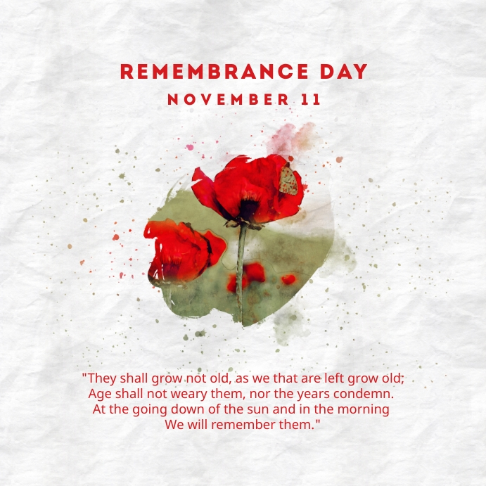

Slide 3
Project Overview
In honor of Remembrance Day, we will work together to create a large poster that reflects our gratitude and remembrance for the soldiers who served. We will use sponge painting techniques and explore perspective to bring our ideas to life.

Slide 4
Instructions
Step 1: Understand the Theme
Discussion: Talk about Remembrance Day and its significance. What does it mean to remember those who served? What symbols or images come to mind?
Discuss various scenes and symbols associated with the day, such as poppy fields, memorials, and soldiers.
You can also choose to re-create a specific event or battle that happened during WW2 as part of Canada’s history.

Slide 5
Instructions
Step 2:
Group Work: In small groups, brainstorm specific scenes that reflect the meaning of Remembrance Day. Examples might include:
A field of poppies.
Soldiers marching or saluting.
A memorial with candles and flowers.
Sketch: Each group should sketch their chosen scene, considering composition and emotional impact.

Slide 6
Instructions
Step 3: Share and Combine Ideas
Class Discussion: Each group presents their scene sketches to the class.
Design the Layout: As a class, decide how to arrange the scenes on the poster. Discuss how the different scenes will connect visually and thematically.

Slide 7
Instructions
Step 4: Assign Sections
Divide the Work: Assign specific scenes to each group, ensuring that each section fits into the overall design and narrative of the poster.

Slide 8
Instructions
Step 5: Prepare Materials
Gather Supplies: Collect all necessary materials (poster board, sponges, paints, brushes, water cups, and paper towels).
Step 6: Practice Sponge Painting Techniques
Technique Practice: Before starting, practice sponge painting on scrap paper. Focus on creating textures that enhance your scenes.

Slide 9
Instructions
Step 7: Start Painting Your Scene
Get Creative: Begin painting your assigned scene on the poster. Use sponges to create the background and main elements of your scene.
Coordinate with Others: Ensure that your scene transitions smoothly to the adjacent sections. Consider how colors and elements will blend.
Step 8: Add Details and Depth
Enhance Your Scene: Once the main areas are painted, use brushes to add details, such as outlines, highlights, and additional features (like clouds, shadows, or people).
Include Text: Add a meaningful quote or title relevant to your scene, reinforcing the message of remembrance.

Slide 10
Instructions
Step 9: Reflection and Presentation
Prepare to Present: Each group prepares to present their scene, explaining its significance and how it fits into the overall artwork.
Discuss the Collaboration: Reflect on how working together helped create a unified tribute.
Step 10: Display the Artwork
Exhibit Your Work: Once completed, the poster will be displayed in a prominent place in the school to honor Remembrance Day.

Slide 11
Tips for Success
Tips for Success:
Teamwork: Remember to communicate and collaborate effectively with your group.
Creativity: Don’t be afraid to try new ideas and techniques.
Respect the Theme: Keep in mind the importance of the subject matter as you create your artwork.

Slide 12
Distinct Scenes
Here are some distinct scene ideas you may want to consider for your group’s Remembrance Day artwork:
Poppy Field:
  A serene landscape filled with red poppies swaying in the breeze, symbolizing remembrance and peace.
Soldiers in Silhouette:
  A powerful silhouette of soldiers standing at attention or saluting against a sunset backdrop, representing honor and respect.
War Memorial:
  A scene depicting a war memorial with candles, flowers, and people paying their respects, highlighting remembrance and gratitude.
Peace Dove:
  A dove flying over a battlefield or a poppy field, symbolizing peace and hope following conflict.
Soldiers in Action:
  A dynamic scene showing soldiers helping each other or providing aid in a combat setting, illustrating bravery and camaraderie.

Slide 13
Key Events to Think About
Battle of Britain (1940) - Canadian pilots were involved in defending Britain from the German Luftwaffe.
Battle of Hong Kong (1941) - Canadian troops fought to defend the British colony but were eventually captured.
Dieppe Raid (1942) - A major Allied raid on the German-occupied port of Dieppe, primarily involving Canadian forces.
Italian Campaign (1943-1945) - Canada participated in several key battles, including:
  Battle of Ortona (1943) & Battle of the Moro River (1943)
  Battle of the Liri Valley (1944)
D-Day and the Battle of Normandy (1944) - Canadian forces landed on Juno Beach and fought throughout the Normandy Campaign.
Battle of Caen (1944) - A crucial part of the Normandy campaign, involving intense fighting.
Liberation of the Netherlands (1944-1945) - Canadian troops played a pivotal role in liberating Dutch cities and villages.
Battle of the Scheldt (1944) - Critical for securing the port of Antwerp.
Battle of Groningen (1945) - Involved in the final push into the Netherlands.
Battle of Falaise (1944) - Part of the overall Normandy Campaign, where Canadian forces were heavily engaged.

Slide 14
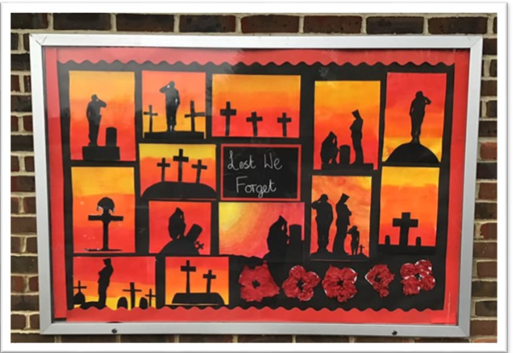

Slide 15
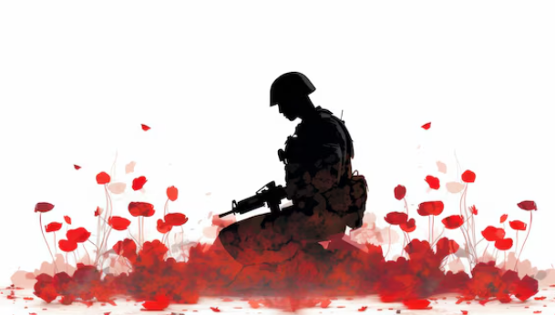

Slide 16
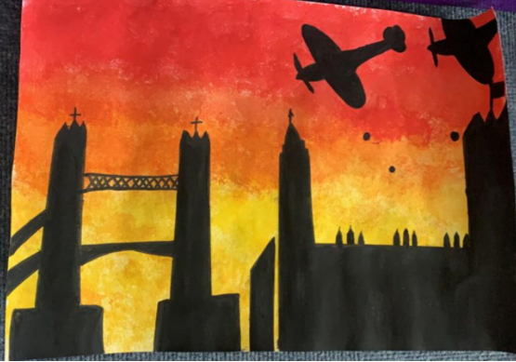

Slide 17
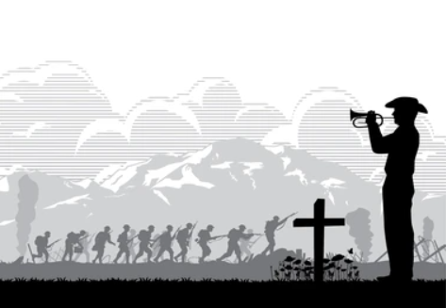

Slide 18


Slide 19
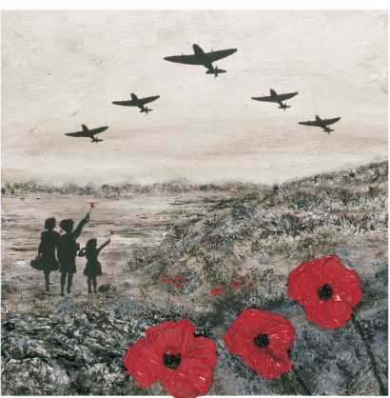

Slide 20
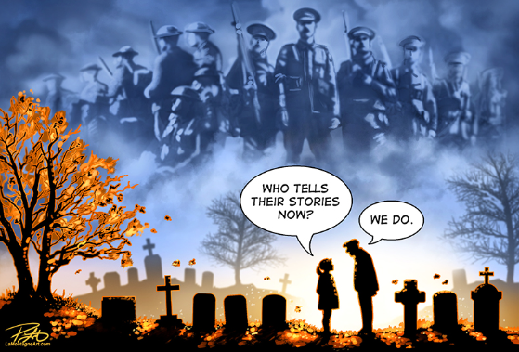

Slide 21
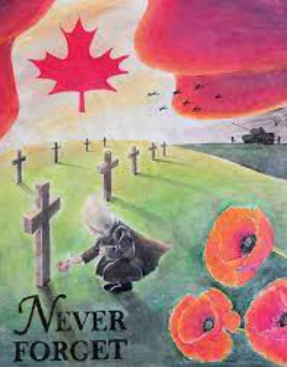

Slide 22
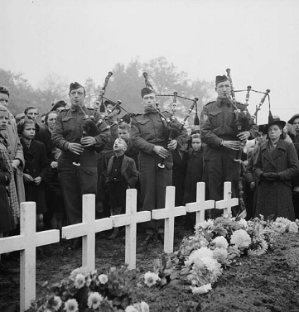

Slide 23
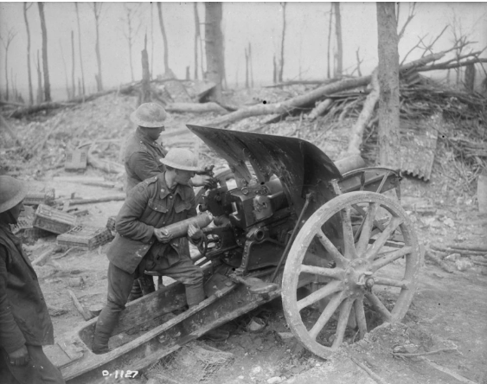
Notes:
Vimy ridge

Slide 24
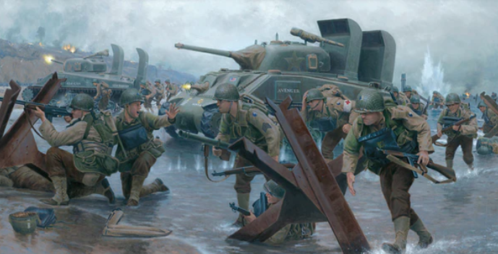
Notes:
D-Day

Slide 25
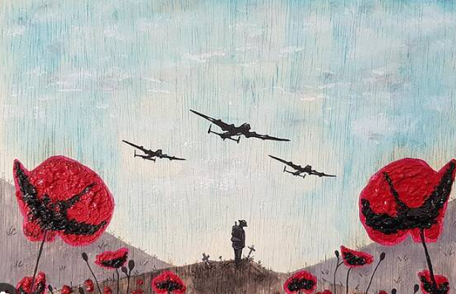

Slide 26
