Slide 1
GEOMETRY
Measurement, Area, and Volume of
2D & 3D Shapes

Slide 2
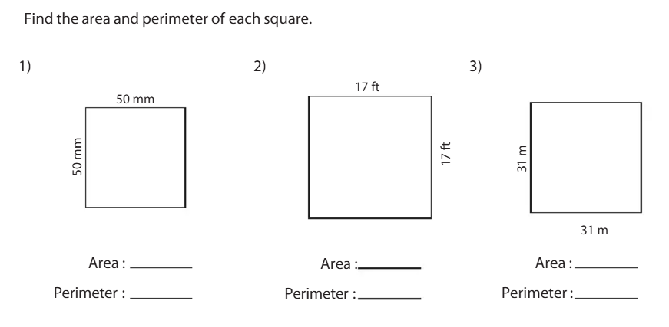
Pop Quiz: Review from Last Year

Slide 3
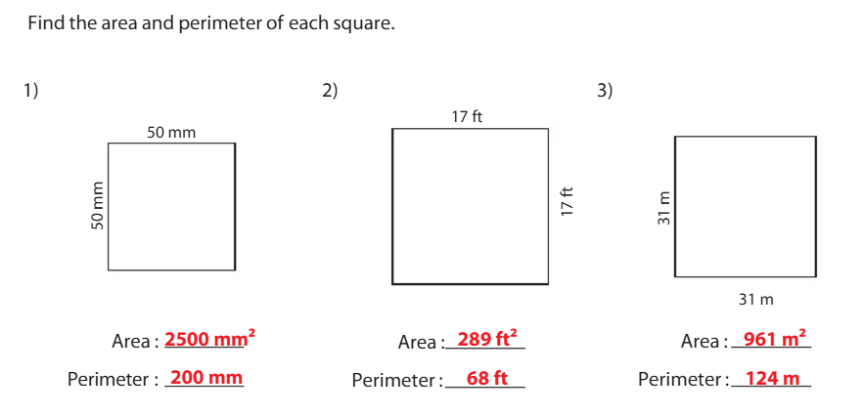

Slide 4
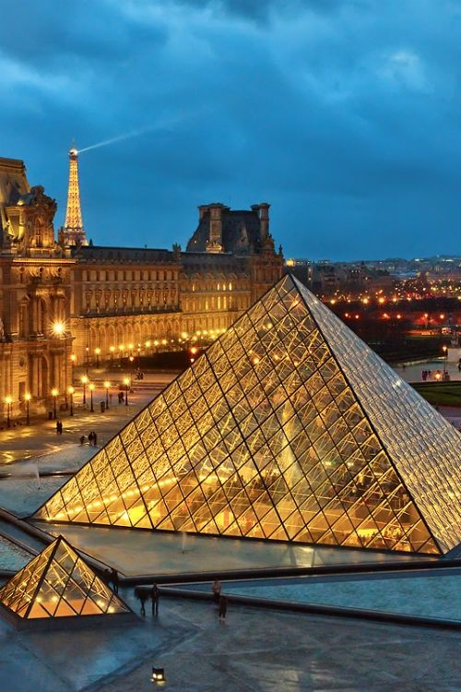

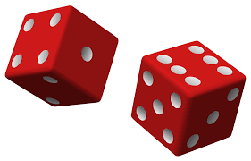
Measurement & Geometry
Where do you see shapes and measurements in your everyday life?

Slide 5
Measurement
Key Concepts:
Measurement involves determining the size, length, area, or volume of an object or space.
The concept of measurement is essential in daily life and is used to calculate distances, areas, volumes, and other physical quantities.
Units of Measurement:
Metric System: millimeters (mm), centimeters (cm), meters (m), kilometers (km), grams (g), liters (L)
Imperial System: inches (in), feet (ft), yards (yd), miles (mi), pounds (lb), gallons (gal)

Slide 6
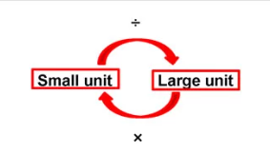
Conversion of Units
Conversion between units is essential for solving problems in real-world contexts.
Example: Convert 2.5 meters to centimeters (2.5 m = 250 cm).
Conversion formula: Multiply or divide by powers of 10 (e.g., 1 meter = 100 centimeters).

Slide 7
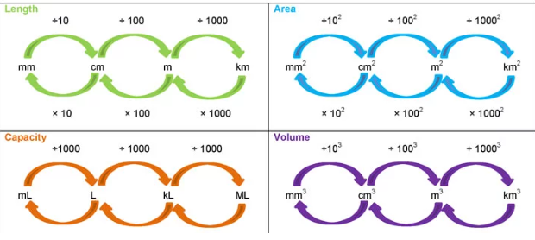
Unit Conversions
Depending on what you are trying to do, you will either multiply or divide to get a new unit.

Slide 8
How to Convert
Step 1: Identify the unknown amount and its units:
Determine what you're trying to find. For example, if you're converting 5 kilometers to meters, the unknown amount is the number of meters.
Example: Convert 5 kilometers to meters.
  Unknown amount: Meters
  Unknown units: Meters
2. Identify the known amount and its units:
Look at the given value and its unit.
Example: 5 kilometers.
  Known amount: 5
  Known units: Kilometers
By identifying the units, understanding whether you’re converting to a larger or smaller unit, and applying multiplication or division, you can successfully convert between different units.

Slide 9
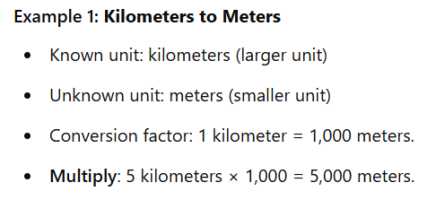
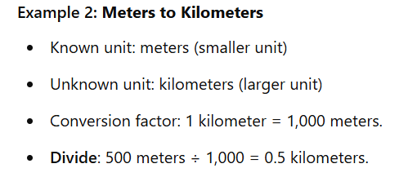
How to Convert
3. Determine which operation to use: multiply or divide:
Use multiplication or division based on the relationship between the units.
  If you are converting from a larger unit to a smaller unit, multiply by the conversion factor.
  If you are converting from a smaller unit to a larger unit, divide by the conversion factor.

Slide 10
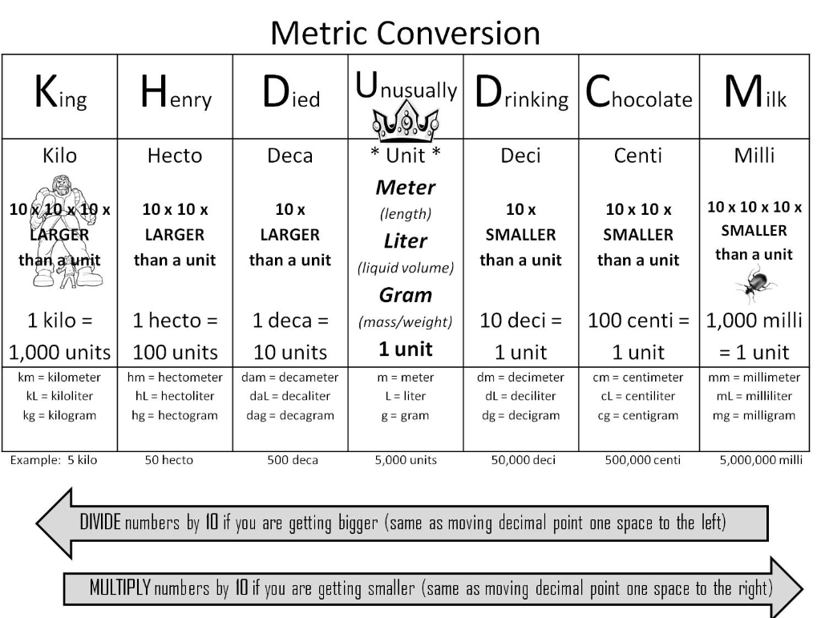

Slide 11
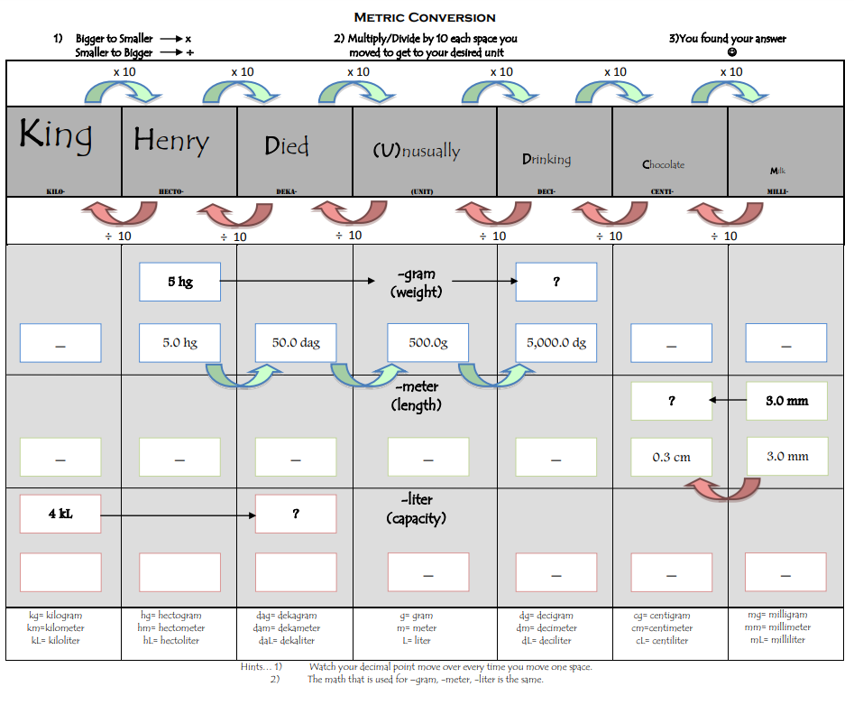

Slide 12
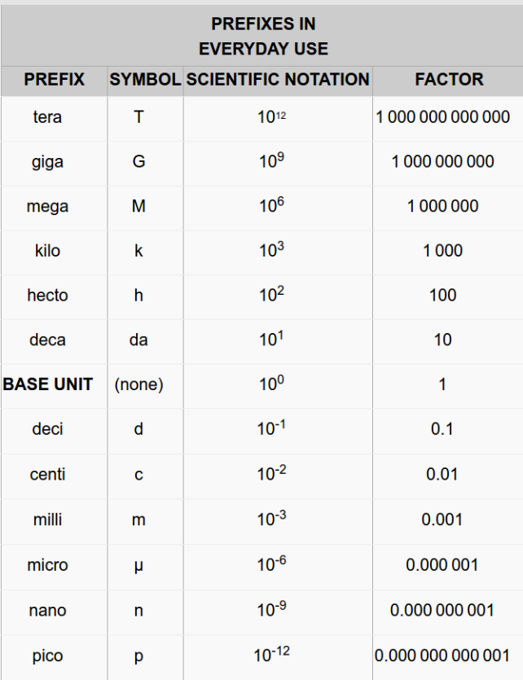
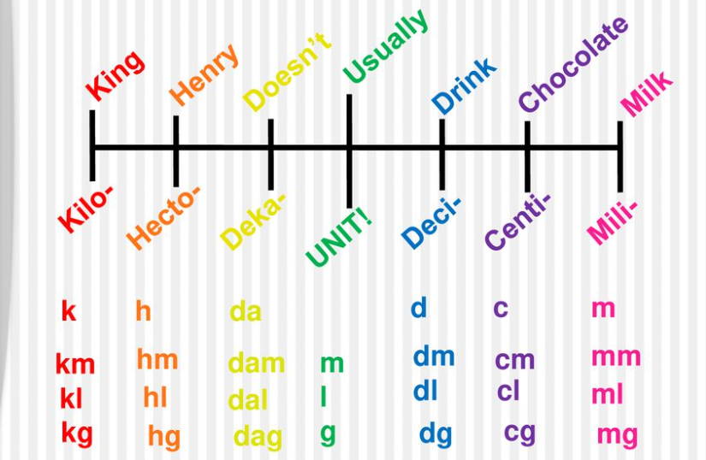

Slide 13
Homework:
4,000L → ml
10,000km → mm
12.753 gr → kg
30 decimetres → Hm
4.2718 cm → Km
19.93 centigrams → Kg (divide, 5 spaces = 100000)
0.988 Kl → ml (multiply, 6 spaces = 1000000)
1348.2 km → cm (multiply, 5 spaces = 100000)
2024 M → Hm (divide, 2 spaces = 100)
12,978.34 centilitres → dekalitres (divide, 3 spaces = 1000)
Notes:
King Henry Doesn’t Usually Drink Chocolate Milk: Divide to go from small to big; Multiply to go from Big to Small

Slide 14
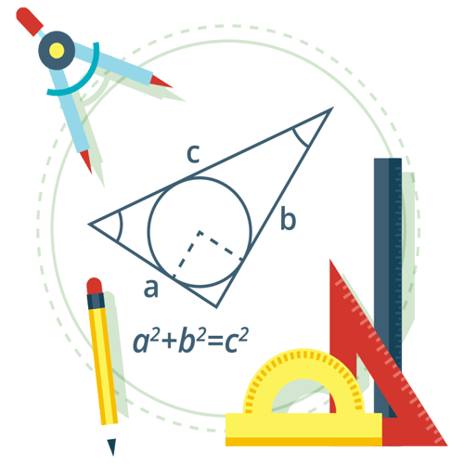
Geometry
Geometry is the branch of mathematics concerned with the properties and relations of points, lines, surfaces, and solids.
It involves understanding shapes, angles, and the space they occupy.

Slide 15
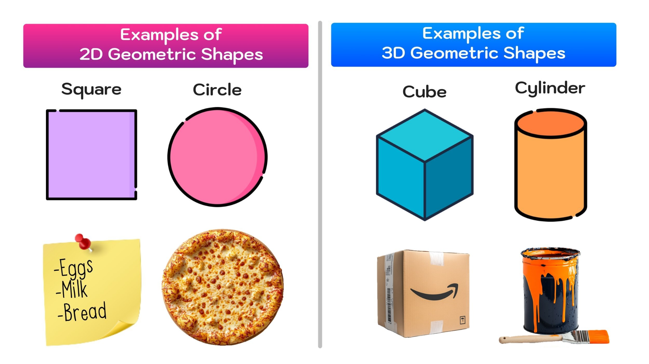
2D Shapes vs. 3D Shapes

Slide 16
Surface Area
Surface Area:
Definition: Surface area is the total area that the surface of a 3D object covers. It’s like wrapping the object in a sheet of paper and measuring the total amount of paper you need to cover it.
Units: Square units (e.g., cm², m²).
Calculation: You calculate surface area by adding up the areas of all the faces or curved surfaces of the object.
  For a cube: Surface Area = 6 × side² (since all faces are squares).
  For a cylinder: Surface Area = 2πr² + 2πrh (includes both circular bases and the curved surface).
Examples of real-world applications:
Painting the outside of a box.
Wrapping a present.
Calculating the amount of material needed to cover an object.

Slide 17
Volume
Volume:
Definition: Volume measures the amount of space an object occupies or how much liquid or material it can hold.
Units: Cubic units (e.g., cm³, m³).
Calculation: You calculate volume by multiplying the object's length, width, and height (or appropriate dimensions for other shapes).
  For a cube: Volume = side³.
  For a cylinder: Volume = πr²h (area of the base × height).
Examples of real-world applications:
Determining how much water can fill a swimming pool.
Measuring the capacity of a container.
Finding the amount of soil needed to fill a garden bed.

Slide 18
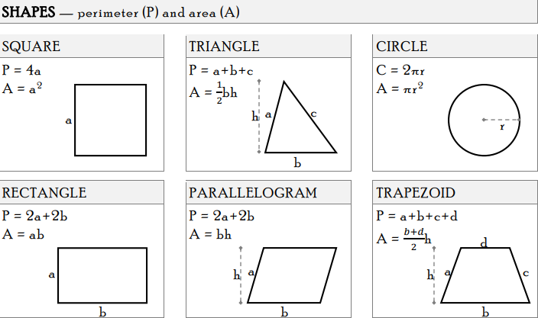
Formulas

Slide 19
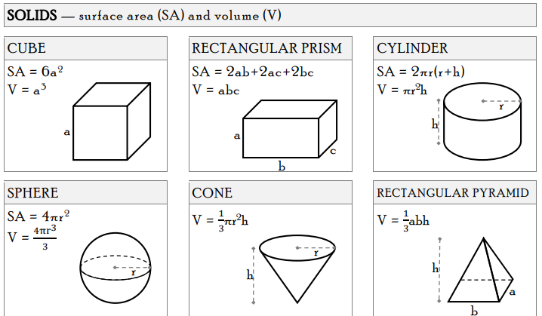
Formulas

Slide 20
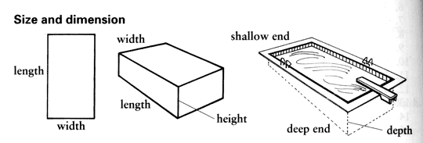
Length vs. Width vs. Height

Slide 21
Surface Area Practice Questions
Cube: A cube has a side length of 4 cm. What is the surface area of the cube?
Rectangular Prism: A rectangular prism has dimensions of 5 cm, 3 cm, and 7 cm. Find the surface area.
Sphere: The radius of a sphere is 6 cm. What is the surface area of the sphere?
Cylinder: A cylinder has a radius of 4 cm and a height of 10 cm. Calculate the surface area of the cylinder.
Cone: A cone has a radius of 3 cm and a slant height of 8 cm. Find the surface area of the cone.

Slide 22
Answers
Cube: A cube has a side length of 4 cm. What is the surface area of the cube?
Formula: Surface Area = 6 × side²
Steps:
Side length = 4 cm.
Surface Area = 6 × (4 cm)²
Surface Area = 6 × 16 cm²
Surface Area = 96 cm²
Answer: The surface area of the cube is 96 cm².

Slide 23
Answers
2. Rectangular Prism: A rectangular prism has dimensions of 5 cm, 3 cm, and 7 cm. Find the surface area.
Formula: Surface Area = 2lw + 2lh + 2wh, where l = length, w = width, and h = height.
Steps:
Length (l) = 5 cm, Width (w) = 3 cm, Height (h) = 7 cm.
Surface Area = 2(5 × 3) + 2(5 × 7) + 2(3 × 7)
Surface Area = 2(15) + 2(35) + 2(21)
Surface Area = 30 + 70 + 42
Surface Area = 142 cm²
Answer: The surface area of the rectangular prism is 142 cm².

Slide 24
Answers
3. Sphere: The radius of a sphere is 6 cm. What is the surface area of the sphere?
Formula: Surface Area = 4πr²
Steps:
Radius (r) = 6 cm.
Surface Area = 4π(6 cm)²
Surface Area = 4π(36 cm²)
Surface Area ≈ 4 × 3.14 × 36
Surface Area ≈ 452.16 cm²
Answer: The surface area of the sphere is approximately 452.16 cm².

Slide 25
Answers
4. Cylinder: A cylinder has a radius of 4 cm and a height of 10 cm. Calculate the surface area of the cylinder.
Formula: Surface Area = 2πr² + 2πrh
Steps:
Radius (r) = 4 cm, Height (h) = 10 cm.
Surface Area = 2π(4 cm)² + 2π(4 cm)(10 cm)
Surface Area = 2π(16 cm²) + 2π(40 cm)
Surface Area ≈ 2 × 3.14 × 16 + 2 × 3.14 × 40
Surface Area ≈ 100.48 cm² + 251.2 cm²
Surface Area ≈ 351.68 cm²
Answer: The surface area of the cylinder is approximately 351.68 cm².

Slide 26
Answers
5. Cylinder: A cylinder has a radius of 4 cm and a height of 10 cm. Calculate the surface area of the cylinder.
Formula: Surface Area = 2πr² + 2πrh
Steps:
Radius (r) = 4 cm, Height (h) = 10 cm.
Surface Area = 2π(4 cm)² + 2π(4 cm)(10 cm)
Surface Area = 2π(16 cm²) + 2π(40 cm)
Surface Area ≈ 2 × 3.14 × 16 + 2 × 3.14 × 40
Surface Area ≈ 100.48 cm² + 251.2 cm²
Surface Area ≈ 351.68 cm²
Answer: The surface area of the cylinder is approximately 351.68 cm².

Slide 27
Volume Practice Questions
Cube: A cube has a side length of 5 cm. What is the volume of the cube?
Rectangular Prism: A rectangular prism has dimensions of 8 cm, 6 cm, and 2 cm. Calculate its volume.
Sphere: The radius of a sphere is 7 cm. What is the volume of the sphere?
Cylinder: A cylinder has a radius of 3 cm and a height of 12 cm. What is the volume of the cylinder?
Cone: A cone has a radius of 4 cm and a height of 9 cm. Find the volume of the cone.

Slide 28
Answers - #1
Cube: A cube has a side length of 5 cm. What is the volume of the cube?
Formula: Volume = side³
Steps:
Side length = 5 cm.
Volume = (5 cm)³
Volume = 5 × 5 × 5
Volume = 125 cm³
Answer: The volume of the cube is 125 cm³.

Slide 29
Answers #2
Rectangular Prism: A rectangular prism has dimensions of 8 cm, 6 cm, and 2 cm. Calculate its volume.
Formula: Volume = l × w × h
Steps:
Length (l) = 8 cm, Width (w) = 6 cm, Height (h) = 2 cm.
Volume = 8 cm × 6 cm × 2 cm
Volume = 96 cm³
Answer: The volume of the rectangular prism is 96 cm³.

Slide 30
Answers #3
Sphere: The radius of a sphere is 7 cm. What is the volume of the sphere?
Formula: Volume = (4/3)πr³
Steps:
Radius (r) = 7 cm.
Volume = (4/3)π(7 cm)³
Volume = (4/3)π(343 cm³)
Volume ≈ (4/3) × 3.14 × 343
Volume ≈ 1436.76 cm³
Answer: The volume of the sphere is approximately 1436.76 cm³.

Slide 31
Answers #4
Cylinder: A cylinder has a radius of 3 cm and a height of 12 cm. What is the volume of the cylinder?
Formula: Volume = πr²h
Steps:
Radius (r) = 3 cm, Height (h) = 12 cm.
Volume = π(3 cm)²(12 cm)
Volume = 3.14 × 9 cm² × 12 cm
Volume ≈ 3.14 × 108 cm³
Volume ≈ 339.12 cm³
Answer: The volume of the cylinder is approximately 339.12 cm³.

Slide 32
Answers #5
Cone: A cone has a radius of 4 cm and a height of 9 cm. Find the volume of the cone.
Formula: Volume = (1/3)πr²h
Steps:
Radius (r) = 4 cm, Height (h) = 9 cm.
Volume = (1/3)π(4 cm)²(9 cm)
Volume = (1/3)π(16 cm²)(9 cm)
Volume ≈ (1/3) × 3.14 × 144 cm³
Volume ≈ 150.72 cm³
Answer: The volume of the cone is approximately 150.72 cm³.

Slide 33
Homework Question
Mixed Shapes: A swimming pool is in the shape of a rectangular prism, with a length of 10 m, width of 4 m, and depth of 2.5 m. On top of the pool, there's a dome (hemisphere) with a radius of 4 m. Find the total volume of water the pool and dome can hold.

Slide 34
Homework Question - Solution
Volume of the Rectangular Prism (pool):
  Volume = l × w × h
  Volume = 10 m × 4 m × 2.5 m
  Volume = 100 m³
Volume of the Hemisphere (dome):
  Volume of a sphere = (4/3)πr³. For a hemisphere, divide by 2.
  Volume = (1/2) × (4/3)π(4 m)³
  Volume = (1/2) × (4/3)π(64 m³)
  Volume ≈ (1/2) × 268.08 m³
  Volume ≈ 134.04 m³
Total Volume = Volume of pool + Volume of dome
  Total Volume = 100 m³ + 134.04 m³
  Total Volume ≈ 234.04 m³
Answer: The total volume is approximately 234.04 m³.

Slide 35
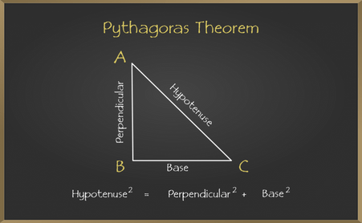
Triangles
Surface Area, Volume, Pythagorean Theorem

Slide 36
Introduction to Triangles
Key Points:
A triangle is a 2D shape with three sides and three angles.
The sum of the interior angles of a triangle always equals 180°.
Types of triangles based on side lengths:
  Equilateral Triangle: All sides and angles are equal (60° each).
  Isosceles Triangle: Two sides are equal, two angles are equal.
  Scalene Triangle: All sides and angles are different.
Types of triangles based on angles:
  Acute Triangle: All angles are less than 90°.
  Right Triangle: One angle is exactly 90°.
  Obtuse Triangle: One angle is greater than 90°.

Slide 37
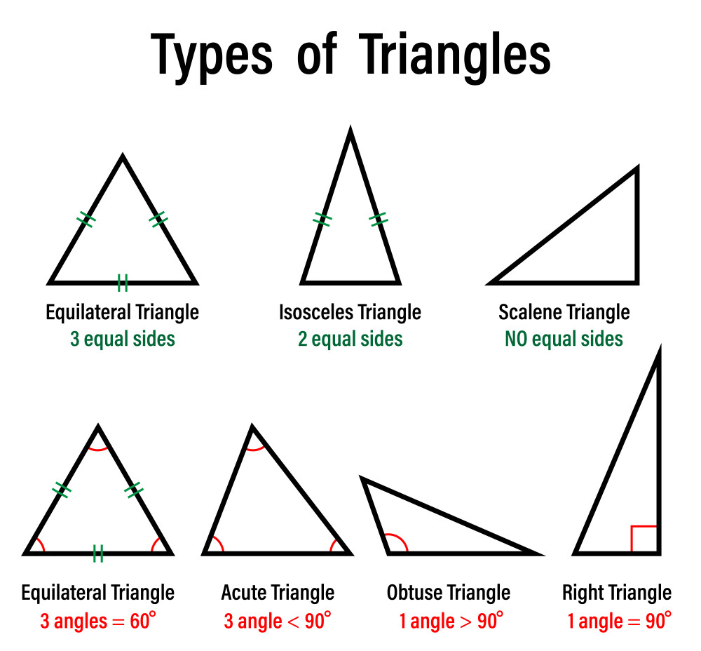

Slide 38
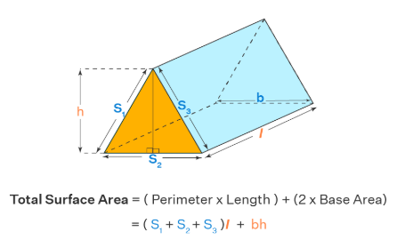
Surface Area of Triangular Prisms
Surface area
= (Perimeter of the base × Length of the prism) + (2 × Base Area)
= (S1 +S2 + S3)L + bh
where,
b is the bottom edge of the base triangle,
h is the height of the base triangle,
L is the length of the prism and
S1, S2, and S3 are the three edges (sides) of the base triangle
(bh) is the combined area of the two triangular faces [2 × (1/2 × bh)] = bh

Slide 39
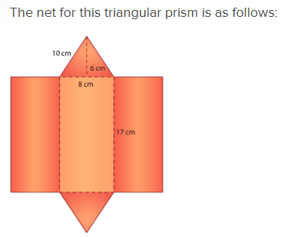
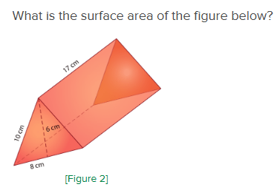

Slide 40
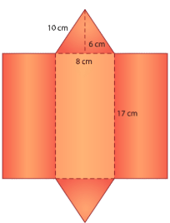
Now, let's fill in the measurements for the sides of each face in order to calculate their area.
Triangular prisms have their own formula for finding surface area because they have two triangular faces opposite each other.
17 cm
8 cm

Slide 41


The formula
𝐴=12𝑏ℎ
is used to find the area of the top and bases triangular faces, where A = area, b = base, and h = height.
The formula
𝐴=𝑙𝑤
is used to find the area of the three rectangular side faces, where A = area, l = length, and w = width.

Slide 42
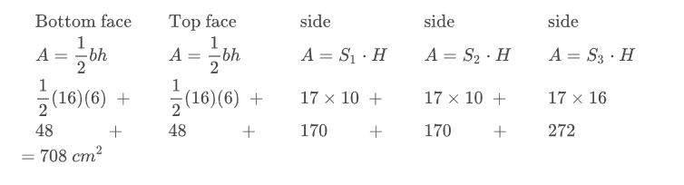

Plugging in the measurements that are given in the net, calculate the area of each face. Remember to use the correct area formula for the triangles and rectangles.
When you add these values together, you get a surface area of 708 square centimeters for this triangular prism.

Slide 43
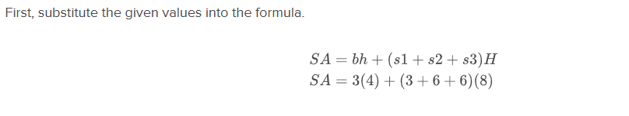
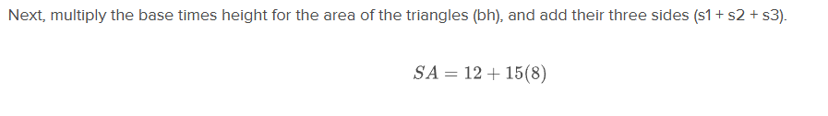
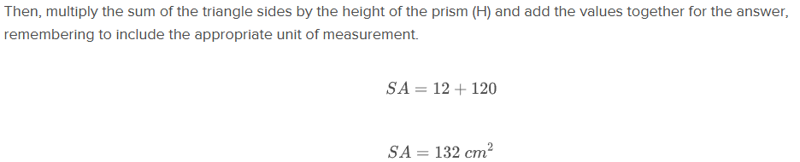
Earlier, you were given a problem about the gift Max bought for his mom.
The triangular end has a base of 3 cm and height of 4 cm. The length of each side is 6 cm and the height of the prism (length of the rectangle) is 8 cm. What is the surface area of this triangular prism?

Slide 44
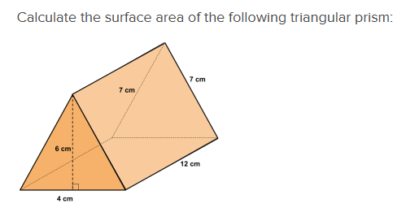
Try It!

Slide 45
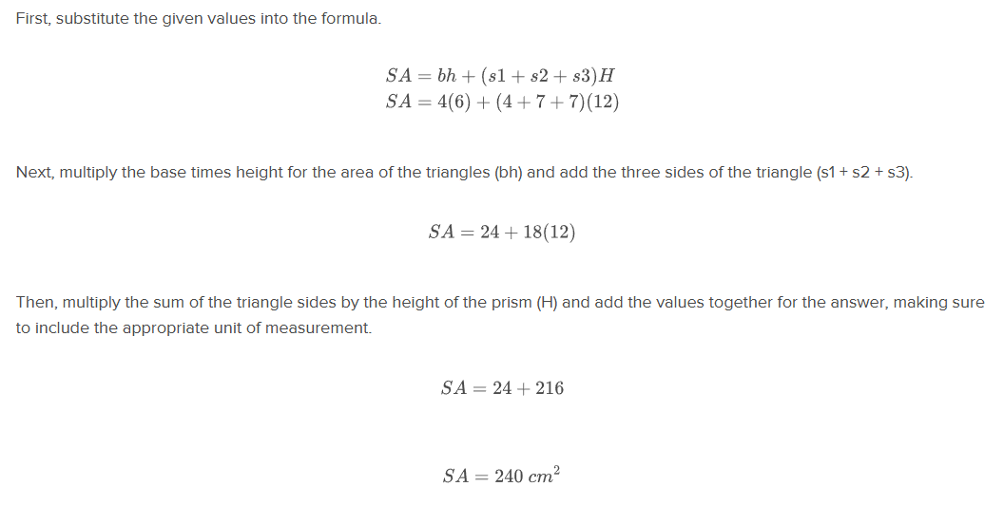
Solution

Slide 46
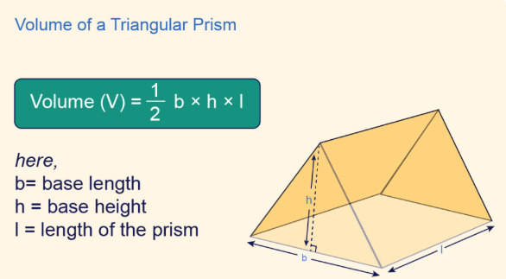
Volume of a Triangular Prism
The volume of a triangular prism is the amount of space it takes up in three-dimensional space. To find the volume, we multiply the area of the triangular base by the length of the prism. Since the base is a triangle, its area is found using the formula for the area of a triangle.
The formula for the area of a triangle is:
Area= ½ x base x height
This simple formula allows for easy calculation of the area of any triangle, providing a foundational concept in geometry and mathematics.

Slide 47
Example #1
Find the volume of a triangular prism with a base length of 8 units, a height of 5 units, and a length of 12 units.

Slide 48
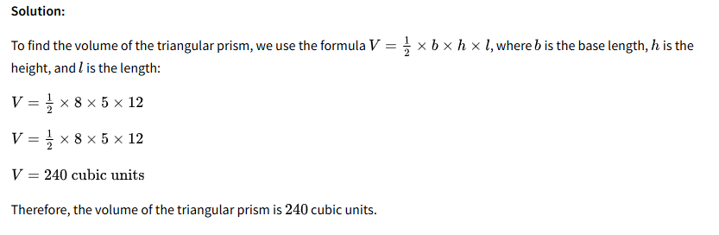
Solution

Slide 49
Example 2
Calculate the surface area of a triangular prism with a base area of 15 square units, a length of 8 units, and a perimeter of the base as 20 units.

Slide 50
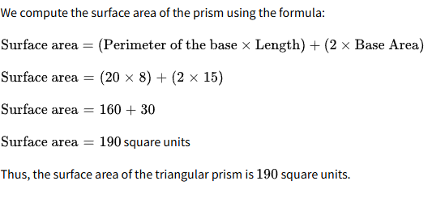
Solution

Slide 51
Example 3
Find the volume of a triangular prism with a base area of 35 c𝑚2 and a length of 12 cm.

Slide 52
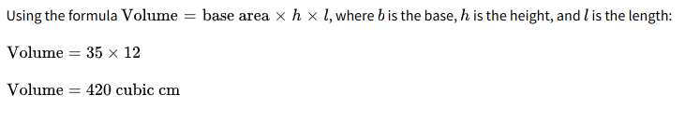
Solution

Slide 53
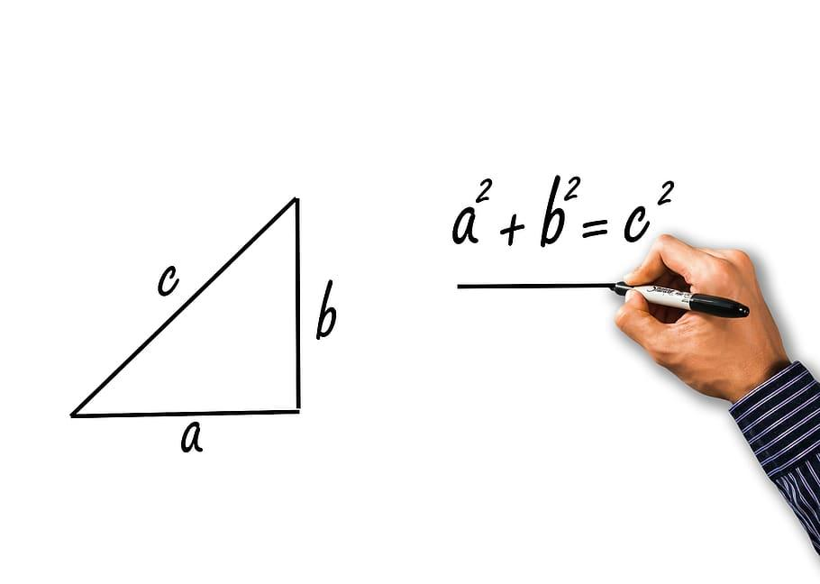
Pythagorean Theorem

Slide 54
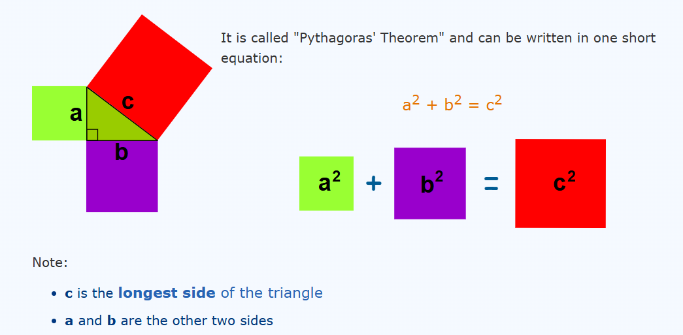

Slide 55
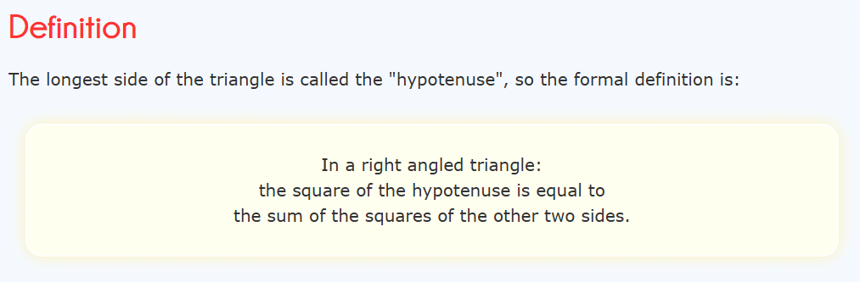

Slide 56
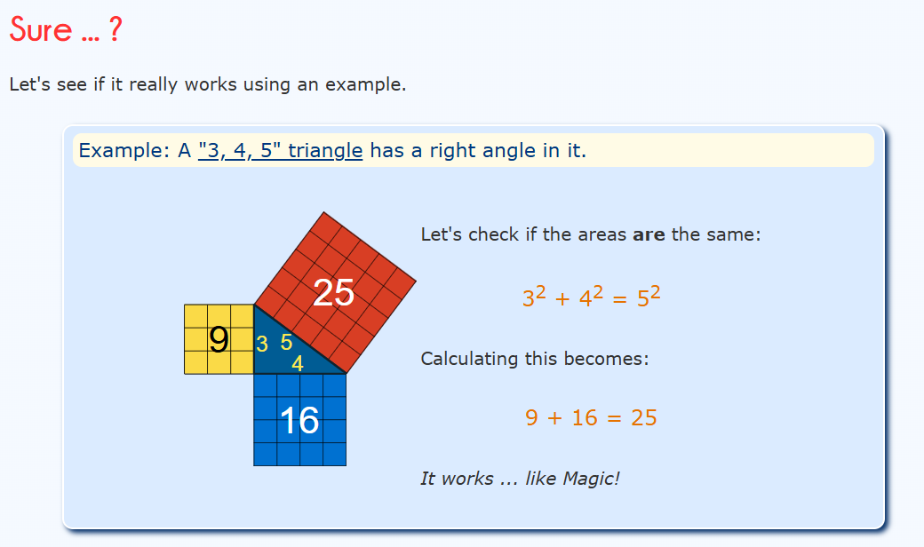

Slide 57
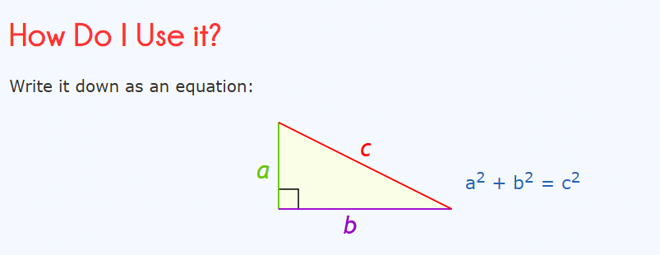

Slide 58
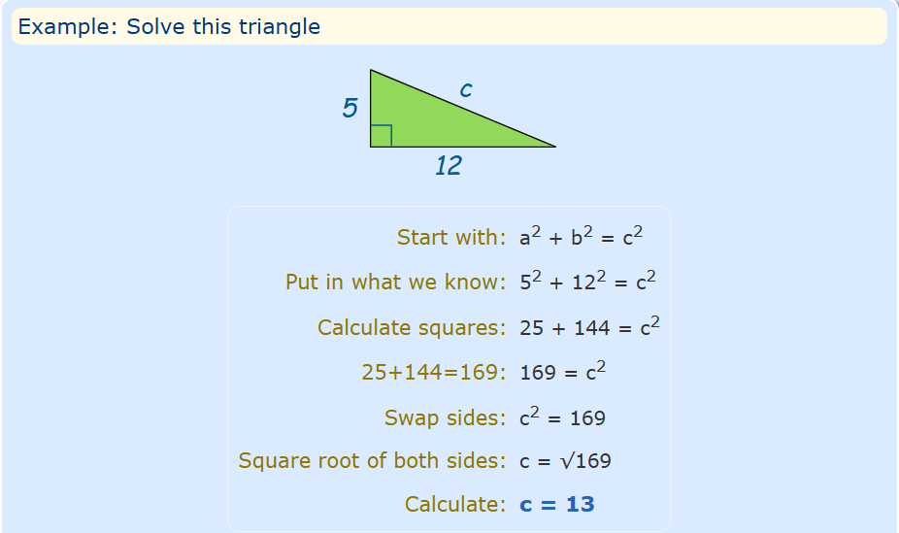

Slide 59
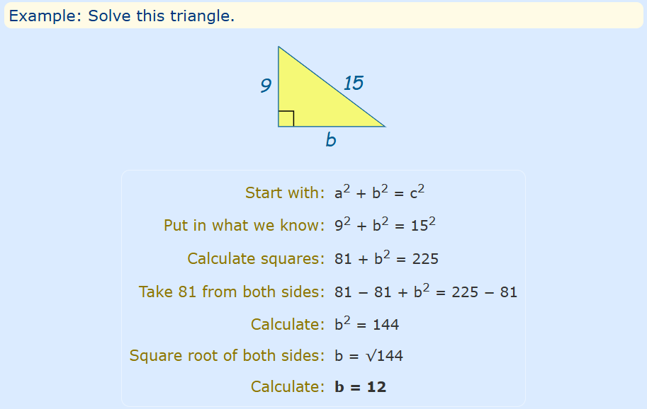

Slide 60
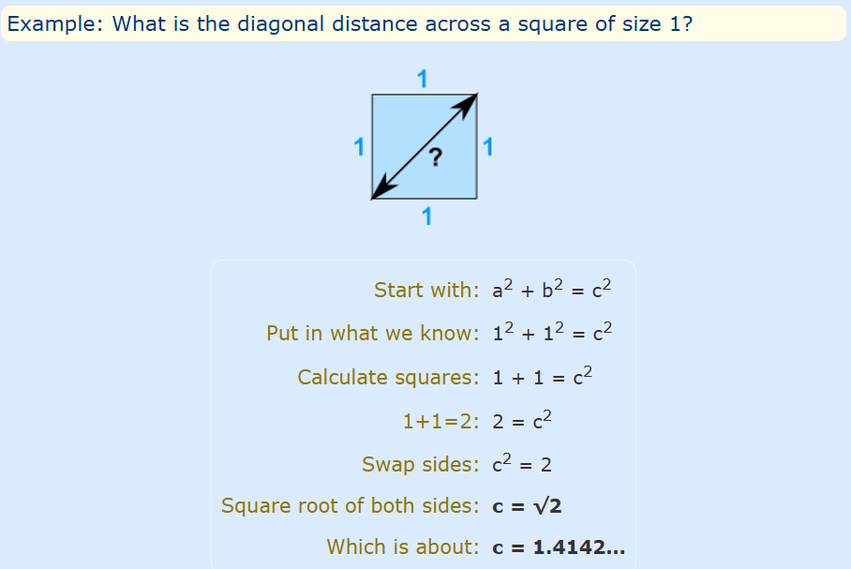

Slide 61
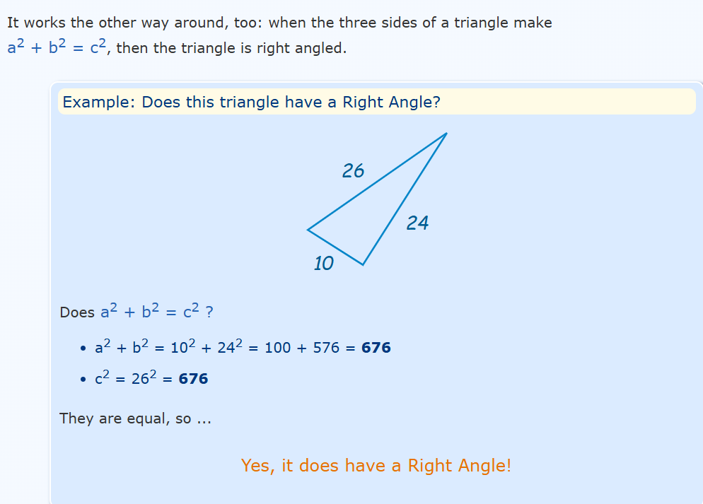

Slide 62
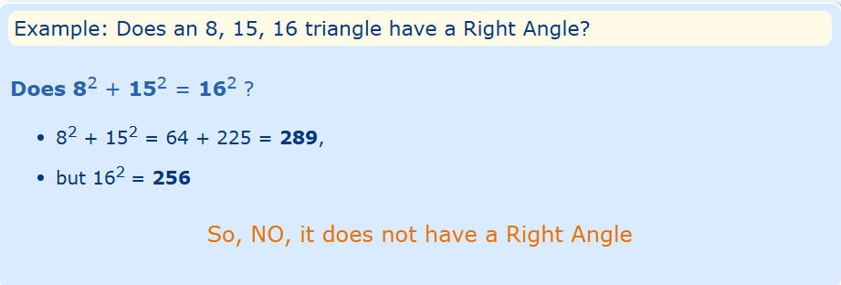

Slide 63
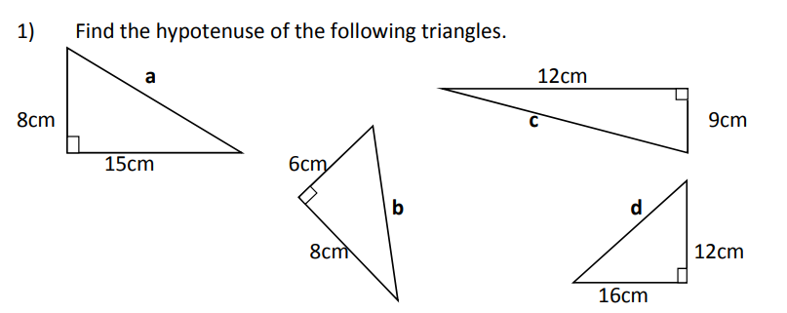
Homework

Slide 64
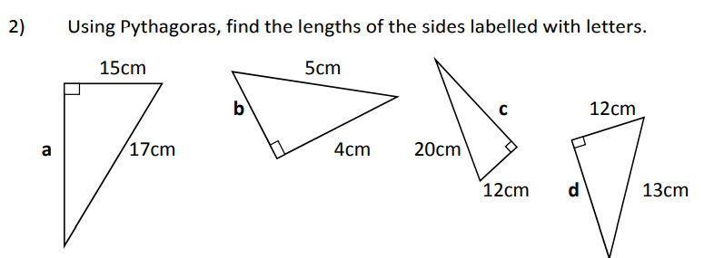

Slide 65
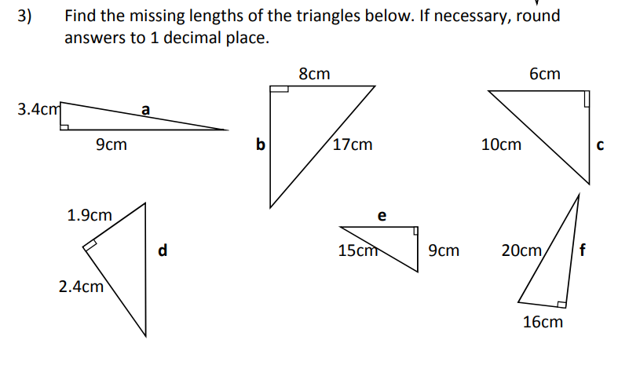

Slide 66
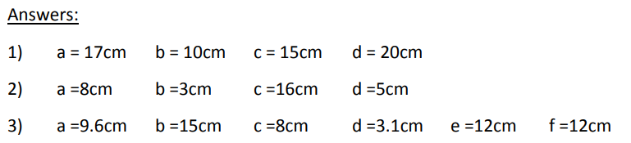

Slide 67
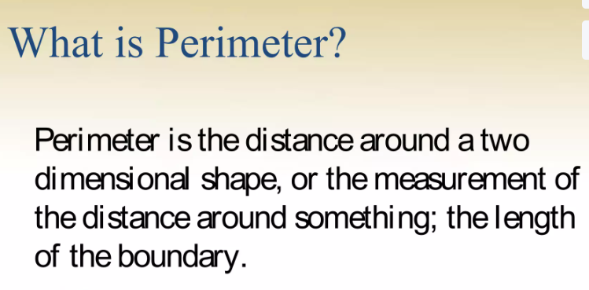
Perimeter

Slide 68
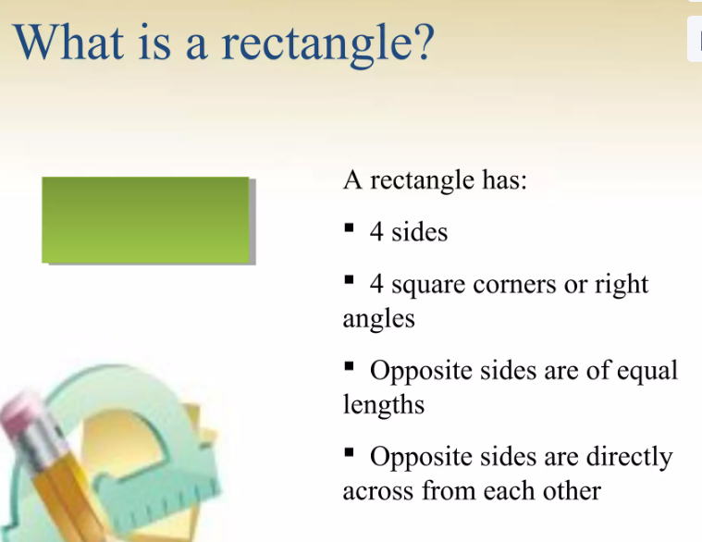

Slide 69
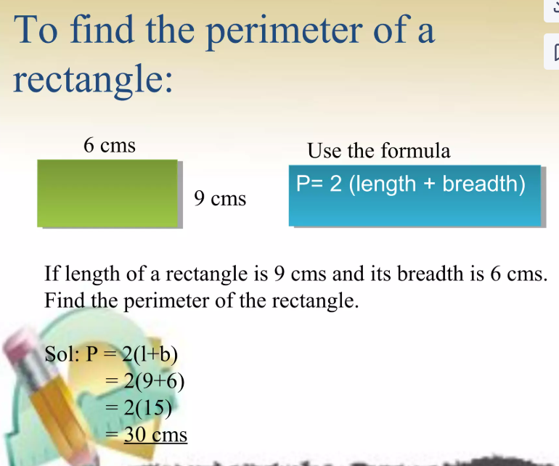

Slide 70


Slide 71


Slide 72


Slide 73


Slide 74


Slide 75
Circumference of a Circle

