Slide 1
MATH SUBJECT FOR ELEMENTARY FRACTIONS
7TH GRADE

Slide 2
Overall Expectation - Strand B, Number
B1 Number Sense: Understanding numbers in daily life
B2 Operations: Applying operations in real-world math problems
https://www.dcp.edu.gov.on.ca/en/curriculum/elementary-mathematics/grades/g7-math/strand-b/b2

Slide 3
Specific Expectations
Number Sense
B1.1: Rational numbers (positive/negative)
B1.4: Equivalencies among fractions, decimals, percentages
Operations
B2.1: Properties and order of operations
B2.2: Recall common fractions, decimals, percentages
B2.3: Mental math strategies
B2.5: Addition and subtraction of fractions
B2.6: GCF and LCM in simplifying fractions
B2.8: Multiply and divide fractions

Slide 4
Unit Plan Overview
This unit is designed to build a solid understanding of fractions. Students will work with fractions in various contexts, including simplifying, comparing, adding, subtracting, multiplying, and dividing fractions. They will also explore real-world applications and solve problems involving fractions. The unit culminates in a project-based assessment to demonstrate their mastery of fraction operations.

Slide 5
Learning Objectives
By the end of this lesson, students will be able to:
Identify factors and multiples
Classify rational numbers
Convert between fractions (proper, improper, mixed)
Simplify fractions using GCF and LCM
Convert fractions to decimals and percentages
Perform fraction operations (add, subtract, multiply, divide)
Apply BEDMAS
Demonstrate proportional reasoning

Slide 6
Success Criteria
Students succeed when they:
Explain concepts clearly
Independently perform operations
Solve real-world fraction problems
Complete quizzes, tests, and presentations

Slide 7
Materials
Fraction manipulatives
Worksheets, practice problems
Calculators (optional)
Textbooks
Digital tools (research, presentations)
Assessment rubrics

Slide 8
Culminating Activities
Fraction Recipe Book: Convert measurements, scale recipes
Fraction Art: Visual representations using fractions
Real-World Fraction Problems: Practical applications research

Slide 9
Unit Plan Document
Unit Plan - Fractions

Slide 10
TABLE OF CONTENTS
01
Review: Factors
02
Rational Numbers, Positive & Negative Numbers
03
Proper, Improper, & Mixed Fractions

Slide 11
TABLE OF CONTENTS
04
Equivalent Fractions, Simplifying Fractions, LCM & GCF
05
Convert Fractions to Percentages & Decimals
06
Comparing Fractions

Slide 12
TABLE OF CONTENTS
07
Generating Fractions
08
Mental Math
09
Adding & Subtracting Fractions

Slide 13
TABLE OF CONTENTS
10
Multiply & Divide Fractions
11
Operations & BEDMAS
12
Proportional Reasoning, Ratios, & Rates

Slide 14
WHOA!
Welcome to our unit on fractions! Fractions are not just abstract numbers; they are essential building blocks in understanding and mastering math in both the classroom and the real world. From cooking to shopping, from building to budgeting, fractions are everywhere.

Slide 15
INTRODUCTION
Let’s Review from Last Year

Slide 16
Understanding Factors
A factor of a number is a whole number that divides that number evenly, meaning there is no remainder left over.
When we talk about factors, we only use positive whole numbers. This means factors cannot be fractions or decimals. Also, 0 cannot be a factor of any number because you cannot divide by 0.
To find out if a number ( x ) is a factor of another number ( n ), you can divide ( n ) by ( x ). If the result leaves a remainder of 0, then ( x ) is a factor of ( n ). If there is a remainder, then ( x ) is not a factor of ( n ).

Slide 17
Key Points
Definition of Factors: Factors are numbers that multiply together to produce another number.
Factor Pairs: Every number has pairs of factors (e.g., factors of 12 are 1 and 12, 2 and 6, 3 and 4).
Common Factors: Numbers that are factors of two or more numbers.
Prime Factors: Factors that are prime numbers (numbers greater than 1 that only have two factors: 1 and itself).

Slide 18
Examples of Factors
Let’s take the number 12 as an example. The factors of 12 are the whole numbers that can divide 12 evenly.
Factors of 12:
1 (because 12÷1=12 with no remainder)
2 (because 12÷2=6 with no remainder)
3 (because 12÷3=4 with no remainder)
4 (because 12÷4=3 with no remainder)
6 (because 12÷6=2 with no remainder)
12 (because 12÷12=1 with no remainder)
So, the factors of 12 are: 1, 2, 3, 4, 6, and 12.

Slide 19
Another Example
Factors of 15
1 (because 15÷1=15 with no remainder)
3 (because 15÷3=5 with no remainder)
5 (because 15÷5=3 with no remainder)
15 (because 15÷15=1 with no remainder)
So, the factors of 15 are: 1, 3, 5, and 15.

Slide 20
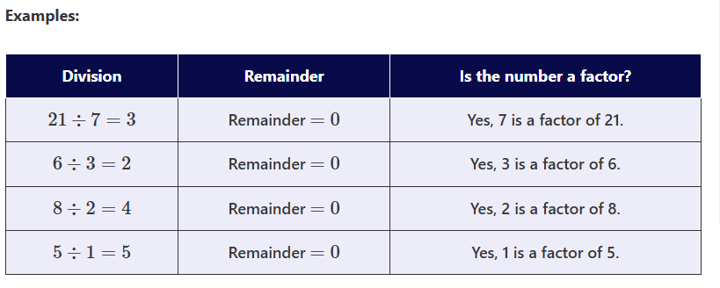

Slide 21
Remember…
We know that division and multiplication are inverse operations (opposite operations). Thus, we can also define factors in math in terms of multiplication.
If we can express the given number as the product of two positive integers, then both the integers are factors of the given number.
A general formula to remember is that a and b are factors of the product ab.

Slide 22
Finding Factors for Larger Numbers
To find the factors of larger numbers, you can follow these steps:
Start with 1 and the Number Itself: Every number has at least two factors: 1 and the number itself. For example, for the number 36, we start with 1 and 36.
Divide the Number: Begin dividing the number by whole numbers starting from 1 up to the square root of that number. The square root is chosen because if a number can be divided evenly by a larger number, it must also be divisible by a smaller number.
Check for Remainders: For each whole number x that you try dividing into the larger number
n, check if there is a remainder:
  If n÷x gives a remainder of 0, then x is a factor.
  Record both x and n ÷x as factors.
Continue Until You Reach the Square Root: Keep dividing by whole numbers until you reach the square root of the number. This will ensure you find all factor pairs.

Slide 23
Example: Find the Factors for 36
Start with 1 and 36.
Check divisibility:
  36÷1=36 (factors: 1 and 36)
  36÷2=18 (factors: 2 and 18)
  36÷3=12 (factors: 3 and 12)
  36÷4=9 (factors: 4 and 9)
  36÷5 is not a whole number (not a factor).
  36÷6=6 (factors: 6 and 6)
Stop when you reach the square root (approximately 6).
Final List of Factors for 36: 1, 2, 3, 4, 6, 9, 12, 18, and 36.

Slide 24
You Try!
Find the factors of 10.

Slide 25
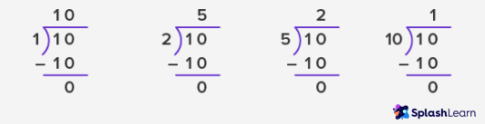
The factors of 10 are…
Any number that does not have a remainder!

Slide 26
Properties of Factors
The smallest factor of any number is 1.
The largest factor of any number is the number itself.
All integers have a finite number of factors.
A factor is always less than or equal to the number; it can never be bigger than the number.
Except for 0 and 1, every integer has a minimum of two factors: 1 and the number itself.

Slide 27
Factor Pairs
A factor pair refers to the pair of integers that, when multiplied together, give us the required number. Factor pairs of a number do not include fractions.
As mentioned earlier, we only consider positive factors when we study or list the factors of a number. However, the concept of factor pairs includes both positive and negative integers.
For every positive factor pair, we have a corresponding negative factor pair, since the product of two negative integers is always positive.

Slide 28
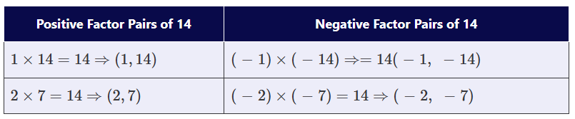
Factor Pairs

Slide 29
Different Types of Factors
Prime Factors: The factors of a number which are also prime numbers are called Prime factors. Prime numbers are numbers that have only two factors, 1 and the number itself.
For example, the factors of 6 are 1, 2, 3, and 6. Out of these, the prime factors of 6 are 2 and 3.

Slide 30
Different Types of Factors
Common Factors: Common factors of two numbers are the factors common to (or shared by) both the numbers.
Factors of 4: 1, 2, 4
Factors of 6: 1, 2, 3, 6
Common factors of 4 and 6: 1, 2
Greatest Common Factor: The greatest number among the common factors identified between the two numbers is called the Greatest Common Factor (GCF). In the previous example, the common factors of 4 and 6 are 1 and 2. The GCF is 2.

Slide 31
Prime Factorization
When we write a number as a product of all its prime factors, it is called prime factorization. Every number in prime factorization is a prime number. To write the number as a product of prime factors, sometimes we might have to repeat the factors too.
Example 1: To write the prime factorization of 8, we can write
8=2×2×2
The prime factor 2 is repeated three times.
Example 2: Prime factorization of 30
30 = 2 x 3 x 5

Slide 32
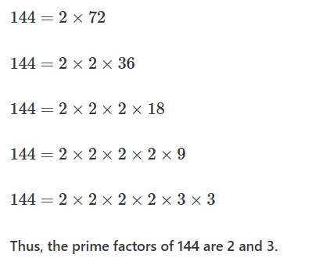
Let’s Try it
Find the prime factors of 144.
Let’s start dividing 144 by the smallest possible prime factor: 2.

Slide 33
02
Rational, Positive, and Negative Numbers
Understand rational numbers and explore both positive and negative values.

Slide 34
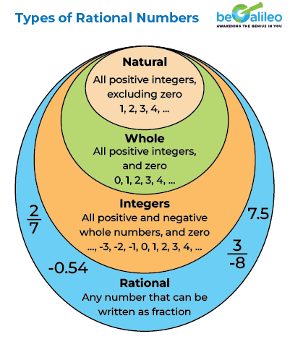
What are Rational Numbers?
They are numbers that can be written as fractions.
Examples:
½
¾
5
⅛
⅕

Slide 35
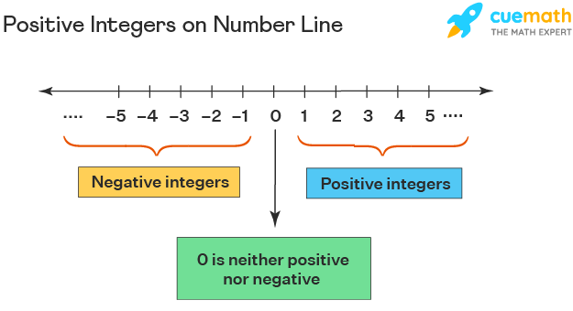
Positive Numbers
Positive numbers are any number greater than 0. These are sometimes called positive integers.
Remember, integer is another way to say number.

Slide 36
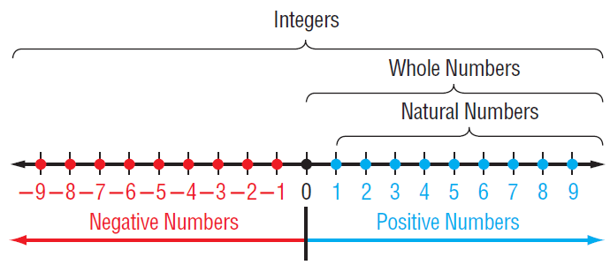
Visualizing Negative Fractions
Easy to Remember:
Negative fractions are less than zero.
They go on the left side of zero on a number line.
The negative fraction closest to zero is the largest.

Slide 37
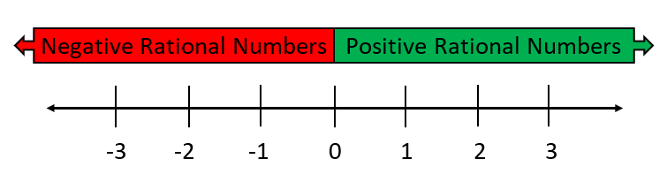
Number Line Activity
Let’s place ½ on the number line.

Slide 38
Number Line Activity
Why did we place ½ in between 0 and 1?
½

Slide 39
Your Turn
Draw a number line on your notebook.
Place the following numbers on the line: ¾ -½, 1 ½, -1 ¼.

Slide 40
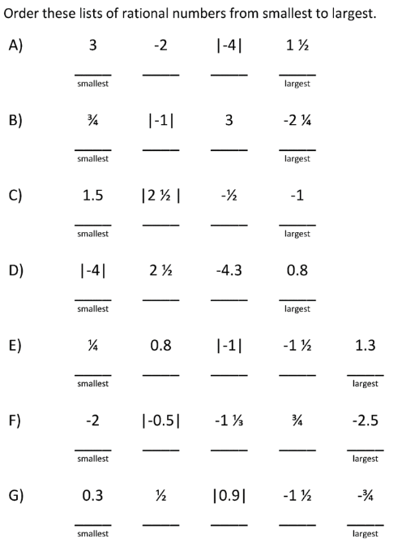
Group Work
Quietly, and in small groups, work on the questions here:
You can place them on a number line to help you.

Slide 41
03
IMPROPER FRACTIONS AND MIXED NUMBERS
Understanding the Relationship and Conversion Between
Improper Fractions and Mixed Numbers

Slide 42
WHAT ARE YOU GOING TO LEARN?
By the end of this lesson, students will be able to:
Define improper fractions and mixed numbers.
Convert improper fractions to mixed numbers and vice versa.
Solve real-world problems involving improper fractions and mixed numbers.

Slide 43
Math Cap!
Look at these fractions:
🟠 ¾
🔵 5/5
🟢 1 ⅔
💬 Can you guess what type of fraction each one is?
→ Share your thinking with the class!

Slide 44
Match the Fraction to the Term
¾
11/5
2 ½
Mixed Fraction
Improper Fraction
Proper Fraction

Slide 45
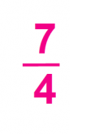
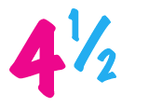
DEFINE CONCEPTS
IMPROPER FRACTIONS
MIXED NUMBERS
A fraction where the numerator (top number) is greater than or equal to the denominator (bottom number).
A number consisting of a whole number and a proper fraction.

Slide 46
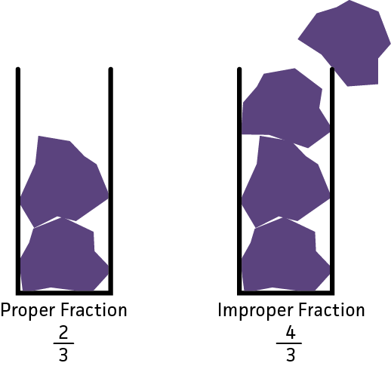
Converting Improper Fractions
Step-by-step Guide

Slide 47
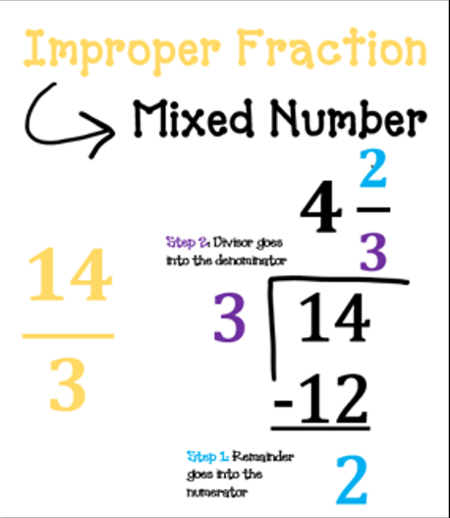
Long Division
Long Division involves dividing the numerator (the top number of the fraction) by the denominator (the bottom number).

Slide 48
IMPROPER FRACTION TO MIXED NUMBER
STEP 1
STEP 2
STEP 3
Divide the numerator by the denominator.
Multiply the denominator by the result from the division. This is the quotient (whole number).
Subtract the result from the numerator. This is the remainder.

Slide 49
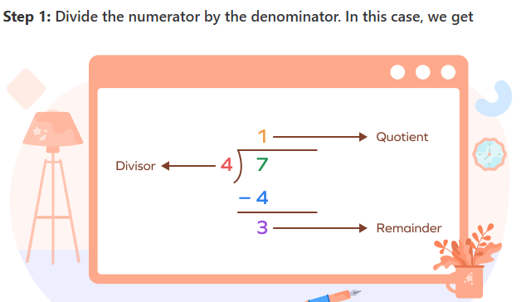
Example
Let’s try converting an improper fraction to a mixed number:
7
4
The QUOTIENT is the whole number.

Slide 50
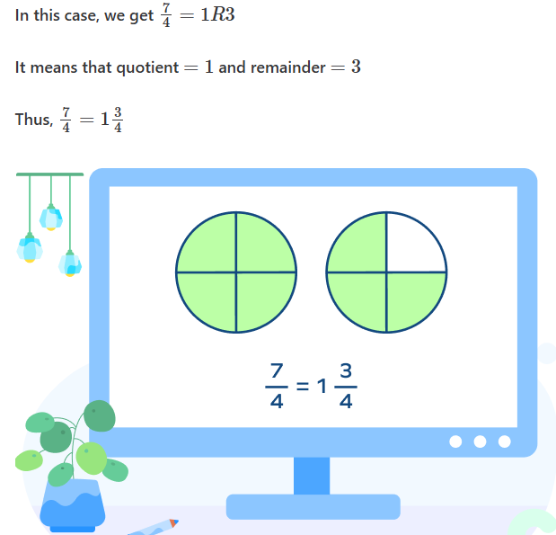
Step 2: Note down the quotient and remainder. The quotient acts as the whole number part of the mixed number. The remainder is the new numerator. The denominator stays the same.
In simple words, write the mixed number in the form:
Quotient remainder
divisor

Slide 51
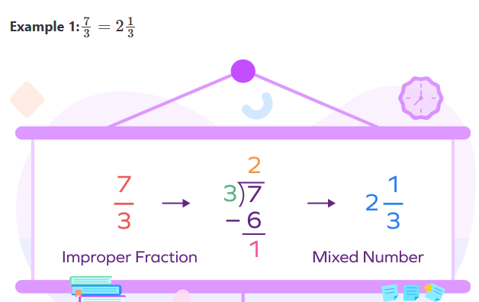
Example 2

Slide 52
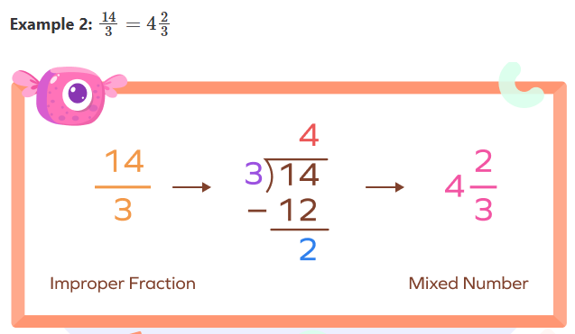
Example 3

Slide 53
Independent Practice
    Convert 13/5 to a mixed number.
    Convert 19/7 to a mixed number.
    Convert 22/4 to a mixed number.
    Convert 29/8 to a mixed number.

Slide 54
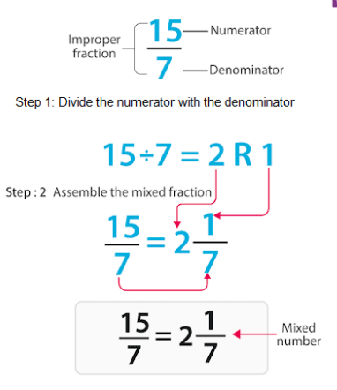
Let’s Review the Steps
Step 1: Divide the numerator by the denominator to get the whole number.
Step 2: Multiply the denominator by the result and subtract to find the remainder.
Step 3: The remainder becomes the numerator of the fraction, and the denominator stays the same.

Slide 55
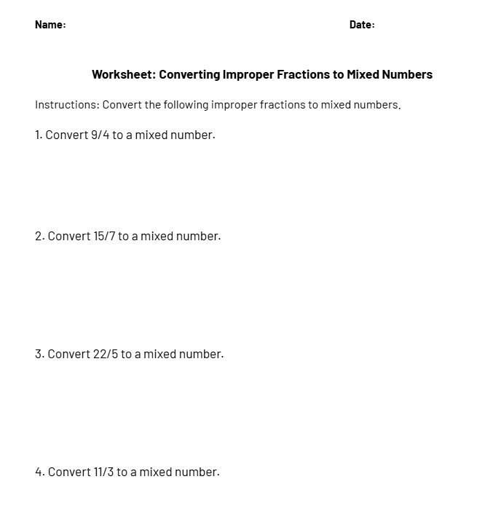
Homework
Complete the given worksheet on converting improper fractions to mixed numbers for tomorrow.

Slide 56
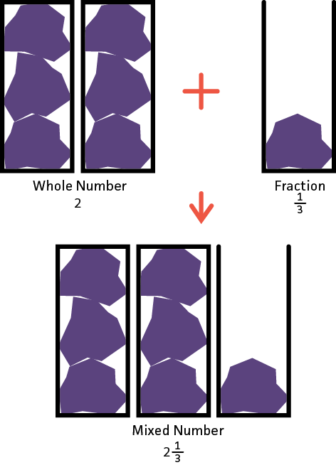
Mixed Fractions

Slide 57

Learning Goals
Students will be able to:
What mixed fractions are,
How to convert mixed fractions,
How to simplify mixed fractions.

Slide 58
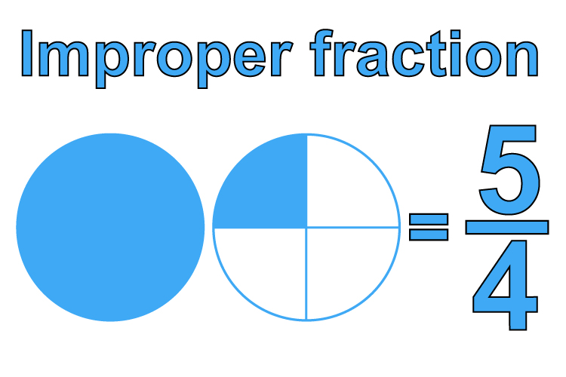
Let’s Review Improper Fractions
Improper fractions happen when the numerator is bigger than the denominator.
We can fix an improper fraction by converting it into a mixed fraction: whole parts + a proper fraction.

Slide 59
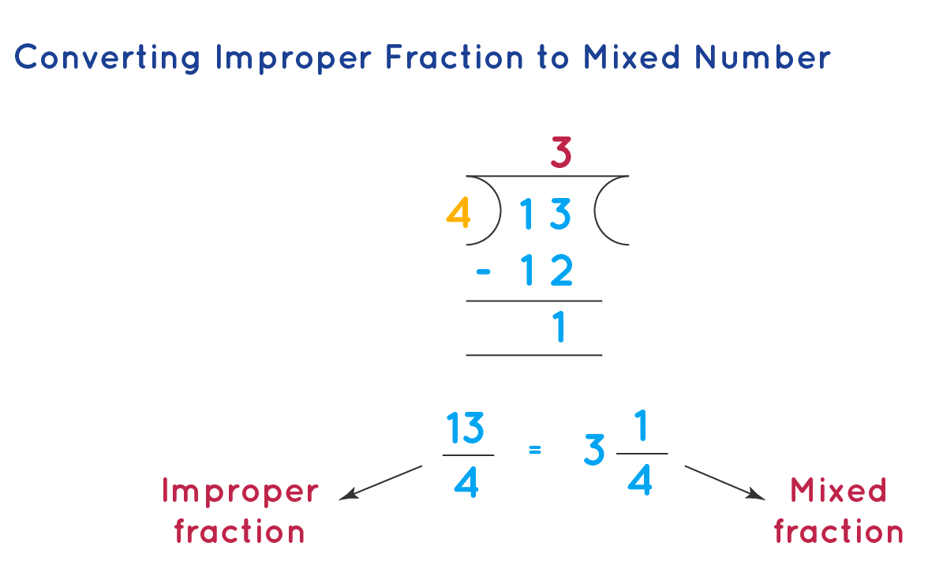
Let’s Review How to Convert Improper Fractions
When we divide fractions, we get a whole number (quotient) and a remainder.
The whole number becomes the whole part of the mixed fraction, and the remainder becomes the numerator.
The divisor (the number we divide by) becomes the denominator of the fraction part of the mixed number.

Slide 60
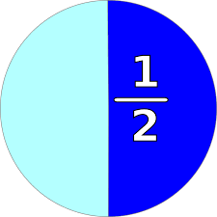
What is a mixed fraction?
A mixed fraction (or mixed number) is a whole number combined with a fraction. It represents a quantity that is greater than one but not a whole number. For example, 2 ½ is a mixed fraction.
It means 2 whole parts and ½ of another part.
Example of a Mixed Fraction:
  2 ½ means you have 2 whole parts and ½ of another part.
1
2

Slide 61
Let’s Try
Write the Mixed Fraction based on the Image Below

Slide 62
Let’s Try
Write the Mixed Fraction based on the Image Below
= 2 ¾
1 + 1 + ¾

Slide 63
Try again
What is the mixed fraction in this example?

Slide 64
Try again
What is the mixed fraction in this example?
1 + 6/8
= 1 6/8

Slide 65
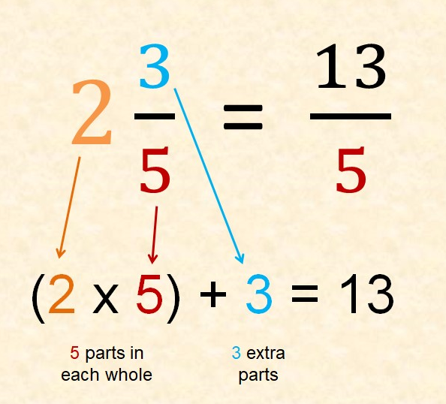
How to convert a mixed fraction?
Step 1: Multiply the whole number by the denominator of the fraction.
Step 2: Add the result to the numerator of the fraction.
Step 3: The denominator stays the same.

Slide 66
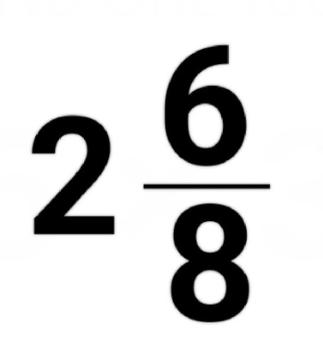
Let’s Try Converting Together
What do we do first?

Slide 67
Let’s Try Converting Together
First, we need to convert it into an improper fraction.
How?

Slide 68
Let’s Try Converting Together
We need to multiply the denominator by the whole number.
2 x 8 = 16

Slide 69
Let’s Try Converting Together
Then, we add the numerator to that number:
2 x 8 = 16
16 + 6 = 22

Slide 70
Let’s Try Converting Together
We rewrite it as a fraction, keeping the denominator the same.
22
8

Slide 71
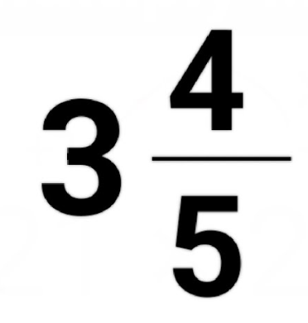
You Try!
Convert the following mixed fraction into an improper fraction.

Slide 72
You Try!
Step 1: multiply the denominator by the whole number
3 x 5 = 15
Step 2: add the numerator to that number
15 + 4 = 19
Step 3: keep the denominator the same and rewrite the fraction
19
5

Slide 73
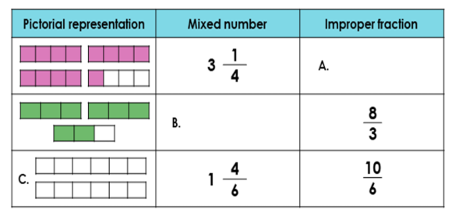
Challenge: Complete the Table

Slide 74
Challenge: Complete the Table
13 /4
2 ⅔

Slide 75
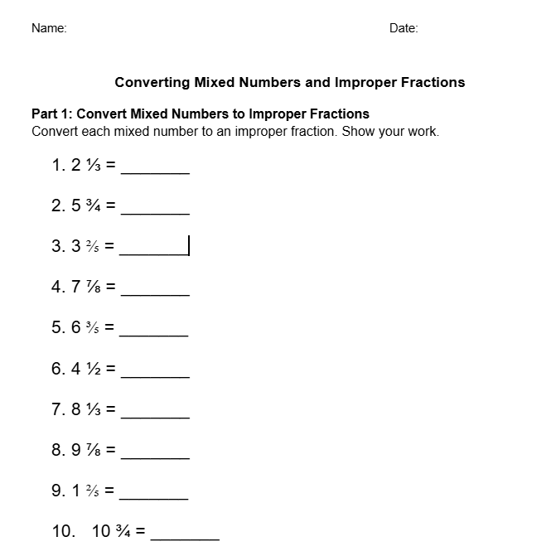
Homework
Complete the worksheet on converting mixed fractions and improper fractions.

Slide 76
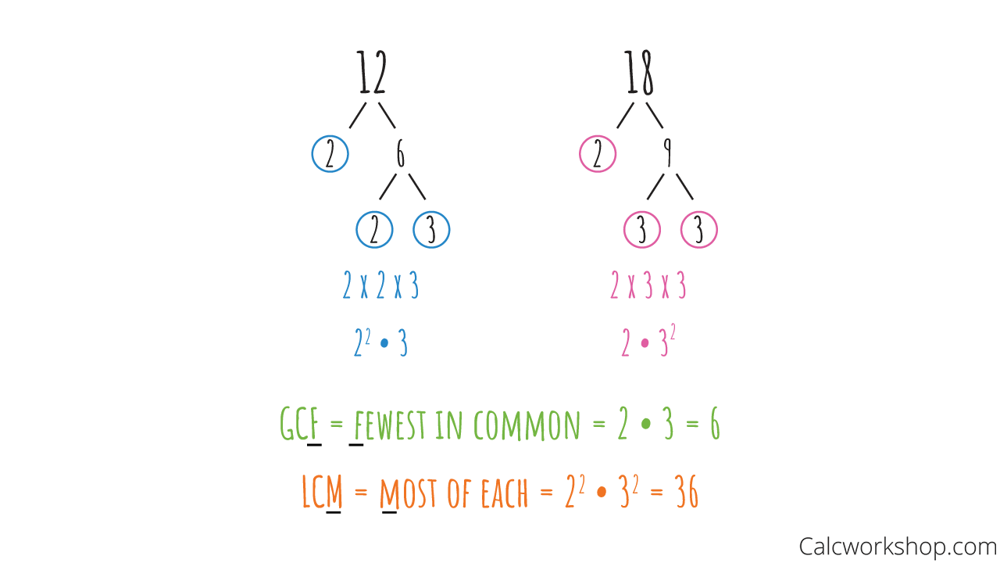
GCF & LCM
Finding the GCF & LCM

Slide 77
Review
What is the simplest form for the following fraction:
18
24
3 6 4.5 9
4 8 6 12

Slide 78
Let’s Solve it Together
Step 1 - Find the GREATEST COMMON FACTOR of 18 and 24.
*This means we need to find the largest number that can be divided easily by both 18 and 24.
The factors of 18 are: 1, 2, 3, 6, 9, 18
The factors of 24 are: 1, 2, 3, 4, 6, 8, 12, 24
The greatest common factor is: ?

Slide 79
Let’s Solve it Together
Step 1 - Find the GREATEST COMMON FACTOR of 18 and 24.
*This means we need to find the largest number that can be divided easily by both 18 and 24.
The factors of 18 are: 1, 2, 3, 6, 9, 18
The factors of 24 are: 1, 2, 3, 4, 6, 8, 12, 24
The greatest common factor is: 6.

Slide 80
Now that we have the Greatest Common Factor, we need to divide the numerator and the denominator by 6.
18 18 ÷ 6 3
= =
24 24 ÷ 6 4
Therefore, the simplest form of 18/24 is ¾.

Slide 81
Let’s Review Some Vocabulary
Fraction: A number expressed as the quotient of two integers, where the numerator is divided by the denominator (e.g., ¾ .
Numerator: The top part of a fraction that represents how many parts are being considered (e.g., in ¾ , 3 is the numerator).
Denominator: The bottom part of a fraction that shows how many equal parts the whole is divided into (e.g., in ¾ ​, 7 is the denominator).
Proper Fraction: A fraction where the numerator is smaller than the denominator (e.g., ¾ ).
Improper Fraction: A fraction where the numerator is equal to or larger than the denominator (e.g., 7/3).
Mixed Number: A whole number combined with a proper fraction (e.g., 2 ½ ).
Equivalent Fractions: Fractions that represent the same value (e.g., ½ and 2/4).

Slide 82
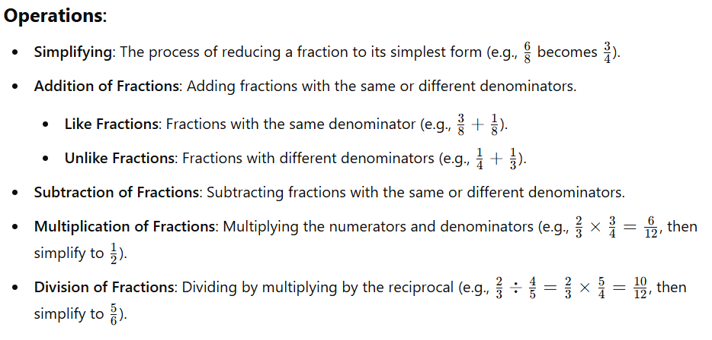
Let’s Review the Operations

Slide 83
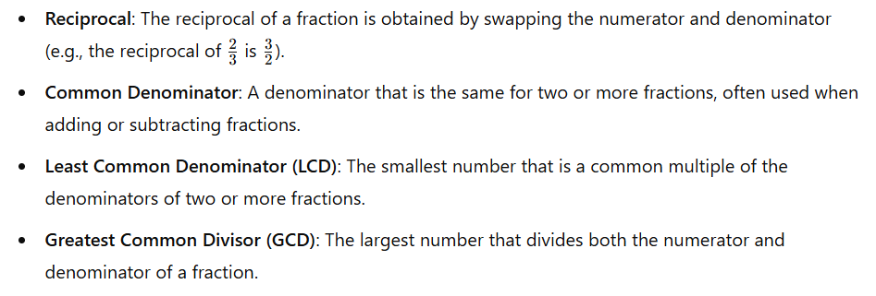
Properties of Fractions

Slide 84
So what’s the difference?
The Least Common Denominator is the smallest number that two or more denominators (bottom numbers in fractions) can both fit into evenly. It helps you add or subtract fractions.
How to find it: Find the smallest number that both denominators can divide into without leaving a remainder.
The Greatest Common Factor is the biggest number that can divide evenly into two or more numbers. It's used to simplify fractions or break numbers down into smaller pieces.
How to find it: Find the biggest number that both numbers share as a factor.

Slide 85
Let’s Practice
Find the Greatest Common Factor of the following numbers:
10 and 25
32 and 84
60 and 80
42 and 56
14 and 35
3 and 9
2 and 24

Slide 86
Let’s Practice
Find the Greatest Common Factor of the following numbers:
10 and 25 = 5
32 and 84 = 4
60 and 80 = 20
42 and 56 = 14
14 and 35 = 7
3 and 9 = 3
2 and 24 = 2

Slide 87
Find the Least Common Denominator
LCD of 5 and 15 =
LCD of 6 and 24 =
LCD of 10 and 60 =
LCD of 11 and 44 =
LCD of 12 and 60 =
LCD of 9 and 81 =
LCD of 2 and 8 =

Slide 88
Find the Least Common Denominator
LCD of 5 and 15 = 15
LCD of 6 and 24 = 24
LCD of 10 and 60 = 60
LCD of 11 and 44 = 44
LCD of 12 and 60 = 60
LCD of 9 and 81 = 81
LCD of 2 and 8 = 8

Slide 89
What are Equivalent Fractions?
Definition:
Equivalent fractions represent the same value
📌 Example:
1/2 = 2/4 = 4/8
🔍 Tip: Multiply or divide numerator and denominator by the same number

Slide 90
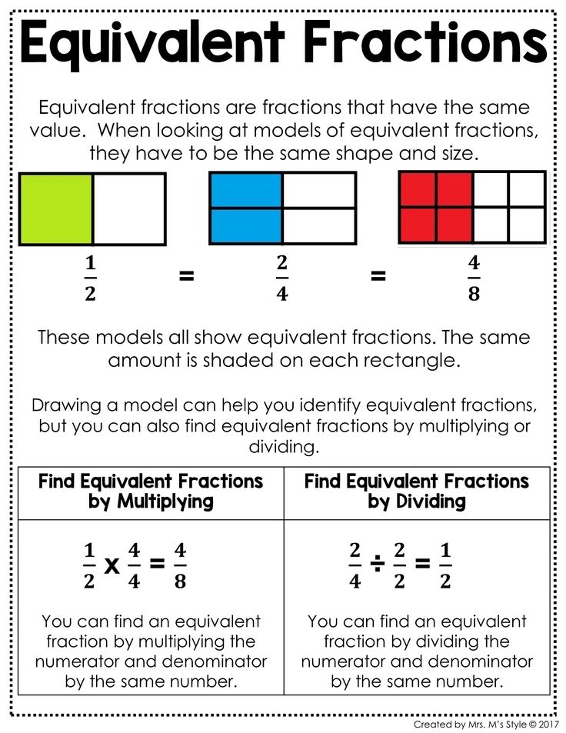

Slide 92
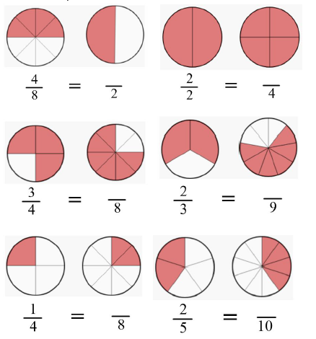
What are Equivalent Fractions?
Try finding the equivalent fractions.

Slide 93
What Does it Mean to Simplify?
Simplifying Fractions:
Divide both the numerator and denominator by the Greatest Common Factor (GCF)
📌 Example:
6/12 → GCF = 6 → 6 ÷ 6 / 12 ÷ 6 = 1/2
💡 Goal: Get the lowest terms!

Slide 94
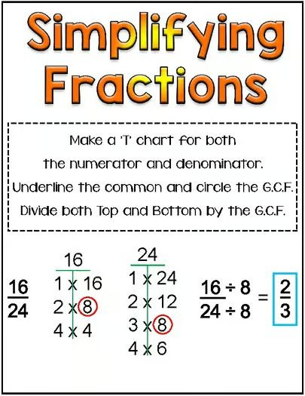
How can we simplify?
We first need to find the factors (multiples) of the numerator and denominator. We can do this by using a t-chart like the one here.

Slide 95
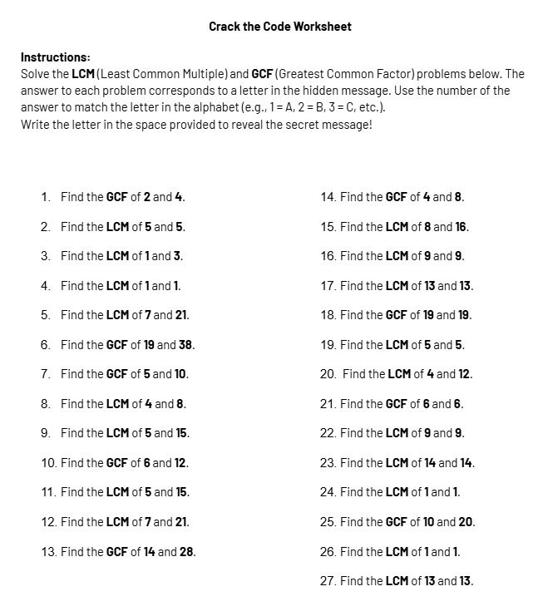
Homework
Complete the assigned worksheet on the LCM and GCF for tomorrow!
Good luck :)

Slide 96
05
Conversions
🎯 Learning Goal:
We will learn how to convert fractions into decimals and percentages using division and multiplication!

Slide 97
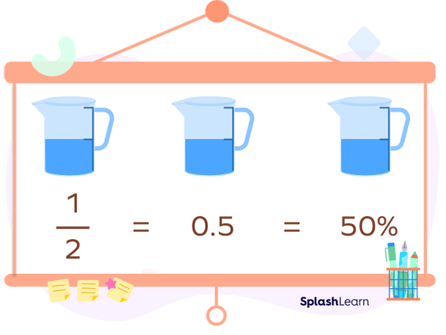
Math Caps!
💬 How do fractions and percentages help us understand parts of a whole?
→ Share ideas with a partner or group

Slide 98
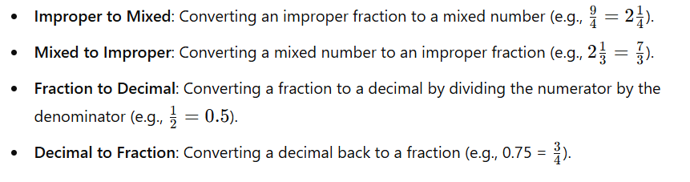
Let’s Review: Converting Fractions

Slide 99
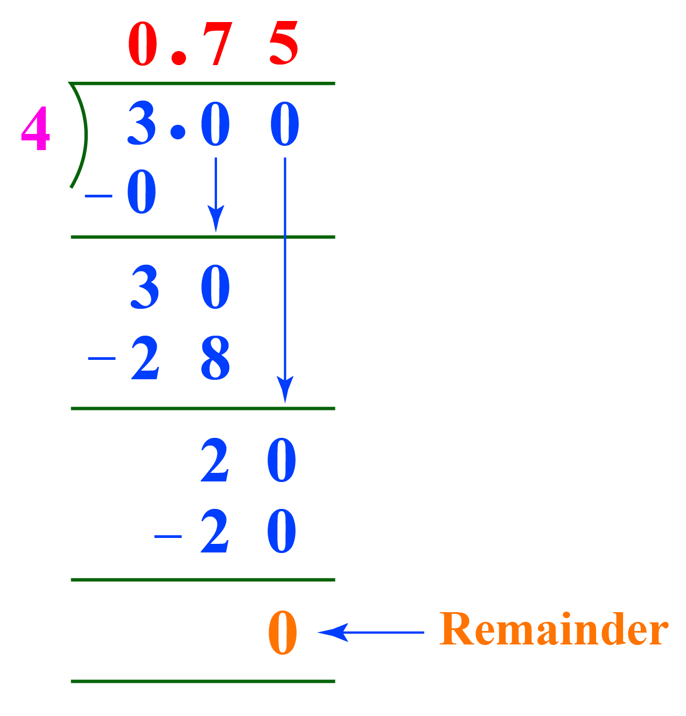
Fractions → Decimals
How do we convert a fraction to a decimal?
👉 Divide the numerator by the denominator.
📌 Example:
3/4 = 3 ÷ 4 = 0.75
💡 Use long division if needed!

Slide 100
Let’s Break it Down
What Is 3/4 As a Decimal?
The word "Decimal" is derived from the Latin word Decimus which means one-tenth. The decimal system has base 10
1/10 as a decimal means 0.1 and 1/100 represents 0.01
When we convert a fraction into decimal form, we convert it into a number that has a denominator 1. So, the numerator takes a form that has a decimal point in it.
The decimal form of
¾ is 0.75

Slide 101
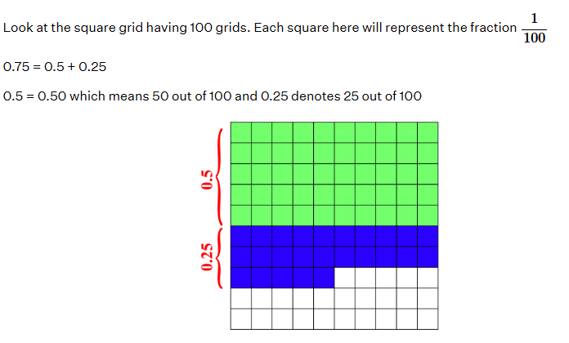
Let’s Visualize It

Slide 102
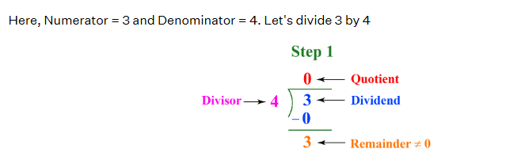
So, how do we change ¾ as a decimal?
The fraction ¾ can be converted to a form with denominator 1 by finding its decimal form.
Method 1: Long Division

Slide 103
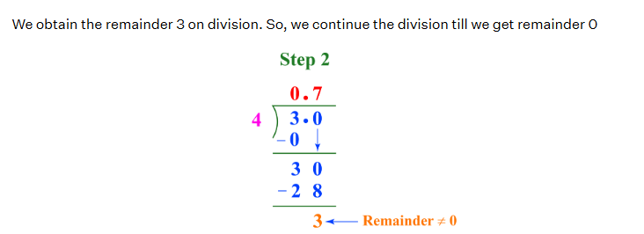
We add a decimal point, then a 0 so we can keep going until the remainder is 0.

Slide 104
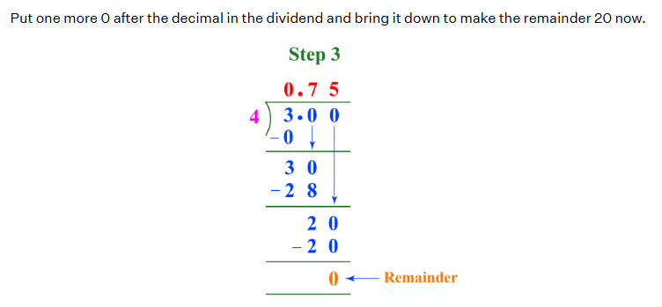

Slide 105
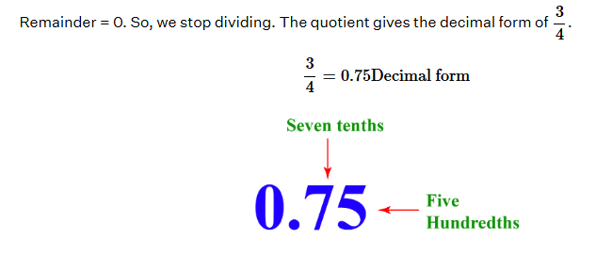
We stop dividing when our remainder is 0.

Slide 106
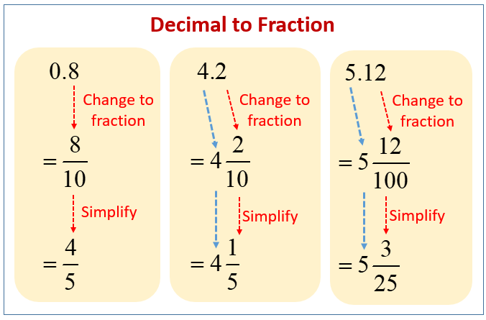
Decimals → Fractions
But what if we have decimals and need a fraction?
First, we need to remember place value.
This will help us when we write out the fractions.

Slide 107
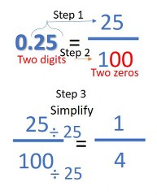
Let’s Try
We need to convert 0.25 into a fraction.
Looking at place value, we need to make the denominator 100.

Slide 108
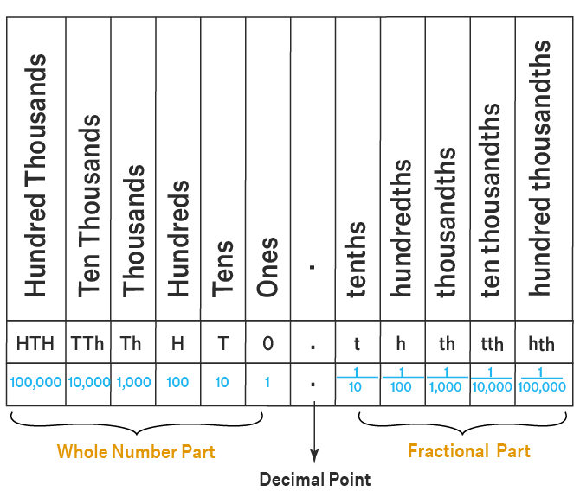
Why is it 100?
Our decimal is 0.25.
If we look at our chart, two spaces after the decimal is the hundredths column.

Slide 109
Let’s Try another Example
Convert 0.72 to a fraction.
Step 1: First, we divide the decimal number by 1.
→ 0.72
1
Step 2: For every decimal point in the numerator, we add a zero to the denominator. Or, multiply it by the factor of 10.
→ 0.72
100
Step 3: Multiply the numerator by same factor of 10. In this case, 100. Then, rewrite the fraction.
→ 72
100

Slide 110
Let’s Try another Example
Now that we have converted into a fraction, we need to simplify.
→ 72 / 100
Find the GCF of 72 and 100.
Factors of 72: 1, 2, 3, 4, 6, 8, 9, 12, 18, 24, 36, 72
Factors of 100: 1, 2, 4, 5, 10, 20, 25, 50, 100
Common factors: 1, 2, 4
✅ GCF = 4

Slide 111
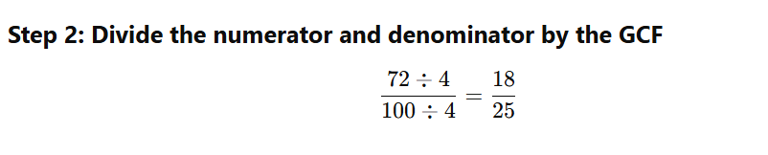
Let’s Try another Example

Slide 112
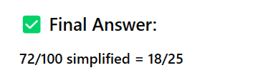
Let’s Try another Example

Slide 113
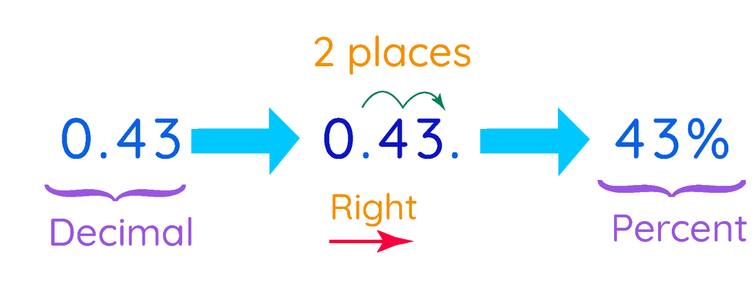
Decimal → Percent
Understanding Percentages:
A percentage represents a part of a whole, where the whole is considered to be 100.

Slide 114
Decimal → Percent
To convert a decimal to a percentage, multiply the decimal by 100, which is the same as moving the decimal point two places to the right, and then add the "%" symbol.

Slide 115
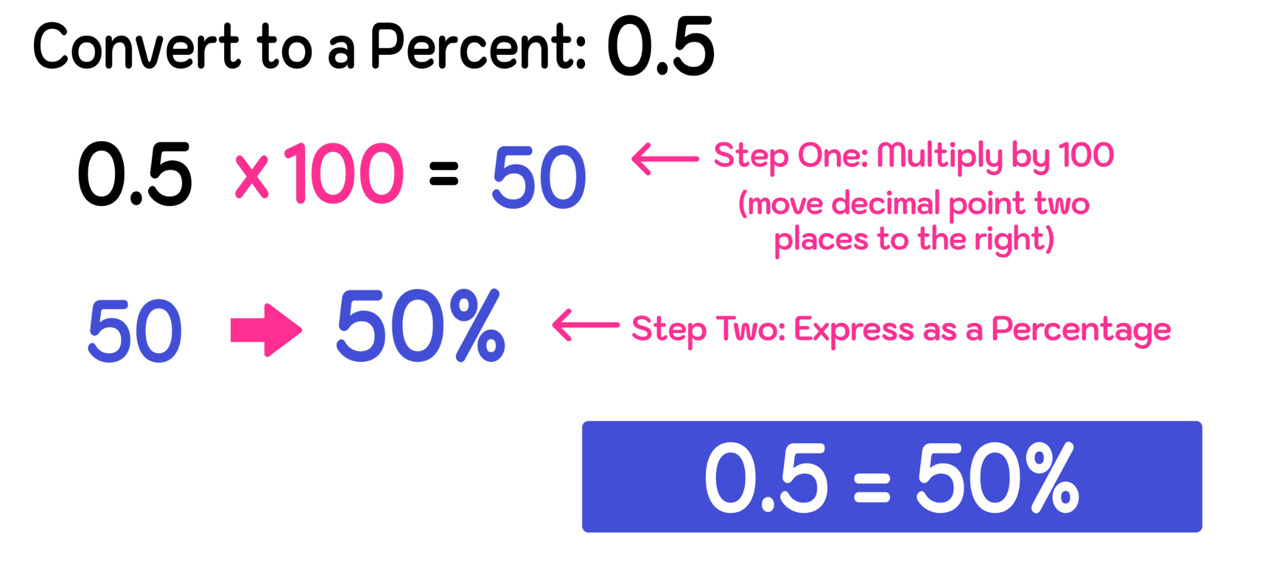
Example 2

Slide 116

Example 3

Slide 117

Example 4

Slide 118

Percent → Decimal
To convert a percentage to a decimal, divide by 100.
So 25% is 25/100, or 0.25.

Slide 119

Example 1

Slide 120

What about Fractions?

Slide 121
Let’s review
To convert a fraction to a percentage by multiplying by 100, choose your preferred process order:
Either:
Divide the numerator by the denominator
Multiply the result by 100
Or:
Multiply by 100
Divide the result by the denominator

Slide 122

Example 1
To convert 2⁄5 to a percentage, divide 2 by 5 and then multiply the result by 100.
Your decimal is 0∙4 x 100 = 40.
Therefore, 2⁄5 is 40%.
You get the same answer if 2⁄5 is multiplied by 100 first and then divided by 5

Slide 123


Example 2

Slide 124

Key Concept

Slide 125
Group Work
Title: Fundraiser Success! 🎉📊
At the school fundraiser, 72 out of 100 smoothies were sold by lunchtime.Ms. Greco wants to display the sales data in different formats to show how successful the morning was.
Your Task as a Group:
Fraction: What fraction of the smoothies were sold?
Decimal: Convert the fraction to a decimal.
Percentage: Convert the decimal to a percentage.
Explain the steps you took for each conversion.
Why might it be helpful to represent the same number in all three forms?

Slide 126
Bonus Challenge
If 180 smoothies were made in total, how many would need to be sold to match the same percentage of sales?

Slide 127
Answer
Fraction: 72/100
Decimal: 72 ÷ 100 = 0.72
Percentage: 0.72 × 100 = 72%
Bonus: 72% of 180 = 0.72 × 180 = 129.6 → about 130 smoothies

Slide 128
06
Comparing Fractions
We will learn how to compare fractions using common denominators and benchmark fractions like ½!

Slide 129
Let’s Talk
Which is bigger?
👉 3/4 or ⅔
💬 Turn and talk: What strategy did you use to decide?

Slide 130

What does it mean to compare fractions?
📌 When comparing two fractions, you’re deciding:
Which one is greater
Which one is lesser
Or if they are equal

Slide 131
Method 1 - Use Common Denominators
Compare 3/4 and 2/3
Find the Least Common Denominator (LCD): 12
Convert:
  3/4 = 9/12
  2/3 = 8/12
  ✅ So, 3/4 is greater than 2/3

Slide 132
Method 2 - Use Benchmarks
Use ½ as a reference point:
Is the fraction less than, equal to, or more than ½?
📌 Example:
1/3 < ½
3/4 > ½
💬 Helps estimate which is greater when denominators are different!

Slide 133
Benchmark Fractions
Benchmark fractions are commonly known and easily recognizable fractions that help us estimate and compare other fractions.
The most common benchmark fractions are:
0
½
1

Slide 134

Using Benchmarks Visually
You can show this using:
📏 Number lines: Place both fractions and see which is closer to 0, ½, or 1
🧩 Fraction circles or bars: Visually shade parts of a whole and compare

Slide 135

Example 1

Slide 136

Example 2

Slide 137
Be Careful!
❌ “The bigger numerator means it’s the bigger fraction”
✅ Not always true!
📌 Example: 3/8 vs. 2/3 → 3 is more than 2, but 3/8 is less than 2/3
🔍 Always look at the whole picture

Slide 138

Let’s Try

Slide 139

Example 2

Slide 140

Example 3

Slide 141


Slide 142
Remember
Close to 0? → Very small fraction (like 1/10, 1/12)
Close to 1/2? → In the middle range (like 4/9, 5/10)
Close to 1? → Almost a whole (like 7/8, 9/10)

Slide 143

Homework
Complete the Benchmarks Worksheet.

Slide 144
07
Generating Fractions
We will learn how to generate fractions using whole numbers and specific conditions!

Slide 145
Math Cap!
How can we make fractions from whole numbers like 2, 5, or 10?
Share your ideas with a partner or small group.

Slide 146
What Does It Mean to Generate Fractions?
Generating Fractions = Creating Fractions
📌 Example: From the number 3, we can create:
1/3, 2/3, 3/3
Even 4/3 or 5/3 (improper fractions!)
💡 Fractions are parts of a whole or wholes split into parts.

Slide 147
Fractions from Whole Numbers
Try this:
What fractions can we make from 5?
👉 Think of denominators as "number of parts"
1/5, 2/5, 3/5, 4/5, 5/5
Can also go beyond: 6/5, 7/5 (improper)

Slide 148


Slide 149


Slide 150


Slide 151


Slide 152
Generating Fractions with Criteria
Let's add conditions!
Create a fraction that is:
Greater than 1/2
Less than 1
Equivalent to 3/6
A proper fraction
An improper fraction
A mixed number

Slide 153
Visualize It
Use number lines, fraction bars, or circles to help visualize:
📏 0 ———— ½ ———— 1
Where does your fraction fall?

Slide 154

08
Mental Math
Strategies

Slide 155
Question
How do you usually do quick math in your head?
Have you ever tried doing that with fractions?
💬 Share with a partner or the class!

Slide 156
Why Mental Math for Fractions?
💡 It saves time
💡 It builds number sense
💡 It helps in everyday decisions (cooking, shopping, time)

Slide 157
Strategy 1 – Estimation
Round to Benchmarks (like 0, ½, or 1)
📌 Example:
5/8 ≈ a little more than 1/2
3/10 ≈ less than 1/2
🧠 Use this to estimate sums or compare quickly

Slide 158
Strategy 2 – Friendly Denominators
Look for easy-to-combine fractions
📌 Example:
1/4 + 3/4 = 1
1/2 + 1/2 = 1
1/3 + 2/3 = 1
💬 Think: “Can I make a whole?”

Slide 159
Strategy 3 – Quick Common Denominators
If the numbers are small, find a shared denominator quickly
📌 Example:
1/3 + 1/6 → LCD = 6
1/3 = 2/6 → 2/6 + 1/6 = 3/6 = 1/2

Slide 160
Strategy 4 – Simplify Before You Add or Subtract
Look for patterns
📌 Example:
2/4 + 1/4 = 3/4
But 2/4 can be simplified to 1/2 → 1/2 + 1/4 = 3/4
Same answer—but sometimes it's faster if simplified first!

Slide 161
Let’s Practice
Let’s solve these mentally:
1/2 + 1/4
3/5 + 2/5
3/8 + 2/8
1/6 + 2/3 (Hint: common denominators!)
💬 Turn and talk your thinking!

Slide 162

Group Challenge 1
The first group to answer this correctly, wins a point.

Slide 163

Group Challenge 2
The first group to answer this correctly, wins a point.

Slide 164

Group Challenge 3
The first group to answer this correctly, wins a point.

Slide 165
Test Review
Test #1

Slide 166
Let’s Review – What’s on the Test?
📘 Topics Covered:
Factors & Multiples (GCF and LCM)
Types of Fractions (Proper, Improper, Mixed)
Equivalent Fractions & Simplifying
Converting Fractions ↔ Decimals ↔ Percents
Comparing Fractions
Generating Fractions
Mental Math Strategies

Slide 167
Test Format
📝 Test Includes:
Multiple choice questions
Short answer questions
Word problems
Estimation and mental math
⏳ Time Limit: __60__ minutes
✅ Read all instructions carefully!

Slide 168
Test-Taking Tips
💡 Before You Start:
Read every question slowly
Underline key information
Use scrap paper to show thinking
💡 While Working:
Check units, labels, and signs
Use estimation to double-check
Breathe & pace yourself

Slide 169
Common Mistakes to Avoid
🚫 Don’t assume bigger numerator = bigger fraction
🚫 Don’t forget to simplify
🚫 Don’t rush through word problems
✅ Always check your final answer

Slide 170
Let’s Practice Together!
Simplify: 12/18
Convert: 3/4 → decimal → percent
Compare: 2/5 or 3/8
Add: 1/2 + 1/4
💬 Let’s discuss each step as a class!

Slide 171
Final Questions Before We Begin
❓ Anything you're unsure about?
Raise your hand now!
🧠 You've got this—you've been practicing for weeks!

Slide 172
09
Adding & Subtracting Fractions

Slide 173

Adding Fractions
Step-by-Step Guide

Slide 174

How to Add Fractions with Like Denominators
To add fractions there are
Three Simple Steps:
Step 1: Make sure the bottom numbers (the denominators) are the same
Step 2: Add the top numbers (the numerators), put that answer over the denominator
Step 3: Simplify the fraction (if possible)

Slide 175

Let’s Break it Down Again
Step 1: Make sure all the denominators are the same.
What is the denominator in this fraction?

Slide 176
Let’s Break it Down Again
Step 2: add all the numerators together:
2 + 5 + 1 = 8

Slide 177
Let’s Break it Down Again
Step 3: rewrite it as a fraction, keeping the numerator the same.
8
11

Slide 178

Let’s Look at it Visually
There are eleven squares - this represents the denominator.

Slide 179

Let’s Look at it Visually
We need to show 2 parts out of the eleven.
Then we need to show 5 parts out of the eleven.
Then we need to show 1 part out of the eleven.
2 shaded parts
5 shaded parts
One shaded part

Slide 180
Let’s Look at it Visually
When we add, we keep the denominator the same and then add the top numbers together. This is how we get 8/11.
There are a total of 8 shades parts out of 11 total parts.

Slide 181

You Try It!

Slide 182
You Try It!
Step 1: Make sure the denominators are the same.
Step 2: add the two numerators together.
Step 3: rewrite the fraction, keeping the denominator the same.
Answer: ⅞

Slide 183

Homework
Complete the following worksheet on adding fractions.

Slide 184
09
Adding Fractions
With Like and Unlike Denominators

Slide 185

Adding Fractions with Unlike Denominators
Step-by-Step Guide

Slide 186

Adding Fractions with Unlike Denominator
What is an unlike denominator?
This means that the fractions have different denominators. When this happens, it means we cannot add them.
Instead, we need to find the least common factor or multiple that both denominators can go into evenly.

Slide 187
Adding Fractions with Unlike Denominator
12 is the smallest number. Why?
Multiples of 4 are: 4, 8, 12, 16, 20
Multiples of 6 are: 6, 12, 18, 20

Slide 188

What’s Step 2?
Now that you’ve found the common denominator, you need to multiply the numerator. This means that whatever you multiply the denominator by, you must also multiply the numerator (top number) by the same thing.
If we need to add ¼ and 2/6 we need to find the lowest common factor first.
But that does not mean that we multiply each fraction by the same number.

Slide 189

What’s Step 3?
Now that we have the new fractions and both denominators are the same, we can add the numerators.

Slide 190

You Try!
Try adding the following fractions.
Remember, you cannot add them until you find the lowest common factor.

Slide 191

You Try!
Let’s see if we can find the lowest common factor of these fractions.
Even though 12 is a common multiple, it isn’t the lowest.

Slide 192
You Try!
Let’s see if we can find the lowest common factor of these fractions.
Even though 12 is a common multiple, it isn’t the lowest. The lowest multiple (factor) is 6.

Slide 193

You Try!
Now that we know the lowest common multiple is 6, let’s change the numerators.

Slide 194
You Try!
Now we can add the numerators.
2 + 1 = 3

Slide 195

You Try!
We keep the denominator the same and rewrite the fraction.
Our new fraction is:
3/6
Note, we can simplify this fraction. 3 and 6 can be divided by 3, so we can simplify this fraction.

Slide 196

Let’s Try it Again
Add the following fractions.

Slide 197

Let’s Try it Again
What is the lowest common multiple of 5 and 11?
55.

Slide 198

Let’s Try it Again
Now we can add the fractions using the common denominator of 55.
33 + 20 = 53
Therefore, our new fraction is 53/55.

Slide 199

Homework
Complete the following worksheet on adding fractions with unlike denominators.

Slide 200
09
Subtracting Fractions

Slide 201
Question
🧠 Think About It:
If you eat 2/5 of a pizza and your friend eats 1/5, how much more did you eat?
💬 Let’s figure it out together using subtraction of fractions.

Slide 202


Slide 203
Step 1: Understand the problem
You're comparing two amounts:
You: 2/5
Friend: 1/5 You want to find the difference → use subtraction.
🧠 Think:
⅖ - ⅕

Slide 204
Step 2: Check the denominators
Are the denominators the same?
Yes! Both fractions are out of 5.
📌 Since the denominators are the same, we keep the denominator and subtract the numerators.

Slide 205

Step 3: Subtract the numerators

Slide 206
Unlike Denominators?
Example #1: 1/2 - 3/7
Step One: Identify whether the denominators are the same (like) or different (unlike).
In this example, the fractions have unlike denominators (they are different). The first fraction’s denominator is 2 and the other’s is 7.
Step Two: If the example involves like denominators, move onto Step Three. If they are unlike denominators, find a common denominator.
Since the fractions have unlike denominators, you can not skip ahead.

Slide 207
Unlike Denominators?
Before you can move onto Step Three, you have to find a number that both denominators can divide into evenly. This is called a common denominator.
A very easy and effective way to find a common denominator between two fractions is by multiplying the denominators together (i.e. multiplying the denominator of the first fraction by the second fraction and multiplying the denominator of the second fraction by the first fraction.

Slide 208

Unlike Denominators?

Slide 209
Unlike Denominators?
Now that Step Two is complete, you can see that the original question has been transformed and you are now working with equivalent fractions that have common denominators, which means that the heavy lifting has been done and you can now solve the problem by subtracting the numerators and keep the same denominator:
7/14 - 6/14 = (7-6)/14 = 1/14
Since 1/14 can not be reduced further, you have solved the problem…

Slide 210

Unlike Denominators?

Slide 211

Review

Slide 212

Homework

Slide 213
10
Multiplying Fractions

Slide 214
Review: What is a Fraction?
A fraction shows part of a whole.
It has two parts:
Top number (numerator) → how many parts
Bottom number (denominator) → total parts
Example:
🟩🟩🟦🟦
2 out of 4 = 2/4

Slide 215

Review: What does it mean to multiply?
Multiply = groups of
Just like 2 x 5 means 2 groups of 5…
Fractions work the same way, just with parts instead of whole numbers.

Slide 216
Rule for Multiplying Fractions
🧠 Here's the rule:
👉 Multiply the top numbers (numerators)
👉 Multiply the bottom numbers (denominators)
Example:
2/3 × 3/4 = ?
Top: 2 × 3 = 6
Bottom: 3 × 4 = 12
✅ Answer: 6/12 (we’ll simplify next!)

Slide 217

Let’s Look at an Example
To begin multiplying fractions, you only need to multiply like terms.
What this means is you multiply both numerators together first. Then you multiply the denominators.
You don’t need to have the same denominator in order to multiply.

Slide 218

Let’s Try Another One
When we multiply, we are combining both fractions and then taking part of a part.
The overlap is the part we are taking out from the combination of both fractions.

Slide 219

But if we have a whole fraction?
Can we still multiply this?

Slide 220
But if we have a whole fraction?
Yes!
First, let’s convert the whole number into a fraction.

Slide 221
But if we have a whole fraction?
Since 3 is not broken into any parts, we add a 1 as the denominator.
This means that we have 3 whole numbers.
1

Slide 222
But if we have a whole fraction?
Now that we have 2 fractions, let’s multiply straight across.
2 x 3 = 6
7 x 1 = 7
Our fraction is 6/7.
1

Slide 223
Let’s Practice Together
2/5 × 3/4 = ?
5/6 × 2/3 = ?
3 × 2/7 = ?
4/9 × 1/2 = ?

Slide 224
Let’s Practice Together
2/5 × 3/4 = (2 x 3) / (5 x 4) = 6 / 20
5/6 × 2/3 = (5 x 2) / (6 x 3) = 10 / 18
3 × 2/7 = (3 x 2) / (1 x 7) = 6 / 7
4/9 × 1/2 = (4 x 1) / (9 x 2) = 4 / 18

Slide 225

Homework: Complete the Following Worksheet
Your task is to complete the worksheet on multiplying fractions.
It is due tomorrow.

Slide 226
10
Dividing Fractions

Slide 227

Review: What does it mean to divide?
Division = sharing or splitting
Example: 6 ÷ 2 means “how many 2s fit into 6?”
For fractions, we ask:
“How many times does this fraction fit into another?”

Slide 228

Rule to Dividing Fractions
🤔 How do we divide fractions?
We use a special trick called:
🔁 Keep – Change – Flip
👉 Keep the first fraction
👉 Change the division sign to multiplication
👉 Flip the second fraction (take its reciprocal)

Slide 229

What is a reciprocal?
A reciprocal just means flip the fraction
Example:
  Reciprocal of ¾ is 4/3
  Reciprocal of ½ is 2/1
The top and bottom switch places

Slide 230

Let’s Break This Down Again
What do we do first?

Slide 231

Step 1
Turn the second fraction upside down (it becomes a reciprocal):

Slide 232

Step 2
Change the division sign to a multiplication sign.

Slide 233

Step 3
Multiply the numerators and the denominators.

Slide 234

Simplify
If you can, simplify the fraction. Remember that not all fractions can be simplified.

Slide 235

Example 2

Slide 236
Whole Numbers Divided by Fractions
Example: 3 ÷ 1/2
Write 3 as a fraction: 3/1
Flip: ½ to 2/1
Multiply: (3 x 2) / (1 x 1) = 6 / 1
🎉 So, 3 ÷ ½ = 6
(Makes sense – how many halves are in 3? Six!)

Slide 237

You Try!

Slide 238

You Try!

Slide 239

Homework: Dividing Fractions Worksheet
Complete the following worksheet by tomorrow.

Slide 240
11
BEDMAS
We will apply the BEDMAS rule to solve problems involving fractions accurately and confidently.

Slide 241
What is BEDMAS?
📚 BEDMAS =
Brackets
Exponents
Division & Multiplication (left to right)
Addition & Subtraction (left to right)
🧠 Always follow this order — it helps avoid mistakes!

Slide 242


Slide 243
Why Does BEDMAS Matter?
Compare:
2+3×4=14
(2+3)×4=20
👀 See how different the answers are?
✅ BEDMAS helps us stay consistent in math.

Slide 244

BEDMAS and Fractions
Just like simple addition and subtraction, you need to follow BEDMAS if you’re solving complex fractions.

Slide 245

Example 2
How would we solve this equation?

Slide 246

🪜 Step 1: Identify the Brackets (B in BEDMAS)

Slide 247

🪜 Step 2: Multiply (M in BEDMAS)

Slide 248

🪜 Step 3: Simplify

Slide 249
Example 2
· Example Expression: (3/4 - 1/8) ÷ 1/2

Slide 250
Step 1: Solve the brackets
1. → (3/4 - 1/8)
· - Find a common denominator: 3/4 = 6/8
· - Subtract: 6/8 - 1/8 = 5/8

Slide 251
Step 2: Divide the Result by 1/2
· ⅝ ÷ ½ = ⅝ × 2/1
· Multiply: (5 × 2)/(8 × 1) = 10/8
· Simplify: 10/8 = 1 2/8 = 1 ¼

Slide 252
💬 Quick Recap:
Brackets → Convert to common denominator, add
Multiply result by whole number
Simplify final answer

Slide 253

Group Work
In small groups, work on the following worksheet together. We will take it up tomorrow.

Slide 254
12
Proportional Reasoning
Reasoning, Ratios, Rates

Slide 255
Question
🍰 A recipe calls for 2 cups of flour and 3 cups of sugar.
What is the ratio of flour to sugar?
Write it as:
  a ratio: ____ : ____
  a fraction: ____
  💬 Where else do you see ratios in real life?

Slide 256

What is a Ratio?
📌 A ratio compares two or more quantities
Example:
3 red marbles : 2 blue marbles
Written as: 3:2 or 3/2
💡 Ratios can be simplified like fractions!

Slide 257

What is a Rate?
📌 A rate is a ratio that compares quantities with different units
Examples:
60 km per hour = 60 km/1 hr​
$3 for 2 apples = 3/2 dollars per apple
🛒 You see rates when shopping, driving, and cooking!

Slide 258

Proportional Reasoning
✅ Proportional reasoning helps us:
Scale up or down
Solve real-life problems
Compare ratios using equivalent fractions
📌 If 2:3 = 4:6 → these are proportional

Slide 259
Solving Proportion Problems
If 4 pencils cost $10, how much do 9 pencils cost?

Slide 260

🪜 Step 1: Write a proportion

Slide 261

🪜 Step 2: Cross multiply

Slide 262

🪜 Step 3: Solve for x

Slide 263
Answer
✅ Answer:
It would cost $22.50 for 9 pencils.

Slide 264

Homework
Practice solving proportions, ratios, and rates with a partner.

