Slide 1
Irish Settlers
in
British North
America
7th grade
1800-1850

Slide 2
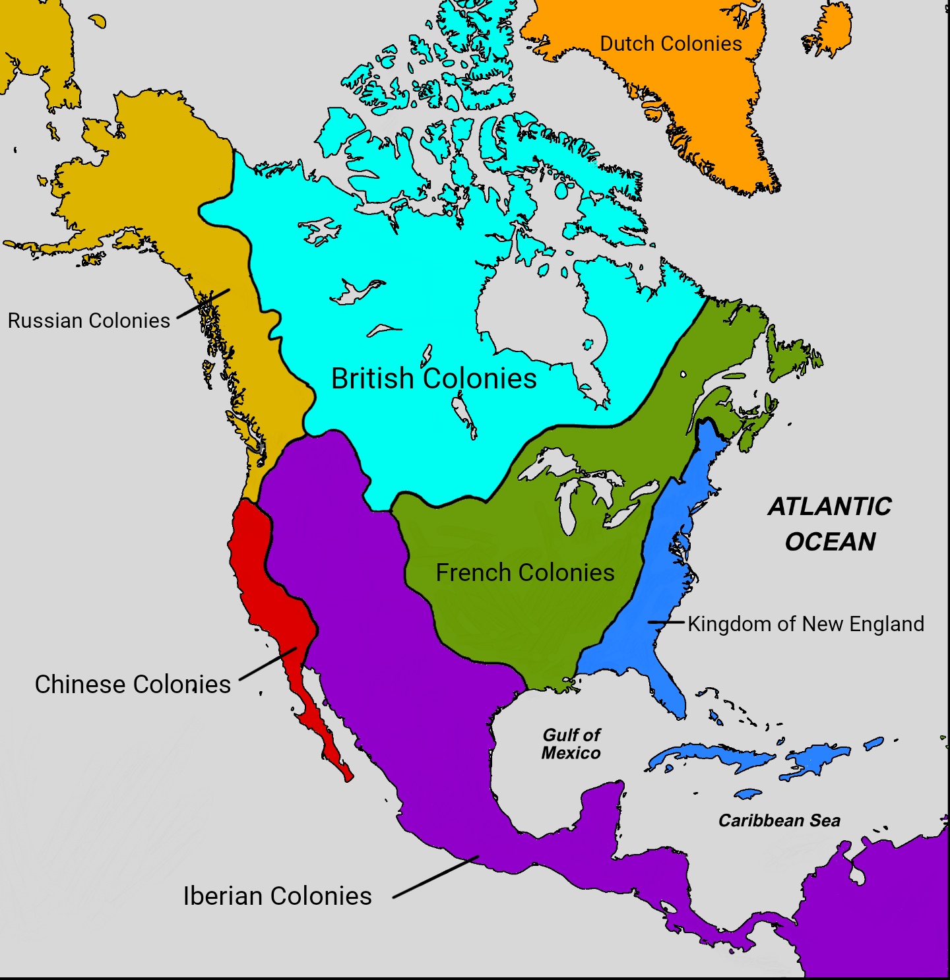
British North America - Pre-1800
Overview:
  British North America (BNA) was composed of colonies including Quebec, Nova Scotia, Newfoundland, and Prince Edward Island.
  The population consisted of Indigenous peoples, French settlers, British colonists, and enslaved people.
Key Features:
  The fur trade was central to the economy.
  Governance was influenced by the British Crown but varied across colonies.
  Relationships with Indigenous peoples were shaped by trade and conflict.

Slide 3
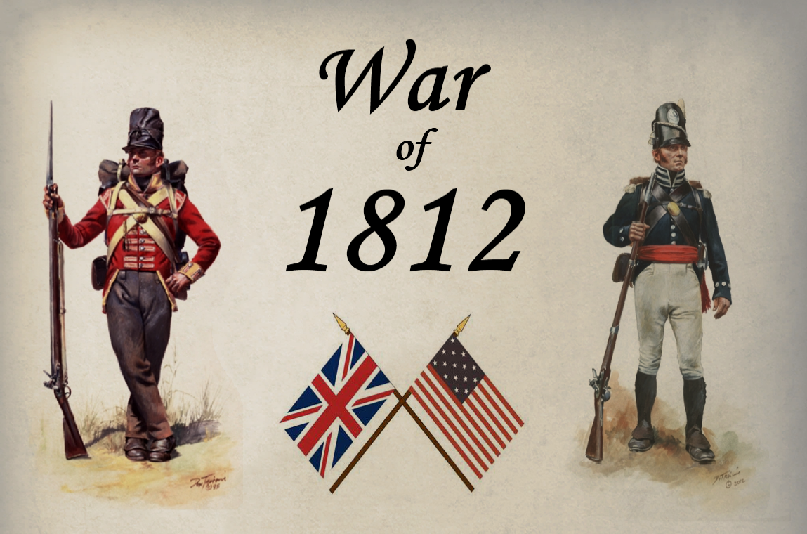
The War of 1812 – Causes
Tensions Between Britain and the U.S.:
  U.S. anger over British trade restrictions and impressment of American sailors.
  British support for Indigenous resistance against U.S. expansion.
Canadian Defense:
  British North America was drawn into the war as the U.S. sought to expand its territory.

Slide 4
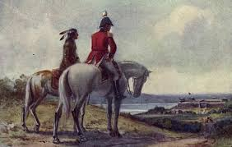
The War of 1812 – Consequences
Military Stalemate:
No territorial changes; pre-war boundaries restored.
Impact on British North America:
Strengthened Canadian identity and loyalty to Britain.
Increased settlement and infrastructure development.
Indigenous Dispossession:
Loss of land and reduced British support for Indigenous allies.

Slide 5
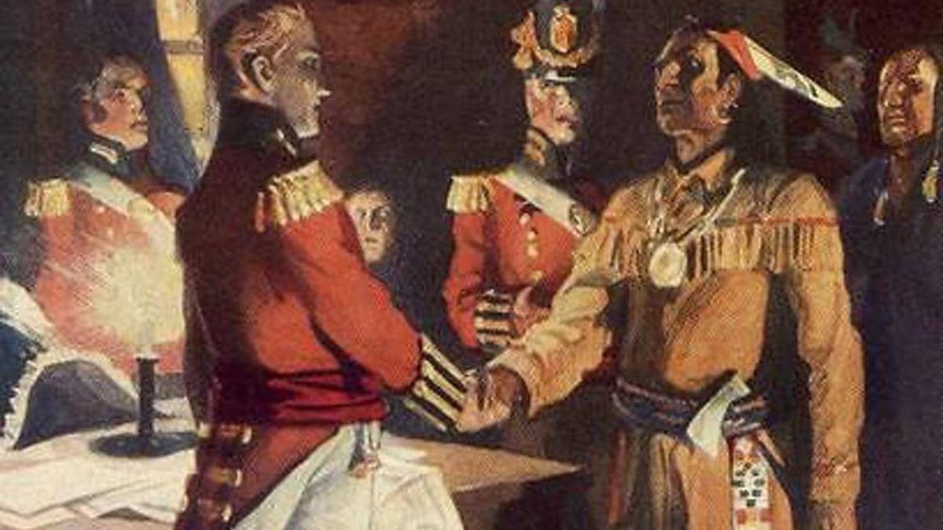
Key Figures – Brock and Tecumseh
Sir Isaac Brock:
  British commander known for his leadership at the Battle of Detroit.
  Died heroically at Queenston Heights.
Tecumseh:
  Shawnee leader who united Indigenous nations against U.S. expansion.
  Allied with the British, but his death in 1813 weakened Indigenous resistance.

Slide 6
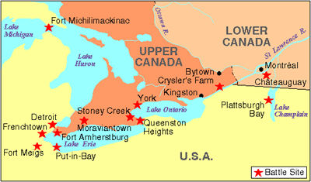
Battles of the War of 1812
The War of 1812 is sometimes called the "Second War of Independence" because it was a major test for the young United States. The war began because Britain was forcing American sailors to join their navy and helping Indigenous groups attack settlers on the frontier. For the first time in U.S. history, Congress declared war on another country: Great Britain.
The fighting took place on the ocean and on land. British soldiers invaded the U.S., captured Washington, D.C., and even burned the White House. Despite these challenges, the U.S. stood strong. By the end of the war, the American flag proudly flew as a symbol of freedom and bravery. This war shaped American history, and its battles and heroes are remembered to this day.

Slide 7
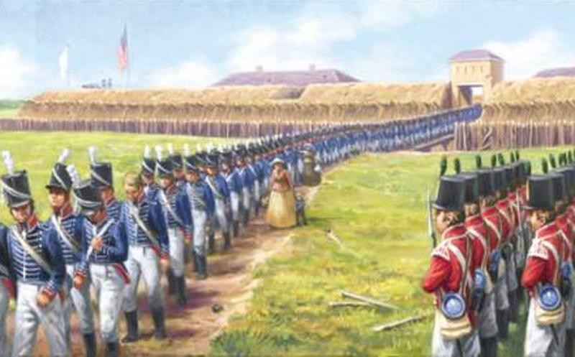
The Battle of Detroit
Battle of Detroit (1812)
British and Indigenous forces captured Detroit without bloodshed.
Boosted morale for British North America.
What happened?
The battle involved the British, Canadian militia, and Native American warriors.
The British and Native Americans used deception to intimidate the Americans into surrendering.
General William Hull, the American commander, surrendered the fort and his army.
The British captured many cannons, horses, and other equipment.

Slide 8
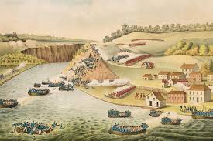
The Battle of York
Battle of York (1813)
U.S. forces captured and burned York (Toronto).
Highlighted the vulnerability of BNA.
What happened?
An American force landed on the western lakeshore of York
The British and Ojibwa Indians were outnumbered by the Americans
The British retreated to Fort York and set charges to destroy the powder supply
The magazine exploded, killing 38 Americans and wounding 222 more
The Americans looted and set buildings ablaze, including the Parliament Buildings
The Americans withdrew from the town weeks later

Slide 9
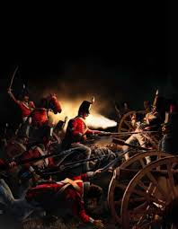
The Battle of Stoney Creek
The Battle of Stoney Creek was an important moment in the War of 1812, marking a turning point in American efforts to take Upper Canada. Although the Americans controlled Fort George, their movements were limited by British outposts and the fear of First Nations warriors using surprise attacks in the wilderness.
Together with the Battle of Beaver Dams two weeks later, this battle helped return the Niagara Peninsula to British and Canadian control, ending the U.S. attempt to capture the western part of the province.

Slide 10
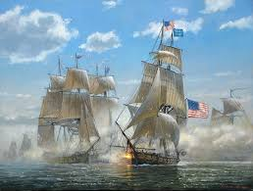
Other Key Battles
Battle of Beaver Dams (1813)
Laura Secord warned British forces of a U.S. attack.
Indigenous forces ambushed and defeated the U.S. troops.
Battle of Lundy’s Lane (1814)
One of the bloodiest battles, ending in a draw but halting U.S. progress.
Battle of Lake Erie (1813)
U.S. naval victory that gave control of Lake Erie to the Americans.

Slide 11
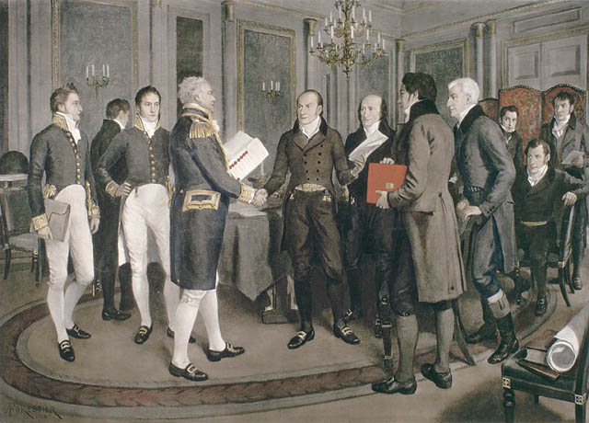
End of the War – Treaty of Ghent (1814)
Signed on December 24, 1814.
Restored pre-war boundaries but left Indigenous concerns unresolved.
Marked the end of major hostilities between Britain and the U.S.
Great Britain agreed to relinquish claims to the Northwest Territory, and both countries pledged to work toward ending the slave trade.
America, in turn, gained influence as a foreign power.
News of the treaty spread slowly, and word of peace did not reach the American and British armies for some time.

Slide 12
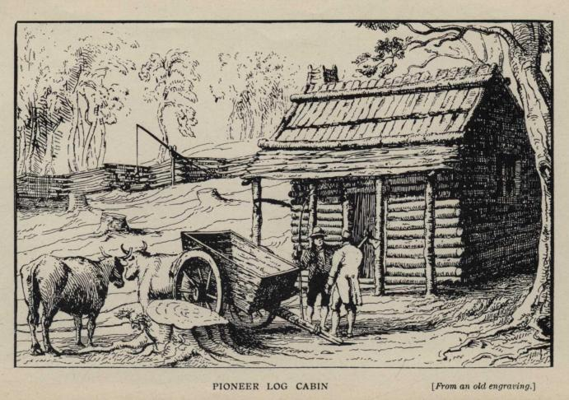
Aftermath of the War in Upper Canada
Economic Struggle:
Farms and towns were devastated by fighting.
Social Divisions:
Tensions between loyalists and reformers emerged.
Infrastructure Growth:
Post-war investment in canals, roads, and defense.

Slide 13
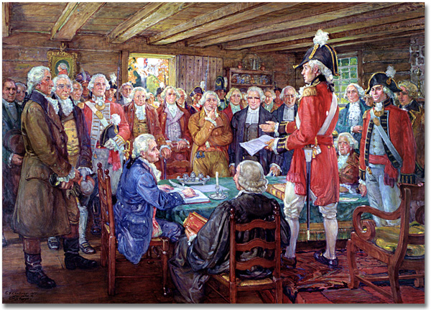
The Rebellion of 1837 -
Upper Canada
Causes:
Discontent with the Family Compact’s control over politics.
Demands for land reform and responsible government.
Outcome:
William Lyon Mackenzie led an unsuccessful uprising.
Strengthened the push for political reform.

Slide 14
The Family Compact
The Family Compact was a small group of elite, conservative individuals in Upper Canada (now Ontario) during the early 19th century. They held significant political, economic, and social power, often concentrated in the hands of a few families. This group included many of the colony's top officials, judges, military leaders, and landowners, who were closely connected to British colonial authorities.
The Family Compact was known for its opposition to democratic reforms and its resistance to the growing influence of more reform-minded groups, such as the Reformers, who sought political change and greater representation for the population. The Family Compact's members controlled much of the governance of the colony, influencing key decisions related to land distribution, economic policies, and government appointments.
Their rule led to widespread resentment, especially among settlers who felt excluded from political power. This tension contributed to the Rebellions of 1837 in Upper Canada, which were fueled in part by dissatisfaction with the Family Compact's influence and the lack of democratic representation.

Slide 15
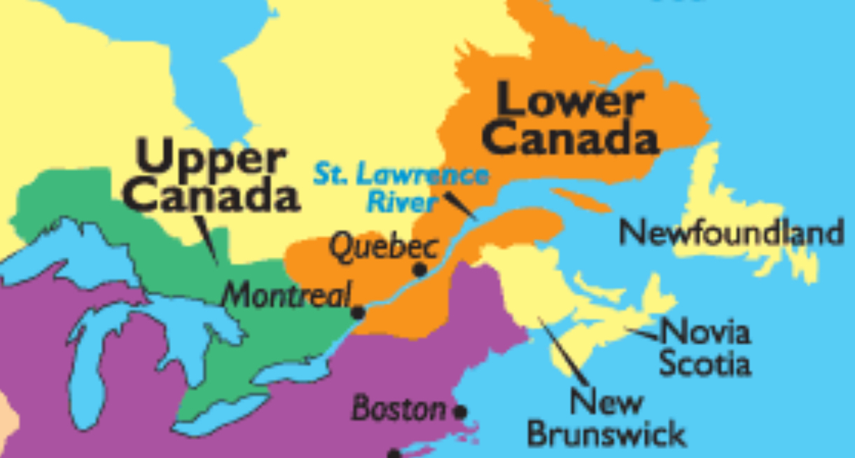
The Rebellion of 1837 -
Lower Canada
Causes:
Discrimination against French Canadians by the British-controlled government.
Economic inequality and grievances over land distribution.
Key Events:
Battles at Saint-Denis, Saint-Charles, and Saint-Eustache.
Outcome:
Rebellion was crushed, but it highlighted the need for reform.

Slide 16
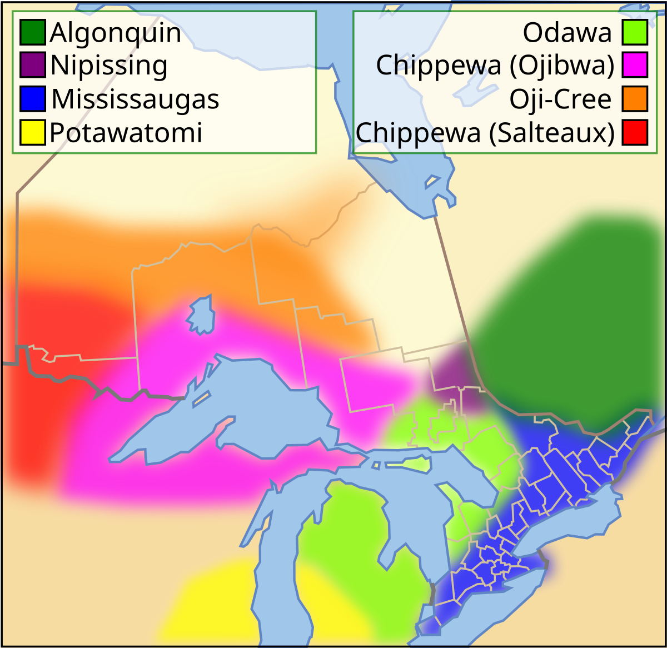
First Nations Impact Post-1812
Loss of British Support:
Promises of land and protection were not honored.
Land Loss and Marginalization:
Indigenous peoples faced increased settlement pressure.
Legacy of Resistance:
Inspired future advocacy for Indigenous rights and sovereignty.

Slide 17
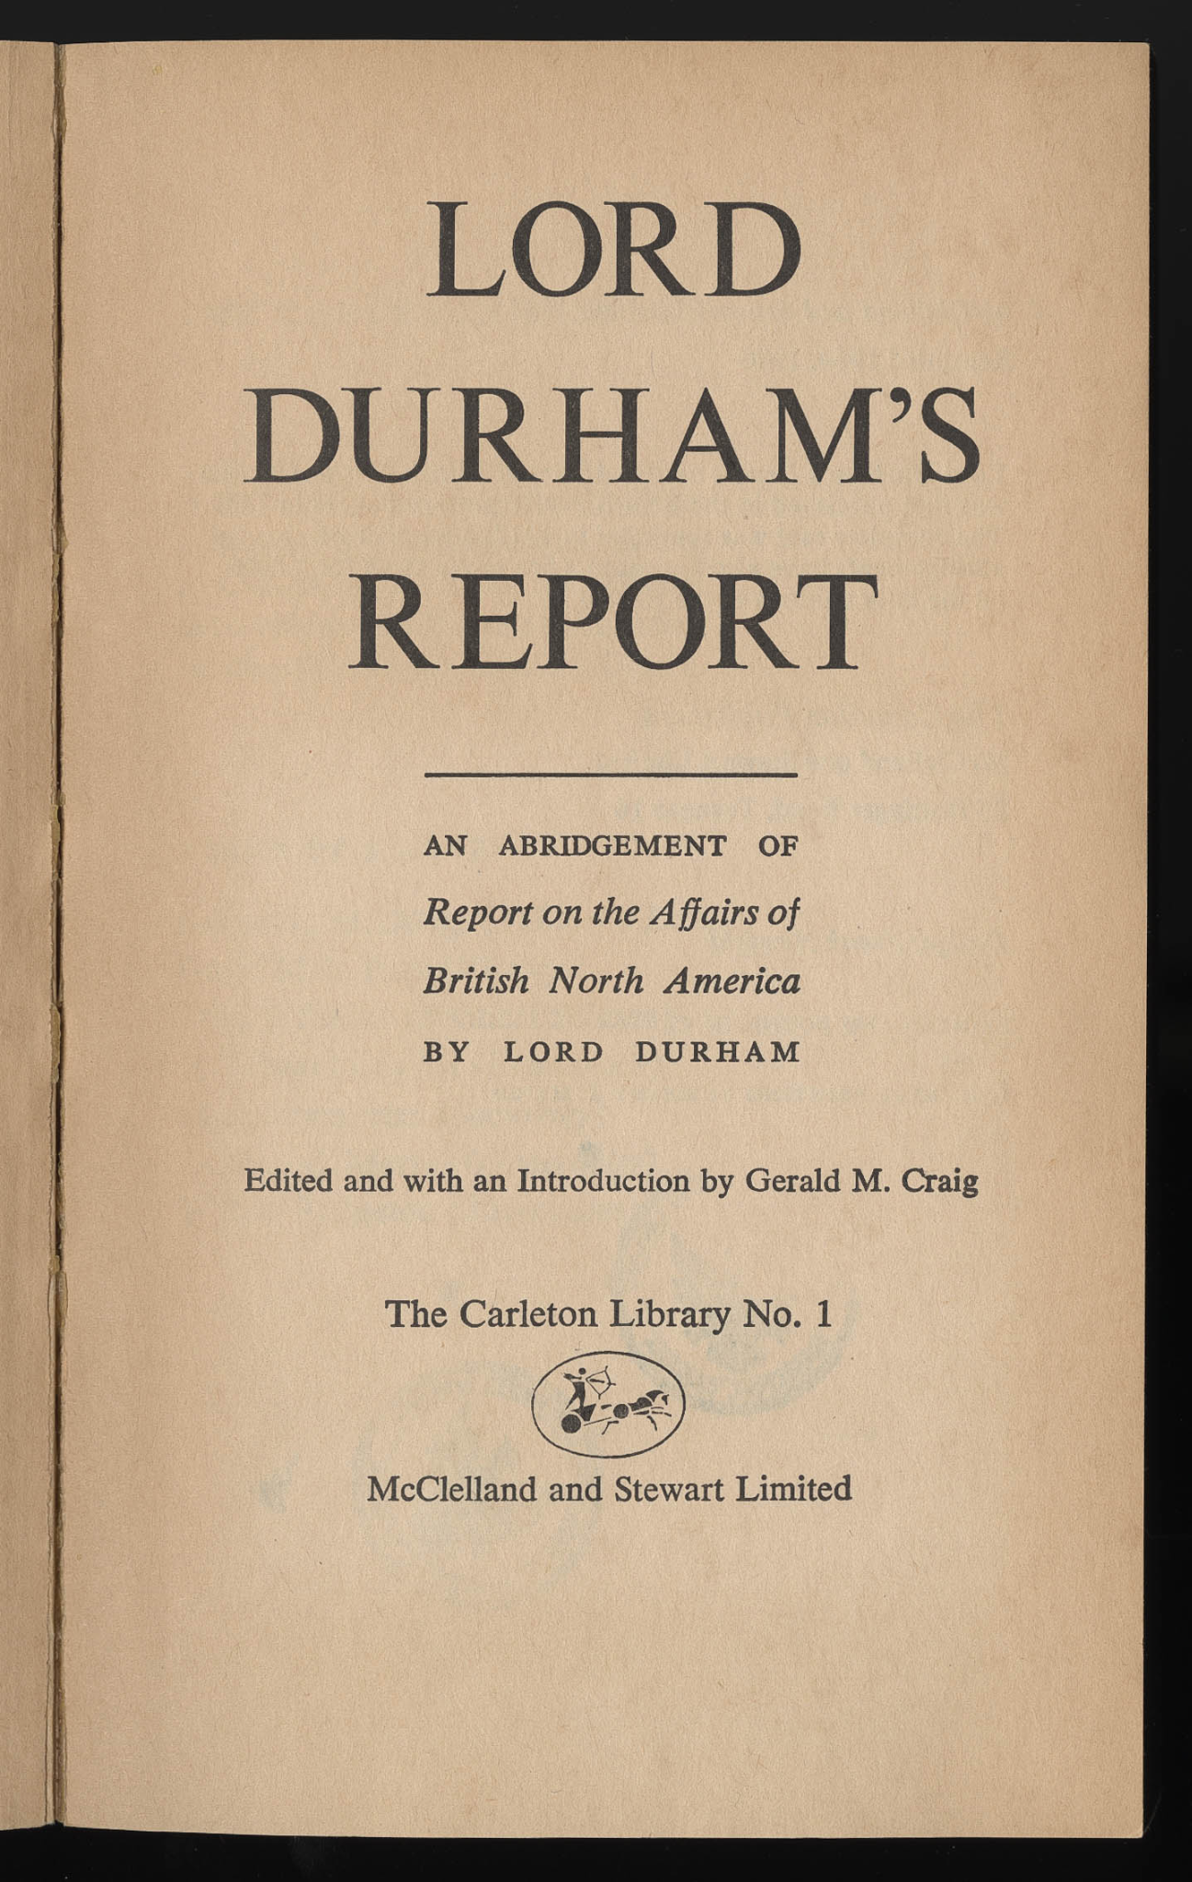
Impact of the Rebellions (1837–1838)
The Rebellions of 1837 in Upper and Lower Canada had a profound impact on British North America, leading to the creation of the pivotal "Durham Report," which called for the unification of the colonies and the establishment of responsible government. This set the stage for the eventual formation of the Canadian federation, marking a significant shift toward self-governance in Canada.

Slide 18
Consequences of the Rebellions
Durham Report:
The most significant outcome was the appointment of Lord Durham to investigate the causes of the rebellions. His findings, outlined in the "Durham Report," recommended the union of Upper and Lower Canada and the introduction of responsible government.
Act of Union:
Following the recommendations of the Durham Report, the British government passed the Act of Union in 1840, merging Upper and Lower Canada into a single entity known as the Province of Canada.
Responsible Government:
While not immediately put into practice, the rebellions sparked a movement toward responsible government, in which the colonial executive would be held accountable to the elected assembly.
Political Reform:
The rebellions underscored the need for political reform within the colonies, advocating for increased representation and expanded rights for the population.
Social Unrest:
The rebellions caused significant social unrest, particularly in Lower Canada, where the French-Canadian population felt marginalized and disenfranchised.

Slide 19
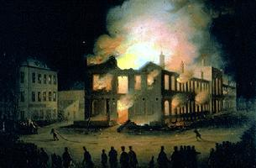
Lord Elgin & Rebellion Losses Bill
Rebellion Losses Bill (1849):
Compensated property losses from the Lower Canada rebellion.
Controversial among English-speaking Canadians.
Montreal Riots:
Protests against the bill culminated in the burning of Parliament.
Lord Elgin’s Role:
Refused to veto the bill, reinforcing responsible government.

Slide 20
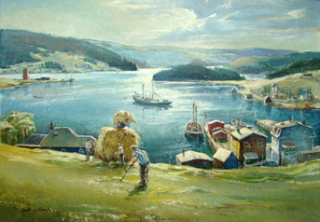
Irish Settlers in BNA
Who Were They?
Majority were Catholic, but Protestant settlers also emigrated.
Many were tenant farmers, laborers, and tradespeople.
Why They Left Ireland
Economic hardship and the Great Famine (1845–1852).
Religious and political oppression under British rule.
Journey to BNA
Traveled on overcrowded “coffin ships” with high mortality rates.
Quarantined at stations like Grosse Isle.
Life in BNA
Faced discrimination and poverty.
Contributed to infrastructure, agriculture, and cultural growth.

Slide 21
Irish Exploration
Irish Exploration and Early Presence:
Some claim Irish explorers like Brendan the Bold may have preceded the Norse to Canada, but this idea lacks strong evidence.
The Irish have been present in Canada since the 17th century, mainly due to political and military ties between France and Ireland.
Around 5% of the population of New France may have been Irish, with Irish surnames influencing French-Canadian and Acadian names (e.g., Riel from Reilly).

Slide 22
Irish Immigration
Irish in Newfoundland:
Irish have been in Newfoundland since the early 18th century, often working as fishermen.
The Irish had group consciousness in Newfoundland, especially as their numbers grew in the 18th century.
Irish Immigration Waves:
Significant Irish migration to British North America began in the 19th century, particularly after the Irish Great Famine (1847-52).
By 1850, over 500,000 Irish had immigrated, though many moved to the U.S.
Today, around 12.1% of the Canadian population are of Irish descent.

Slide 23
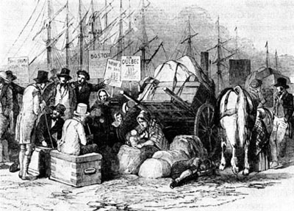
Irish Emigrants & Famine
Irish Emigrants and Settlement:
Many early Irish settled in the Maritimes and eventually moved inland.
They provided cheap labor for construction projects and worked in cities like Halifax and Saint John.
After the Great Famine, the Irish migration intensified, particularly to urban centers.
The Irish Famine:
The Irish fleeing the Famine faced poor living conditions upon arrival in Canada.
Many stayed in Canada temporarily before moving to the U.S.
By 1871, the Irish had become the largest ethnic group in many Canadian towns and cities.

Slide 24
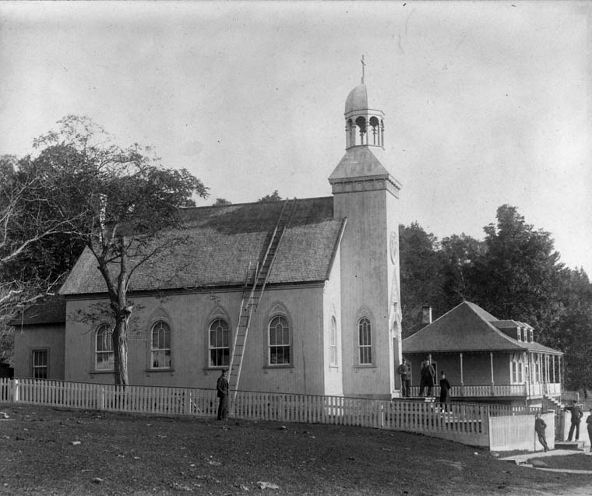
Socio-Cultural Life
Irish immigrants in Canada were divided by faith: Catholic and Protestant.
Catholic Irish often faced social and economic challenges but found support through the Catholic Church.
Protestant Irish were better off economically and more accepted by the dominant society.
The Irish retained their culture but often had different approaches to identity based on their religious background.

Slide 25
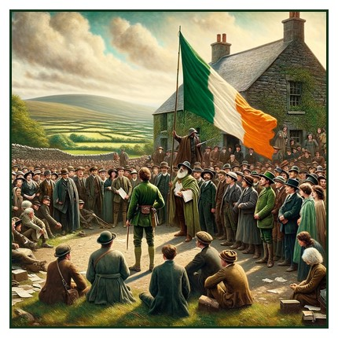
Irish Catholics
Irish nationalism, especially after the Famine, had an impact in Canada, with movements like the Fenian Raids, although they were viewed with suspicion by the government.
The Irish Church, particularly Catholic Irish, played a crucial role in helping immigrants settle in Canada.

Slide 26
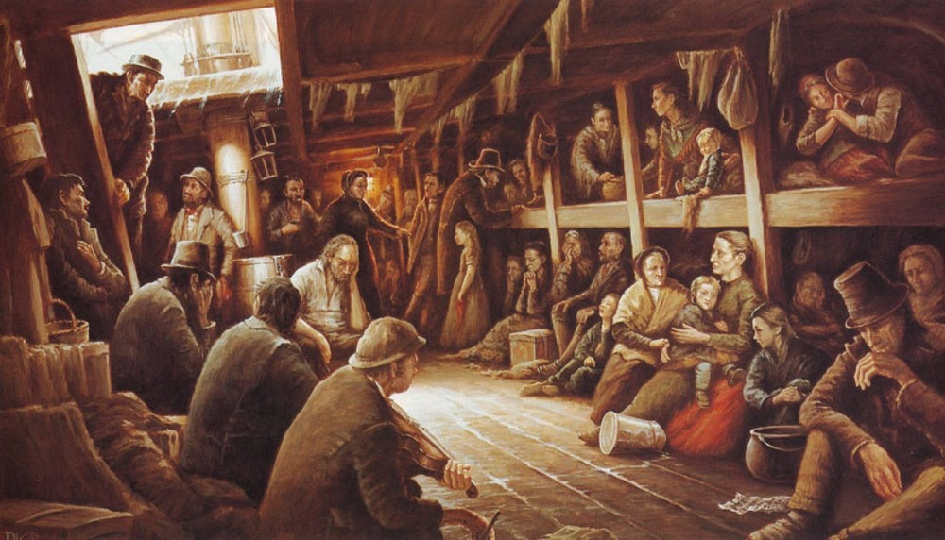
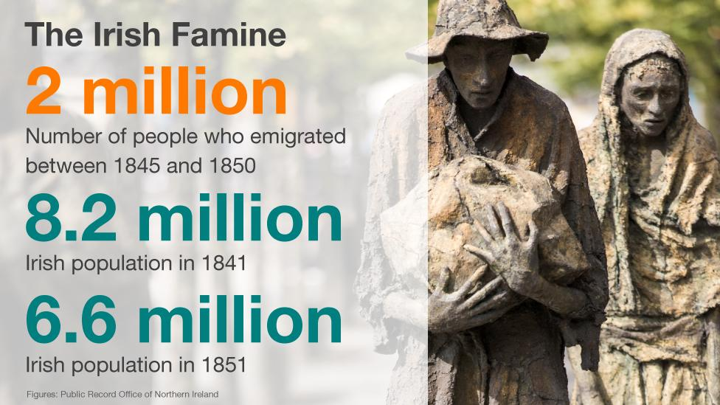
Let’s Explore Some More
Irish Immigration to Canada: A Journey of Resilience and Legacy - Kids Social Studies

Slide 27
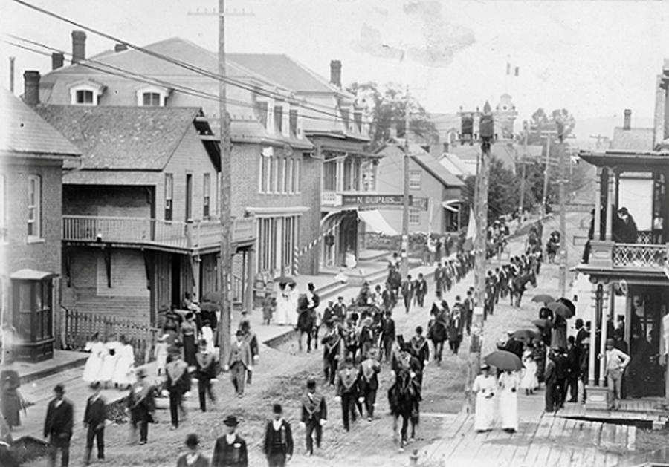
Legacy of the Irish Settlers
Population Growth:
Formed a large segment of BNA’s population.
Cultural Contributions:
Introduced traditions like St. Patrick’s Day.
Political Impact:
Advocated for labor rights and social reform.
Thomas D’Arcy McGee - Played a leading role in Confederation.
Mother Teresa Dease - Founded schools and educated Canadian youth.

Slide 28
Irish Legacy - Construction
Canals and railroads
Irish laborers built the Welland Canal, Rideau Canal, and early railroads. They also worked in the lumber industry.
Land settlements
Irish families settled in areas with cheap or free land, including the St. Lawrence Valley, the Talbot Settlement, and the Huron Tract.
Iconic landmarks
Irish immigrants built many iconic landmarks, including St. Patrick's Basilica in Montreal and heritage buildings in St. John's, Newfoundland.

Slide 29
Jeopardy: Canadian History from 1800 to Irish Settlers
We are going to review key moments in Canadian history between 1800 and the arrival of Irish settlers. You'll need to work together to create a timeline to understand the events that shaped early Canada.

Slide 30
Key Figures | Major Events | Dates and Timelines | War of 1812 | Irish Settlers
100 | 100 | 100 | 100 | 100
200 | 200 | 200 | 200 | 200
300 | 300 | 300 | 300 | 300
400 | 400 | 400 | 400 | 400

Slide 31
Key Figures - 100
Who was the first Prime Minister of Canada?
Sir John A. Macdonald

Slide 32
Key Figures - 200
Who was a Shawnee chief and warrior who promoted resistance to the expansion of the United States onto Native American lands.?
Tecumseh

Slide 33
Key Figures - 300
Who was the leader of the Rebellions of 1837–1838 in Upper Canada?
William Lyon Mackenzie

Slide 34
Key Figures - 400
Which Canadian figure is known for negotiating the Canadian Pacific Railway and expanding Canada to the Pacific Coast?
Sir John A. Macdonald

Slide 35
Major Events - 100
In which year did Canada officially become a country with the signing of the British North America Act?
1867

Slide 36
Major Events - 200
What was the name of the rebellion in Upper Canada in 1837, led by William Lyon Mackenzie?
The Upper Canada Rebellion

Slide 37
Major Events - 300
In what year did the Montreal Riots take place?
1849

Slide 38
Major Events - 400
What major event occurred in 1812 that involved Canada and the United States?
The War of 1812

Slide 39
Dates and Timelines - 100
In what year did the Irish famine begin, prompting large-scale Irish immigration to Canada?
1845

Slide 40
Dates and Timelines - 200
In which year was the Treaty of Ghent signed?
1814

Slide 41
Dates and Timelines - 300
In which year was the Durham Report published?
1839

Slide 42
Dates and Timelines - 400
When did the Battle of Queenston Heights take place during the War of 1812?
1812

Slide 43
War of 1812 - 100
What was the main reason the United States declared war on Britain in 1812?
Issues related to trade restrictions and impressment of American sailors

Slide 44
War of 1812 - 200
Who was the commander of Canadian forces during the Battle of Queenston Heights?
Major General Isaac Brock

Slide 45
War of 1812 - 300
What was the outcome of the Battle of York in 1813?
American forces captured and burned Toronto (then known as York)

Slide 46
War of 1812 - 400
Which famous Canadian naval officer became a hero during the War of 1812 for his victories on Lake Erie?
Commodore Sir James Yeo

Slide 47
Irish Settlers - 100
Why did many Irish immigrants come to Canada in the 1840s?
Due to the Irish Potato Famine

Slide 48
Irish Settlers - 200
Which province in Canada received the highest number of Irish immigrants during the 19th century?
Ontario

Slide 49
Irish Settlers - 300
What was the name of the Irish-Canadian who became a father of Confederation in 1867?
Thomas D’Arcy McGee

Slide 50
Irish Settlers - 400
What was the name given to the ships that transported Irish settlers to Canada?
Coffin Ships

Slide 51
Life in BNA

Slide 52
Learning Goals
Understand the daily life of people living in British North America before Confederation (1867).
Explore the social, political, and economic aspects of life during this period.
Analyze the diverse experiences of different groups in British North America.

Slide 53
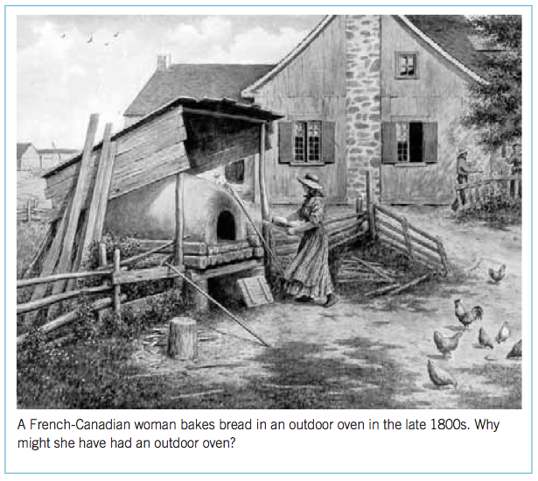
Rural Life
What do you think rural life was like for them?
What may be some hardships they faced? Why?

Slide 54
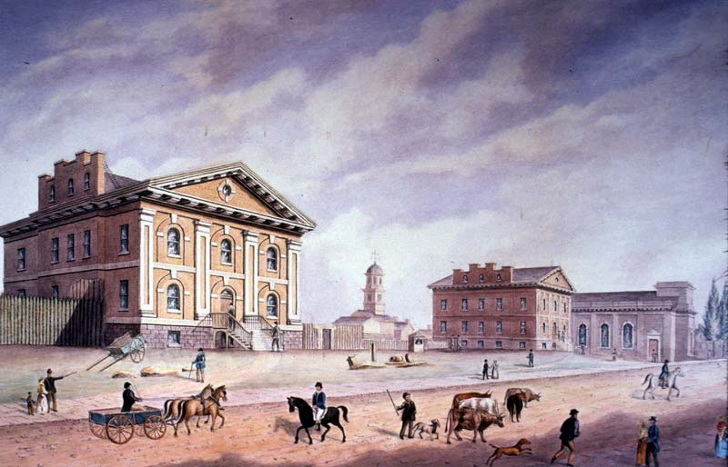
City Life
What do you think was good about living in a city during this time?
What hardships do you think they faced?

Slide 55
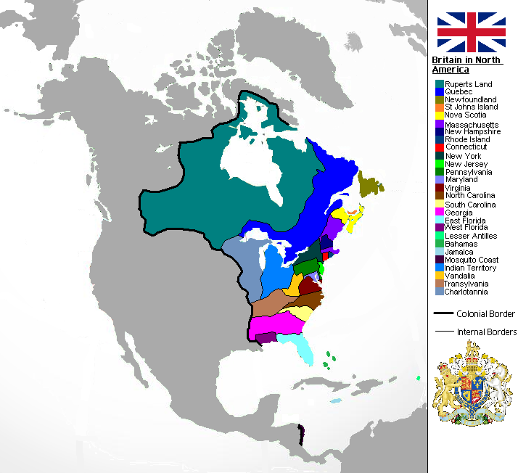
What is British North America?
What was British North America?
  Refers to the territories in North America that were under British control before Canada became a country in 1867. These included areas like Upper Canada (Ontario), Lower Canada (Quebec), Nova Scotia, New Brunswick, and Newfoundland.
Key Groups in British North America:
  Settlers from Britain and other European countries.
  Indigenous Peoples with long-standing cultures and traditions.
  Enslaved people and African Canadians.
  French Canadians, especially in Quebec.

Slide 56
Daily Life
Social Structure:
Life was structured by a hierarchy where wealthy landowners and merchants had the most power, while farmers and working-class people had less influence.
Indigenous peoples lived in diverse ways, from nomadic hunting groups to settled agricultural communities.
Economy and Work:
The economy was based on agriculture, trade, and natural resources. Farmers grew crops like wheat, corn, and tobacco.
Fur trade played a huge role in the economy, especially in the west, with companies like the Hudson’s Bay Company driving much of the trade.
Craftsmen and laborers built much of the infrastructure, including roads and homes.

Slide 57
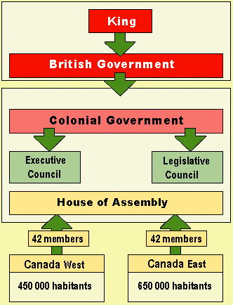
Political & Legal Life
Government: British North America was governed by a colonial system with appointed governors who made decisions on behalf of the British Crown.
Legal Systems: The legal system was based on British common law, with a focus on property rights and loyalty to the British Crown.

Slide 58
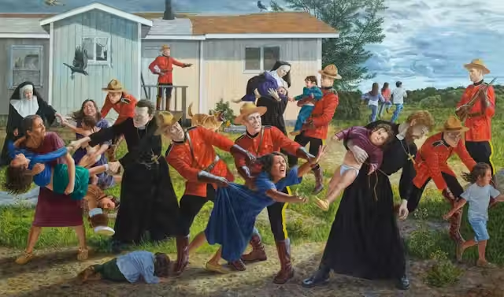
Indigenous Peoples
What is happening in this image?
What can we learn about Indigenous peoples and the British?
What do you think life was like for Indigenous people in BNA?

Slide 59
Key Events & Issues
The Rebellions of 1837-1838: A pivotal event in Lower Canada (Quebec) and Upper Canada (Ontario), where people, especially in rural areas, revolted against the British colonial government, pushing for democratic reforms.
Indigenous Relations: Relationships with Indigenous peoples were complex, as settlers pushed westward, leading to conflict and displacement of native communities.

Slide 60
Exit Ticket
How would life differ for a French farmer in Quebec compared to a British merchant in Nova Scotia?
Why were the fur trade and agriculture so important to the economy of British North America?
What are some of the challenges faced by Indigenous peoples during this period?

Slide 61
The Underground Railroad
1854

Slide 62
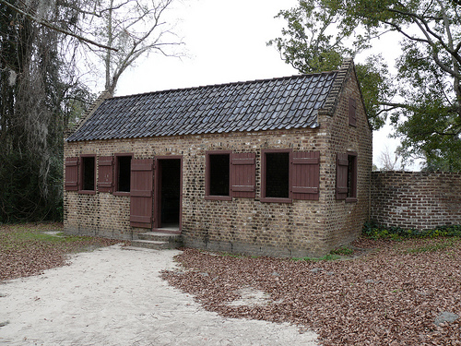
Historian Moment
What kind of house is this?
Who do you think lived here?

Slide 63
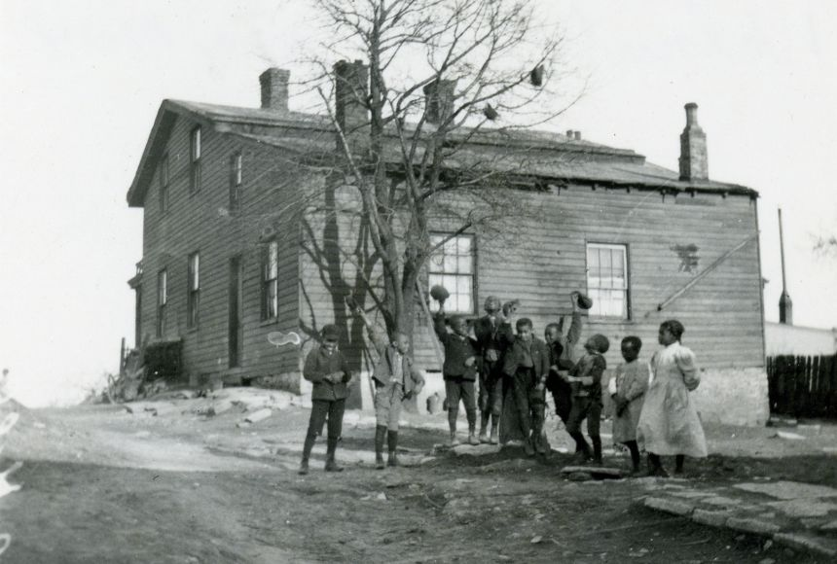
The Underground Railroad
The Underground Railroad was a network of secret routes and safe houses used by enslaved African Americans to escape to free states and Canada, particularly during the early 19th century.
It was not a physical railroad but a system supported by abolitionists and allies who helped hide and transport escapees. Many slaves sought freedom in Canada, where slavery had been abolished.
Key figures like Harriet Tubman were crucial in guiding and assisting fugitives along the journey.
Key Question: Why was Canada a destination for runaway slaves?

Slide 64
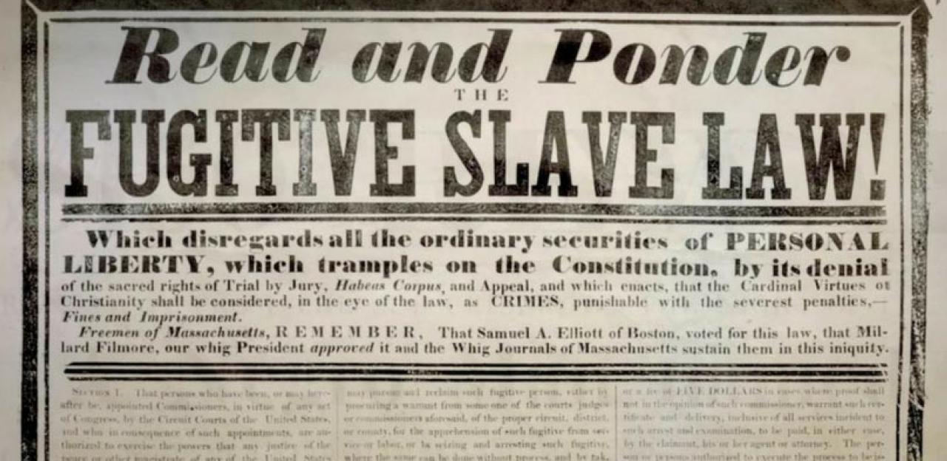
Key Terms
Slavery: The practice of owning people as property.
Abolition: The movement to end slavery.
Underground Railroad: A network of people and places that helped enslaved people escape to freedom.
Fugitive Slave Act: A law that required escaped slaves to be returned to their owners, even if they had reached free states.
Refuge in Canada: Canada became an important destination for runaway slaves, where they were granted freedom under British colonial law.

Slide 65
The Need for The Underground Railroad
Historical Context:
  Enslavement of African Americans in the U.S.
  Harsh conditions and lack of freedoms.
  The Fugitive Slave Act of 1850 (allowed runaway slaves to be captured even in free states).
Importance: The Underground Railroad was a lifeline for many escaping these conditions.

Slide 66
The Route to Freedom
Key Safe Haven Locations:
Michigan, Ohio, New York, and other northern states.
Canada: Ontario (e.g., St. Catharines, Windsor), Nova Scotia, and Quebec.
Modes of Escape:
Foot travel, wagon, or boat.
Use of landmarks like rivers, railways, and coded messages.

Slide 67
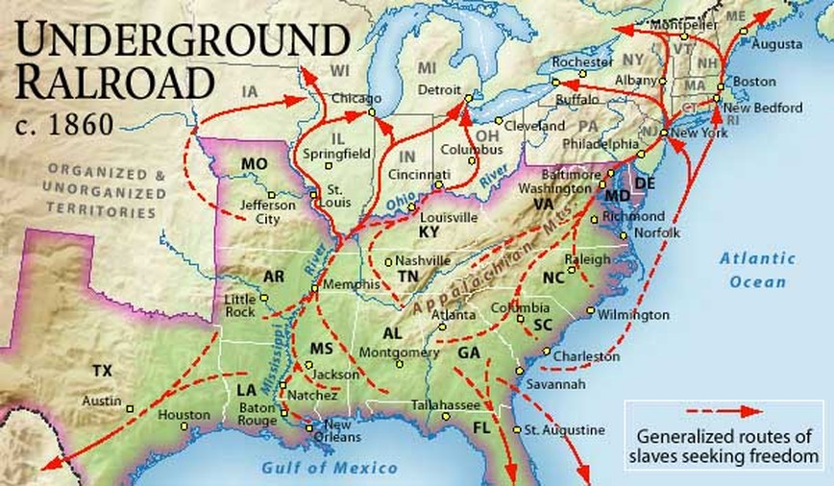

Slide 68
Canada as a Safe Haven
Why Canada?
British colonial law: Slavery was abolished in Canada in 1834 (with the passage of the Slavery Abolition Act).
Canada as a symbol of freedom.
Canadian Black communities provided support to escaping slaves.
Key Cities/Settlements:
Windsor, Ontario: Gateway to Canada from Detroit.
St. Catharines, Ontario: Home to Harriet Tubman and key figures.
Toronto: Center of Black Canadian culture and activism.

Slide 69
Life in Canada
In Canada, a special order-in-council which received Royal Consent in 1855 made it official policy to accept runaway slaves, provide food and clothing and shelter for new arrivals, and to arrest and imprison any bounty hunters found crossing the border. Waves of fugitive slaves arrived in the barely settled lands of Upper Canada (today’s Ontario), often disoriented by the freezing winters, which were a stark contrast to the humid southern states. Despite the environmental challenges, most newly arrived blacks managed to thrive in Canada. Entire towns consisting entirely of black populations sprung up along the St Lawrence River and the counties just outside of York (present-day Toronto).
Life wasn’t without difficulties, of course. Just like their American cousins, many white Canadians held severely racist views of their new black neighbours. While the more pious and generous went out of their way to help the new settlers, most Canadians turned a blind eye to their struggles and in some cases assaults and murders against black immigrants were recorded. These were in the minority, however. Institutionalized racism in Canada meant that blacks found it difficult to get jobs or attend schools or apply for any type of government benefits.

Slide 70
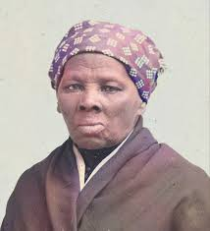
Harriet Tubman and Her Role
Biography: Born into slavery in Maryland, Tubman escaped and then risked her life to return to guide others to freedom.
Key Contributions:
Led over 300 enslaved individuals to freedom on the Underground Railroad.
Worked as a conductor, scout, and spy during the Civil War.
Symbol of bravery, leadership, and dedication to freedom.
Quote: "I never ran my train off the track and I never lost a passenger."

Slide 71
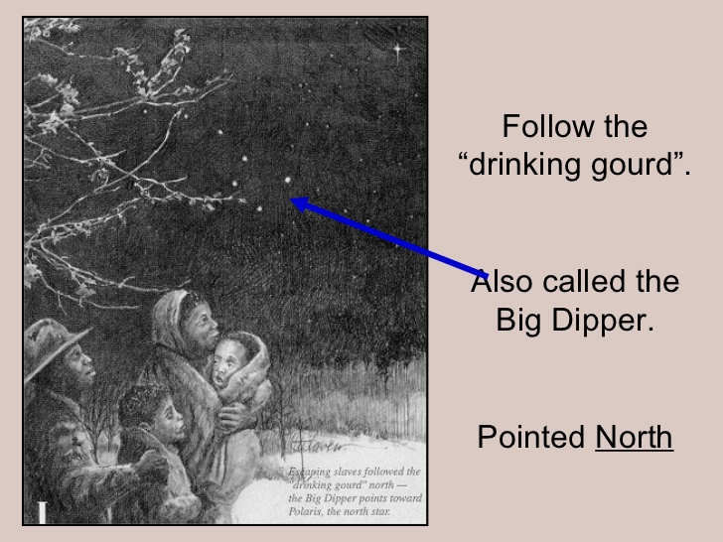
The Roles of Abolitionists
Abolitionists in the U.S.: Figures like William Still and Levi Coffin who helped coordinate escapes.
Canadian Helpers: Black Canadians, Indigenous people, and white allies who provided shelter, food, and resources.
Methods of Assistance: Safe houses, hidden routes, and coded signals (e.g., “Follow the Drinking Gourd,” meaning the Big Dipper constellation).

Slide 72
The Impact on Canadian Society
Cultural and Demographic Changes:
Large influx of Black refugees to Canada, particularly after 1850.
Formation of communities in Ontario, Nova Scotia, and Quebec.
Legacy: The descendants of these refugees contributed to the development of Canada’s diverse cultural and social fabric.
Modern Recognition: Celebrating the achievements of those who participated in the Underground Railroad through museums, events, and monuments.

Slide 73
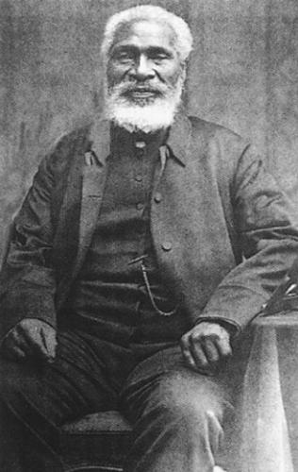
Key Events & Figures
William Still (The Father of the Underground Railroad): African American abolitionist who recorded the stories of those who escaped slavery.
Josiah Henson: An escaped slave who became a prominent leader in the Canadian Black community.
The 1850 Fugitive Slave Law: Heightened the need for a safe refuge like Canada.

Slide 74
Early Black Settlement In Canada
https://www.tiki-toki.com/timeline/entry/306010/Early-Black-Settlement-in-Canada/#vars!date=1587-05-08_11:16:27!

Slide 75
Exit Ticket
How did Canada’s laws and society provide a safe environment for runaway slaves?
What impact did the Underground Railroad have on the future of Canada and the U.S.?
What lessons can we learn from the bravery and courage of those involved in the Underground Railroad?

Slide 76
Beothuk People

Slide 77
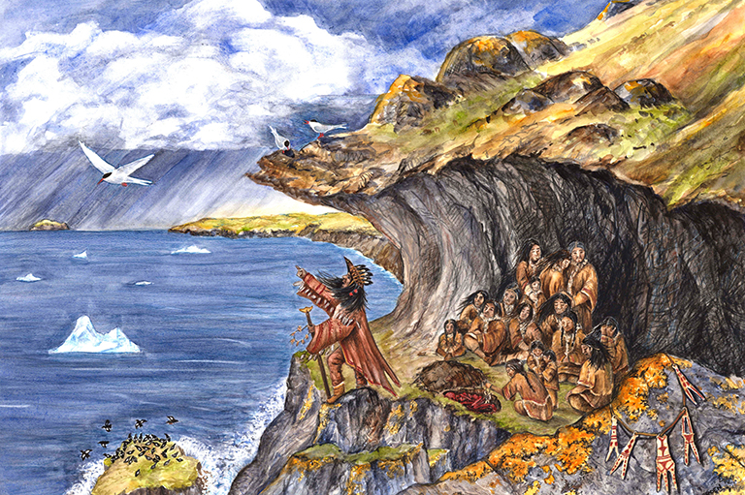
Historian Moment
What does it mean to live in harmony with the land?

Slide 78
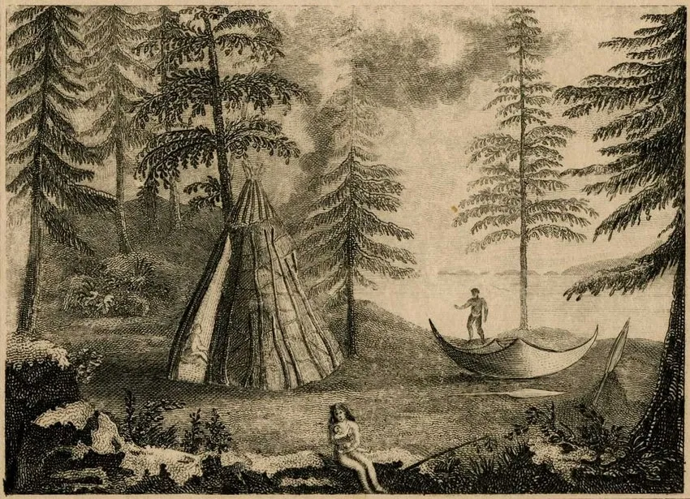
KWL Charts
What do you know about Indigenous peoples and their relationship with the land?
What do you want to know about the Beothuk people?
What did you learn about the Beothuk people?

Slide 79
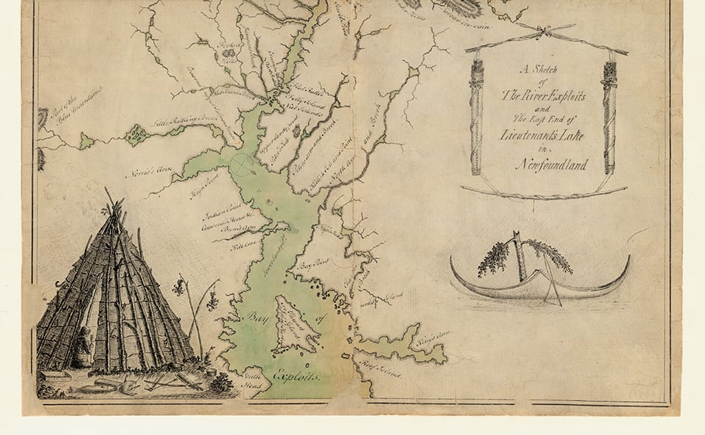
Overview of the Beothuk People
The Beothuk were an Indigenous people who lived in what is now Newfoundland, Canada. They are considered one of the most well-documented Indigenous groups in Canada, though tragically, they are also one of the most well-known examples of cultural extinction due to European colonization. The Beothuk had a rich, complex culture and a deep connection with their environment, but their population began to rapidly decline after European contact.

Slide 80
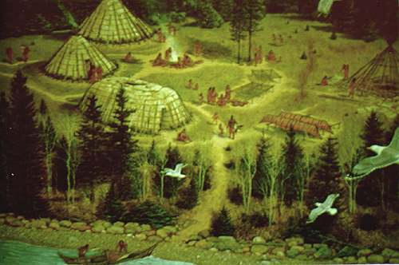
Location & Environment
The Beothuk people lived primarily on the island of Newfoundland, particularly along its coasts and interior regions.
They inhabited a diverse environment with dense forests, coastal areas, and waterways that supported fishing, hunting, and gathering.
Their settlements were seasonal, with some groups moving based on the availability of resources such as fish, caribou, and berries.

Slide 81
Culture
Subsistence and Food Sources:
Primarily hunters, fishers, and gatherers.
Relied on land resources for survival, including caribou, seals, fish, and other wildlife.
  Hunting: Hunted large animals like caribou, moose, and seals using spears, bows, and arrows.
  Fishing: Fished along coasts, rivers, and bays for salmon, cod, and other fish.
  Gathering: Collected wild plants and berries, including blueberries, cranberries, and other edible plants.
Housing and Shelters:
Built temporary shelters called "mamateeks" or "wigwams".
  Made from birch bark, wooden poles, and moss.
  Shelters suited for seasonal migrations.
Used shelters during:
  Winter months inland for hunting.
  Summer months along the coast for fishing.

Slide 82
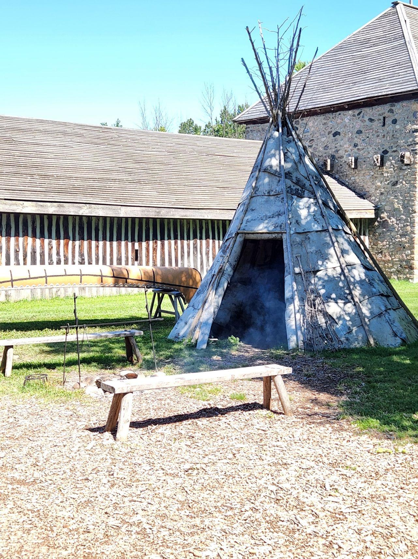
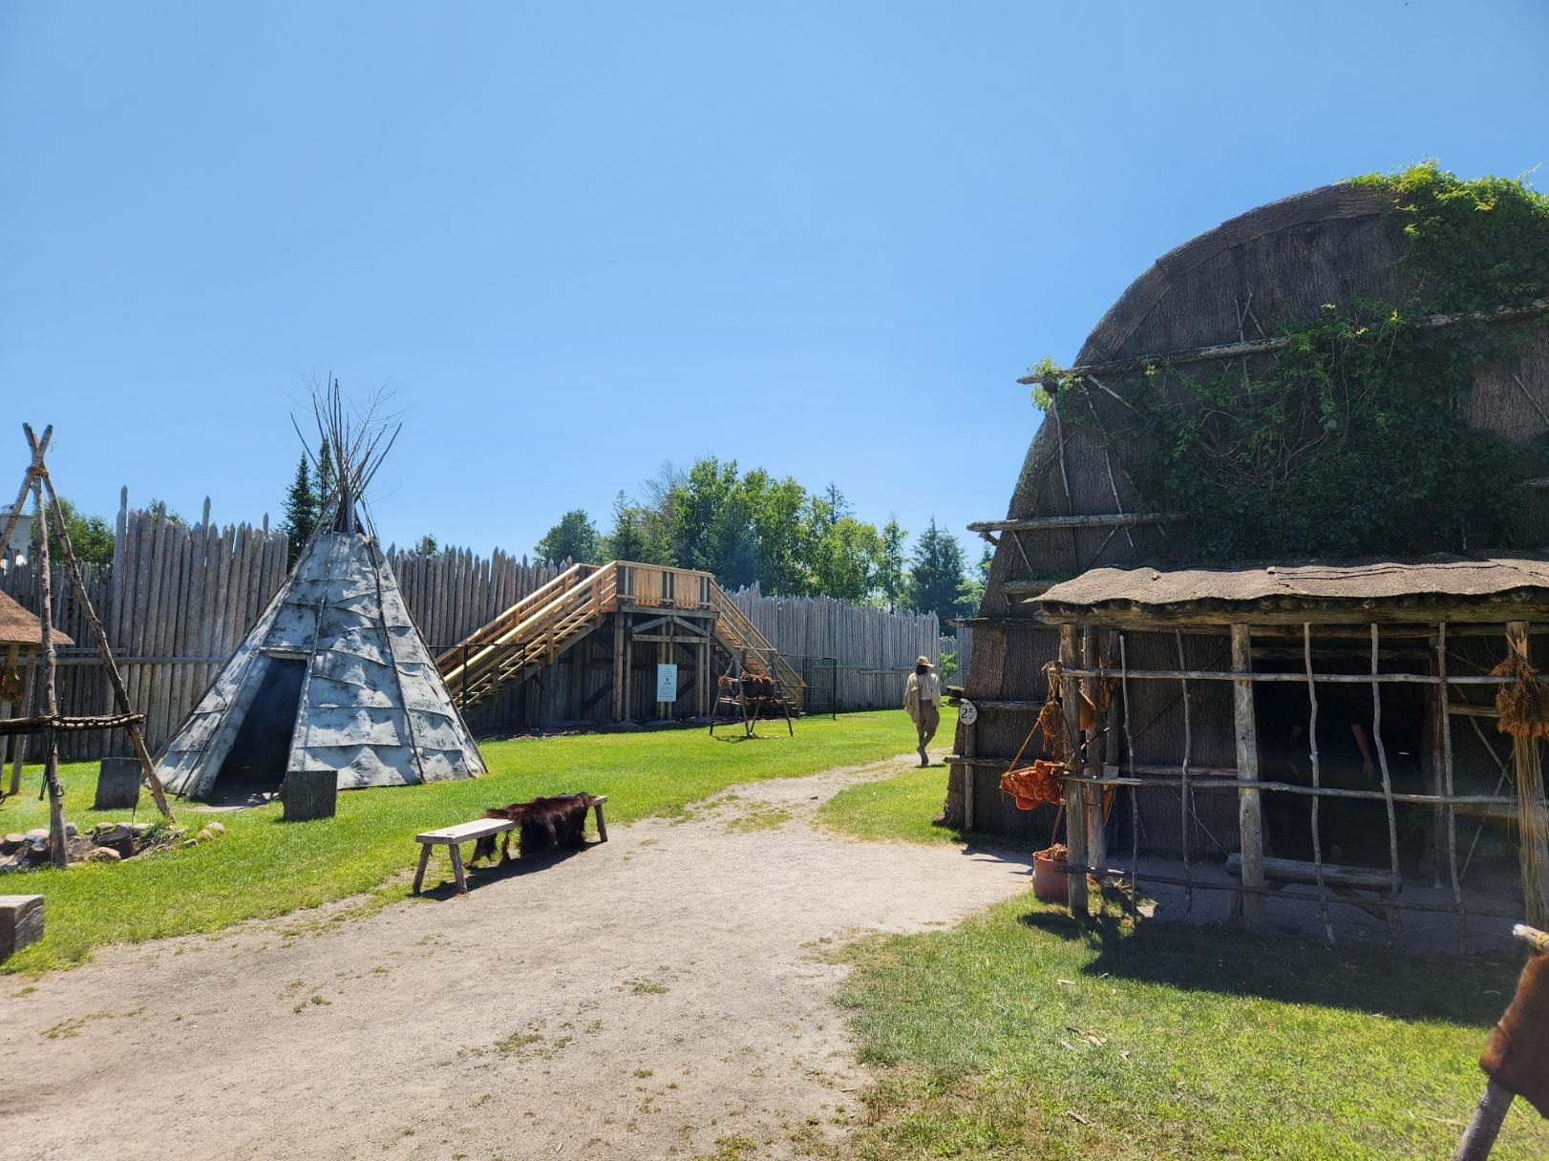

Slide 83
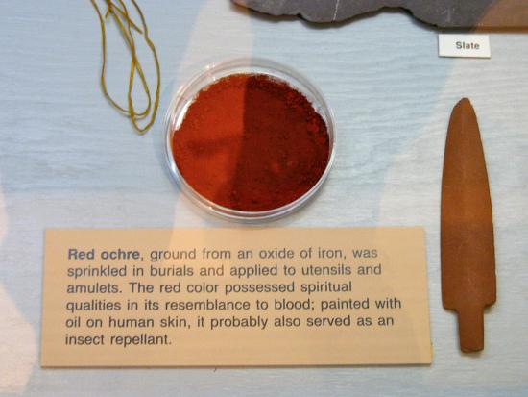
Symbolism
Known for distinctive red ochre body paint:
Used for ceremonial purposes and possibly spiritual significance.
Applied to skin, tools, and objects as a symbol of identity and protection.
Did not have a written language.
Relied on oral traditions, including stories and songs, to pass down knowledge, history, and cultural practices.

Slide 84

Living with the Land
Living with the land refers to the deep and reciprocal relationship many Indigenous peoples have with their environment. This relationship is built on the understanding that humans are not separate from nature, but rather an integral part of the ecosystem. For thousands of years, Indigenous cultures across North America, including the Beothuk people of Newfoundland, have cultivated an intimate knowledge of the land, its cycles, and its resources.

Slide 85
Key Aspects of Living with the Land
Sustainable Resource Use:
Indigenous peoples, including the Beothuk, did not view the land as something to be exploited. Instead, they took only what they needed and ensured the sustainability of resources for future generations.
Practices such as seasonal hunting, fishing, and foraging were essential to this balance. For example, the Beothuk harvested fish, game, and berries at specific times of the year to ensure the land’s ability to replenish these resources.
Seasonal and Nomadic Lifestyles:
Many Indigenous groups, including the Beothuk, practiced seasonal migration. This meant that they moved between different locations according to the seasons to follow the food supply and avoid over hunting or overfishing specific areas.
The Beothuk, for example, would move inland during the winter to hunt caribou and other animals and return to the coastal areas during the warmer months for fishing.

Slide 86
Reciprocity
Indigenous cultures see all elements of nature—plants, animals, water, and the land itself—as interconnected and imbued with spirit or life force. This is called “reciprocity.”
Practices like hunting, fishing, and gathering were often accompanied by ceremonies or rituals that expressed gratitude for the animals or plants that provided sustenance, as well as respect for their life cycles.
Cultural and Spiritual Connection:
The Beothuk and many other Indigenous peoples viewed the land not just as a resource but as a source of spiritual connection. They had sacred sites in nature, such as rivers, forests, and mountains, which were integral to their belief systems.
Spiritual practices often centered around nature’s cycles, such as the changing of seasons or the migration of animals, and were connected to rituals that reinforced their connection to the land.

Slide 87
Knowledge
Indigenous peoples possessed profound knowledge of their environments, including detailed understanding of local ecosystems, plants, animals, weather patterns, and natural landmarks. This knowledge was passed down through generations orally, through stories, teachings, and experiences.
For the Beothuk, their survival relied on their ability to read the land’s signs—weather patterns, animal movements, and plant growth. This understanding was key to their ability to navigate Newfoundland’s rugged and sometimes harsh environment.

Slide 88
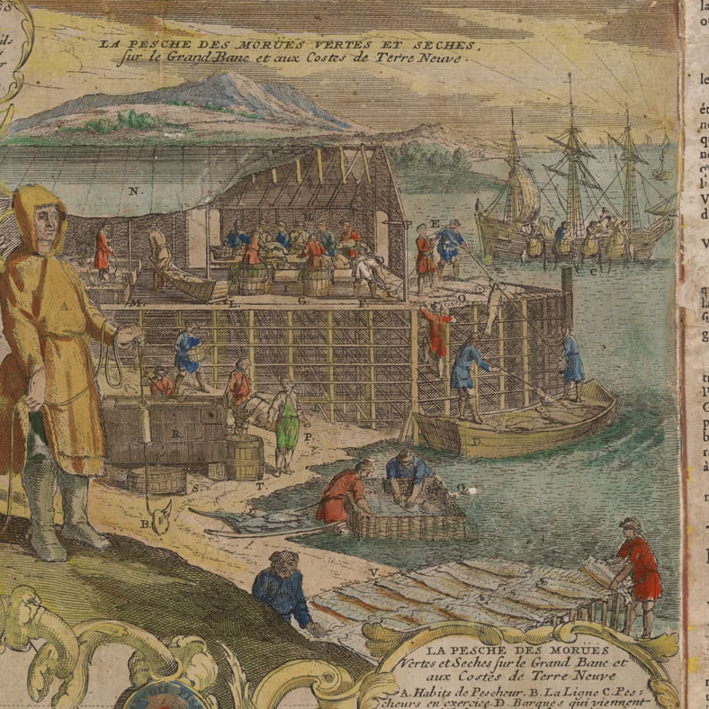
Colonization Impact
With the arrival of European settlers, this deeply rooted relationship with the land was disrupted. The Beothuk, like many Indigenous groups, were forced off their traditional lands as European settlers took control of the coasts for fishing and settlement.
The introduction of European diseases, new hunting practices, and the loss of land led to a significant decline in the Beothuk population, disrupting their sustainable way of life and their relationship with the land.

Slide 89
European Contact
The first European contact with the Beothuk is believed to have occurred around the early 1500s, with the Portuguese and later the English arriving in Newfoundland.
The Beothuk initially avoided contact with settlers, possibly due to their past experiences with other Indigenous groups and the threat posed by European diseases.
European settlers began to establish fishing stations along the coasts of Newfoundland, encroaching on the Beothuk's traditional territories.
Over time, the Beothuk were displaced from their coastal settlements and faced growing pressure from European settlers, who also introduced diseases that devastated the Beothuk population.
Resource depletion due to European fishing practices, competition for hunting grounds, and the loss of access to vital territories further strained the Beothuk people’s ability to maintain their way of life.
By the early 19th century, the Beothuk population had significantly declined. The last known member of the Beothuk people, Shanawdithit, died in 1829, marking the effective extinction of the Beothuk as a distinct group.

Slide 90
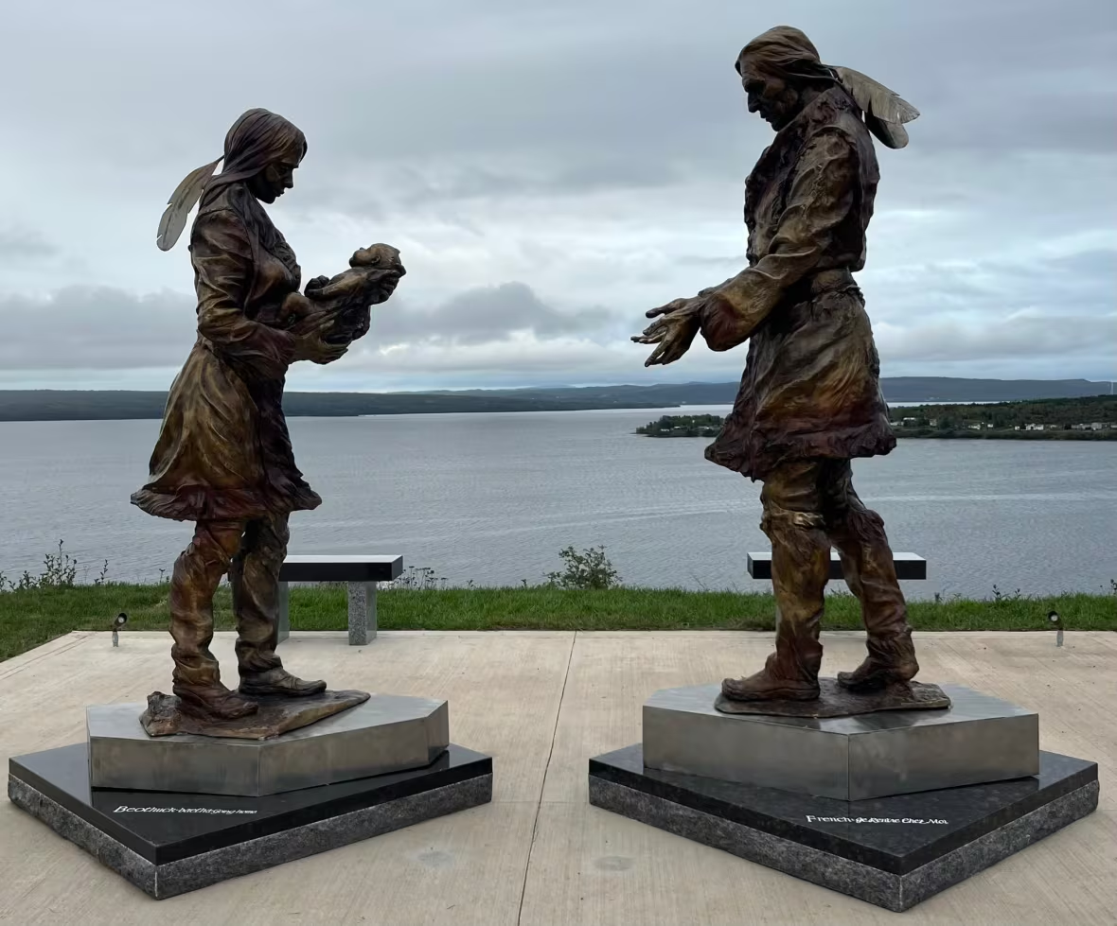
Legacy
Despite their extinction, the Beothuk people's story remains a powerful reminder of the devastating effects of European colonization on Indigenous cultures.
Their story is important for understanding the broader impacts of contact between Indigenous peoples and settlers, including the loss of land, culture, and life.
Researchers and scholars continue to study the Beothuk to learn more about their way of life, and their legacy is remembered in the history of Newfoundland and Canada.
Demasduit is one of the few Beothuk whose likeness is known. The town of Botwood revealed a bronze statue of her family's likeness on Monday. (Andrew Furey/X)

