Slide 1
Keeping a Budget
Budgeting & Financial Literacy

Slide 2
Table of contents
01
02
03
Budget
Savings
Case Studies
Budgeting is the process of planning how to spend your money.
Savings is the process of putting money away in the bank and not spending it.
Some things we’ll be doing together.

Slide 3
01
What is
a budget
Budgeting is the process of planning how to spend your money.

Slide 4
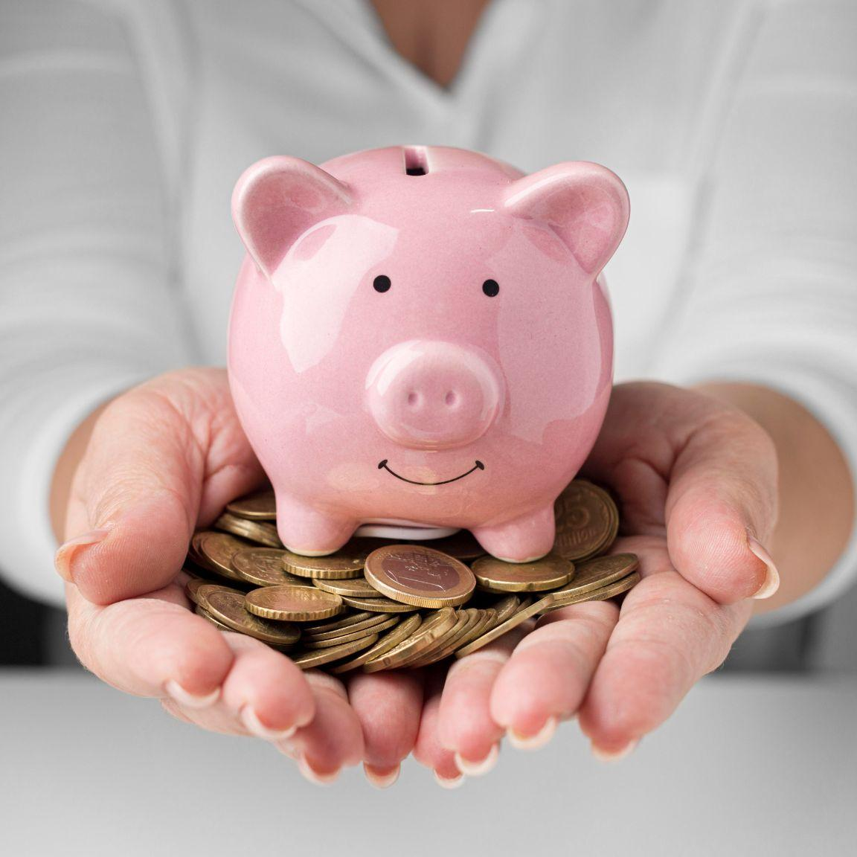
How to make a budget
Budgets begin with compiling your data: Expenses & Income.
Expenses are classified into 2 categories:
Needs & Wants.

Slide 5
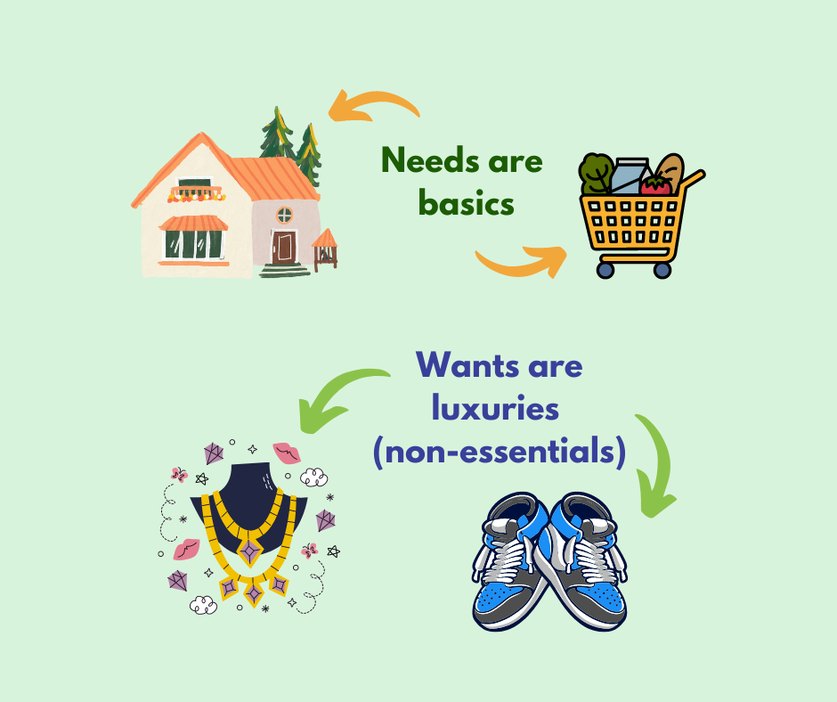
Needs vs. Wants
Needs
Wants
Things you must have (e.g., food, clothing).
Things you want but can live without (e.g., toys, games).

Slide 6
Activity 1
Write your needs and wants for your budget of $70.00.
Needs
Notebooks | $10
Wants
Video game | $50

Slide 7
The Basics of Budgeting
Income: The money you earn (e.g., allowance, gift money).
Expenses: The money you spend (e.g., snacks, games, savings).
Needs vs. Wants:
Needs: Things you must have (e.g., food, clothing).
Wants: Things you want but can live without (e.g., toys, games).
Example:
Income: $20
Needs: $10 (food, transport)
Wants: $5 (games, snacks)
Savings: $5

Slide 8
How to Create a Budget
Step 1: Track Your Income
Identify all the money you have coming in (income, salary).
Step 2: List Your Expenses (Debts)
Write down all the things you spend money on (needs and wants).
Step 3: Calculate the Balance (Difference)
Subtract expenses from income to see how much is left.
Step 4: Set a Savings Goal (Surplus)
Decide how much to save each month.

Slide 9
Activity 2
Complete the budget with your needs, just make sure you have enough!
Budget
$10
Item | Price | Yes | No | How much do you have left?
Notebook | $3 | x |  | $7
Ice cream | $4
Pencil | $1
Ruler | $3
Soda | $4

Slide 10
Activity 3
Compare the objects and color the one that is in your budget!
Your budget | Item 1 | Price | Item 2 | Price
$8.00 | Pizza menu | $7.68 | Burger menu | $8.50
$6.00 | Soccer ball | $.8.00 | Basquet ball | $5.49
$2.00 | Pen | $1.13 | Pencil | $2.01
$4.00 | Notebook | $2.00 | Pencil case | $5.00
$10.00 | Back back | $15.00 | Lunchbox | $9.45
$5.00 | Doll | $8.00 | Car toy | $4.45

Slide 11
The Basics of Saving
Why Save?
  To prepare for future purchases.
  To have money in emergencies.
  To earn interest and grow savings.
Example:
  If you save $100, with 5% interest, you'll have $105 in one year.
Types of Savings:
  Short-term savings: For goals like a new video game (saving for a few months).
  Long-term savings: For big goals like college or a car (saving for years).

Slide 12
Activity 4
Learning how to save money to buy what you want. With the prices below, answer the question: How much money do I need?
Lunch
Pizza slice | $5
Soda | $2
Chips | $3
Cookie | $4
How much do I need? | $14
B-day
Cake slice | $8
Soda | $2
Burger | $5
Fries | $3
How much do I need?
New toys
Game | $12
Car toy | $5
Doll | $4
Teddy bear | $10
How much do I need?
School
Notebooks | $10
Pencils | $3
Pencil case | $8
Back back | $15
How much do I need?

Slide 13
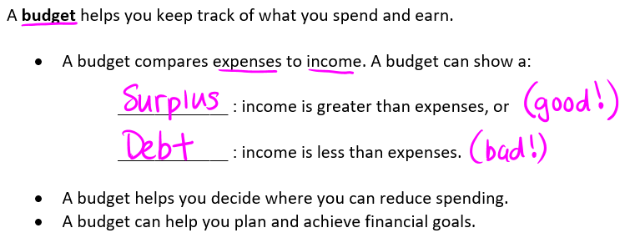
Surplus vs. Debt

Slide 14
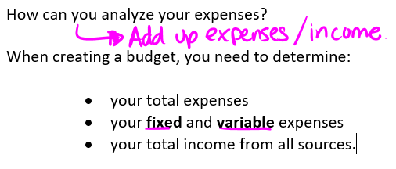
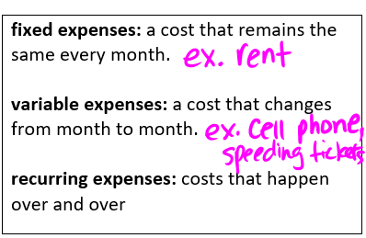
Analyzing Expenses

Slide 15
You Try!
In the list below, complete each of the following:
· Circle the fixed expenses.
· Underline the variable expenses.
· Check any recurring expenses.
Car payments
Utilities
Video games
Netflix
Insurance
Groceries
Gym Membership
Rent
9. Cellphone
10. Clothes
11. Restaurant Dinner
12. Spotify
13. Internet
14. Vacation to Mexico
15. Speeding Tickets
16. Tim’s

Slide 16
Case Study 1
Grocery Shopping on a Budget

Slide 17
Case Study - Grocery Shopping
Scenario:
You have $80 to spend on groceries for the week for a family of 4. Use the sample grocery prices below to plan your shopping list. Remember, you need to prioritize essentials like fruits, vegetables, and basic meals while staying within your budget.
Did you have money left over?
Did you spend it all?

Slide 18
Ms. Greco’s Store
Fruits & Vegetables:
  Bananas (per 100g): $0.25
  Apples (per lb): $1.47
  Carrots (2 lb bag): $2.97
  Lettuce (1 head): $1.97
  Potatoes (10 lb bag): $4.97
Dairy:
  Milk (4L bag): $4.69
  Cheese (450g block): $5.97
  Yogurt (650g tub): $2.97
  12 Eggs: $5.97
Protein:
  Chicken Breasts (per lb): $5.47
  Beef Steaks (per lb): $19.97
  Canned Tuna (170g can): $2.75
Grains:
  Bread (1 loaf): $2.47
  Rice (900g bag): $2.97
  Pasta (900g package): $1.97
Snacks & Beverages:
  Chips (200g bag): $2.47
  Cookies (300g package): $2.97
  Soda (2L bottle): $1.97

Slide 19
Your Budget Sheet
Fill out the table with the items you plan to purchase and calculate the total cost. Ensure your total does not exceed $80.
Item | Price per Unit | Quantity | Total Cost
Total Cost: |  |  | $

Slide 20
Reflection Questions
Did you spend all $80? If not, how much is left?
Answer: $
Were there any items you wanted to buy but had to leave out because of the budget?
Answer:
If your budget were $100, what extra item(s) would you add?
Answer:
How can this activity help you when shopping in real life?
Answer:

Slide 21
Case Study 2
Prices vs. Preference

Slide 22
Prices vs. Preference
Main Dish Options:
Chicken Breasts (1 lb): $5.47
Ground Beef (1 lb): $6.97
Canned Tuna (170g): $1.27
Side Dish Options:
Rice (900g bag): $2.97
Potatoes (10 lb bag): $4.97
Pasta (900g package): $1.97
Dessert Options:
Cookies (300g package): $2.97
Chips (200g bag): $2.47
Soda (2L bottle): $1.97
Sometimes you have to make decisions about what to buy based on your preferences and budget. Let’s practice!
Scenario:
You’re planning a family dinner, and you want to include a main dish, side dish, and dessert. Here are your options. Choose one item from each category while staying within a budget of $15.

Slide 23
Reflection Questions
Did you stay within the $15 budget? If not, what would you change to fit the budget?
How did you decide what to include in your meal? Did cost, preferences, or both influence your choice?
How would you adjust your shopping list if the budget was increased to $20?

Slide 24
Currency

Slide 25
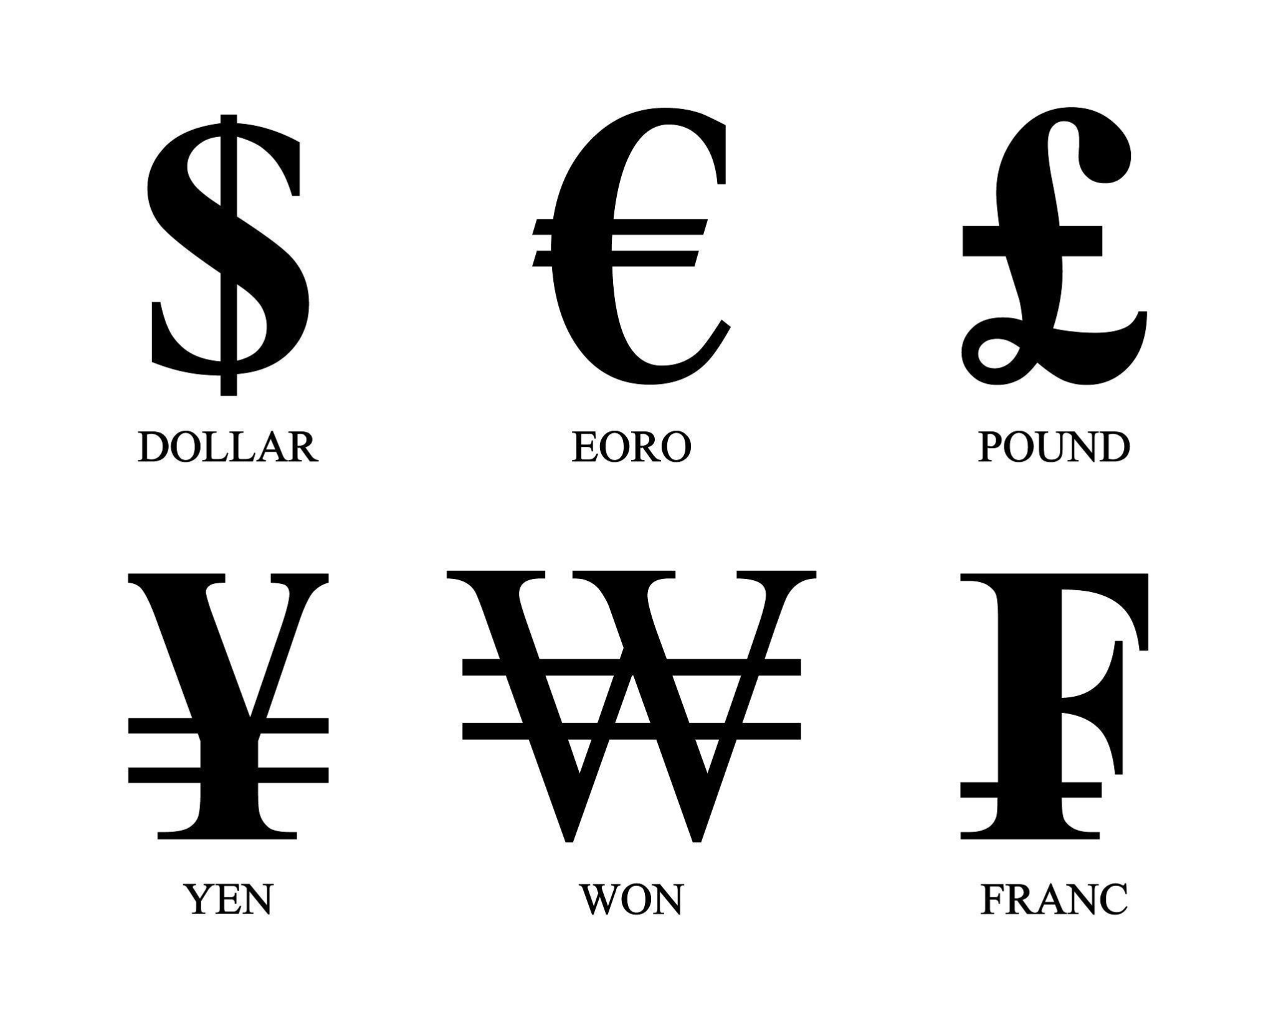
Do you recognize any of these?

Slide 26
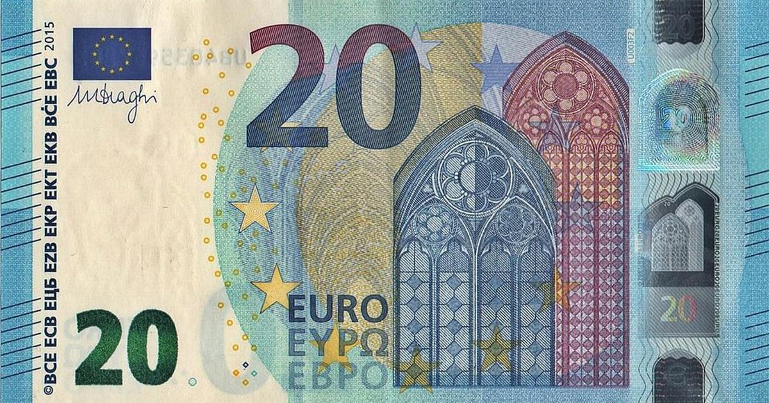
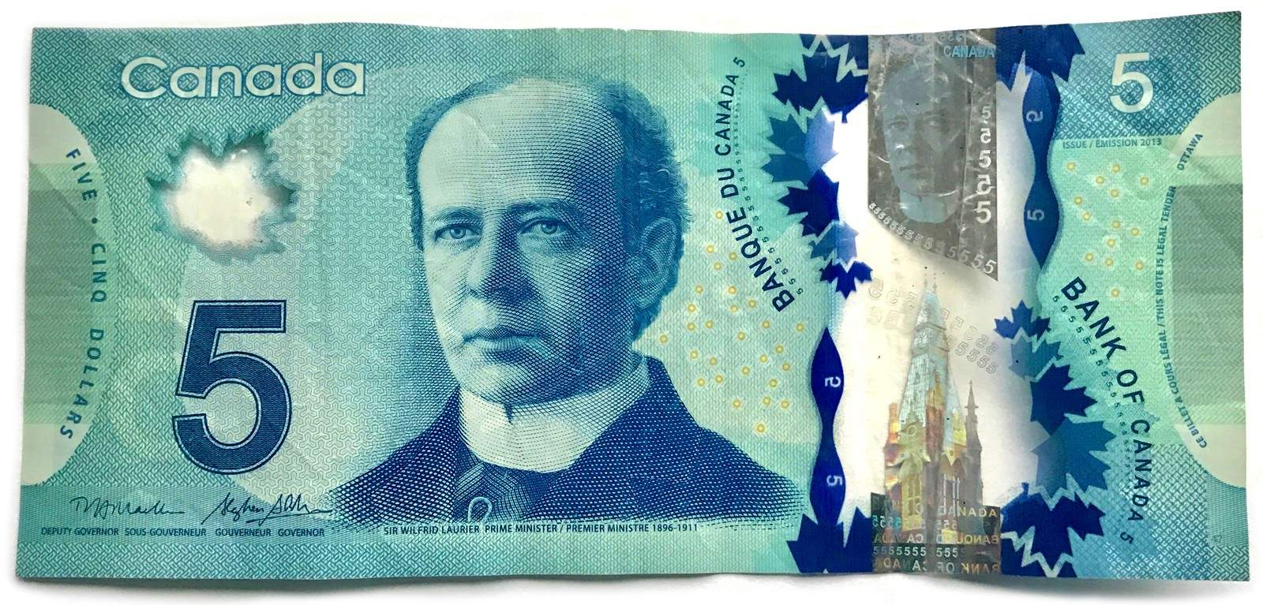
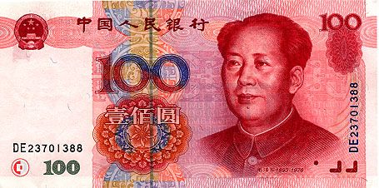
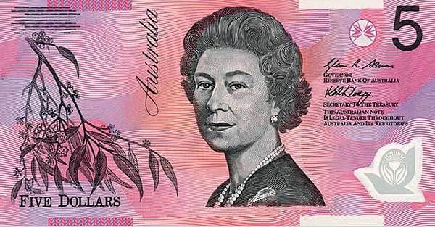
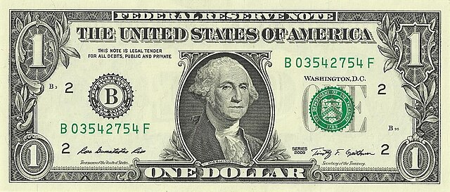
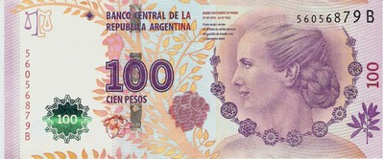
Match the Currency
Your choices are:
Canadian
Argentinian Peso
Australia
Euro
Chinese Yuen
American

Slide 27
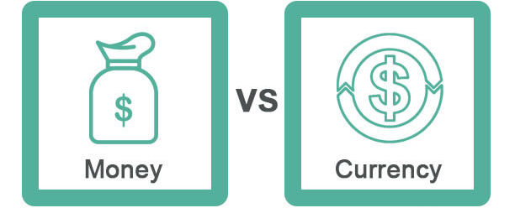
Discussion
What is currency?
What is the difference between currency and money?

Slide 28
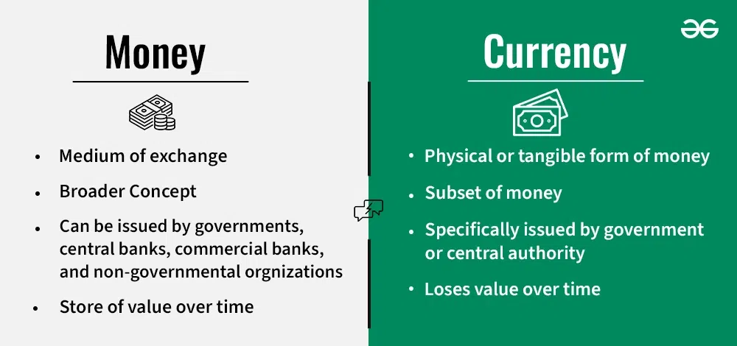
Currency vs. Money

Slide 29
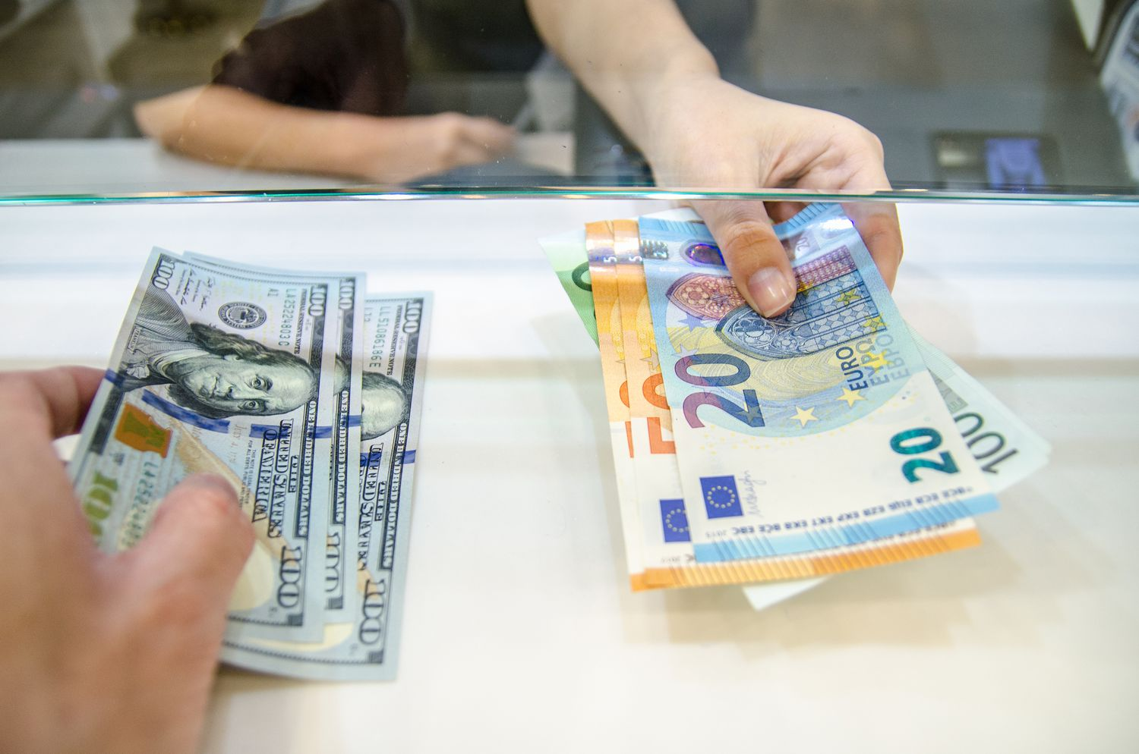
What is Currency Exchange?
What is an exchange rate? The value of one currency compared to another.
Example: If 1 CAD = 0.75 USD, then for every $1 CAD, you get $0.75 USD.
Exchange rates fluctuate due to supply, demand, and economic conditions.
✅ Basic Conversion Formula:
Foreign Currency= Canadian Dollars × Exchange Rate
Example: Converting $50 CAD to USD at an exchange rate of 1 CAD = 0.75 USD.
50 × 40.75 = $37.50

Slide 30
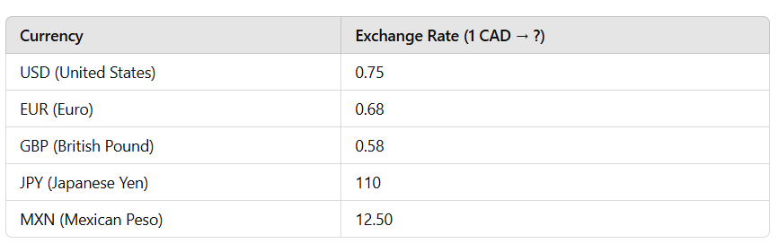
Currency Conversion Challenge
In small groups of 3 or 4, you will have to determine how to convert the following amounts based on the rates above.
$100 CAD to USD
$90 CAD to EURO
$10 CAD to JPY
$1,000,000 CAD to MXN
$750,000 CAD to GBP

Slide 31
Let’s Talk About It
What happens if the exchange rate for USD changes from 0.75 to 0.80?
Why do exchange rates matter when traveling or shopping internationally?
If you exchanged $100 CAD into a foreign currency but didn’t spend it, what would happen if the rate changed when you converted it back?

Slide 32
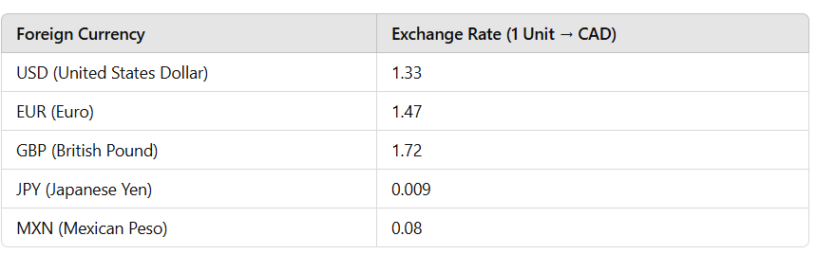
Let’s Try Something Else…
Now that you’ve mastered how to convert Canadian dollars to other forms of currency, can you determine how much you’d get back?
You have $80 USD left from your trip. How much CAD will you receive?
You have €50 EUR left from your trip. How much CAD will you receive?
You have £30 GBP left from your trip. How much CAD will you receive?
You have ¥10,000 JPY left from your trip. How much CAD will you receive?
You have $500 MXN left from your trip. How much CAD will you receive?

Slide 33

Exit Ticket
Did you get more or less CAD than expected?
What would happen if the exchange rate changed?
How can knowing exchange rates help you make smart financial decisions while traveling?

Slide 34
Review from Last Class
Guess the Country by its Currency Quiz | Guess the Currency Challenge

